Slide 1
Constraint-based
Relational Verification
Hiroshi Unno (University of Tsukuba)
Joint work with Tachio Terauchi and Eric Koskinen

Slide 2

Constraint-based Program Verification
Target Program $P$ & Specification $ψ$
Constraint Generation
Constraints $𝓒$ on Function Variables
Verification Intermediary Independent of Particular Target and Method ☺
Constraint Solving
$𝓒$ is Sat ($P$ satisfies $ψ$),
$𝓒$ is Unsat ($P$ violates $ψ$),
or Unknown/Timeout

Slide 3
Program Verification based on
Constrained Horn Clauses (CHCs)
Target Program $P$ & Specification $ψ$
Constraint Generation
JayHorn for Java [Kahsai+ ’16]
SeaHorn for C [Gurfinkel+ ’15]
RCaml for OCaml [Unno+ ’09]
CHCs Constraints $𝓒$ on Predicate Variables
SPACER [Komuravelli+ ’14]
Hoice [Champion+ ’18]
Eldarica [Hojjat+ ’18]
Constraint Solving
$𝓒$ is Sat ($P$ satisfies $ψ$),
$𝓒$ is Unsat ($P$ violates $ψ$),
or Unknown/Timeout

Slide 4
CHCs: Constrained Horn Clauses (see e.g., [Bjørner+ ’15] )
A finite set $𝓒$ of Horn-clauses of either form:
where $X_{0},X_{1}…,X_{m}$ are predicate variables,
$\tilde{t_{0}},…,\tilde{t_{m}}$ are sequences of terms of a 1st-order theory $T$,
$φ$ is a formula of $T$ without predicate variables.
$𝓒$ is satisfiable (modulo $T$) if there is an interpretation $ρ$ of predicate variables such that $ρ⊨⋀𝓒$
$$X_{0}\left(\tilde{t_{0}}\right)⟸\left(X_{1}\left(\tilde{t_{1}}\right)∧…∧X_{m}\left(\tilde{t_{m}}\right)∧φ\right)$$
or
$$⊥ ⟸\left(X_{1}\left(\tilde{t_{1}}\right)∧…∧X_{m}\left(\tilde{t_{m}}\right)∧φ\right)$$

Slide 5
Prog. & Spec.
CHCs
SAT or UNSAT
Constraint Generation
Constraint Solving
Example Program and Partial Correctness Specification:
If the initial state satisfies
the pre-condition $x=x_{0}$
and the loop terminates
Pre-condition
$$\left\{x=x_{0}\right\} \\ y=0; \\ while x≠0 do \\ y←y+1; \\ x←x−1 \\ done \\ \left\{y=x_{0}\right\}$$
the post-condition $y=x_{0}$ is satisfied by the resulting state
Post-condition

Slide 6
Prog. & Spec.
CHCs
SAT or UNSAT
Constraint Generation
Constraint Solving
represents a loop invariant
Input:
$$\left\{x=x_{0}\right\} \\ y=0; \\ while x≠0 do \\ y←y+1; \\ x←x−1 \\ done \\ \left\{y=x_{0}\right\}$$
Output $𝓒$:
$I\left(x_{0},x,y\right)⟸x=x_{0}∧y=0$,
$I\left(x_{0},x−1,y+1\right)$
$⟸I\left(x_{0},x,y\right)∧x≠0,$
$y=x_{0}⟸I\left(x_{0},x,y\right)∧x=0$
$𝓒$ is satisfiable, witnessed by a solution $I\left(x_{0},x,y\right)≡x_{0}=x+y$

Slide 7
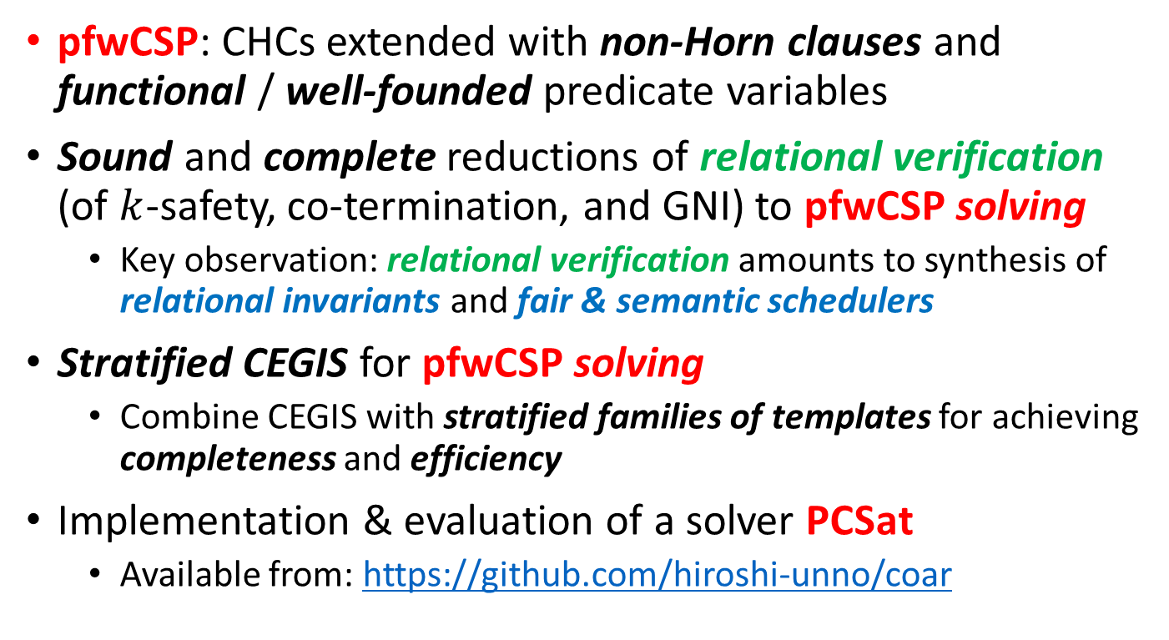
This Talk [CAV ’21]
pfwCSP: CHCs extended with non-Horn clauses and
functional / well-founded predicate variables
Sound and complete reductions of relational verification
(of $k$-safety, co-termination, and GNI) to pfwCSP solving
  Key observation: relational verification amounts to synthesis of relational invariants and fair & semantic schedulers
Stratified CEGIS for pfwCSP solving
  Combine CEGIS with stratified families of templates for achieving completeness and efficiency
Implementation & evaluation of a solver PCSat
  Available from: https://github.com/hiroshi-unno/coar

Slide 8
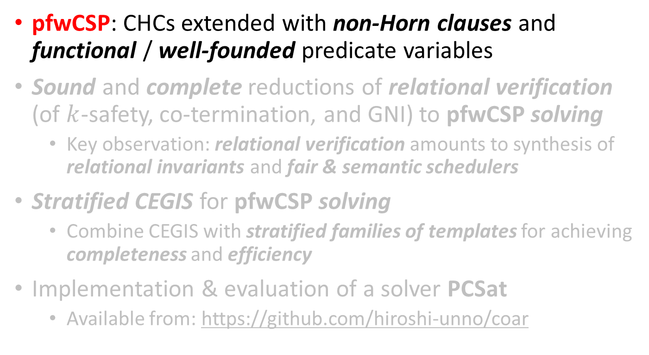
This Talk [CAV ’21]
pfwCSP: CHCs extended with non-Horn clauses and
functional / well-founded predicate variables
Sound and complete reductions of relational verification
(of $k$-safety, co-termination, and GNI) to pfwCSP solving
  Key observation: relational verification amounts to synthesis of relational invariants and fair & semantic schedulers
Stratified CEGIS for pfwCSP solving
  Combine CEGIS with stratified families of templates for achieving completeness and efficiency
Implementation & evaluation of a solver PCSat
  Available from: https://github.com/hiroshi-unno/coar

Slide 9

Program Verification based on
Constrained Horn Clauses (CHCs)
Target Program $P$ & Specification $ψ$
Limited to $∀$Linear-Time Safety Verification ☹
Constraint Generation
CHCs Constraints $𝓒$ on Predicate Variables
Constraint Solving
$𝓒$ is Sat ($P$ satisfies $ψ$),
$𝓒$ is Unsat ($P$ violates $ψ$),
or Unknown

Slide 10
Program Verification based on
Predicate Constraint Satisfaction [AAAI ’20]
Target Program $P$ & Specification $ψ$
Applicable to (Finitely-) Branching-Time Safety Verification ☺
Constraint Generation
pCSP Constraints $𝓒$ on Predicate Variables
Constraint Solving
PCSat [AAAI ’20, CAV ’20]
$𝓒$ is Sat ($P$ satisfies $ψ$),
$𝓒$ is Unsat ($P$ violates $ψ$),
or Unknown

Slide 11
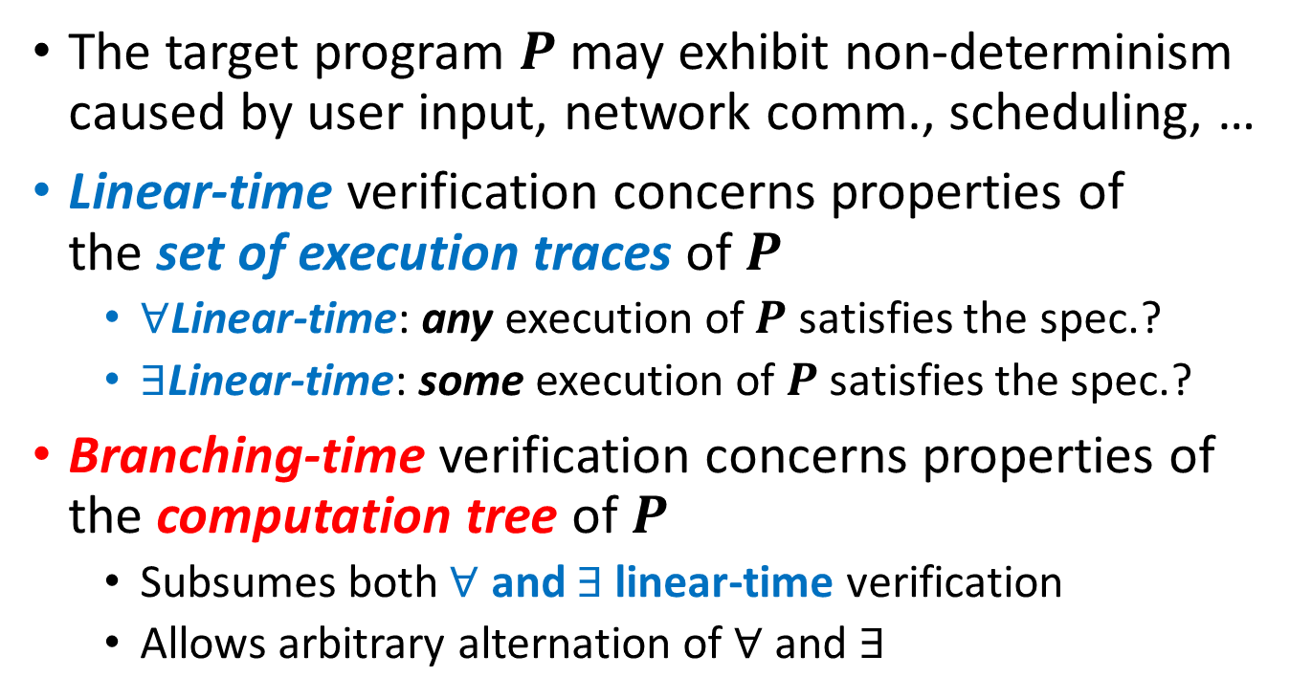
Linear-Time vs. Branching-Time Verification of Non-det. Programs
The target program $P$may exhibit non-determinism caused by user input, network comm., scheduling, …
Linear-time verification concerns properties of
the set of execution traces of $P$
  $∀$Linear-time: any execution of $P$ satisfies the spec.?
  $∃$Linear-time: some execution of $P$ satisfies the spec.?
Branching-time verification concerns properties of the computation tree of $P$
  Subsumes both $∀$ and $∃$ linear-time verification
  Allows arbitrary alternation of $∀$ and $∃$

Slide 12

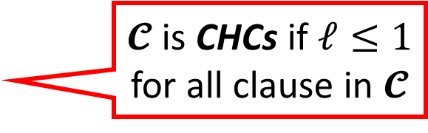
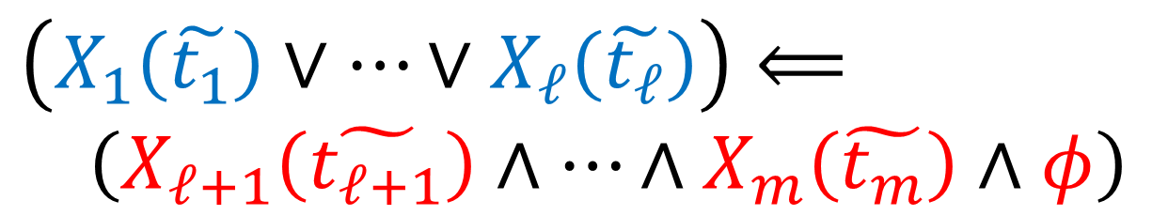
pCSP: Predicate Constraint Satisfaction Problem [AAAI ’20]
Generalize CHCs [Bjørner+ ’15] with non-Horn clauses
A finite set $𝓒$ of clauses of the form:
where $X_{1},…,X_{ℓ},X_{ℓ+1},…,X_{m}$ are predicate variables,
$\tilde{t_{1}},…,\tilde{t_{m}}$ are sequences of terms of a 1st-order theory $T$,
$φ$ is a formula of $T$ without predicate variables
$𝓒$ is satisfiable (modulo $T$) if there is an interpretation $ρ$ of predicate variables such that $ρ⊨⋀𝓒$
$𝓒$ is CHCs if $ℓ≤1$ for all clause in $𝓒$
$$\left(X_{1}\left(\tilde{t_{1}}\right)∨…∨X_{ℓ}\left(\tilde{t_{ℓ}}\right)\right)⟸ \\ \left(X_{ℓ+1}\left(\tilde{t_{ℓ+1}}\right)∧…∧X_{m}\left(\tilde{t_{m}}\right)∧φ\right)$$

Slide 13
Prog. & Spec.
pCSP
SAT or UNSAT
Constraint Generation
Constraint Solving
Example Program and Specification:
If the initial state satisfies the pre-condition $x>0$
Pre-condition
$$\left\{x>0\right\} \\ while x≠0 do \\ if read_bool{\left( \right)}^{∃} then \\ x←x−1 \\ else \\ x←x+1 \\ done \\ \left\{⊥\right\}$$
Non-det. branching
there is an execution of the program such that
the post-condition $⊥$ is satisfied when the while loop terminates
Post-condition
Contradiction

Slide 14
Prog. & Spec.
pCSP
SAT or UNSAT
Constraint Generation
Constraint Solving
Example Program and Specification:
If the initial state satisfies the pre-condition $x>0$
Pre-condition
$$\left\{x>0\right\} \\ while x≠0 do \\ if read_bool{\left( \right)}^{∃} then \\ x←x−1 \\ else \\ x←x+1 \\ done \\ \left\{⊥\right\}$$
Non-det. branching
there is an execution of the program such that
the while loop
never terminates
Post-condition
Contradiction

Slide 15
Prog. & Spec.
pCSP
SAT or UNSAT
Constraint Generation
Constraint Solving
represents a loop invariant
preserved by some execution (i.e., recurrent set)
Input:
$$\left\{x>0\right\} \\ while x≠0 do \\ if read_bool{\left( \right)}^{∃} then \\ x←x−1 \\ else \\ x←x+1 \\ done \\ \left\{⊥\right\}$$
Output $𝓒$:
$I\left(x\right)⟸x>0$,
$I\left(x−1\right)∨I\left(x+1\right)$
$⟸I\left(x\right)∧x≠0,$
$⊥ ⟸I\left(x\right)∧x=0$
𝓒 is beyond CHCs!
$𝓒$ is satisfiable, witnessed by a solution $I\left(x\right)≡x>0$

Slide 16
Program Verification based on Extended Predicate Constraint Satisfaction [CAV ’21]
Target Program $P$ & Specification $ψ$
Applicable to (Infinitely-) Branching-Time Safety & Liveness Verification ☺
Constraint Generation
pfwCSP Constraints $𝓒$ on Predicate Variables
Constraint Solving
PCSat [AAAI ’20, CAV ’21]
$𝓒$ is Sat ($P$ satisfies $ψ$),
$𝓒$ is Unsat ($P$ violates $ψ$),
or Unknown

Slide 17
Safety vs. Liveness Verification
Safety is a class of properties of the form
“something bad will never happen”
  Examples (absence of): assertion failure, division-by-zero, array boundary violation, …
Liveness is a class of properties of the form
“something good will eventually happen”
  Examples: termination, deadlock freedom, …

Slide 18

pfwCSP: pCSP extended with Functional and Well-founded Predicates [CAV ’21]
(cf. $∀∃$CHCs with dwf [Beyene+ ’13])
A finite set $𝓒$ of pCSP clauses equipped with
a map $𝓚$ from predicate variable $X$ in $𝓒$ to $\left\{⋆,λ,⇓\right\}$
  $X$ is ordinary predicate if $𝓚\left(X\right)= ⋆$
  $X$ is functional predicate if $𝓚\left(X\right)=λ$
  $X$ is well-founded predicate if $𝓚\left(X\right)= ⇓$
$𝓒$ is satisfiable (modulo $T$) if there is an interpretation $ρ$ of predicate variables such that
  $ρ⊨⋀𝓒$
  $∀X.𝓚\left(X\right)=λ ⟹ ρ\left(X\right)$ characterizes a total function
  $∀X.𝓚\left(X\right)= ⇓ ⟹ ρ\left(X\right)$ represents a well-founded relation

Slide 19
Prog. & Spec.
pfwCSP
SAT or UNSAT
Constraint Generation
Constraint Solving
Example Program and Specification:
If the initial state satisfies the pre-condition $x>0$
Pre-condition
$$\left\{x>0\right\} \\ while x>0 do \\ x←read_int{\left( \right)}^{∃}−x \\ done \\ \left\{⊥\right\}$$
there is an execution of the program such that
Non-det. integer
Post-condition
Contradiction
the while loop
never terminates

Slide 20
Prog. & Spec.
pfwCSP
SAT or UNSAT
Constraint Generation
Constraint Solving
represents a loop invariant
preserved by some execution (i.e., recurrent set)
Input:
$$\left\{x>0\right\} \\ while x>0 do \\ x←read_int{\left( \right)}^{∃}−x \\ done \\ \left\{⊥\right\}$$
Output $𝓒$:
$I\left(x\right)⟸x>0$,
$\left(∃r.I\left(r−x\right)\right)$
$⟸I\left(x\right)∧x>0,$
$⊥ ⟸I\left(x\right)∧x≤0$
𝓒 is beyond pCSP but can be encoded in pfwCSP using a functional pred. var. that characterizes
a Skolem function for $r$

Slide 21
Prog. & Spec.
pfwCSP
SAT or UNSAT
Constraint Generation
Constraint Solving
Input:
$$\left\{x>0\right\} \\ while x>0 do \\ x←read_int{\left( \right)}^{∃}−x \\ done \\ \left\{⊥\right\}$$
Output $𝓒$:
$I\left(x\right)⟸x>0$,
$I\left(r−x\right)⟸S_{λ}\left(x,r\right)$
$∧I\left(x\right)∧x>0,$
$⊥ ⟸I\left(x\right)∧x≤0$
characterizes a Skolem function mapping $x$ to $r$
$𝓒$ is satisfiable, witnessed by a solution $I\left(x\right)≡x>0$, $S_{λ}\left(x,r\right)≡r=x+1$

Slide 22
Prog. & Spec.
pfwCSP
SAT or UNSAT
Constraint Generation
Constraint Solving
Example Program and Total Correctness Specification:
If the initial state satisfies the pre-condition $x≠0$
Pre-condition
$$\left[x≠0\right] \\ while x≠0 do \\ if x>0 then \\ x←x−1 \\ else \\ x←x+1 \\ done \\ \left[⊤\right]$$
the loop always terminates
and the post-condition $⊤$ is satisfied by the resulting state
Post-condition
Tautology

Slide 23
Prog. & Spec.
pfwCSP
SAT or UNSAT
Constraint Generation
Constraint Solving
represents a loop invariant
Input:
$$\left[x≠0\right] \\ while x≠0 do \\ if x>0 then \\ x←x−1 \\ else \\ x←x+1 \\ done \\ \left[⊤\right]$$
Output $𝓒$:
$I\left(x\right)⟸x=0$,
$I\left(x−1\right)⟸I\left(x\right)∧x>0,$
$I\left(x+1\right)⟸I\left(x\right)∧x<0,$
$T_{⇓}\left(x,x−1\right)⟸I\left(x\right)∧x>0,$
$T_{⇓}\left(x,x+1\right)⟸I\left(x\right)∧x<0,$
represents a well-founded relation for termination of the loop
$𝓒$ is satisfiable, witnessed by a solution $I\left(x\right)≡⊤$, $T_{⇓}\left(x,x′\right)≡\left|x\right|>\left|x^{′}\right|≥0$

Slide 24
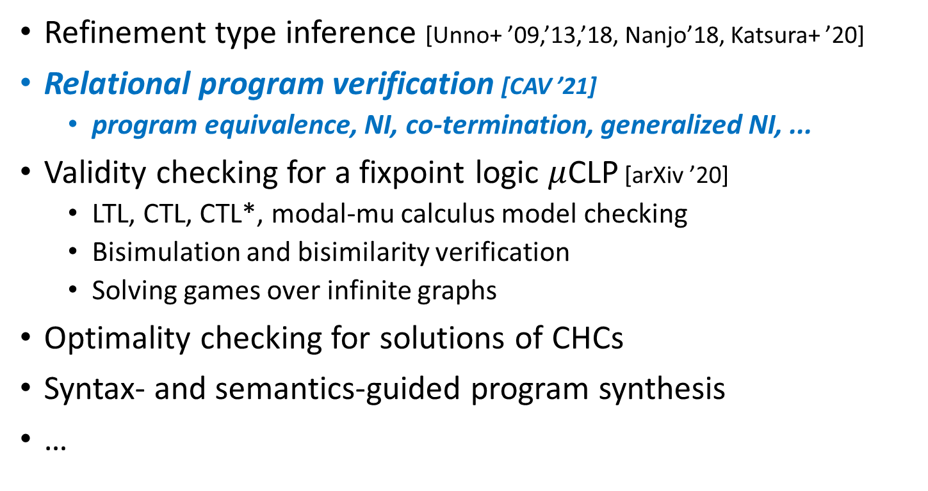
Further Applications of pfwCSP
Refinement type inference [Unno+ ’09,’13,’18, Nanjo’18, Katsura+ ’20]
Relational program verification [CAV ’21]
  program equivalence, NI, co-termination, generalized NI, ...
Validity checking for a fixpoint logic $μ$CLP [arXiv ’20]
  LTL, CTL, CTL*, modal-mu calculus model checking
  Bisimulation and bisimilarity verification
  Solving games over infinite graphs
Optimality checking for solutions of CHCs
Syntax- and semantics-guided program synthesis
…

Slide 25
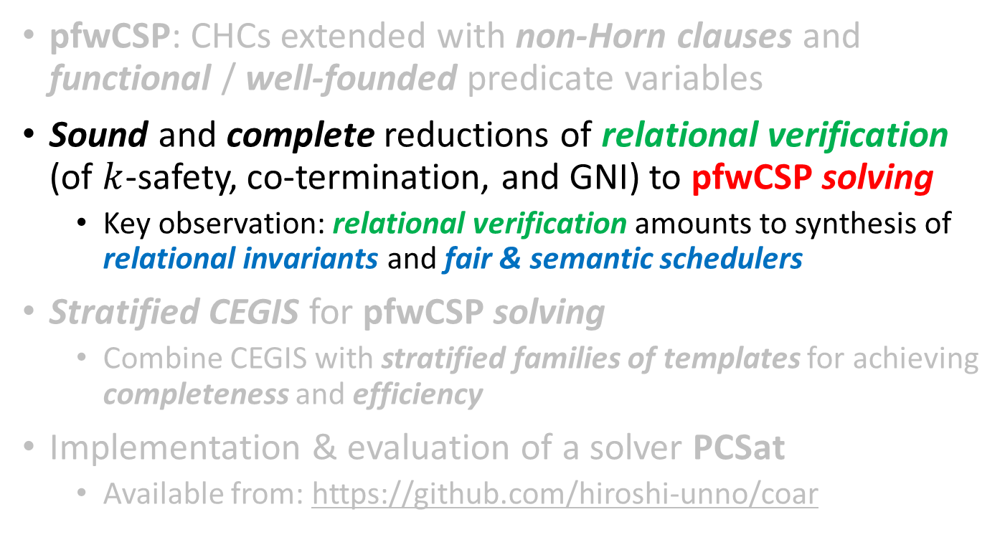
This Talk [CAV ’21]
pfwCSP: CHCs extended with non-Horn clauses and
functional / well-founded predicate variables
Sound and complete reductions of relational verification
(of $k$-safety, co-termination, and GNI) to pfwCSP solving
  Key observation: relational verification amounts to synthesis of relational invariants and fair & semantic schedulers
Stratified CEGIS for pfwCSP solving
  Combine CEGIS with stratified families of templates for achieving completeness and efficiency
Implementation & evaluation of a solver PCSat
  Available from: https://github.com/hiroshi-unno/coar

Slide 26
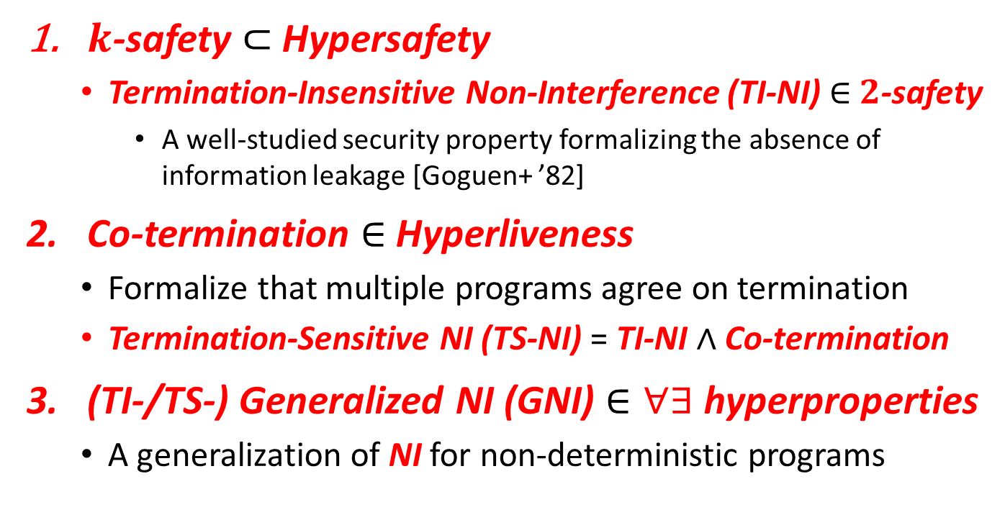
Automated Verification of Relational Properties
$k$-safety $⊂$ Hypersafety
  Termination-Insensitive Non-Interference (TI-NI) $∈$ $2$-safety
    A well-studied security property formalizing the absence of information leakage [Goguen+ ’82]
Co-termination $∈$ Hyperliveness
  Formalize that multiple programs agree on termination
  Termination-Sensitive NI (TS-NI) = TI-NI $∧$ Co-termination
(TI-/TS-) Generalized NI (GNI) $∈∀∃$ hyperproperties
  A generalization of NI for non-deterministic programs

Slide 27

Relational Verification via
Synthesis of Relational Invariants and Fair & Semantic Schedulers
$k$-safety $⊂$ Hypersafety
  Termination-Insensitive Non-Interference (TI-NI) $∈$ $2$-safety
    A well-studied security property formalizing the absence of information leakage [Goguen+ ’82]
Co-termination $∈$ Hyperliveness
  Formalize that multiple programs agree on termination
  Termination-Sensitive NI (TS-NI) = TI-NI $∧$ Co-termination
(TI-/TS-) Generalized NI (GNI) $∈∀∃$ hyperproperties
  A generalization of NI for non-deterministic programs

Slide 28

Relational Verification via
Synthesis of Relational Invariants and Fair & Semantic Schedulers
$k$-safety $⊂$ Hypersafety
  Termination-Insensitive Non-Interference (TI-NI) $∈$ $2$-safety
    A well-studied security property formalizing the absence of information leakage [Goguen+ ’82]
Co-termination $∈$ Hyperliveness
  Formalize that multiple programs agree on termination
  Termination-Sensitive NI (TS-NI) = TI-NI $∧$ Co-termination
(TI-/TS-) Generalized NI (GNI) $∈∀∃$ hyperproperties
  A generalization of NI for non-deterministic programs

Slide 29


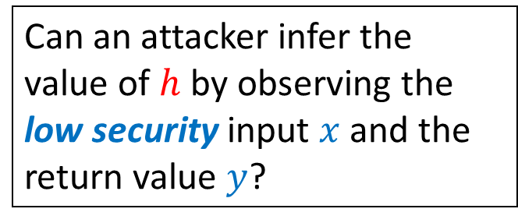

Example: Termination-Insensitive Non-Interference (TI-NI) $∈$ $2$-safety
doubleSquare$\left(h,x\right)$ [Shemer+ ’19] computes ${2⋅x}^{2}$ in two different ways depending on the high security input $h$
doubleSquare(bool h,int x) {
int z, y=0;
if(h) { z=2*x }
else { z=x }
while(z>0) { z--; y=y+x }
if(!h) { y=2*y }
return y;
}
Can an attacker infer the value of $h$ by observing the low security input $x$ and the return value $y$?
No! Formally, TI-NI holds:
$$∀h_{1},x_{1},y_{1},h_{2},x_{2},y_{2}.$$
doubleSquare$\left(h_{1},x_{1}\right)⇝y_{1}∧$ doubleSquare$\left(h_{2},x_{2}\right)⇝y_{2}∧$
$$x_{1}=x_{2}⇒y_{1}=y_{2}$$

Slide 30






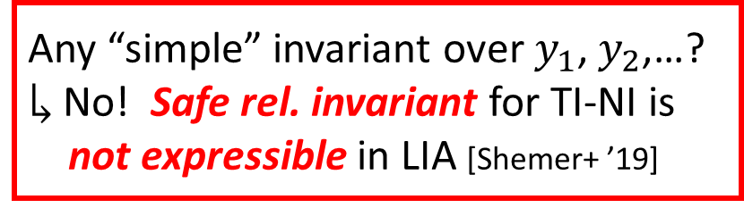




Existing Approaches to TI-NI
Find a safe rel. invariant of the parallel executions of
2 copies of the program under the lock-step scheduler
doubleSquare(bool h,int x) {
int z, y=0;
$ℓ_{1}:$ if(h) {z=2*x} else {z=x}
$ℓ_{2}:$ while(z>0) { z--; y=y+x }
$ℓ_{3}:$ if(!h) { y=2*y }
return y;
}
A run with lock-step scheduler:
$\left(h_{1},x_{1},y_{1},z_{1},h_{2},x_{2},y_{2},z_{2}\right)$
$$↦\left(⊤,2,0,_,⊥,2,0,_\right)$$
$$→_{1,2}^{ℓ_{1}}\left(⊤,2,0,4,⊥,2,0,2\right)$$
$$→_{1,2}^{ℓ_{2}}\left(⊤,2,2,3,⊥,2,2,1\right)$$
$$→_{1,2}^{ℓ_{2}}\left(⊤,2,4,2,⊥,2,4,0\right)$$
$$→_{1}^{ℓ_{2}}\left(⊤,2,6,1,⊥,2,4,0\right)$$
$$→_{1}^{ℓ_{2}}\left(⊤,2,8,0,⊥,2,4,0\right)$$
$$→_{1,2}^{ℓ_{3}}\left(⊤,2,8,0,⊥,2,8,0\right)$$
$$x_{1}=x_{2}$$
$$y_{1}=y_{2}$$
$$y_{1}=y_{2}$$
$$y_{1}=y_{2}$$
Synchronize at $ℓ_{3}$
$$y_{1}≠y_{2}$$
Any “simple” invariant over $y_{1}$, $y_{2}\text{,}$…?
$↳$ No! Safe rel. invariant for TI-NI is
not expressible in LIA [Shemer+ ’19]
$$y_{1}≠y_{2}$$
$$y_{1}=y_{2}$$

Slide 31
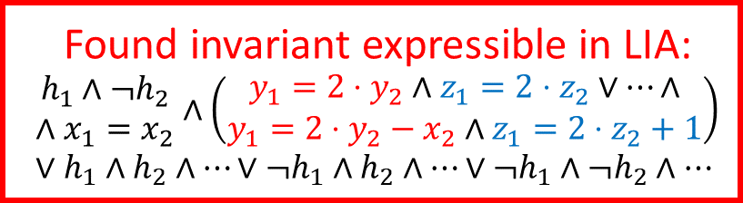




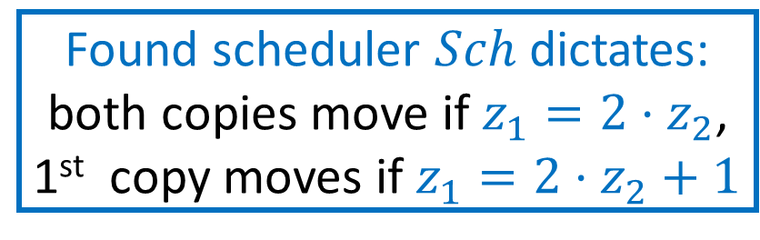
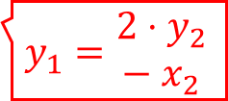







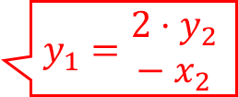

Our Approach to TI-NI
Can choose which program to execute depending on the states
Find a semantic scheduler $Sch$ and a safe invariant of the parallel executions of 2 copies of the program under $Sch$
Found invariant expressible in LIA:
$$\begin{matrix}h_{1}∧¬h_{2} \\ ∧x_{1}=x_{2}\end{matrix}∧\left(\begin{matrix}y_{1}=2⋅y_{2}∧z_{1}=2⋅z_{2}∨…∧ \\ y_{1}=2⋅y_{2}−x_{2}∧z_{1}=2⋅z_{2}+1\end{matrix}\right)∨h_{1}∧h_{2}∧…∨¬h_{1}∧h_{2}∧…∨¬h_{1}∧¬h_{2}∧…$$
An example run under $Sch$:
$\left(h_{1},x_{1},y_{1},z_{1},h_{2},x_{2},y_{2},z_{2}\right)$
$$↦\left(⊤,2,0,_,⊥,2,0,_\right)$$
$$→_{}^{ℓ_{1}}\left(⊤,2,0,4,⊥,2,0,2\right)$$
$$→_{1,2}^{ℓ_{2}}\left(⊤,2,2,3,⊥,2,2,1\right)$$
$$→_{1}^{ℓ_{2}}\left(⊤,2,4,2,⊥,2,2,1\right)$$
$$→_{1,2}^{ℓ_{2}}\left(⊤,2,6,1,⊥,2,4,0\right)$$
$$→_{1}^{ℓ_{2}}\left(⊤,2,8,0,⊥,2,4,0\right)$$
$$→_{}^{ℓ_{3}}\left(⊤,2,8,0,⊥,2,8,0\right)$$
doubleSquare(bool h,int x) {
int z, y=0;
$ℓ_{1}:$ if(h) {z=2*x} else {z=x}
$ℓ_{2}:$ while(z>0) { z--; y=y+x }
$ℓ_{3}:$ if(!h) { y=2*y }
return y;
}
$$x_{1}=x_{2}$$
$$y_{1}={2⋅y}_{2}$$
$$z_{1}=2⋅z_{2}$$
$$y_{1}=\begin{matrix}{2⋅y}_{2} \\ − x_{2}\end{matrix}$$
$z_{1}=2⋅z_{2}$+1
$$y_{1}={2⋅y}_{2}$$
$$z_{1}=2⋅z_{2}$$
Found scheduler $Sch$ dictates:
both copies move if $z_{1}=2⋅z_{2}$,
1st copy moves if $z_{1}=2⋅z_{2}+1$
$$y_{1}=\begin{matrix}{2⋅y}_{2} \\ − x_{2}\end{matrix}$$
$z_{1}=2⋅z_{2}$+1
$$y_{1}={2⋅y}_{2}$$
$$y_{1}=y_{2}$$

Slide 32


Prog. & Spec.
pfwCSP
SAT or UNSAT
Constraint Generation
Constraint Solving
represents a relational invariant
preserved by a semantic scheduler
the relational invariant is inductive and implies TI-NI
Input:
doubleSquare
(bool h, int x) {
int z, y=0;
if(h) { z=2*x }
else { z=x }
while(z>0)
{ z--; y=y+x }
if(!h) { y=2*y }
return y;
}
Output $𝓒$ (with $h_{1}=⊤∧h_{2}= ⊥$ fixed):
$I\left(V_{1},V_{2}\right)⟸\begin{matrix}x_{1}=x_{2}∧y_{1}=y_{2}=0 \\ ∧z_{1}=2⋅x_{1}∧z_{2}=x_{2}\end{matrix}$,
$I\left(x_{1},y_{1}^{′},z_{1}^{′},V_{2}\right)⟸I\left(V_{1},V_{2}\right)∧Sch_{1}\left(V_{1},V_{2}\right)∧ \left(\begin{aligned}z_{1}>0∧z_{1}^{′}=z_{1}−1∧y_{1}^{′}=y_{1}+x_{1}∨ \\ z_{1}≤0∧z_{1}^{′}=z_{1}∧y_{1}^{′}=y_{1}\end{aligned}\right)$,…,
$y_{1}=2⋅y_{2}⟸$ $I\left(V_{1},V_{2}\right)∧z_{1}≤0∧z_{2}≤0$,
$\left(Sch_{1}\left(V_{1},V_{2}\right)∨Sch_{2}\left(V_{1},V_{2}\right)∨Sch_{1,2}\left(V_{1},V_{2}\right)\right)$
$⟸I\left(V_{1},V_{2}\right)∧\left(z_{1}>0∨z_{2}>0\right)$,
$z_{1}>0⟸I\left(V_{1},V_{2}\right)∧Sch_{1}\left(V_{1},V_{2}\right)∧z_{2}>0$,
$z_{2}>0⟸I\left(V_{1},V_{2}\right)∧Sch_{2}\left(V_{1},V_{2}\right)∧z_{1}>0,$
where $V_{1}=x_{1},y_{1},z_{1}$ and $V_{2}=x_{2},y_{2},z_{2}$
the scheduler is fair: at least one unfinished program must be scheduled if there is any
(necessary for the soundness)
non-Horn clause that goes beyond CHCs !
represent the semantic scheduler: if $Sch_{1}$ holds, 1st copy is scheduled

Slide 33
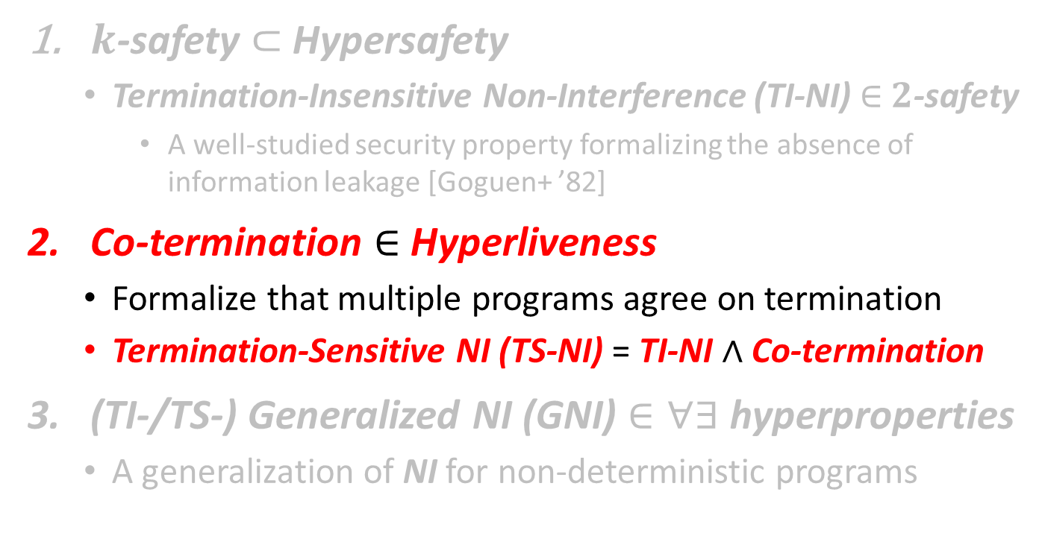
Relational Verification via
Synthesis of Relational Invariants and Fair & Semantic Schedulers
$k$-safety $⊂$ Hypersafety
  Termination-Insensitive Non-Interference (TI-NI) $∈$ $2$-safety
    A well-studied security property formalizing the absence of information leakage [Goguen+ ’82]
Co-termination $∈$ Hyperliveness
  Formalize that multiple programs agree on termination
  Termination-Sensitive NI (TS-NI) = TI-NI $∧$ Co-termination
(TI-/TS-) Generalized NI (GNI) $∈∀∃$ hyperproperties
  A generalization of NI for non-deterministic programs

Slide 34

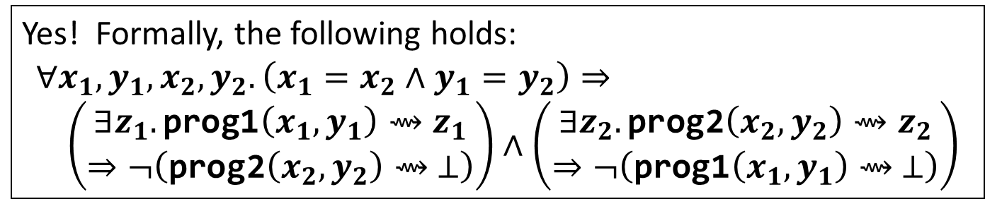
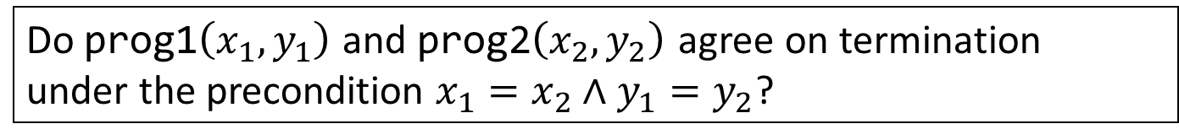
Example: Co-Termination
$∈$ Hyperliveness
prog1(int x, int y) { while(x>0) { x=x–y; } }
prog2(int x, int y) { while(x>0) { x=x–2*y; } }
Do prog1$\left(x_{1},y_{1}\right)$ and prog2$\left(x_{2},y_{2}\right)$ agree on termination
under the precondition $x_{1}=x_{2}∧y_{1}=y_{2}$?
Yes! Formally, the following holds:
$$∀x_{1},y_{1},x_{2},y_{2}. \left(x_{1}=x_{2}∧y_{1}=y_{2}\right)⇒ \\ \left(\begin{aligned}∃z_{1}.\text{prog}\text{1}\left(x_{1},y_{1}\right)⇝z_{1} \\ ⇒¬\left(\text{prog}\text{2}\left(x_{2},y_{2}\right)⇝ ⊥\right)\end{aligned}\right)∧\left(\begin{aligned}∃z_{2}.\text{prog}\text{2}\left(x_{2},y_{2}\right)⇝z_{2} \\ ⇒¬\left(\text{prog}\text{1}\left(x_{1},y_{1}\right)⇝ ⊥\right)\end{aligned}\right)$$
One symmetric co-termination problem boils down to
two asymmetric co-termination problems

Slide 35



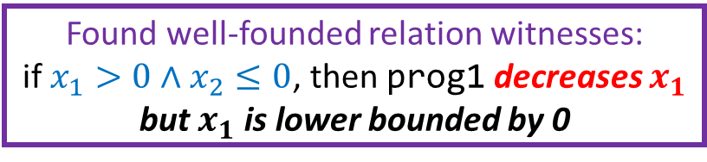

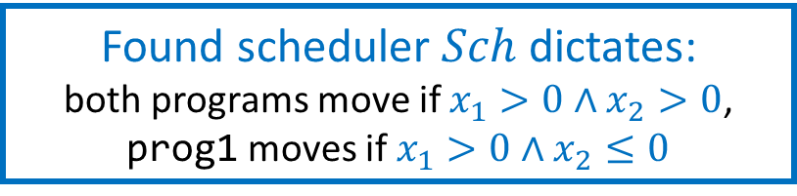

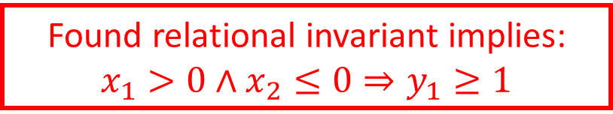


Our Approach to
Asymmetric Co-Termination
Find a fair semantic scheduler $Sch$, a relational invariant, and a well-founded relation under $Sch$
prog1(int x, int y) {
while(x>0) { x=x–y; }
}
prog2(int x, int y) {
while(x>0) { x=x–2*y; }
}
An example run under $Sch$:
$\left(x_{1},y_{1}, x_{2},y_{2}\right)$
$$↦\left(4,1,4,1\right)$$
$$→_{1,2}^{}\left(3,1,2,1\right)$$
$$→_{1,2}^{}\left(2,1,0,1\right)$$
$$→_{1}^{}\left(1,1,0,1\right)$$
$$→_{1}^{}\left(0,1,0,1\right)$$
Found relational invariant implies:
$$x_{1}>0∧x_{2}≤0⇒y_{1}≥1$$
$$x_{1}=x_{2}∧y_{1}=y_{2}$$
$$x_{1}>0∧x_{2}>0$$
$$x_{1}>0∧x_{2}>0$$
Found well-founded relation witnesses:
if $x_{1}>0∧x_{2}≤0$, then prog1 decreases $x_{1}$ but $x_{1}$ is lower bounded by 0
prog2 terminated
$$x_{1}>0∧x_{2}≤0$$
$$x_{1}>0∧x_{2}≤0$$
prog1 terminated
Found scheduler $Sch$ dictates:
both programs move if $x_{1}>0∧x_{2}>0$,
prog1 moves if $x_{1}>0∧x_{2}≤0$

Slide 36

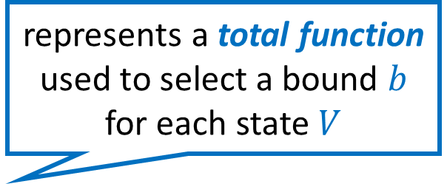
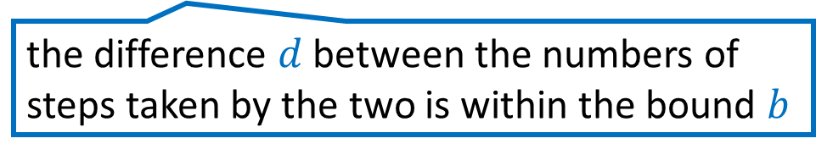
Prog. & Spec.
pfwCSP
SAT or UNSAT
the relational invariant is inductive and, along with the well-founded relation, implies Co-Termination
Constraint Generation
represents a total function used to select a bound $b$ for each state $V$
Constraint Solving
represents a relational invariant
preserved by a semantic scheduler
Input:
prog1(x, y) {
while(x>0)
{ x=x–y }
}
prog2(x, y) {
while(x>0)
{ x=x-2*y }
}
Output $𝓒$:
$I\left(0,b,V\right)⟸F_{λ}\left(V,b\right)∧x_{1}=x_{2}∧y_{1}=y_{2}$,
$I\left({d^{′},b,x}_{1}^{′},y_{1}, x_{2},y_{2}\right)⟸I\left(d,b,V\right)∧Sch_{1}\left(V\right)∧$
$\left(x_{1}>0∧x_{1}^{′}=x_{1}−y_{1}∨x_{1}≤0∧x_{1}^{′}=x_{1}\right)∧$
$\left(x_{1}>0∧x_{2}>0⇒d^{′}=d+1\right)$,…,
$R_{⇓}\left(V_{1},x_{1}−y_{1},y_{1}\right)⟸$ $I\left({d,b,V}_{1},V_{2}\right)∧x_{1}>0∧x_{2}≤0$,
$\left(Sch_{1}\left(d,b,V\right)∨Sch_{2}\left(d,b,V\right)∨Sch_{1,2}\left(d,b,V\right)\right)$
$⟸I\left(d,b,V\right)∧\left(x_{1}>0∨x_{2}>0\right)$,
$x_{1}>0⟸I\left(d,b,V\right)∧Sch_{1}\left(d,b,V\right)∧x_{2}>0$,
$x_{2}>0⟸I\left(d,b,V\right)∧Sch_{2}\left(d,b,V\right)∧x_{1}>0,$
$d∈\left[−b,b\right]∧b≥0 ⟸I\left({d,b,V}_{1},V_{2}\right)∧x_{1}>0∧x_{2}>0$
where $V=x_{1},y_{1}$,$x_{2},y_{2}$
the scheduler is fair: all unfinished programs must be eventually scheduled
(necessary for soundness)
represents a well-founded relation witnessing the termination of prog1 relative to the termination of prog2
the difference $d$ between the numbers of steps taken by the two is within the bound $b$

Slide 37
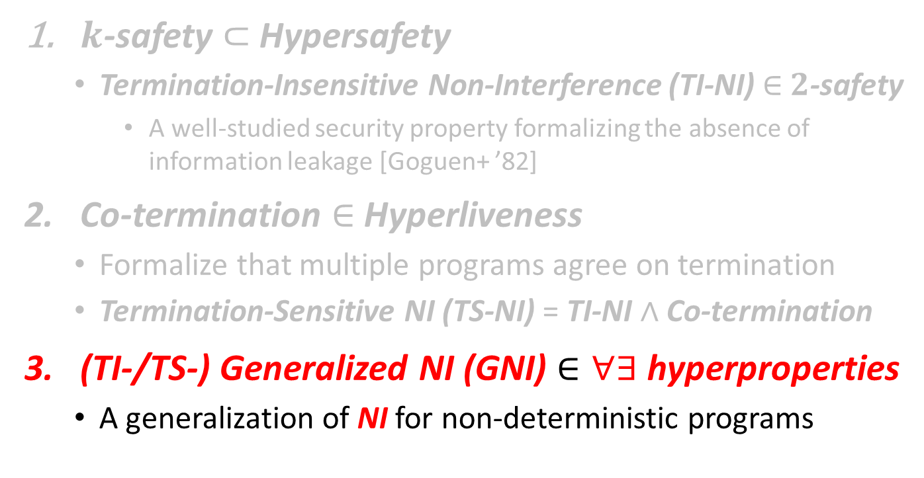
Relational Verification via
Synthesis of Relational Invariants and Fair & Semantic Schedulers
$k$-safety $⊂$ Hypersafety
  Termination-Insensitive Non-Interference (TI-NI) $∈$ $2$-safety
    A well-studied security property formalizing the absence of information leakage [Goguen+ ’82]
Co-termination $∈$ Hyperliveness
  Formalize that multiple programs agree on termination
  Termination-Sensitive NI (TS-NI) = TI-NI $∧$ Co-termination
(TI-/TS-) Generalized NI (GNI) $∈∀∃$ hyperproperties
  A generalization of NI for non-deterministic programs

Slide 38
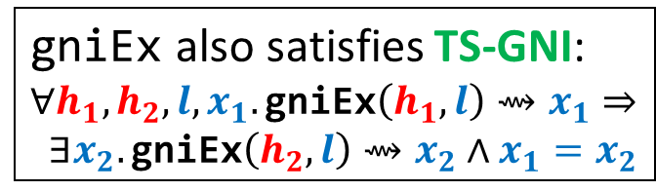


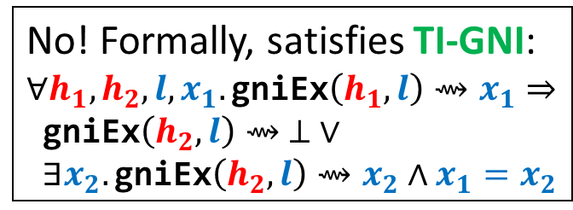
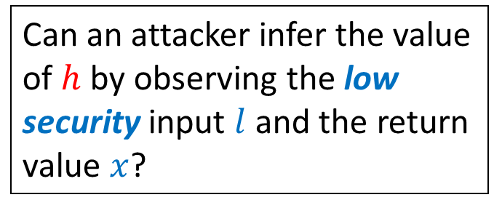


Example: (TI-/TS-)GNI
$∈$ $∀∃$hyperproperties
gniEx$\left(h,l\right)$ non-deterministically returns a value $x≥l$ in two different ways depending on the high security input $h$
gniEx(bool high, int low) {
if(high) {
int x = nondet_int();
if(x >= low) { return x }
else { while(true) {} }
} else {
int x = low;
while(nondet_bool()){x++}
return x;
}
}
Can an attacker infer the value of $h$ by observing the low security input $l$ and the return value $x$?
No! Formally, satisfies TI-GNI:
$$∀h_{1}, h_{2},l,x_{1}.\text{gniEx}\left(h_{1},l\right)⇝x_{1}⇒$$
$\text{gniEx}\left(h_{2},l\right)⇝ ⊥ ∨$
$∃x_{2}.\text{gniEx}\left(h_{2},l\right)⇝x_{2}∧x_{1}=x_{2}$
The demonic ($∀$) side
The angelic ($∃$) side
gniEx also satisfies TS-GNI:
$$∀h_{1}, h_{2},l,x_{1}.\text{gniEx}\left(h_{1},l\right)⇝x_{1}⇒$$
$∃x_{2}.\text{gniEx}\left(h_{2},l\right)⇝x_{2}∧x_{1}=x_{2}$

Slide 39
Our Approach to (TI-/TS-)GNI
Find a fair semantic scheduler, a relational invariant, a well-founded relation, and strategies for the non-deterministic choices of the angelic side
Augment the encodings for TI-NI and Co-Term with
  predicate variables that represent the strategies:
  total functions from states to choices of the angelic side
  prophecy variables that represent the final outputs of the demonic side (necessary for the completeness)
Please refer to the paper for details and examples

Slide 40
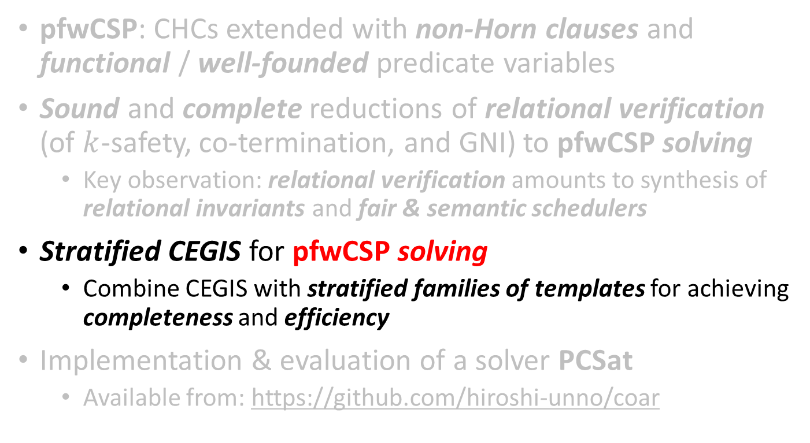
This Talk [CAV ’21]
pfwCSP: CHCs extended with non-Horn clauses and
functional / well-founded predicate variables
Sound and complete reductions of relational verification
(of $k$-safety, co-termination, and GNI) to pfwCSP solving
  Key observation: relational verification amounts to synthesis of relational invariants and fair & semantic schedulers
Stratified CEGIS for pfwCSP solving
  Combine CEGIS with stratified families of templates for achieving completeness and efficiency
Implementation & evaluation of a solver PCSat
  Available from: https://github.com/hiroshi-unno/coar

Slide 41
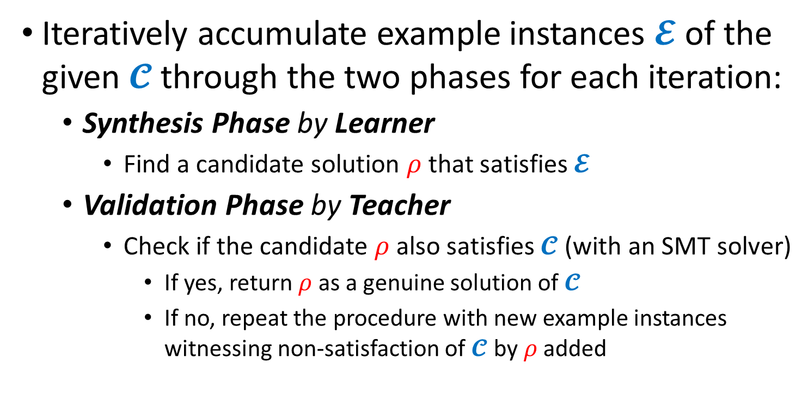
CounterExample Guided Inductive Synthesis (CEGIS) [Solar-Lezama+ ’06]
Iteratively accumulate example instances $𝓔$ of the given $𝓒$ through the two phases for each iteration:
  Synthesis Phase by Learner
    Find a candidate solution $ρ$ that satisfies $𝓔$
  Validation Phase by Teacher
    Check if the candidate $ρ$ also satisfies $𝓒$ (with an SMT solver)
      If yes, return $ρ$ as a genuine solution of $𝓒$
      If no, repeat the procedure with new example instances witnessing non-satisfaction of $𝓒$ by $ρ$ added

Slide 42
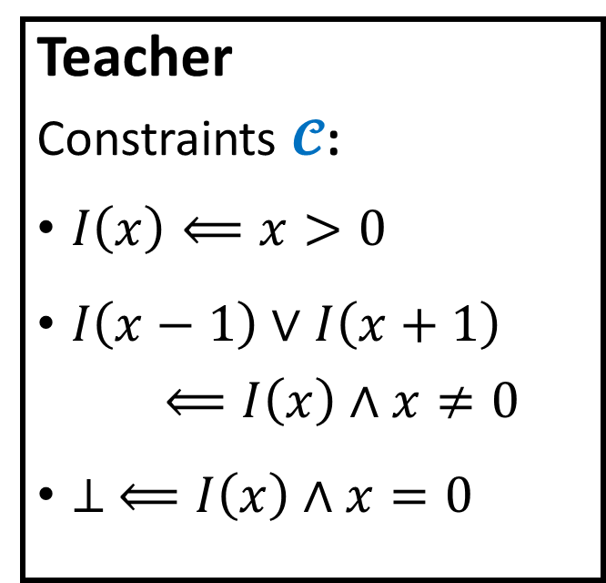
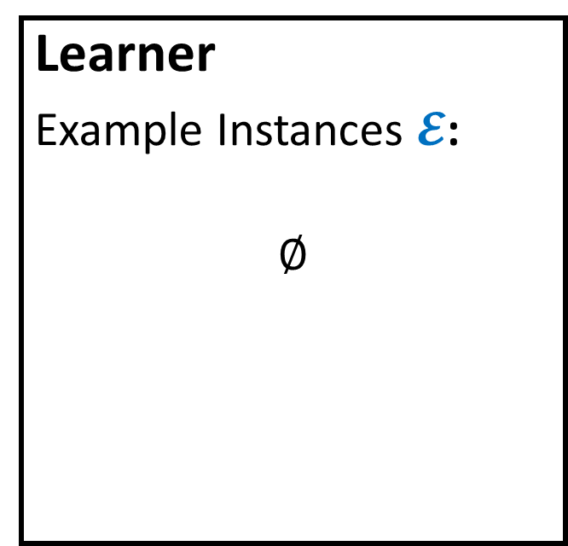
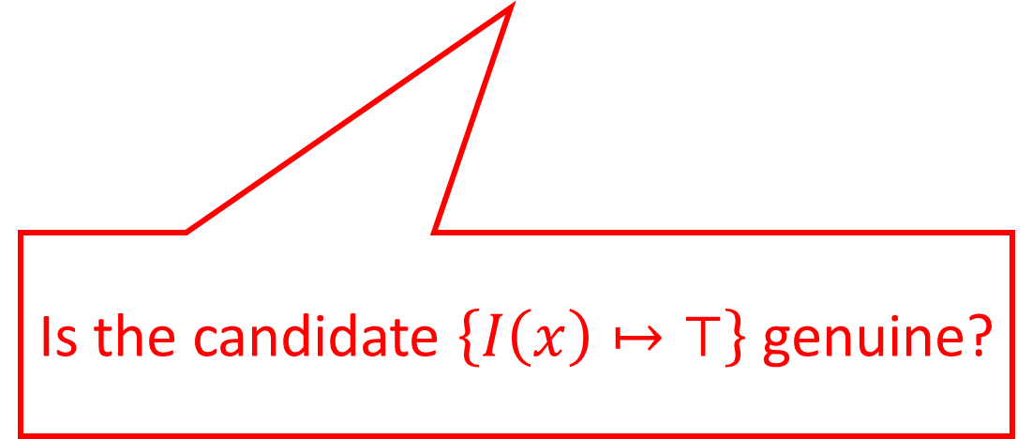
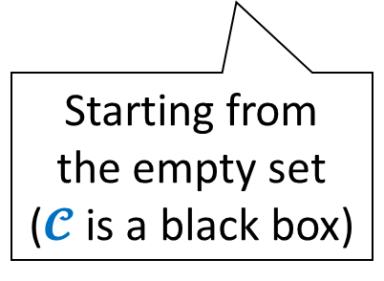
Example Run of CEGIS
Learner
Example Instances $𝓔$:
$$∅$$
Teacher
Constraints $𝓒$:
$I\left(x\right)⟸x>0$
$I\left(x−1\right)∨I\left(x+1\right)$
$⟸I\left(x\right)∧x≠0$
$⊥ ⟸I\left(x\right)∧x=0$
Starting from
the empty set
($𝓒$ is a black box)
Is the candidate $\left\{I\left(x\right)↦⊤\right\}$ genuine?

Slide 43

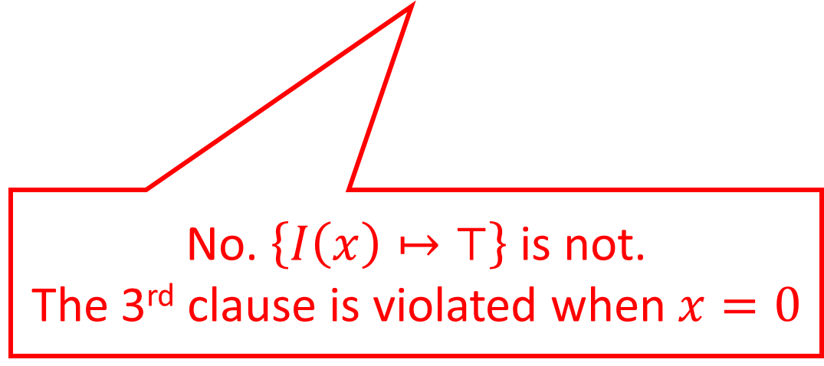
Example Run of CEGIS
Learner
Example Instances $𝓔$:
$$∅$$
Teacher
Constraints $𝓒$:
$I\left(x\right)⟸x>0$
$I\left(x−1\right)∨I\left(x+1\right)$
$⟸I\left(x\right)∧x≠0$
$⊥ ⟸I\left(x\right)∧x=0$
$$⊥ ⟸I\left(0\right)∧0=0$$
No. $\left\{I\left(x\right)↦⊤\right\}$ is not.
The 3rd clause is violated when $x=0$

Slide 44
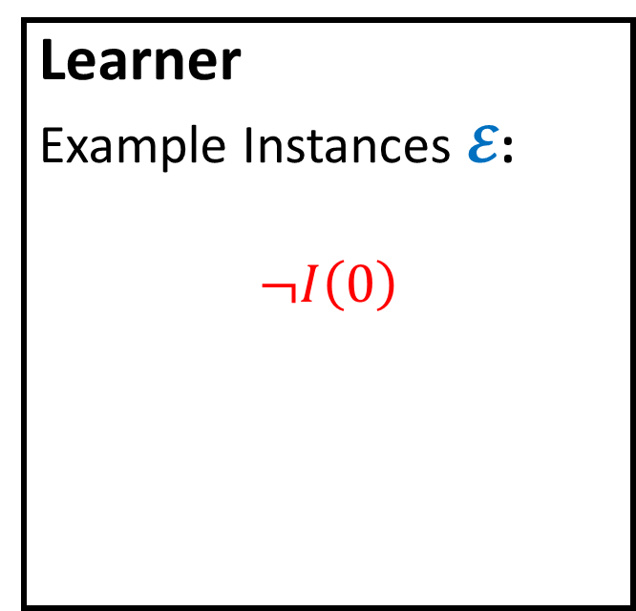

Example Run of CEGIS
Learner
Example Instances $𝓔$:
$$¬I\left(0\right)$$
Teacher
Constraints $𝓒$:
$I\left(x\right)⟸x>0$
$I\left(x−1\right)∨I\left(x+1\right)$
$⟸I\left(x\right)∧x≠0$
$⊥ ⟸I\left(x\right)∧x=0$
Is the cand. $\left\{I\left(x\right)↦x<0\right\}$ genuine?

Slide 45
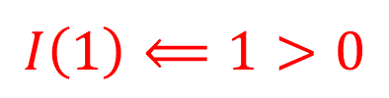
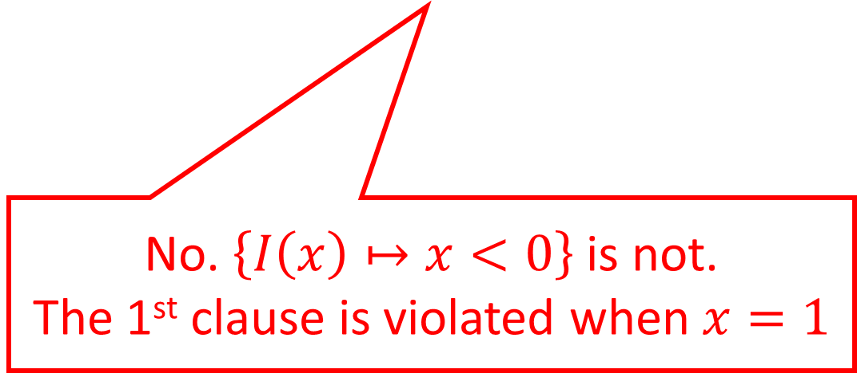
Example Run of CEGIS
Learner
Example Instances $𝓔$:
$$¬I\left(0\right)$$
Teacher
Constraints $𝓒$:
$I\left(x\right)⟸x>0$
$I\left(x−1\right)∨I\left(x+1\right)$
$⟸I\left(x\right)∧x≠0$
$⊥ ⟸I\left(x\right)∧x=0$
$$I\left(1\right)⟸1>0$$
No. $\left\{I\left(x\right)↦x<0\right\}$ is not.
The 1st clause is violated when $x=1$

Slide 46


Example Run of CEGIS
Learner
Example Instances $𝓔$:
$$¬I\left(0\right)$$
$$I\left(1\right)$$
Teacher
Constraints $𝓒$:
$I\left(x\right)⟸x>0$
$I\left(x−1\right)∨I\left(x+1\right)$
$⟸I\left(x\right)∧x≠0$
$⊥ ⟸I\left(x\right)∧x=0$
Is the cand. $\left\{I\left(x\right)↦x=1\right\}$ genuine?

Slide 47


Example Run of CEGIS
Learner
Example Instances $𝓔$:
$$¬I\left(0\right)$$
$$I\left(0\right)∨I\left(2\right)⟸I\left(1\right)$$
$$I\left(1\right)$$
Teacher
Constraints $𝓒$:
$I\left(x\right)⟸x>0$
$I\left(x−1\right)∨I\left(x+1\right)$
$⟸I\left(x\right)∧x≠0$
$⊥ ⟸I\left(x\right)∧x=0$
No. $\left\{I\left(x\right)↦x=1\right\}$ is not.
The 2nd clause is violated when $x=1$

Slide 48
Example Run of CEGIS
Learner
Example Instances $𝓔$:
$$¬I\left(0\right)$$
$$I\left(0\right)∨I\left(2\right)⟸I\left(1\right)$$
$$I\left(1\right)$$
Teacher
Constraints $𝓒$:
$I\left(x\right)⟸x>0$
$I\left(x−1\right)∨I\left(x+1\right)$
$⟸I\left(x\right)∧x≠0$
$⊥ ⟸I\left(x\right)∧x=0$
Is the cand. $\left\{I\left(x\right)↦x≥1\right\}$ genuine?

Slide 49

Example Run of CEGIS
Learner
Example Instances $𝓔$:
$$¬I\left(0\right)$$
$$I\left(0\right)∨I\left(2\right)⟸I\left(1\right)$$
$$I\left(1\right)$$
Teacher
Constraints $𝓒$:
$I\left(x\right)⟸x>0$
$I\left(x−1\right)∨I\left(x+1\right)$
$⟸I\left(x\right)∧x≠0$
$⊥ ⟸I\left(x\right)∧x=0$
Yes. $\left\{I\left(x\right)↦x≥1\right\}$ satisfies $𝓒$!

Slide 50




Template-based Learner
Prepare a solution template with unknown coefficients,
Generate constraints on them, and
Solve them using an SMT solver
Examples: $𝓔≡\left\{I\left(0\right),I\left(0\right)⇒I\left(1\right),¬I\left(−1\right)\right\}$
Solution Template: $I\left(x\right)↦c_{1}⋅x+c_{2}≥0$
Coeff. Constraints: $\left\{c_{2}≥0,c_{2}≥0⇒c_{1}+c_{2}≥0,−c_{1}+c_{2}<0 \right\}$
Satisfying Assignment: $\left\{c_{1}↦1,c_{2}↦0\right\}$
A Candidate Solution: $ρ≡\left\{I\left(x\right)↦x≥0\right\}$

Slide 51
Stratified Template Families
Existing invariant synthesis methods [Jhala+ ’06,Terauchi+ ’15] use a stratified template family of ordinary predicates
  To achieve completeness, often at the price of efficiency
  Search for solutions in a stratified manner: Iteratively update templates to expressive ones, if needed, according to the family
Our pfwCSP solving method combines CEGIS with stratified template families of ordinary/functional/well-founded predicates
  To achieve not only completeness but also efficiency
  The data-driven nature of CEGIS is a good match: the stratified search accelerates the convergence by avoiding the overfitting problem [Padhi+ ’19] of expressive templates to counterexamples

Slide 52
Implementation and Evaluation
Evaluated our solver PCSat for pfwCSP
on 20 relational verification problems:
  15 solved fully automatically, 5 required small hints

Slide 53
Future and Ongoing Work
Further improve the scalability of constraint solving
  Particularly, synthesis of functional predicates
Automate program verification of:
  temporal relational properties expressed in
  hyper temporal logics (e.g., HyperLTL, HyperCTL)
  probabilistic relational properties, motivated from
  security, privacy, cryptography, and machine learning

Slide 54

Summary
pfwCSP: CHCs extended with non-Horn clauses and
functional / well-founded predicate variables
Sound and complete reductions of relational verification
(of $k$-safety, co-termination, and GNI) to pfwCSP solving
  relational verification amounts to synthesis of relational invariants and fair & semantic schedulers, which can be characterized by pfwCSP
Stratified CEGIS for pfwCSP solving
  Combine CEGIS with stratified families of templates for achieving completeness and efficiency
Implementation & evaluation of a solver PCSat
  Available from: https://github.com/hiroshi-unno/coar

Slide 55
Questions?

