Slide 1
Probabilistic Inference for Predicate Constraint Satisfaction
Hiroshi Unno (University of Tsukuba)
Joint Work with Yuki Satake and Hinata Yanagi

Slide 2
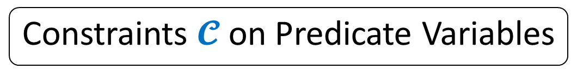
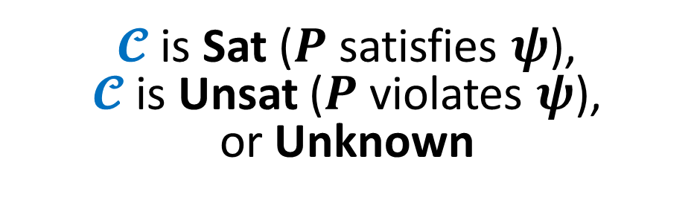

Program Verification via
Predicate Constraint Satisfaction
Target Program $P$ & Specification $ψ$
Constraint Generation
Constraints $𝓒$ on Predicate Variables
Constraint Solving
$𝓒$ is Sat ($P$ satisfies $ψ$),
$𝓒$ is Unsat ($P$ violates $ψ$),
or Unknown

Slide 3

Previous Work: Program Verification via Constrained Horn Clauses (CHCs) [Bjørner+ ’15]
Target Program $P$ & Specification $ψ$
Constraint Generation
JayHorn for Java [Kahsai+ ’16]
SeaHorn for C [Gurfinkel+ ’15]
RCaml for OCaml [Unno+ ’09]
Limited to Linear-Time Safety Verification ☹
CHCs Constraints $𝓒$ on Predicate Variables
Verification Intermediary Independent of Particular Target and Method ☺
SPACER [Komuravelli+ ’14]
Hoice [Champion+ ’18]
Eldarica [Hojjat+ ’18]
Constraint Solving
$𝓒$ is Sat ($P$ satisfies $ψ$),
$𝓒$ is Unsat ($P$ violates $ψ$),
or Unknown

Slide 4

This Work: Program Verification via Predicate Constraint Satisfaction Problem (pCSP)
Target Program $P$ & Specification $ψ$
Support Branching-Time Safety Verification ☺
Constraint Generation
New method for Looping & Recursive Programs
pCSP Constraints $𝓒$ on Predicate Variables
Verification Intermediary Independent of Particular Target and Method ☺
Constraint Solving
New method based on Probabilistic Inference
$𝓒$ is Sat ($P$ satisfies $ψ$),
$𝓒$ is Unsat ($P$ violates $ψ$),
or Unknown

Slide 5
This Work: Program Verification via Predicate Constraint Satisfaction Problem (pCSP)
Target Program $P$ & Specification $ψ$
Constraint Generation
pCSP Constraints $𝓒$ on Predicate Variables
Verification Intermediary Independent of Particular Target and Method ☺
Constraint Solving
$𝓒$ is Sat ($P$ satisfies $ψ$),
$𝓒$ is Unsat ($P$ violates $ψ$),
or Unknown

Slide 6
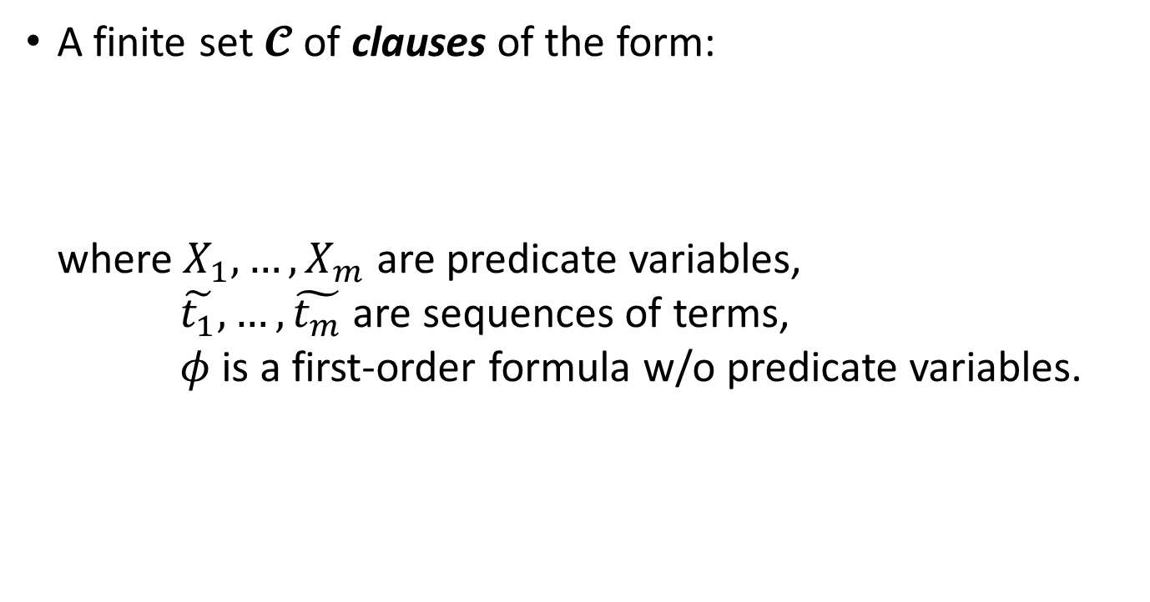
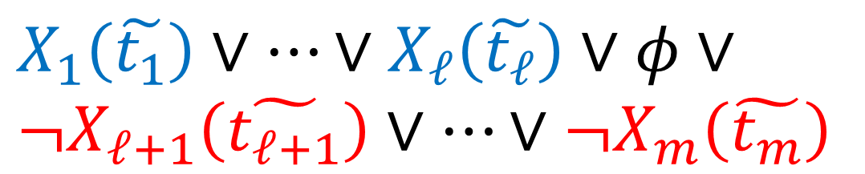
Predicate Constraint Satisfaction Problem (pCSP)
A finite set $𝓒$ of clauses of the form:
where $X_{1},…,X_{m}$ are predicate variables,
$\tilde{t_{1}},…,\tilde{t_{m}}$ are sequences of terms,
$φ$ is a first-order formula w/o predicate variables.
$$X_{1}\left(\tilde{t_{1}}\right)∨…∨X_{ℓ}\left(\tilde{t_{ℓ}}\right)∨φ∨ \\ {¬X}_{ℓ+1}\left(\tilde{t_{ℓ+1}}\right)∨…∨{¬X}_{m}\left(\tilde{t_{m}}\right)$$

Slide 7
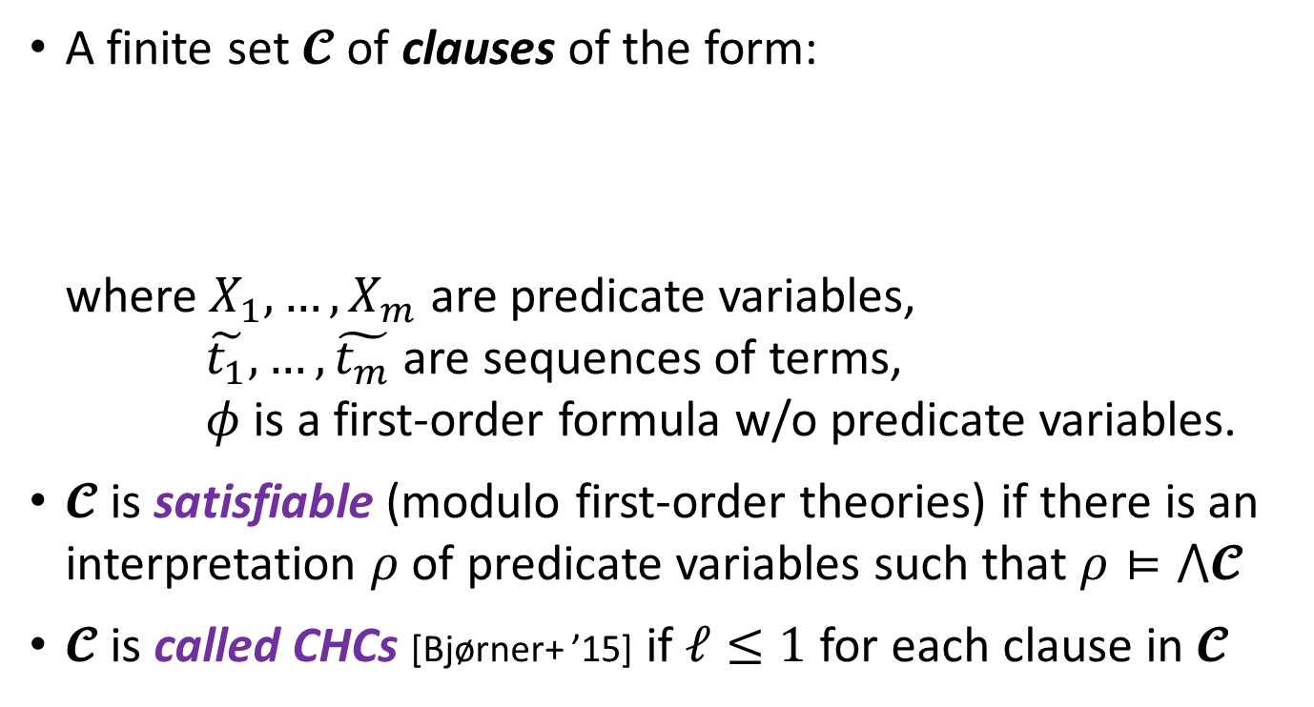
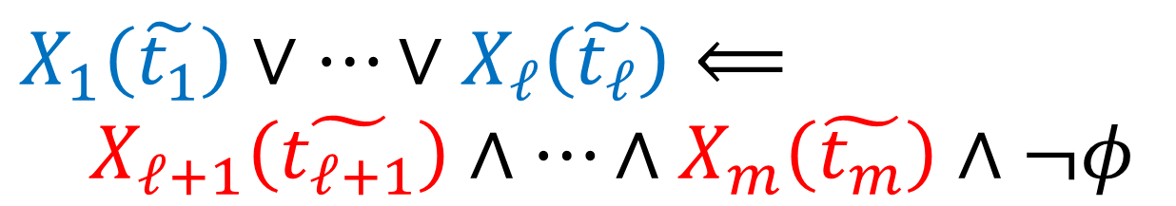
Predicate Constraint Satisfaction Problem (pCSP)
A finite set $𝓒$ of clauses of the form:
where $X_{1},…,X_{m}$ are predicate variables,
$\tilde{t_{1}},…,\tilde{t_{m}}$ are sequences of terms,
$φ$ is a first-order formula w/o predicate variables.
$𝓒$ is satisfiable (modulo first-order theories) if there is an interpretation $ρ$ of predicate variables such that $ρ⊨⋀𝓒$
$𝓒$ is called CHCs [Bjørner+ ’15] if $ℓ≤1$ for each clause in $𝓒$
$$X_{1}\left(\tilde{t_{1}}\right)∨…∨X_{ℓ}\left(\tilde{t_{ℓ}}\right)⟸ \\ X_{ℓ+1}\left(\tilde{t_{ℓ+1}}\right)∧…∧X_{m}\left(\tilde{t_{m}}\right)∧¬φ$$

Slide 8
This Work: Program Verification via Predicate Constraint Satisfaction Problem (pCSP)
Target Program $P$ & Specification $ψ$
Support Branching-Time Safety Verification ☺
Constraint Generation
pCSP Constraints $𝓒$ on Predicate Variables
Constraint Solving
$𝓒$ is Sat ($P$ satisfies $ψ$),
$𝓒$ is Unsat ($P$ violates $ψ$),
or Unknown

Slide 9
Branching-Time Safety Verification of Finitely-Branching Programs
Safety is a class of properties of the form
“something bad will never happen”
Branching-time verification concerns properties of the computation tree of the given program that may exhibit non-deterministic behavior (cf. linear-time verification concerns properties of execution traces)
Subsumes non-termination verification of deciding whether there is a non-terminating execution

Slide 10
This Work: Program Verification via Predicate Constraint Satisfaction Problem (pCSP)
Target Program $P$ & Specification $ψ$
Constraint Generation
New method for Looping & Recursive Programs
pCSP Constraints $𝓒$ on Predicate Variables
Constraint Solving
$𝓒$ is Sat ($P$ satisfies $ψ$),
$𝓒$ is Unsat ($P$ violates $ψ$),
or Unknown

Slide 11
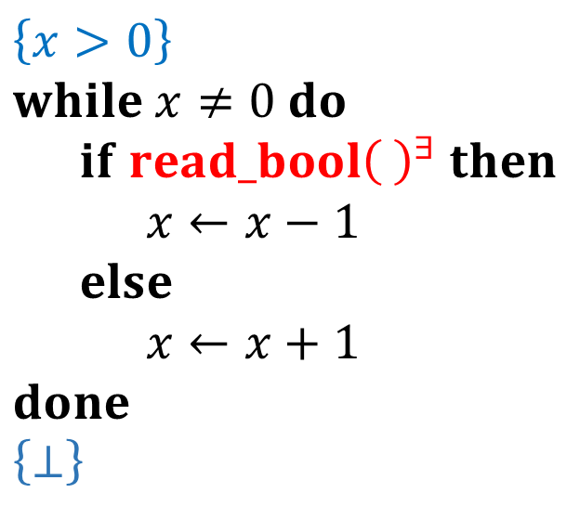
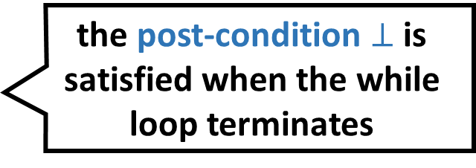
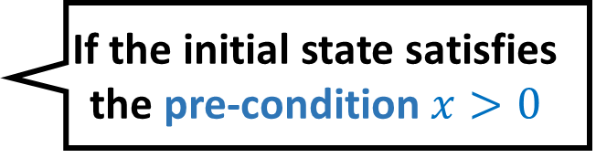
Prog. & Spec.
pCSP
SAT or UNSAT
Constraint Generation
Constraint Solving
Example Program and Specification:
If the initial state satisfies the pre-condition $x>0$
Pre-condition
$$\left\{x>0\right\} \\ while x≠0 do \\ if read_bool{\left( \right)}^{∃} then \\ x←x−1 \\ else \\ x←x+1 \\ done \\ \left\{⊥\right\}$$
Non-det. branching
there is an execution of the program such that
the post-condition $⊥$ is satisfied when the while loop terminates
Post-condition
Contradiction

Slide 12
Prog. & Spec.
pCSP
SAT or UNSAT
Constraint Generation
Constraint Solving
Example Program and Specification:
If the initial state satisfies the pre-condition $x>0$
Pre-condition
$$\left\{x>0\right\} \\ while x≠0 do \\ if read_bool{\left( \right)}^{∃} then \\ x←x−1 \\ else \\ x←x+1 \\ done \\ \left\{⊥\right\}$$
Non-det. branching
there is an execution of the program such that
the while loop
never terminates
Post-condition
Contradiction

Slide 13
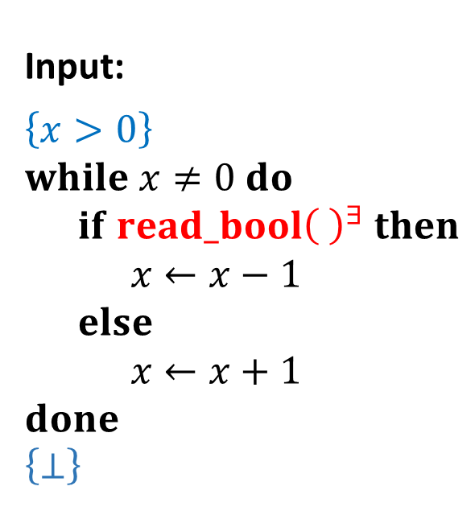
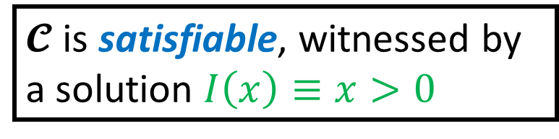
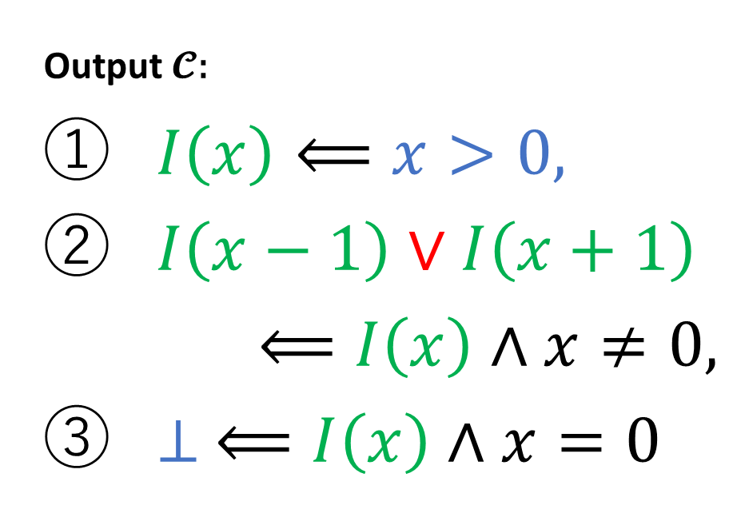
Prog. & Spec.
pCSP
SAT or UNSAT
Constraint Generation
Constraint Solving
represents a loop invariant
preserved by some execution
Input:
$$\left\{x>0\right\} \\ while x≠0 do \\ if read_bool{\left( \right)}^{∃} then \\ x←x−1 \\ else \\ x←x+1 \\ done \\ \left\{⊥\right\}$$
Output $𝓒$:
$I\left(x\right)⟸x>0$,
$I\left(x−1\right)∨I\left(x+1\right)$
$⟸I\left(x\right)∧x≠0,$
$⊥ ⟸I\left(x\right)∧x=0$
𝓒 is beyond CHCs!
$𝓒$ is satisfiable, witnessed by a solution $I\left(x\right)≡x>0$

Slide 14
This Work: Program Verification via Predicate Constraint Satisfaction Problem (pCSP)
Target Program $P$ & Specification $ψ$
Constraint Generation
pCSP Constraints $𝓒$ on Predicate Variables
Constraint Solving
New method based on Probabilistic Inference
$𝓒$ is Sat ($P$ satisfies $ψ$),
$𝓒$ is Unsat ($P$ violates $ψ$),
or Unknown

Slide 15
Challenges in pCSP Solving
Undecidable in general even for decidable theories
The search space of solutions is often very large
(or unbounded), high-dimensional, and non-smooth
We address these challenges by a novel combination of probabilistic inference with
CounterExample Guided Inductive Synthesis (CEGIS) [Solar-Lezama+ ’06]

Slide 16
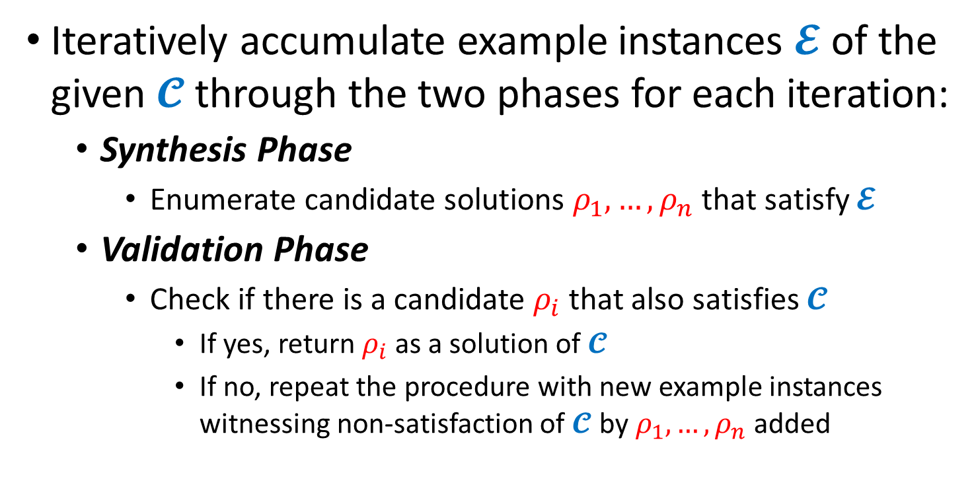
CounterExample Guided Inductive Synthesis (CEGIS)
Iteratively accumulate example instances $𝓔$ of the given $𝓒$ through the two phases for each iteration:
  Synthesis Phase
    Enumerate candidate solutions $ρ_{1},…,ρ_{n}$ that satisfy $𝓔$
  Validation Phase
    Check if there is a candidate $ρ_{i}$ that also satisfies $𝓒$
      If yes, return $ρ_{i}$ as a solution of $𝓒$
      If no, repeat the procedure with new example instances witnessing non-satisfaction of $𝓒$ by $ρ_{1},…,ρ_{n}$ added

Slide 17
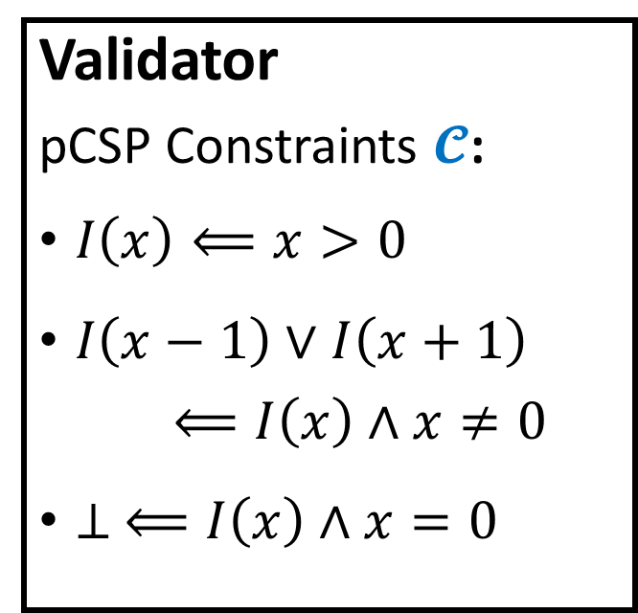
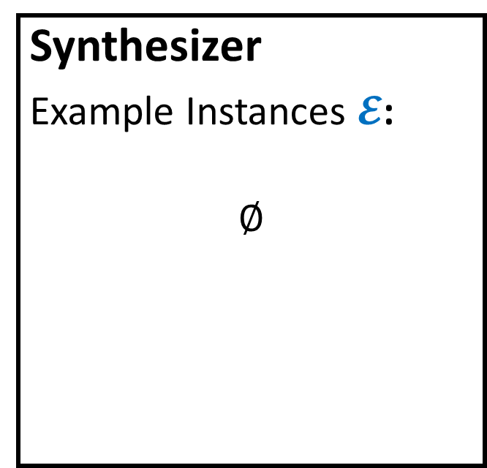
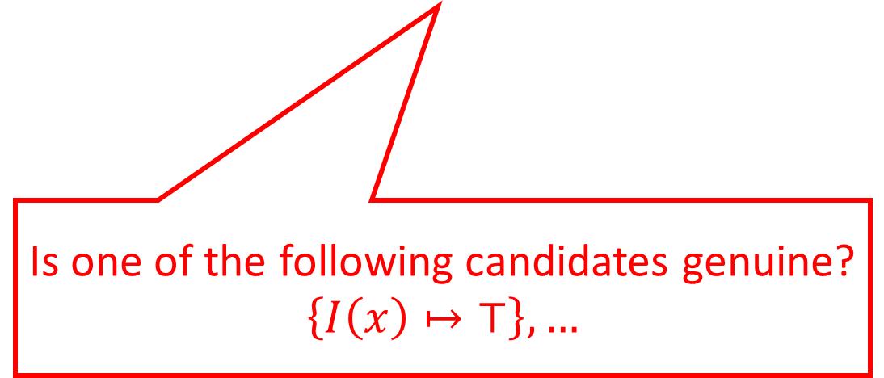
Example Run of CEGIS
Synthesizer
Example Instances $𝓔$:
$$∅$$
Validator
pCSP Constraints $𝓒$:
$I\left(x\right)⟸x>0$
$I\left(x−1\right)∨I\left(x+1\right)$
$⟸I\left(x\right)∧x≠0$
$⊥ ⟸I\left(x\right)∧x=0$
Starting from the empty set
Is one of the following candidates genuine?
$$\left\{I\left(x\right)↦⊤\right\},…$$

Slide 18

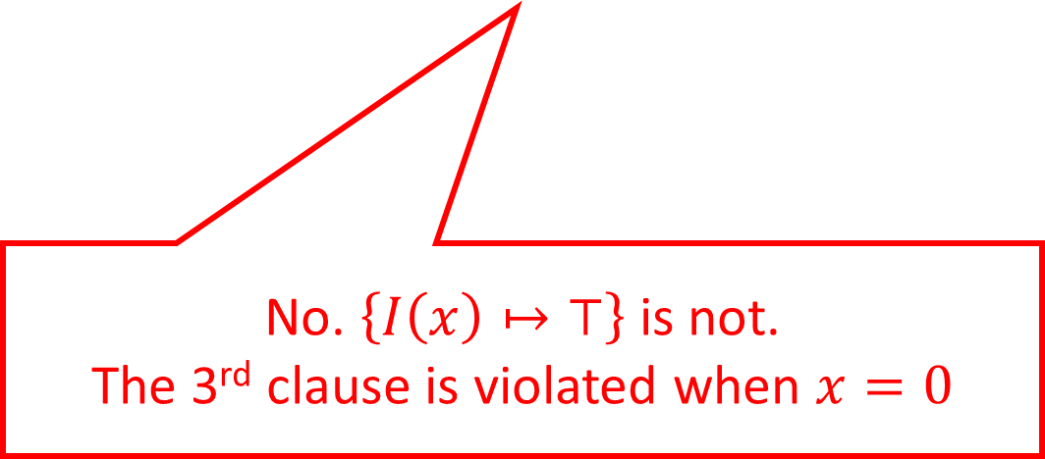
Example Run of CEGIS
Synthesizer
Example Instances $𝓔$:
$$∅$$
Validator
pCSP Constraints $𝓒$:
$I\left(x\right)⟸x>0$
$I\left(x−1\right)∨I\left(x+1\right)$
$⟸I\left(x\right)∧x≠0$
$⊥ ⟸I\left(x\right)∧x=0$
$$⊥ ⟸I\left(0\right)∧0=0$$
No. $\left\{I\left(x\right)↦⊤\right\}$ is not.
The 3rd clause is violated when $x=0$

Slide 19
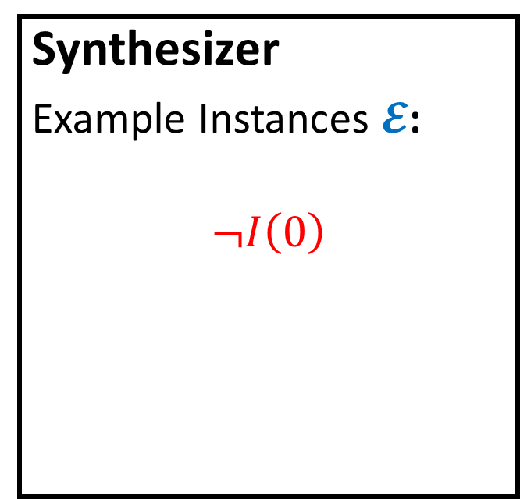
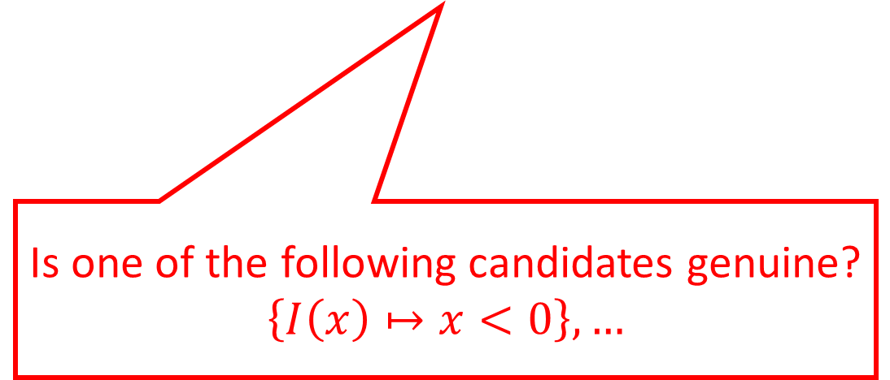
Example Run of CEGIS
Synthesizer
Example Instances $𝓔$:
$$¬I\left(0\right)$$
Validator
pCSP Constraints $𝓒$:
$I\left(x\right)⟸x>0$
$I\left(x−1\right)∨I\left(x+1\right)$
$⟸I\left(x\right)∧x≠0$
$⊥ ⟸I\left(x\right)∧x=0$
Is one of the following candidates genuine?
$$\left\{I\left(x\right)↦x<0\right\},…$$

Slide 20
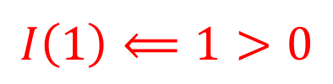

Example Run of CEGIS
Synthesizer
Example Instances $𝓔$:
$$¬I\left(0\right)$$
Validator
pCSP Constraints $𝓒$:
$I\left(x\right)⟸x>0$
$I\left(x−1\right)∨I\left(x+1\right)$
$⟸I\left(x\right)∧x≠0$
$⊥ ⟸I\left(x\right)∧x=0$
$$I\left(1\right)⟸1>0$$
No. $\left\{I\left(x\right)↦x<0\right\}$ is not.
The 1st clause is violated when $x=1$

Slide 21
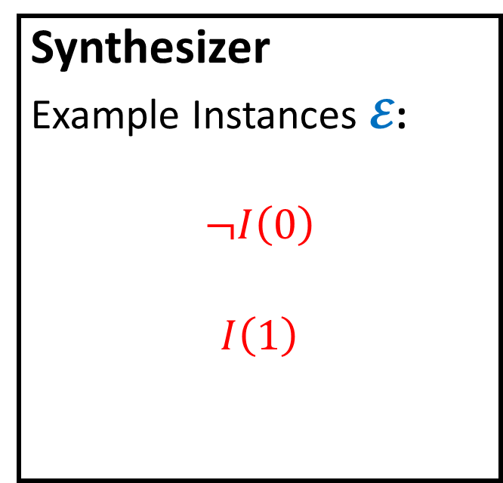

Example Run of CEGIS
Synthesizer
Example Instances $𝓔$:
$$¬I\left(0\right)$$
$$I\left(1\right)$$
Validator
pCSP Constraints $𝓒$:
$I\left(x\right)⟸x>0$
$I\left(x−1\right)∨I\left(x+1\right)$
$⟸I\left(x\right)∧x≠0$
$⊥ ⟸I\left(x\right)∧x=0$
Is one of the following candidates genuine?
$$\left\{I\left(x\right)↦x≥1\right\},…$$

Slide 22
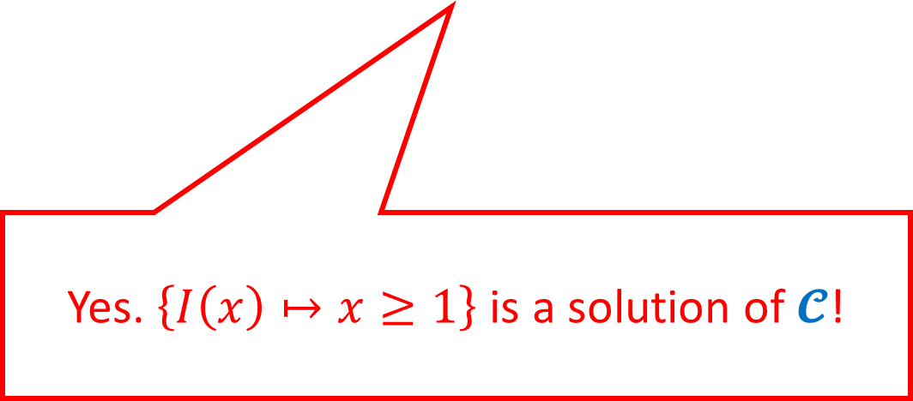
Example Run of CEGIS
Synthesizer
Example Instances $𝓔$:
$$¬I\left(0\right)$$
$$I\left(1\right)$$
Validator
pCSP Constraints $𝓒$:
$I\left(x\right)⟸x>0$
$I\left(x−1\right)∨I\left(x+1\right)$
$⟸I\left(x\right)∧x≠0$
$⊥ ⟸I\left(x\right)∧x=0$
Yes. $\left\{I\left(x\right)↦x≥1\right\}$ is a solution of $𝓒$!

Slide 23
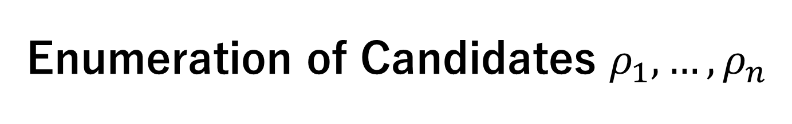
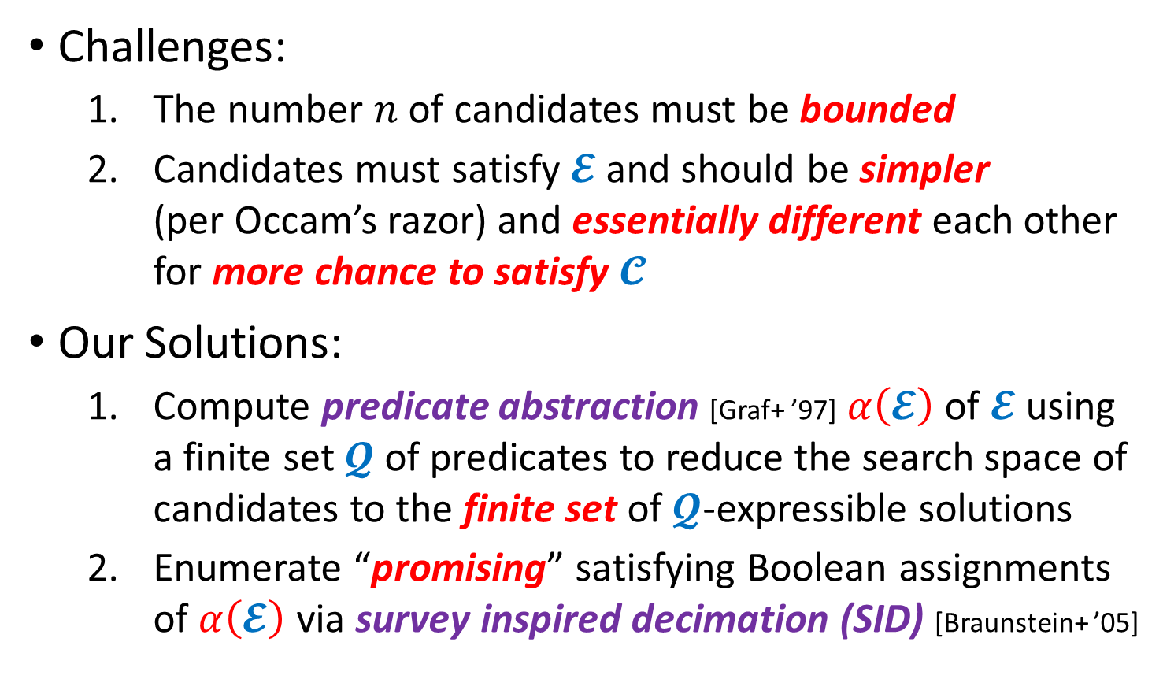
Enumeration of Candidates $ρ_{1},…,ρ_{n}$
Challenges:
  The number $n$ of candidates must be bounded
  Candidates must satisfy $𝓔$ and should be simpler
  (per Occam’s razor) and essentially different each other for more chance to satisfy $𝓒$
Our Solutions:
  Compute predicate abstraction [Graf+ ’97] $α\left(𝓔\right)$ of $𝓔$ using a finite set $𝓠$ of predicates to reduce the search space of candidates to the finite set of $𝓠$-expressible solutions
  Enumerate “promising” satisfying Boolean assignments of $α\left(𝓔\right)$ via survey inspired decimation (SID) [Braunstein+ ’05]

Slide 24
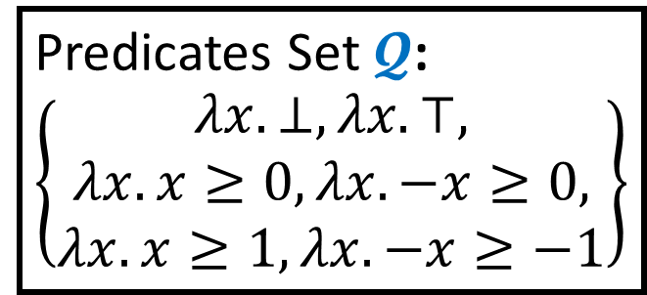
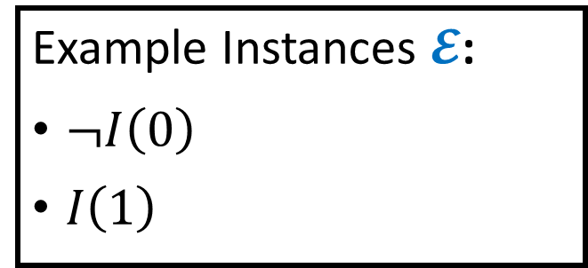
Example: Predicate Abstraction
Example Instances $𝓔$:
$¬I\left(0\right)$
$I\left(1\right)$
Predicates Set $𝓠$:
$$\left\{\begin{aligned}λx. ⊥,λx. ⊤, \\ λx. x≥0,λx. −x≥0, \\ λx. x≥1,λx. −x≥−1\end{aligned}\right\}$$

Slide 25
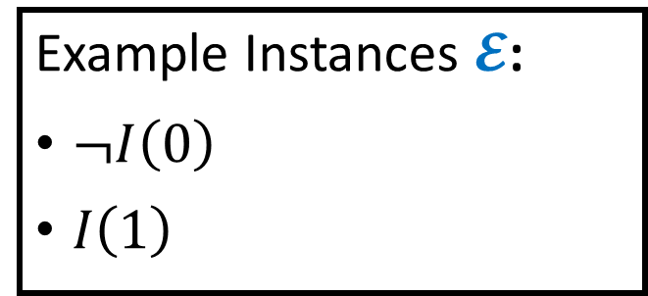
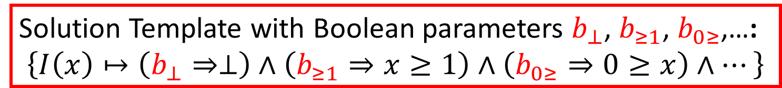
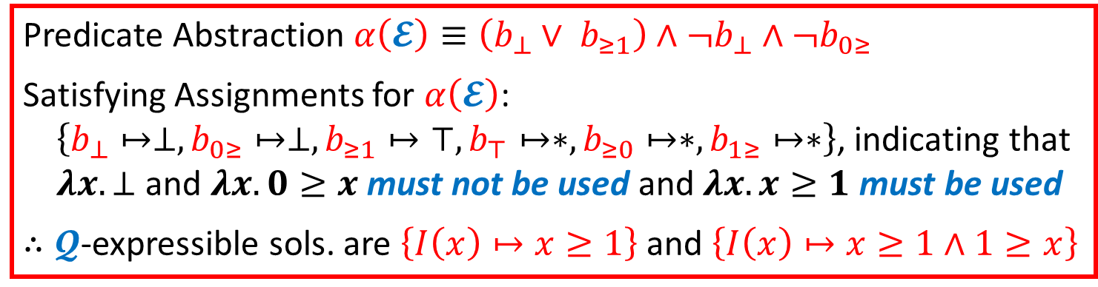
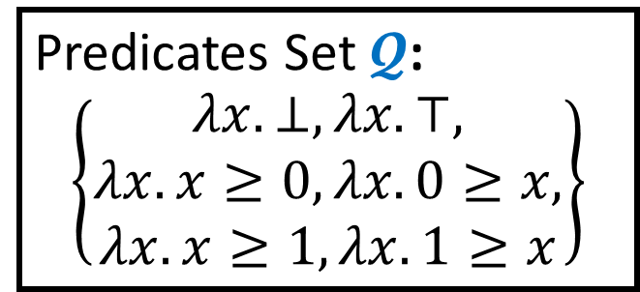
Example: Predicate Abstraction
Example Instances $𝓔$:
$¬I\left(0\right)$
$I\left(1\right)$
Predicates Set $𝓠$:
$$\left\{\begin{aligned}λx. ⊥,λx. ⊤, \\ λx. x≥0,λx. 0≥x, \\ λx. x≥1,λx. 1≥x\end{aligned}\right\}$$
Solution Template with Boolean parameters $b_{⊥}$, $b_{≥1}$, $b_{0≥}$,…:
$$\left\{I\left(x\right)↦\left(b_{⊥}⇒⊥\right)∧\left(b_{≥1}⇒x≥1\right)∧\left(b_{0≥}⇒0≥x\right)∧…\right\}$$
Predicate Abstraction $α\left(𝓔\right)≡\left(b_{⊥}∨ b_{≥1}\right)∧{¬b}_{⊥}∧{¬b}_{0≥}$
Satisfying Assignments for $α\left(𝓔\right)$:
$\left\{b_{⊥}↦⊥,b_{0≥}↦⊥,b_{≥1}↦⊤,b_{⊤}↦∗,b_{≥0}↦∗,b_{1≥}↦∗\right\}$, indicating that
$λx. ⊥$ and $λx.0≥x$ must not be used and $λx.x≥1$ must be used
$∴𝓠$-expressible sols. are $\left\{I\left(x\right)↦x≥1\right\}$ and $\left\{I\left(x\right)↦x≥1∧1≥x\right\}$
don’t care

Slide 26
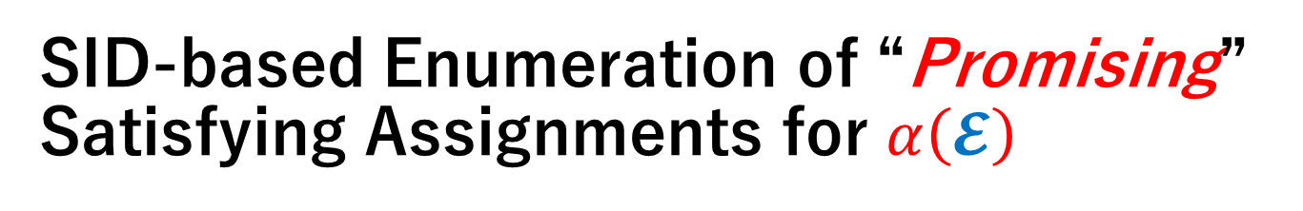
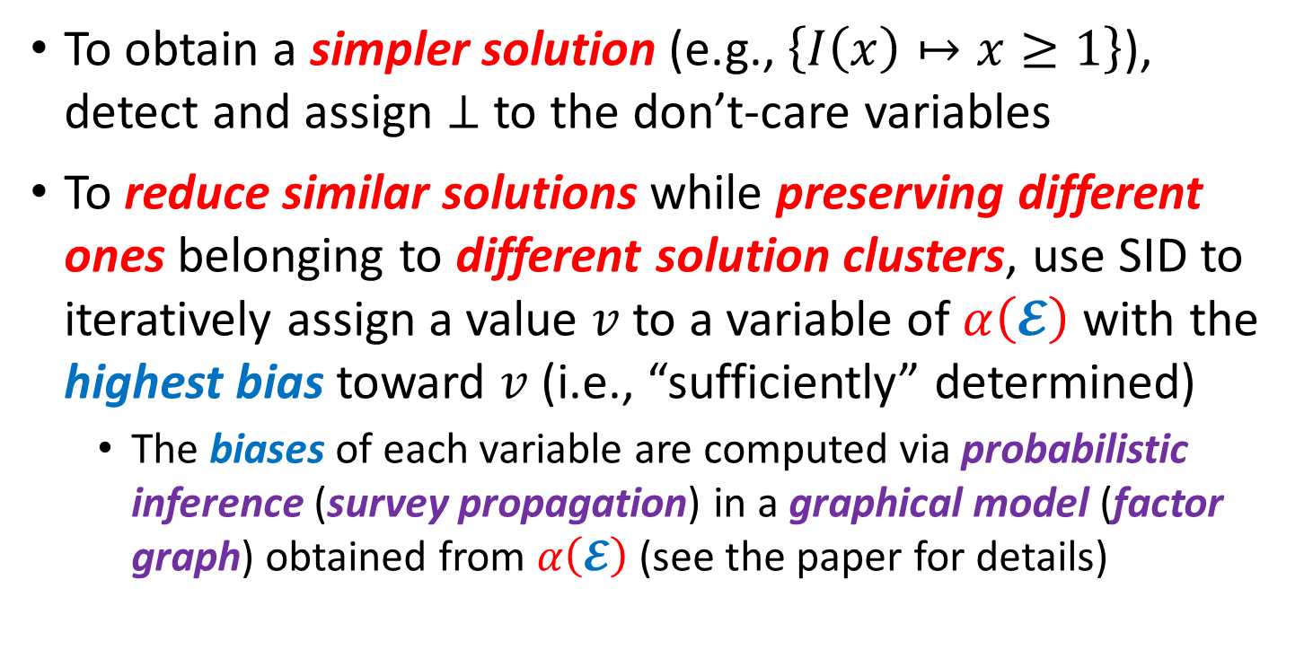
SID-based Enumeration of “Promising” Satisfying Assignments for $α\left(𝓔\right)$
To obtain a simpler solution (e.g., $\left\{I\left(x\right)↦x≥1\right\}$), detect and assign $⊥$ to the don’t-care variables
To reduce similar solutions while preserving different ones belonging to different solution clusters, use SID to iteratively assign a value $v$ to a variable of $α\left(𝓔\right)$ with the highest bias toward $v$ (i.e., “sufficiently” determined)
  The biases of each variable are computed via probabilistic inference (survey propagation) in a graphical model (factor graph) obtained from $α\left(𝓔\right)$ (see the paper for details)

Slide 27
Evaluation
Implemented the presented method as a pCSP solver PCSat using Z3 as the backend SMT solver
Tested PCSat on the benchmark sets from
  SyGuS-Comp 2017 and 2018 (Invariant Synthesis Track)
  CHC-COMP 2019 (LIA-nonlin Track)
  New pCSP benchmarks of branching-time safety verification that go beyond the scope of existing SyGuS and CHC solvers

Slide 28
Results on 127 Benchmarks from SyGuS-Comp 2018

Slide 29
Summary: Program Verification via Predicate Constraint Satisfaction Problem (pCSP)
Target Program $P$ & Specification $ψ$
Support Branching-Time Safety Verification ☺
Constraint Generation
New method for Looping & Recursive Programs
pCSP Constraints $𝓒$ on Predicate Variables
Verification Intermediary Independent of Particular Target and Method ☺
Constraint Solving
New method based on CEGIS, Pred. Abstraction, Survey Inspired Decimation
$𝓒$ is Sat ($P$ satisfies $ψ$),
$𝓒$ is Unsat ($P$ violates $ψ$),
or Unknown

Slide 30
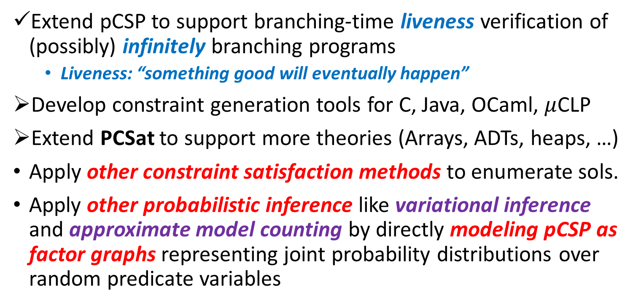
Ongoing and Future Work
Extend pCSP to support branching-time liveness verification of (possibly) infinitely branching programs
  Liveness: “something good will eventually happen”
Develop constraint generation tools for C, Java, OCaml, $μ$CLP
Extend PCSat to support more theories (Arrays, ADTs, heaps, …)
Apply other constraint satisfaction methods to enumerate sols.
Apply other probabilistic inference like variational inference and approximate model counting by directly modeling pCSP as factor graphs representing joint probability distributions over random predicate variables

