Slide 1
Automating Induction for Solving Horn Clauses
Hiroshi Unno, Sho Torii, and Hiroki Sakamoto
University of Tsukuba, Japan

Slide 2
Program Verification via
Horn Constraint Solving
Verification Problems of Programs in
Various Paradigms (e.g., functional [U.+ ’08, ’09, Rondon+ ’08, …], procedural [Grebenshchikov+ ’12, Gurfinkel+ ’15], object-oriented [Kahsai+ ’16], multi-threaded [Gupta+ ’11], constraint logic) with
Advanced Language Features (e.g., algebraic data structures, linked data structures, exceptions, higher-order functions) with
Side-Effects (e.g., non-termination, non-determinism, concurrency, assertions, destructive updates)
Reduce
Horn Constraint Solving Problems

Slide 3
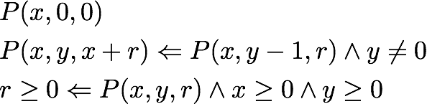

Overall Flow of Horn Constraint based Program Verification
Program & Specification
Constraint Generation
(* OCaml *)
let rec mult x y =
if y = 0 then 0
else x + mult x (y - 1)
/* C */
int mult(int x, int y) {
int s = 0;
while(y != 0){
s += x;
y--;
}
return s;
}
Horn Constraint Set
Constraint Solving
{- Haskell -}
mult :: Int -> Int -> Int
mult x 0 = 0
mult x y = x + mult x (y - 1)
$$P\left(x,y,r\right)≡r=x×y$$
Solution or Counterexample

Slide 4
This Work
Horn Constratint Solving
Horn Constraint Set
Reduce
Inductive Theorem Proving
Constraint Solving
Solvable or Not
SMT Solving
Enable verification of relational specifications across programs in various paradigms
Support constraints over any background theories
(if the backend SMT solver does)

Slide 5
Relational Specifications
Specifications that involve multiple function calls
  Equivalence
  Invertibility
  Non-interference
  Associativity
  Commutativity
  Distributivity
  Monotonicity
  Idempotency
  …

Slide 6
Overall Flow of Horn Constraint based Program Verification
(Functional) Program &
Relational Specification
Constraint Generation
Horn Constraint Set
Constraint Solving
Solvable or Not

Slide 7
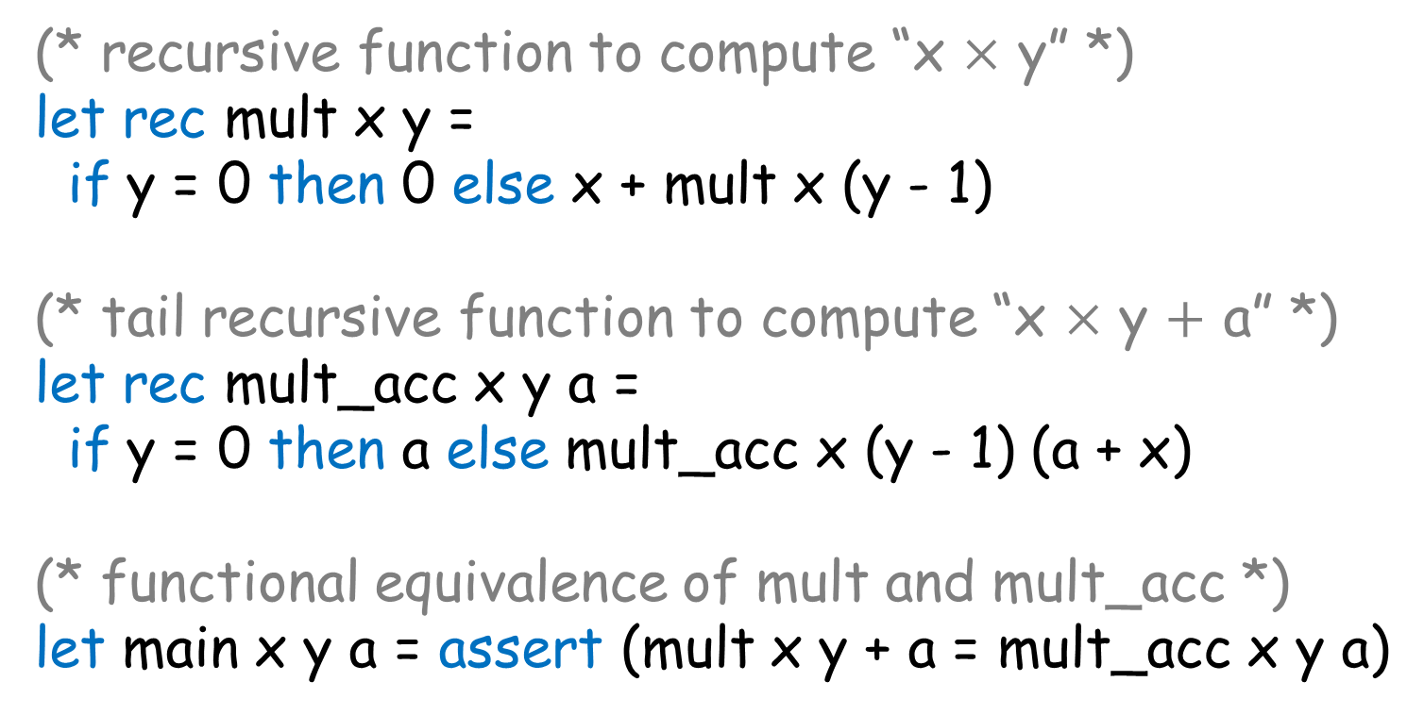
Example: (Functional) Program and Relational Specification
(* recursive function to compute “x $×$ y” *)
let rec mult x y =
if y = 0 then 0 else x + mult x (y - 1)
(* tail recursive function to compute “x $×$ y $+$ a” *)
let rec mult_acc x y a =
if y = 0 then a else mult_acc x (y - 1) (a + x)
(* functional equivalence of mult and mult_acc *)
let main x y a = assert (mult x y + a = mult_acc x y a)

Slide 8
Overall Flow of Horn Constraint based Program Verification
(Functional) Program & Relational Specification
Constraint Generation
Horn Constraint Set
Constraint Solving
Solvable or Not

Slide 9







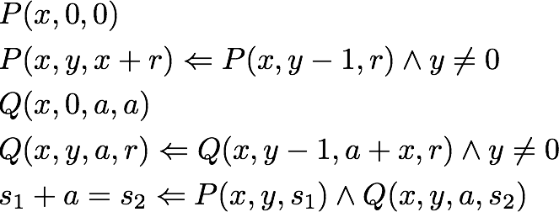

Horn Constraint Generation [U.+ ’09]
let rec mult x y =
if y = 0 then 0
else x + mult x (y - 1)
let rec mult_acc x y a =
if y = 0 then a
else mult_acc x (y - 1) (a + x)
let main x y a =
assert (mult x y + a
= mult_acc x y a)

Slide 10
Overall Flow of Horn Constraint based Program Verification
(Functional) Program & Relational Specification
Constraint Generation
Horn Constraint Set
Constraint Solving
Solvable or Not

Slide 11
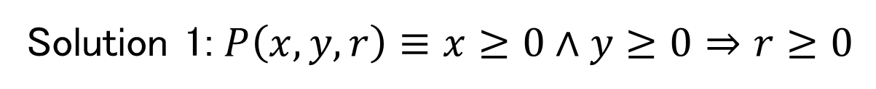
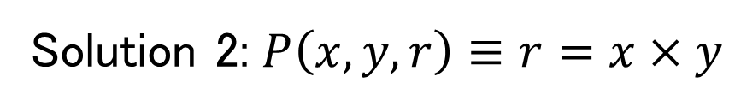
Horn Constraint Solving
Check the existence of a solution for predicate variables satisfying all the Horn constraints
  If a solution exists, the original program is guaranteed to satisfy the specification
Example (Non-relational) specification:
let main x y = if x >= 0 && y >= 0 then assert (mult x y >= 0)
Solution 1: $P\left(x,y,r\right)≡x≥0∧y≥0⇒r≥0$
QF-LIA
Solution 2: $P\left(x,y,r\right)≡r=x×y$
QF-NIA
Nonlinear

Slide 12
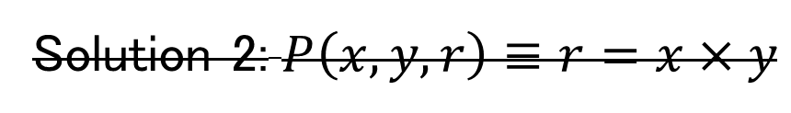
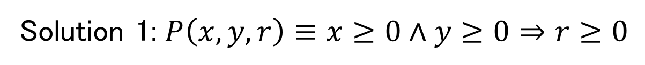
Previous Methods for Solving Horn Clause Constraints [U.+ ’08,’09, Rondon+ ’08, Gupta+ ’11, Hoder+ ’11,’12, McMillan+ ’13, Rümmer+ ’13, …]
Find a solution expressible in QF-LIA (or QF-LRA)
Solution 1: $P\left(x,y,r\right)≡x≥0∧y≥0⇒r≥0$
QF-LIA
Solution 2: $P\left(x,y,r\right)≡r=x×y$
QF-NIA

Slide 13
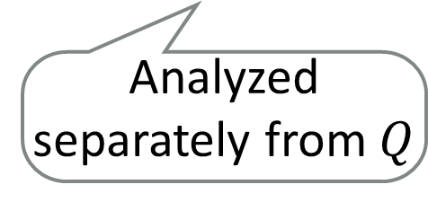


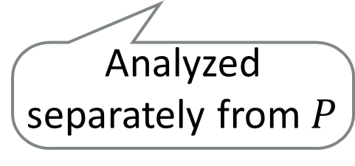
Example Constraints that Can Not be Solved by Previous Methods
Constraint Solving Fails!
Analyzed separately from $Q$
Analyzed separately from $P$
QF-NIA
$$P\left(x,y,s_{1}\right)≡s_{1}=x×y$$
$$Q\left(x,y,a,s_{2}\right)≡s_{2}=x×y+a$$

Slide 14
Our Constraint Solving Method
Horn Constraint Set
Reduce
Inductive Theorem Proving
Constraint Solving
Simultaneously analyze multiple predicates by expressing and exploiting mutual invariants
Solvable or Not

Slide 15




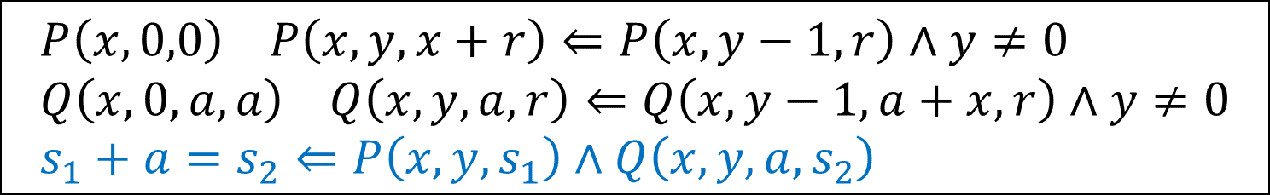
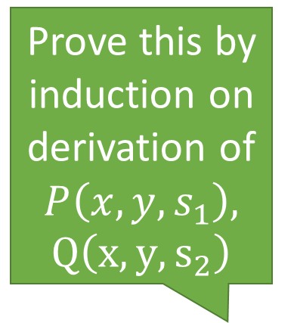
Reduction from Constraint Solving to Inductive Theorem Proving
$$P\left(x,0,0\right) P\left(x,y,x+r\right)⇐P\left(x,y−1,r\right)∧y≠0 \\ Q\left(x,0,a,a\right) Q\left(x,y,a,r\right)⇐Q\left(x,y−1,a+x,r\right)∧y≠0 \\ s_{1}+a=s_{2}⇐P\left(x,y,s_{1}\right)∧Q\left(x,y,a,s_{2}\right)$$
Prove this by induction on derivation of $P\left(x,y,s_{1}\right),$
$Q\left(x,y,s_{2}\right)$
$$∀x,y,s_{1},a,s_{2}.P\left(x,y,s_{1}\right)∧Q\left(x,y,a,s_{2}\right)⇒s_{1}+a=s_{2}$$

Slide 16
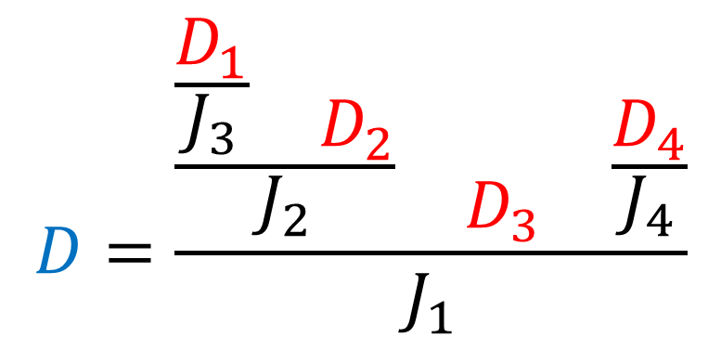
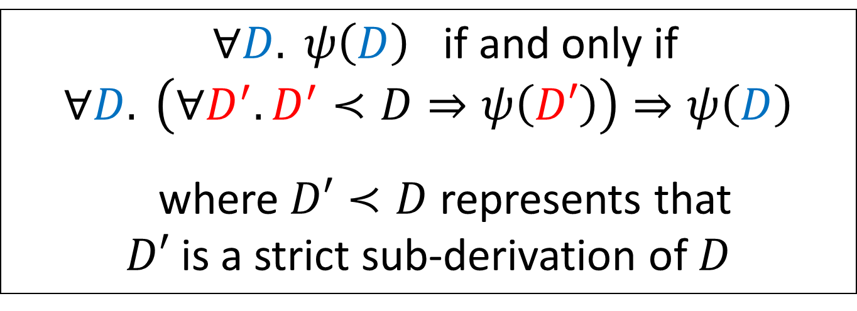
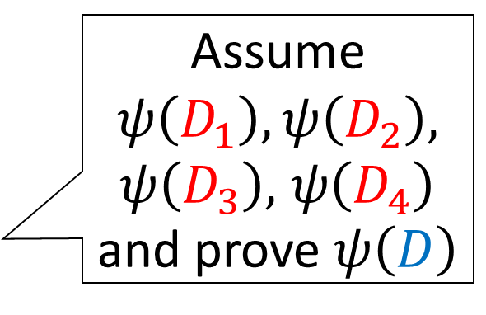
Principle of Induction on Derivation
    $∀D. ψ\left(D\right)$ if and only if
    $∀D. \left(∀D^{′}.D^{′}≺D⇒ψ\left(D′\right)\right)⇒ψ\left(D\right)$
    where $D′≺D$ represents that
    $D′$ is a strict sub-derivation of $D$
$$D=\frac{\begin{matrix}\frac{\begin{matrix}\frac{D_{1}}{J_{3}} & \begin{matrix} \\ D_{2}\end{matrix}\end{matrix}}{J_{2}} & \begin{matrix} \\ D_{3}\end{matrix} & \frac{D_{4}}{J_{4}}\end{matrix}}{J_{1}}$$
Assume $ψ\left(D_{1}\right),ψ\left(D_{2}\right),$ $ψ\left(D_{3}\right),$ $ψ\left(D_{4}\right)$ and prove $ψ\left(D\right)$

Slide 17
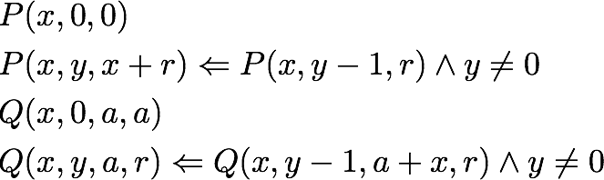
Horn Constraint Solving:
Induction hypotheses and lemmas
Judgment
Inductive Theorem Proving:
$$∅;P\left(x,y,s_{1}\right),Q\left(x,y,a,s_{2}\right)⊢s_{1}+a=s_{2}$$
Premises

Slide 18
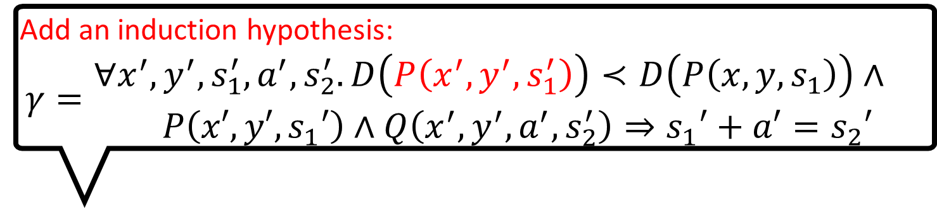
Guard to avoid unsound application
Add an induction hypothesis:
$$γ=\begin{matrix}∀x^{′},y^{′},s_{1}^{′},a^{′},s_{2}^{′}.D\left(P\left(x^{′},y^{′},s_{1}^{′}\right)\right)≺D\left(P\left(x,y,s_{1}\right)\right)∧ \\ P\left(x′,y′,s_{1}′\right)∧Q\left(x^{′},y^{′},a^{′},s_{2}^{′}\right)⇒s_{1}′+a′=s_{2}′\end{matrix}$$
Induct
Unfold
Case analysis on the last rule used

Slide 20
Case analysis on the last rule used
Unfold

Slide 22
Validity checking
Valid

Slide 24
Valid

Slide 26
Unfold
Case analysis on the last rule used

Slide 28
Valid

Slide 30
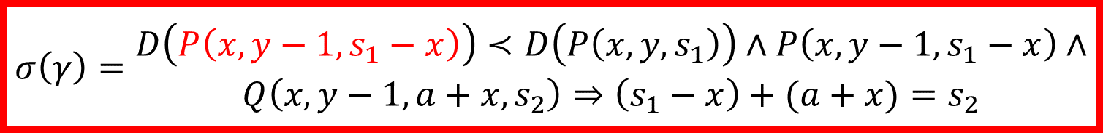
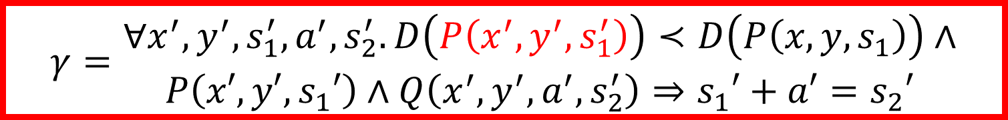
$$σ\left(γ\right)=\begin{matrix}D\left(P\left(x,y−1,s_{1}−x\right)\right)≺D\left(P\left(x,y,s_{1}\right)\right)∧P\left(x,y−1,s_{1}−x\right)∧ \\ Q\left(x,y−1,a+x,s_{2}\right)⇒\left(s_{1}−x\right)+(a+x)=s_{2}\end{matrix}$$
$$γ=\begin{matrix}∀x^{′},y^{′},s_{1}^{′},a^{′},s_{2}^{′}.D\left(P\left(x^{′},y^{′},s_{1}^{′}\right)\right)≺D\left(P\left(x,y,s_{1}\right)\right)∧ \\ P\left(x′,y′,s_{1}′\right)∧Q\left(x^{′},y^{′},a^{′},s_{2}^{′}\right)⇒s_{1}′+a′=s_{2}′\end{matrix}$$
IndHyp
Apply induction hypothesis

Slide 31
Valid
QED

Slide 32
Properties of Inductive Proof System for Horn Constraint Solving
Soundness: If the goal is proved, the original Horn constraints have a solution (which may not be expressible in the underlying logic)
Relative Completeness: If the original constraints have a solution expressible in the underlying logic, the goal is provable

Slide 33
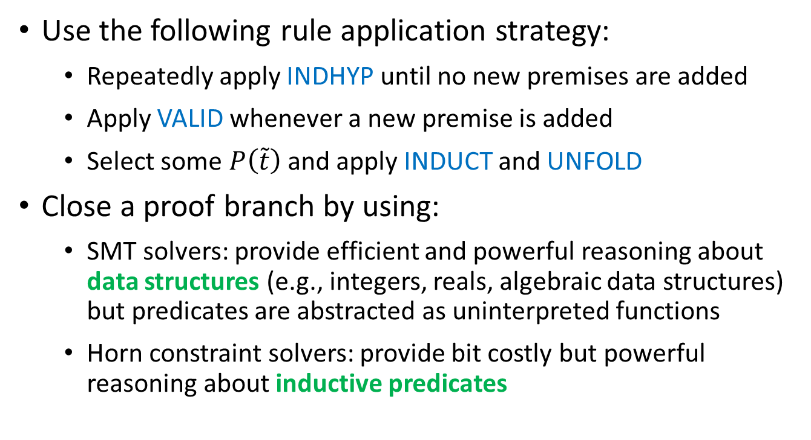
Automating Induction
Use the following rule application strategy:
  Repeatedly apply INDHYP until no new premises are added
  Apply VALID whenever a new premise is added
  Select some $P\left(\tilde{t}\right)$ and apply INDUCT and UNFOLD
Close a proof branch by using:
  SMT solvers: provide efficient and powerful reasoning about data structures (e.g., integers, reals, algebraic data structures) but predicates are abstracted as uninterpreted functions
  Horn constraint solvers: provide bit costly but powerful reasoning about inductive predicates

Slide 34
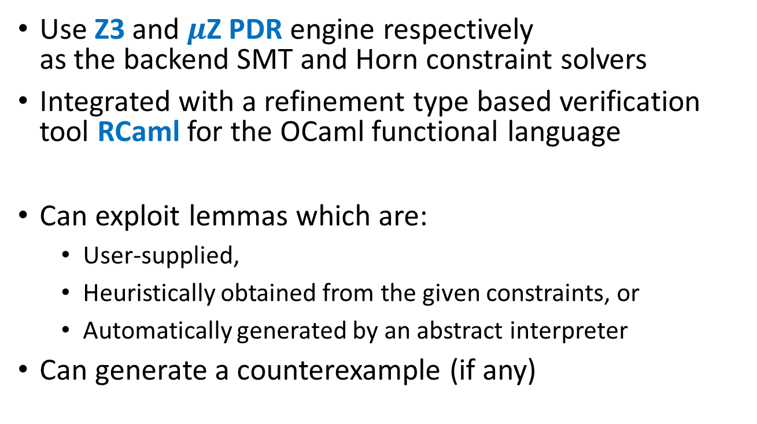
Prototype Constraint Solver
Use Z3 and $μ$Z PDR engine respectively
as the backend SMT and Horn constraint solvers
Integrated with a refinement type based verification tool RCaml for the OCaml functional language
Can exploit lemmas which are:
  User-supplied,
  Heuristically obtained from the given constraints, or
  Automatically generated by an abstract interpreter
Can generate a counterexample (if any)

Slide 35
Experiments on IsaPlanner Benchmark Set
85 (mostly) relational verification problems of
total functions on inductively defined data structures
Inductive Theorem Prover | #Successfully Proved
RCaml | 68
Zeno | 82 [Sonnex+ ’12]
HipSpec | 80 [Claessen+ ’13]
CVC4 | 80 [Reynolds+ ’15]
ACL2s | 74 (according to [Sonnex+ ’12])
IsaPlanner | 47 (according to [Sonnex+ ’12])
Dafny | 45 (according to [Sonnex+ ’12])
Support automatic
lemma discovery &
goal generalization

Slide 36
Experiments on Benchmark Programs with Advanced Language Features & Side-Effects
30 (mostly) relational verification problems for:
  Complex integer functions: Ackermann, McCarthy91
  Nonlinear real functions: dyn_sys
  Higher-order functions: fold_left, fold_right, repeat, find, ...
  Exceptions: find
  Non-terminating functions: mult, sum, …
  Non-deterministic functions: randpos
  Imperative procedures: mult_Ccode

Slide 37
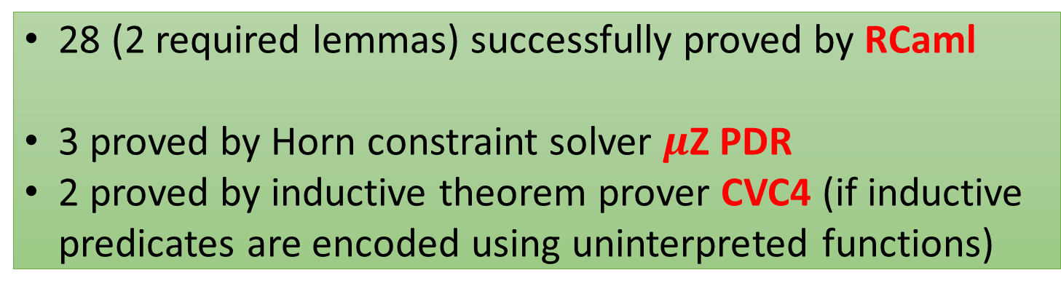
28 (2 required lemmas) successfully proved by RCaml
3 proved by Horn constraint solver $μ$Z PDR
2 proved by inductive theorem prover CVC4 (if inductive predicates are encoded using uninterpreted functions)

Slide 38
Conclusion
Proposed an automated verification method combining
Horn constraint solving and inductive theorem proving
  Enable relational verification across programs in various paradigms with advanced language features and side-effects
  Support constraints over any background theories
  (if the backend SMT solver does)
Future and ongoing work:
  Automatic lemma discovery and goal generalization
  Relational program synthesis
  Coinduction

