Slide 1
Constraint-based
Relational Verification
Hiroshi Unno (U. of Tsukuba / RIKEN AIP, Japan)
Tachio Terauchi (Waseda University, Japan)
Eric Koskinen (Stevens Institute of Technology, USA)

Slide 2
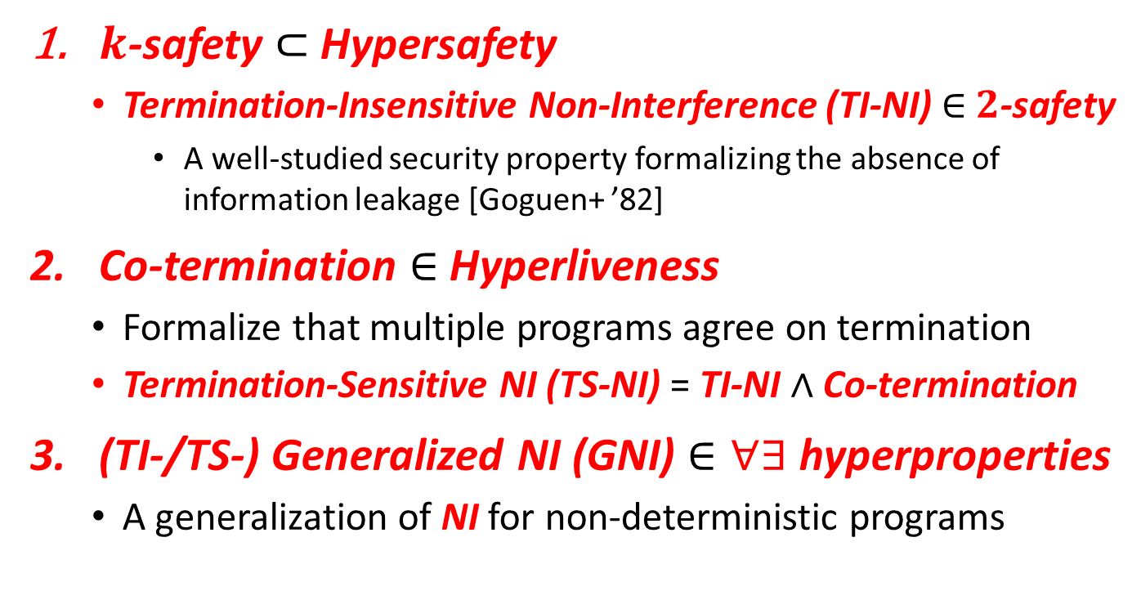
This Work: Automated Verification of Relational Properties
$k$-safety $⊂$ Hypersafety
  Termination-Insensitive Non-Interference (TI-NI) $∈$ $2$-safety
    A well-studied security property formalizing the absence of information leakage [Goguen+ ’82]
Co-termination $∈$ Hyperliveness
  Formalize that multiple programs agree on termination
  Termination-Sensitive NI (TS-NI) = TI-NI $∧$ Co-termination
(TI-/TS-) Generalized NI (GNI) $∈∀∃$ hyperproperties
  A generalization of NI for non-deterministic programs
Notes:
for Infinite-State Programs

Slide 3
Main Contributions
Sound and complete reduction to constraint solving
  Key observation: relational verification amounts to synthesis of relational invariants and fair & semantic schedulers
New expressive class of predicate constraints pfwCSP
  Extend the class of CHCs with non-Horn clauses and
  functional / well-founded predicate variables
Stratified CEGIS for pfwCSP solving
  Combine CEGIS with stratified families of templates for achieving completeness and efficiency
Implementation of a solver PCSat and Evaluation
  Available from: https://github.com/hiroshi-unno/coar

Slide 4
Main Contributions
Sound and complete reduction to constraint solving
  Key observation: relational verification amounts to synthesis of relational invariants and fair & semantic schedulers
New expressive class of predicate constraints pfwCSP
  Extend the class of CHCs with non-Horn clauses and
  functional / well-founded predicate variables
Stratified CEGIS for pfwCSP solving
  Combine CEGIS with stratified families of templates for achieving completeness and efficiency
Implementation of a solver PCSat and Evaluation
  Available from: https://github.com/hiroshi-unno/coar

Slide 5

Relational Verification via
Synthesis of Relational Invariants and Fair & Semantic Schedulers
$k$-safety $⊂$ Hypersafety
  Termination-Insensitive Non-Interference (TI-NI) $∈$ $2$-safety
    A well-studied security property formalizing the absence of information leakage [Goguen+ ’82]
Co-termination $∈$ Hyperliveness
  Formalize that multiple programs agree on termination
  Termination-Sensitive NI (TS-NI) = TI-NI $∧$ Co-termination
(TI-/TS-) Generalized NI (GNI) $∈∀∃$ hyperproperties
  A generalization of NI for non-deterministic programs

Slide 6

Relational Verification via
Synthesis of Relational Invariants and Fair & Semantic Schedulers
$k$-safety $⊂$ Hypersafety
  Termination-Insensitive Non-Interference (TI-NI) $∈$ $2$-safety
    A well-studied security property formalizing the absence of information leakage [Goguen+ ’82]
Co-termination $∈$ Hyperliveness
  Formalize that multiple programs agree on termination
  Termination-Sensitive NI (TS-NI) = TI-NI $∧$ Co-termination
(TI-/TS-) Generalized NI (GNI) $∈∀∃$ hyperproperties
  A generalization of NI for non-deterministic programs

Slide 7


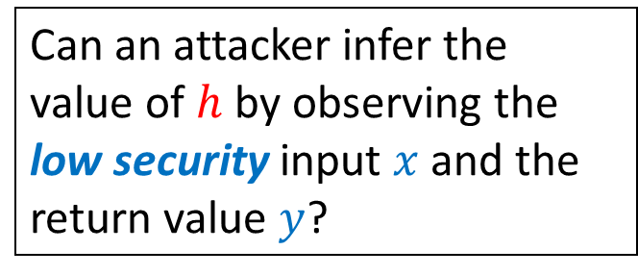

Example: Termination-Insensitive Non-Interference (TI-NI) $∈$ $2$-safety
doubleSquare$\left(h,x\right)$ [Shemer+ ’19] computes ${2⋅x}^{2}$ in two different ways depending on the high security input $h$
doubleSquare(bool h,int x) {
int z, y=0;
if(h) { z=2*x }
else { z=x }
while(z>0) { z--; y=y+x }
if(!h) { y=2*y }
return y;
}
Can an attacker infer the value of $h$ by observing the low security input $x$ and the return value $y$?
No! Formally, TI-NI holds:
$$∀h_{1},x_{1},y_{1},h_{2},x_{2},y_{2}.$$
doubleSquare$\left(h_{1},x_{1}\right)⇝y_{1}∧$ doubleSquare$\left(h_{2},x_{2}\right)⇝y_{2}∧$
$$x_{1}=x_{2}⇒y_{1}=y_{2}$$

Slide 8






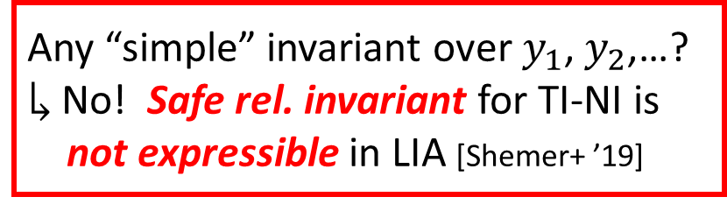




Existing Approaches to TI-NI
Find a safe rel. invariant of the parallel executions of
2 copies of the program under the lock-step scheduler
doubleSquare(bool h,int x) {
int z, y=0;
$ℓ_{1}:$ if(h) {z=2*x} else {z=x}
$ℓ_{2}:$ while(z>0) { z--; y=y+x }
$ℓ_{3}:$ if(!h) { y=2*y }
return y;
}
A run with lock-step scheduler:
$\left(h_{1},x_{1},y_{1},z_{1},h_{2},x_{2},y_{2},z_{2}\right)$
$$↦\left(⊤,2,0,_,⊥,2,0,_\right)$$
$$→_{1,2}^{ℓ_{1}}\left(⊤,2,0,4,⊥,2,0,2\right)$$
$$→_{1,2}^{ℓ_{2}}\left(⊤,2,2,3,⊥,2,2,1\right)$$
$$→_{1,2}^{ℓ_{2}}\left(⊤,2,4,2,⊥,2,4,0\right)$$
$$→_{1}^{ℓ_{2}}\left(⊤,2,6,1,⊥,2,4,0\right)$$
$$→_{1}^{ℓ_{2}}\left(⊤,2,8,0,⊥,2,4,0\right)$$
$$→_{1,2}^{ℓ_{3}}\left(⊤,2,8,0,⊥,2,8,0\right)$$
$$x_{1}=x_{2}$$
$$y_{1}=y_{2}$$
$$y_{1}=y_{2}$$
$$y_{1}=y_{2}$$
Synchronize at $ℓ_{3}$
$$y_{1}≠y_{2}$$
Any “simple” invariant over $y_{1}$, $y_{2}\text{,}$…?
$↳$ No! Safe rel. invariant for TI-NI is
not expressible in LIA [Shemer+ ’19]
$$y_{1}≠y_{2}$$
$$y_{1}=y_{2}$$
Notes:
The most natural self composition to consider is a lock-step composition, where the
copies execute synchronously

Slide 9
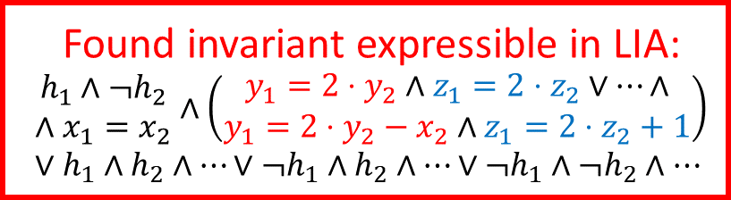




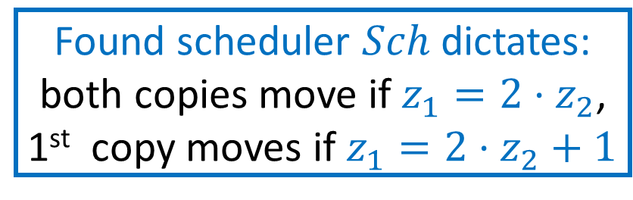
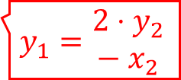







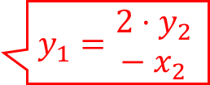

Our Approach to TI-NI
Can choose which program to execute depending on the states
Find a semantic scheduler $Sch$ and a safe invariant of the parallel executions of 2 copies of the program under $Sch$
Found invariant expressible in LIA:
$$\begin{matrix}h_{1}∧¬h_{2} \\ ∧x_{1}=x_{2}\end{matrix}∧\left(\begin{matrix}y_{1}=2⋅y_{2}∧z_{1}=2⋅z_{2}∨…∧ \\ y_{1}=2⋅y_{2}−x_{2}∧z_{1}=2⋅z_{2}+1\end{matrix}\right)∨h_{1}∧h_{2}∧…∨¬h_{1}∧h_{2}∧…∨¬h_{1}∧¬h_{2}∧…$$
An example run under $Sch$:
$\left(h_{1},x_{1},y_{1},z_{1},h_{2},x_{2},y_{2},z_{2}\right)$
$$↦\left(⊤,2,0,_,⊥,2,0,_\right)$$
$$→_{}^{ℓ_{1}}\left(⊤,2,0,4,⊥,2,0,2\right)$$
$$→_{1,2}^{ℓ_{2}}\left(⊤,2,2,3,⊥,2,2,1\right)$$
$$→_{1}^{ℓ_{2}}\left(⊤,2,4,2,⊥,2,2,1\right)$$
$$→_{1,2}^{ℓ_{2}}\left(⊤,2,6,1,⊥,2,4,0\right)$$
$$→_{1}^{ℓ_{2}}\left(⊤,2,8,0,⊥,2,4,0\right)$$
$$→_{}^{ℓ_{3}}\left(⊤,2,8,0,⊥,2,8,0\right)$$
doubleSquare(bool h,int x) {
int z, y=0;
$ℓ_{1}:$ if(h) {z=2*x} else {z=x}
$ℓ_{2}:$ while(z>0) { z--; y=y+x }
$ℓ_{3}:$ if(!h) { y=2*y }
return y;
}
$$x_{1}=x_{2}$$
$$y_{1}={2⋅y}_{2}$$
$$z_{1}=2⋅z_{2}$$
$$y_{1}=\begin{matrix}{2⋅y}_{2} \\ − x_{2}\end{matrix}$$
$z_{1}=2⋅z_{2}$+1
$$y_{1}={2⋅y}_{2}$$
$$z_{1}=2⋅z_{2}$$
Found scheduler $Sch$ dictates:
both copies move if $z_{1}=2⋅z_{2}$,
1st copy moves if $z_{1}=2⋅z_{2}+1$
$$y_{1}=\begin{matrix}{2⋅y}_{2} \\ − x_{2}\end{matrix}$$
$z_{1}=2⋅z_{2}$+1
$$y_{1}={2⋅y}_{2}$$
$$y_{1}=y_{2}$$

Slide 10


Prog. & Spec.
pfwCSP
SAT or UNSAT
Constraint Generation
Constraint Solving
represents a relational invariant
preserved by a semantic scheduler
the relational invariant is inductive and implies TI-NI
Input:
doubleSquare
(bool h, int x) {
int z, y=0;
if(h) { z=2*x }
else { z=x }
while(z>0)
{ z--; y=y+x }
if(!h) { y=2*y }
return y;
}
Output $𝓒$ (with $h_{1}=⊤∧h_{2}= ⊥$ fixed):
$I\left(V_{1},V_{2}\right)⟸\begin{matrix}x_{1}=x_{2}∧y_{1}=y_{2}=0 \\ ∧z_{1}=2⋅x_{1}∧z_{2}=x_{2}\end{matrix}$,
$I\left(x_{1},y_{1}^{′},z_{1}^{′},V_{2}\right)⟸I\left(V_{1},V_{2}\right)∧Sch_{1}\left(V_{1},V_{2}\right)∧ \left(\begin{aligned}z_{1}>0∧z_{1}^{′}=z_{1}−1∧y_{1}^{′}=y_{1}+x_{1}∨ \\ z_{1}≤0∧z_{1}^{′}=z_{1}∧y_{1}^{′}=y_{1}\end{aligned}\right)$,…,
$y_{1}=2⋅y_{2}⟸$ $I\left(V_{1},V_{2}\right)∧z_{1}≤0∧z_{2}≤0$,
$\left(Sch_{1}\left(V_{1},V_{2}\right)∨Sch_{2}\left(V_{1},V_{2}\right)∨Sch_{1,2}\left(V_{1},V_{2}\right)\right)$
$⟸I\left(V_{1},V_{2}\right)∧\left(z_{1}>0∨z_{2}>0\right)$,
$z_{1}>0⟸I\left(V_{1},V_{2}\right)∧Sch_{1}\left(V_{1},V_{2}\right)∧z_{2}>0$,
$z_{2}>0⟸I\left(V_{1},V_{2}\right)∧Sch_{2}\left(V_{1},V_{2}\right)∧z_{1}>0,$
where $V_{1}=x_{1},y_{1},z_{1}$ and $V_{2}=x_{2},y_{2},z_{2}$
the scheduler is fair: at least one unfinished program must be scheduled if there is any
(necessary for the soundness)
non-Horn clause that goes beyond CHCs !
represent the semantic scheduler: if $Sch_{1}$ holds, 1st copy is scheduled
Notes:
$$z_{2}>0⟸\left(\begin{aligned}I\left(x_{1},y_{1},z_{1},x_{2},y_{2},z_{2}\right)∧ \\ Sch_{2}\left(x_{1},y_{1},z_{1},x_{2},y_{2},z_{2}\right)\end{aligned}\right)∧z_{1}>0\text{,}$$

Slide 11
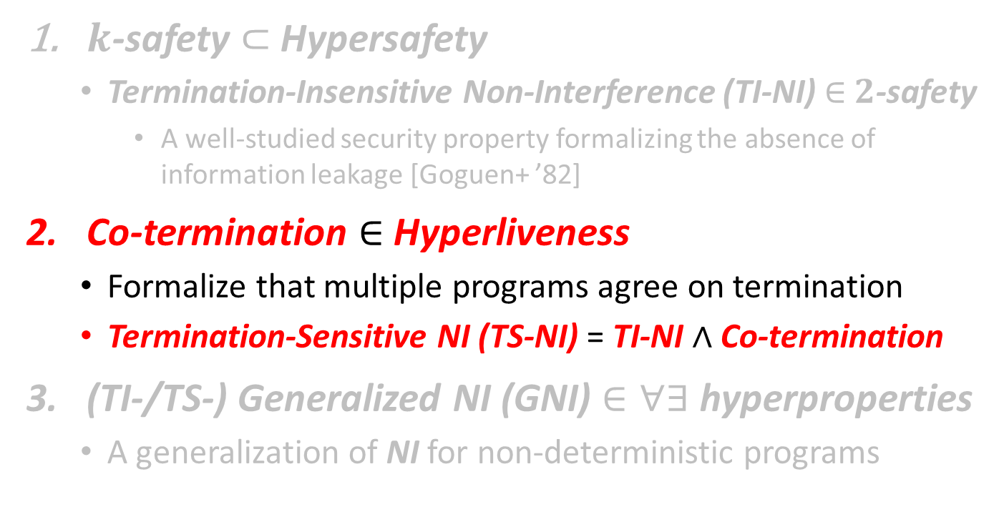
Relational Verification via
Synthesis of Relational Invariants and Fair & Semantic Schedulers
$k$-safety $⊂$ Hypersafety
  Termination-Insensitive Non-Interference (TI-NI) $∈$ $2$-safety
    A well-studied security property formalizing the absence of information leakage [Goguen+ ’82]
Co-termination $∈$ Hyperliveness
  Formalize that multiple programs agree on termination
  Termination-Sensitive NI (TS-NI) = TI-NI $∧$ Co-termination
(TI-/TS-) Generalized NI (GNI) $∈∀∃$ hyperproperties
  A generalization of NI for non-deterministic programs

Slide 12

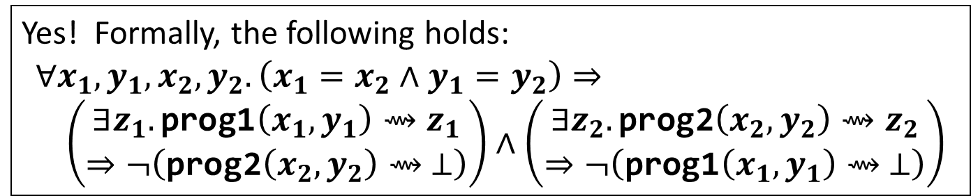
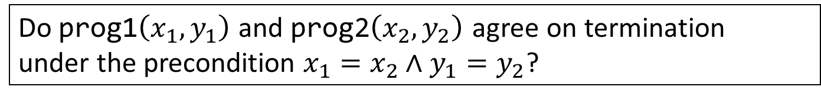
Example: Co-Termination
$∈$ Hyperliveness
prog1(int x, int y) { while(x>0) { x=x–y; } }
prog2(int x, int y) { while(x>0) { x=x–2*y; } }
Do prog1$\left(x_{1},y_{1}\right)$ and prog2$\left(x_{2},y_{2}\right)$ agree on termination
under the precondition $x_{1}=x_{2}∧y_{1}=y_{2}$?
Yes! Formally, the following holds:
$$∀x_{1},y_{1},x_{2},y_{2}. \left(x_{1}=x_{2}∧y_{1}=y_{2}\right)⇒ \\ \left(\begin{aligned}∃z_{1}.\text{prog}\text{1}\left(x_{1},y_{1}\right)⇝z_{1} \\ ⇒¬\left(\text{prog}\text{2}\left(x_{2},y_{2}\right)⇝ ⊥\right)\end{aligned}\right)∧\left(\begin{aligned}∃z_{2}.\text{prog}\text{2}\left(x_{2},y_{2}\right)⇝z_{2} \\ ⇒¬\left(\text{prog}\text{1}\left(x_{1},y_{1}\right)⇝ ⊥\right)\end{aligned}\right)$$
One symmetric co-termination problem boils down to
two asymmetric co-termination problems

Slide 13



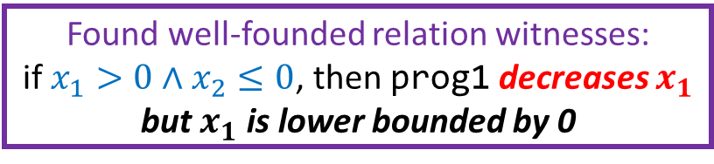

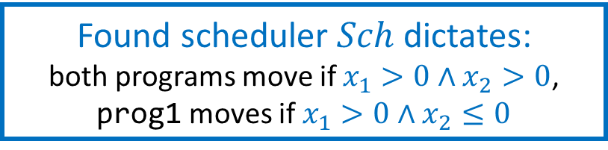

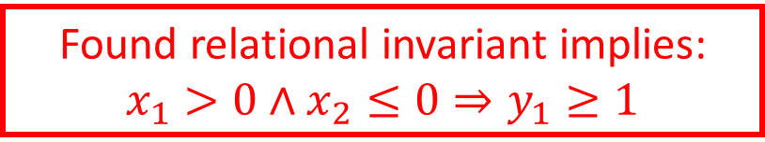


Our Approach to
Asymmetric Co-Termination
Find a fair semantic scheduler $Sch$, a relational invariant, and a well-founded relation under $Sch$
prog1(int x, int y) {
while(x>0) { x=x–y; }
}
prog2(int x, int y) {
while(x>0) { x=x–2*y; }
}
An example run under $Sch$:
$\left(x_{1},y_{1}, x_{2},y_{2}\right)$
$$↦\left(4,1,4,1\right)$$
$$→_{1,2}^{}\left(3,1,2,1\right)$$
$$→_{1,2}^{}\left(2,1,0,1\right)$$
$$→_{1}^{}\left(1,1,0,1\right)$$
$$→_{1}^{}\left(0,1,0,1\right)$$
Found relational invariant implies:
$$x_{1}>0∧x_{2}≤0⇒y_{1}≥1$$
$$x_{1}=x_{2}∧y_{1}=y_{2}$$
$$x_{1}>0∧x_{2}>0$$
$$x_{1}>0∧x_{2}>0$$
Found well-founded relation witnesses:
if $x_{1}>0∧x_{2}≤0$, then prog1 decreases $x_{1}$ but $x_{1}$ is lower bounded by 0
prog2 terminated
$$x_{1}>0∧x_{2}≤0$$
$$x_{1}>0∧x_{2}≤0$$
prog1 terminated
Found scheduler $Sch$ dictates:
both programs move if $x_{1}>0∧x_{2}>0$,
prog1 moves if $x_{1}>0∧x_{2}≤0$

Slide 14

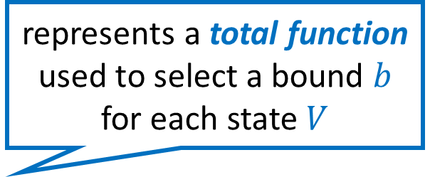
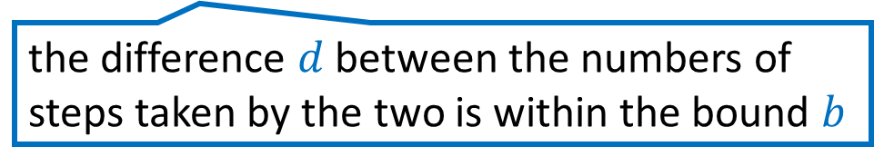
Prog. & Spec.
pfwCSP
SAT or UNSAT
the relational invariant is inductive and, along with the well-founded relation, implies Co-Termination
Constraint Generation
represents a total function used to select a bound $b$ for each state $V$
Constraint Solving
represents a relational invariant
preserved by a semantic scheduler
Input:
prog1(x, y) {
while(x>0)
{ x=x–y }
}
prog2(x, y) {
while(x>0)
{ x=x-2*y }
}
Output $𝓒$:
$I\left(0,b,V\right)⟸F_{λ}\left(V,b\right)∧x_{1}=x_{2}∧y_{1}=y_{2}$,
$I\left({d^{′},b,x}_{1}^{′},y_{1}, x_{2},y_{2}\right)⟸I\left(d,b,V\right)∧Sch_{1}\left(V\right)∧$
$\left(x_{1}>0∧x_{1}^{′}=x_{1}−y_{1}∨x_{1}≤0∧x_{1}^{′}=x_{1}\right)∧$
$\left(x_{1}>0∧x_{2}>0⇒d^{′}=d+1\right)$,…,
$R_{⇓}\left(V_{1},x_{1}−y_{1},y_{1}\right)⟸$ $I\left({d,b,V}_{1},V_{2}\right)∧x_{1}>0∧x_{2}≤0$,
$\left(Sch_{1}\left(d,b,V\right)∨Sch_{2}\left(d,b,V\right)∨Sch_{1,2}\left(d,b,V\right)\right)$
$⟸I\left(d,b,V\right)∧\left(x_{1}>0∨x_{2}>0\right)$,
$x_{1}>0⟸I\left(d,b,V\right)∧Sch_{1}\left(d,b,V\right)∧x_{2}>0$,
$x_{2}>0⟸I\left(d,b,V\right)∧Sch_{2}\left(d,b,V\right)∧x_{1}>0,$
$d∈\left[−b,b\right]∧b≥0 ⟸I\left({d,b,V}_{1},V_{2}\right)∧x_{1}>0∧x_{2}>0$
where $V=x_{1},y_{1}$,$x_{2},y_{2}$
the scheduler is fair: all unfinished programs must be eventually scheduled
(necessary for soundness)
represents a well-founded relation witnessing the termination of prog1 relative to the termination of prog2
the difference $d$ between the numbers of steps taken by the two is within the bound $b$
Notes:
non-terminating copy can be scheduled indefinitely leaving the
other copy unscheduled

Slide 15
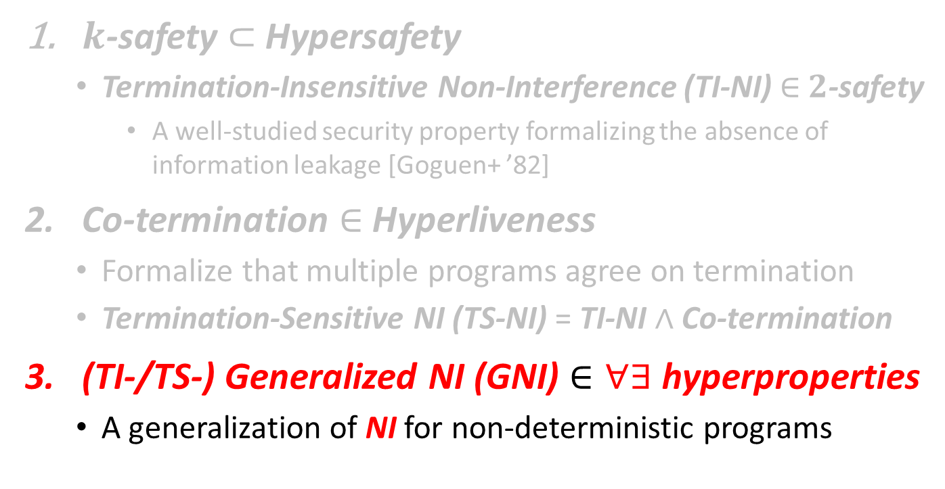
Relational Verification via
Synthesis of Relational Invariants and Fair & Semantic Schedulers
$k$-safety $⊂$ Hypersafety
  Termination-Insensitive Non-Interference (TI-NI) $∈$ $2$-safety
    A well-studied security property formalizing the absence of information leakage [Goguen+ ’82]
Co-termination $∈$ Hyperliveness
  Formalize that multiple programs agree on termination
  Termination-Sensitive NI (TS-NI) = TI-NI $∧$ Co-termination
(TI-/TS-) Generalized NI (GNI) $∈∀∃$ hyperproperties
  A generalization of NI for non-deterministic programs

Slide 16
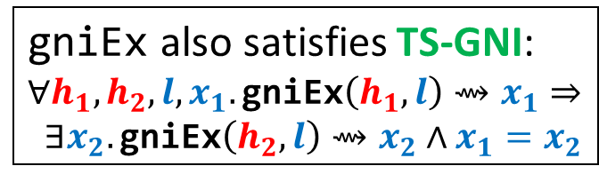


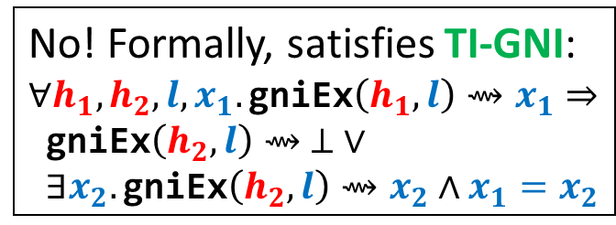
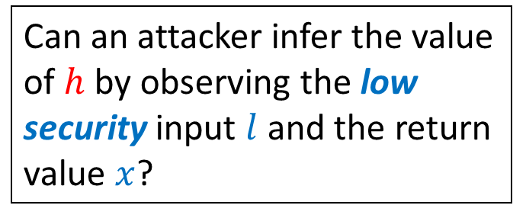


Example: (TI-/TS-)GNI
$∈$ $∀∃$hyperproperties
gniEx$\left(h,l\right)$ non-deterministically returns a value $x≥l$ in two different ways depending on the high security input $h$
gniEx(bool high, int low) {
if(high) {
int x = nondet_int();
if(x >= low) { return x }
else { while(true) {} }
} else {
int x = low;
while(nondet_bool()){x++}
return x;
}
}
Can an attacker infer the value of $h$ by observing the low security input $l$ and the return value $x$?
No! Formally, satisfies TI-GNI:
$$∀h_{1}, h_{2},l,x_{1}.\text{gniEx}\left(h_{1},l\right)⇝x_{1}⇒$$
$\text{gniEx}\left(h_{2},l\right)⇝ ⊥ ∨$
$∃x_{2}.\text{gniEx}\left(h_{2},l\right)⇝x_{2}∧x_{1}=x_{2}$
The demonic ($∀$) side
The angelic ($∃$) side
gniEx also satisfies TS-GNI:
$$∀h_{1}, h_{2},l,x_{1}.\text{gniEx}\left(h_{1},l\right)⇝x_{1}⇒$$
$∃x_{2}.\text{gniEx}\left(h_{2},l\right)⇝x_{2}∧x_{1}=x_{2}$

Slide 17
Our Approach to (TI-/TS-)GNI
Find a fair semantic scheduler, a relational invariant, a well-founded relation, and strategies for the non-deterministic choices of the angelic side
Augment the encodings for TI-NI and Co-Term with
  predicate variables that represent the strategies:
  total functions from states to choices of the angelic side
  prophecy variables that represent the final outputs of the demonic side (necessary for the completeness)
Please refer to the paper for details and examples

Slide 18
Main Contributions
Sound and complete reduction to constraint solving
  Key observation: relational verification amounts to synthesis of relational invariants and fair & semantic schedulers
New expressive class of predicate constraints pfwCSP
  Extend the class of CHCs with non-Horn clauses and
  functional / well-founded predicate variables
Stratified CEGIS for pfwCSP solving
  Combine CEGIS with stratified families of templates for achieving completeness and efficiency
Implementation of a solver PCSat and Evaluation
  Available from: https://github.com/hiroshi-unno/coar

Slide 19

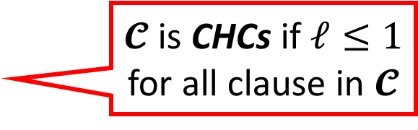
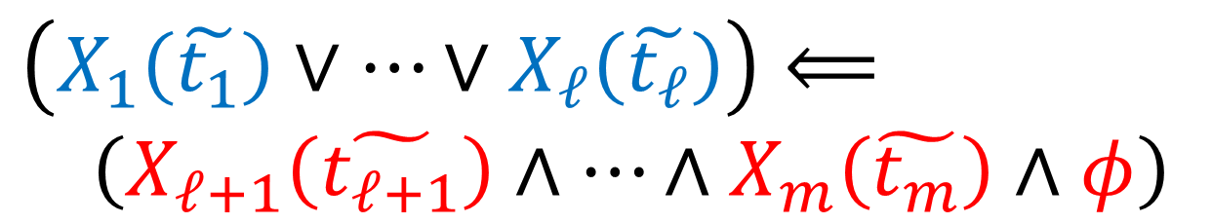
pCSP: Predicate Constraint Satisfaction Problem [Satake+ ’20]
Generalize CHCs [Bjørner+ ’15] with non-Horn clauses
A finite set $𝓒$ of clauses of the form:
where $X_{1},…,X_{ℓ},X_{ℓ+1},…,X_{m}$ are predicate variables,
$\tilde{t_{1}},…,\tilde{t_{m}}$ are sequences of terms of a 1st-order theory $T$,
$φ$ is a formula of $T$ without predicate variables
$𝓒$ is satisfiable (modulo $T$) if there is an interpretation $ρ$ of predicate variables such that $ρ⊨⋀𝓒$
$𝓒$ is CHCs if $ℓ≤1$ for all clause in $𝓒$
$$\left(X_{1}\left(\tilde{t_{1}}\right)∨…∨X_{ℓ}\left(\tilde{t_{ℓ}}\right)\right)⟸ \\ \left(X_{ℓ+1}\left(\tilde{t_{ℓ+1}}\right)∧…∧X_{m}\left(\tilde{t_{m}}\right)∧φ\right)$$

Slide 20
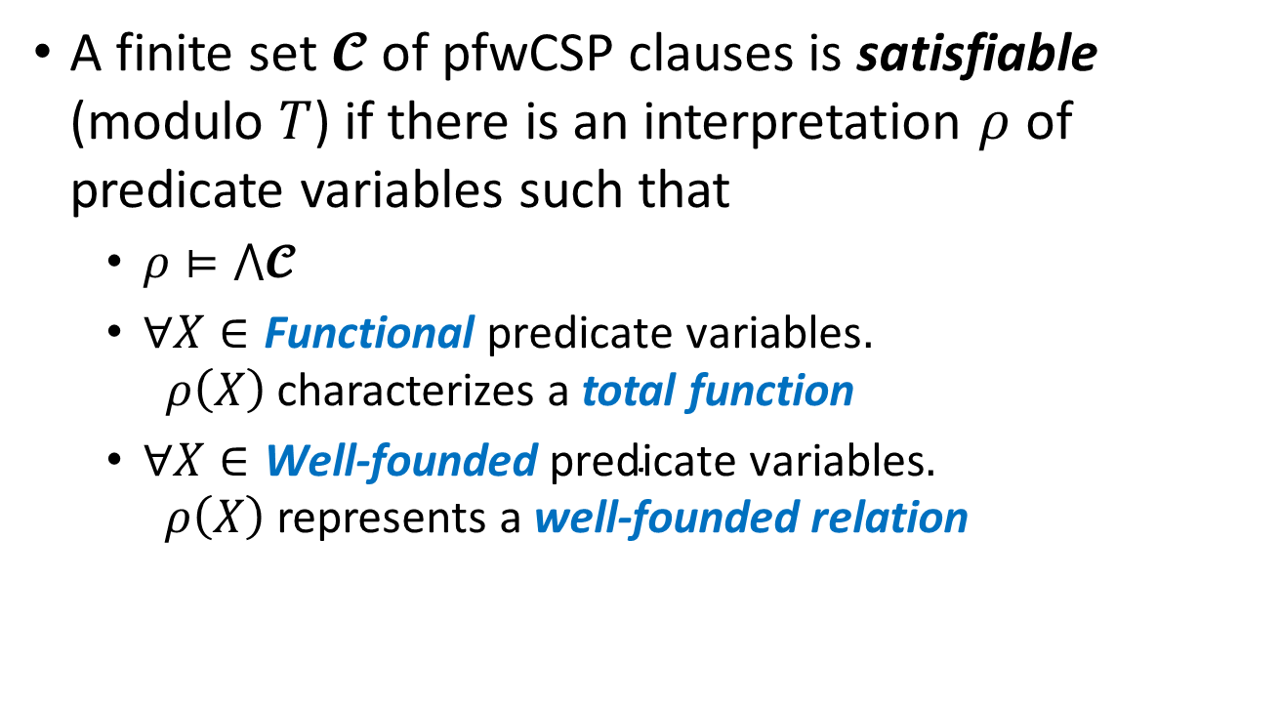
pfwCSP: pCSP with Functional &
Well-founded Predicate Variables
A finite set $𝓒$ of pfwCSP clauses is satisfiable (modulo $T$) if there is an interpretation $ρ$ of predicate variables such that
  $ρ⊨⋀𝓒$
  $∀X∈\text{Functional} \text{predicate} \text{variables}.$
  $ρ\left(X\right)$ characterizes a total function
  $∀X∈\text{Well}\text{−}\text{founded} \text{predicate} \text{variables}.$
  $ρ\left(X\right)$ represents a well-founded relation
Notes:
(cf. $∀∃$CHCs with dwf [Beyene+ ’13])

Slide 21
Main Contributions
Sound and complete reduction to constraint solving
  Key observation: relational verification amounts to synthesis of relational invariants and fair & semantic schedulers
New expressive class of predicate constraints pfwCSP
  Extend the class of CHCs with non-Horn clauses and
  functional / well-founded predicate variables
Stratified CEGIS for pfwCSP solving
  Combine CEGIS with stratified families of templates for achieving completeness and efficiency
Implementation of a solver PCSat and Evaluation
  Available from: https://github.com/hiroshi-unno/coar

Slide 22
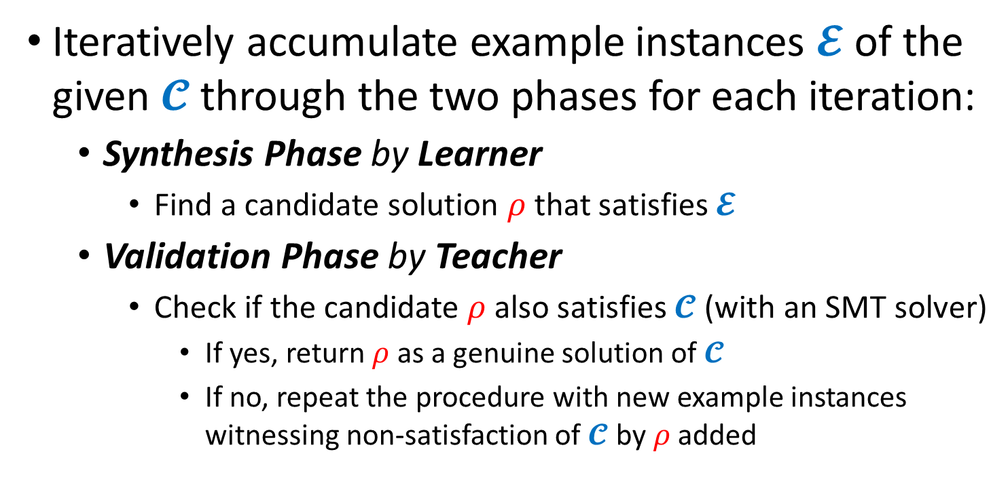
CounterExample Guided Inductive Synthesis (CEGIS) [Solar-Lezama+ ’06]
Iteratively accumulate example instances $𝓔$ of the given $𝓒$ through the two phases for each iteration:
  Synthesis Phase by Learner
    Find a candidate solution $ρ$ that satisfies $𝓔$
  Validation Phase by Teacher
    Check if the candidate $ρ$ also satisfies $𝓒$ (with an SMT solver)
      If yes, return $ρ$ as a genuine solution of $𝓒$
      If no, repeat the procedure with new example instances witnessing non-satisfaction of $𝓒$ by $ρ$ added

Slide 23
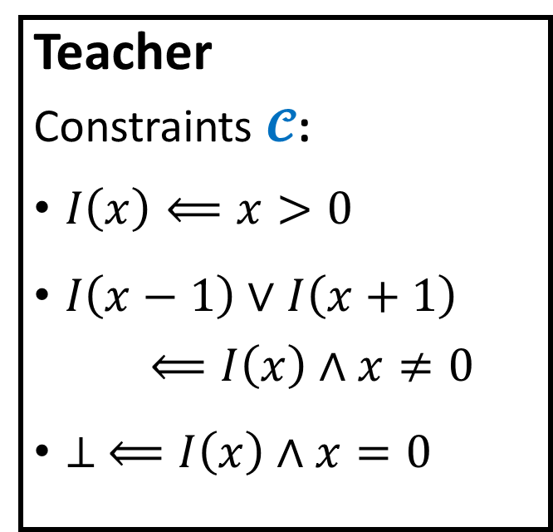
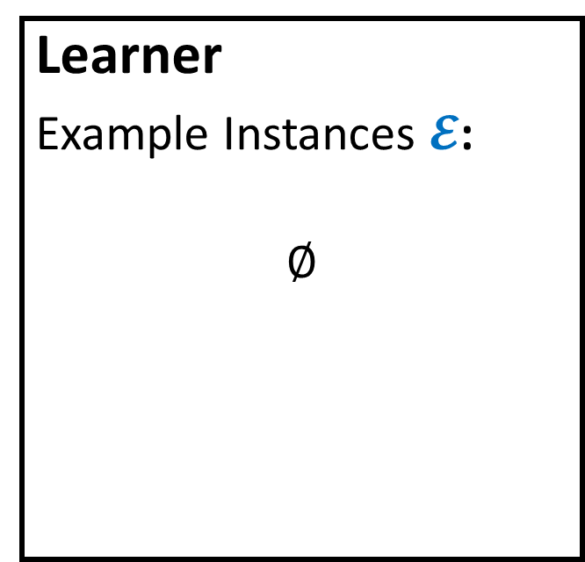
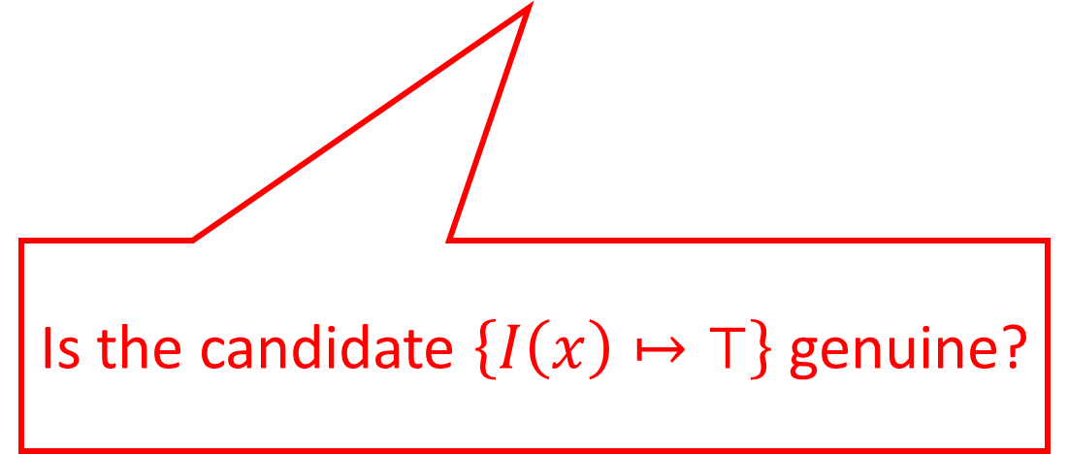
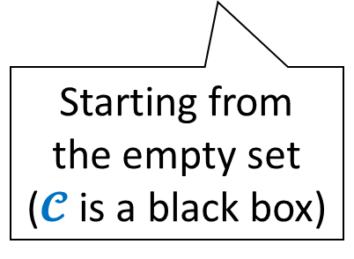
Example Run of CEGIS
Learner
Example Instances $𝓔$:
$$∅$$
Teacher
Constraints $𝓒$:
$I\left(x\right)⟸x>0$
$I\left(x−1\right)∨I\left(x+1\right)$
$⟸I\left(x\right)∧x≠0$
$⊥ ⟸I\left(x\right)∧x=0$
Starting from
the empty set
($𝓒$ is a black box)
Is the candidate $\left\{I\left(x\right)↦⊤\right\}$ genuine?

Slide 24

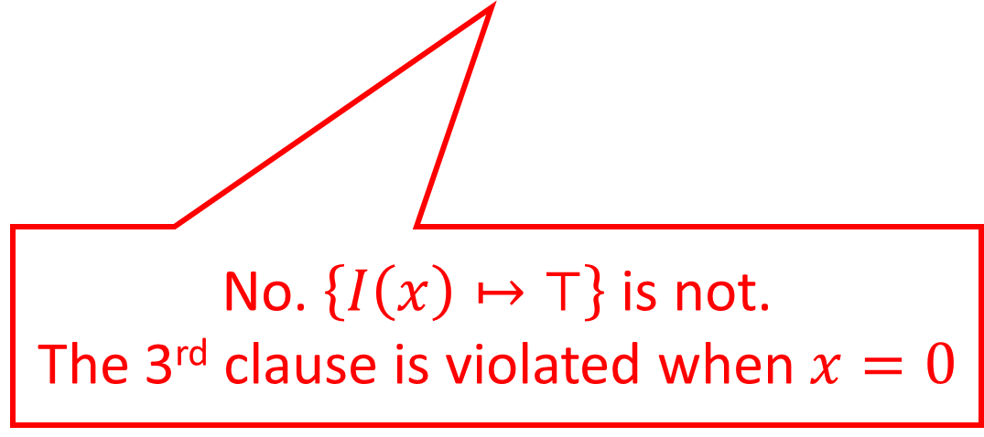
Example Run of CEGIS
Learner
Example Instances $𝓔$:
$$∅$$
Teacher
Constraints $𝓒$:
$I\left(x\right)⟸x>0$
$I\left(x−1\right)∨I\left(x+1\right)$
$⟸I\left(x\right)∧x≠0$
$⊥ ⟸I\left(x\right)∧x=0$
$$⊥ ⟸I\left(0\right)∧0=0$$
No. $\left\{I\left(x\right)↦⊤\right\}$ is not.
The 3rd clause is violated when $x=0$

Slide 25
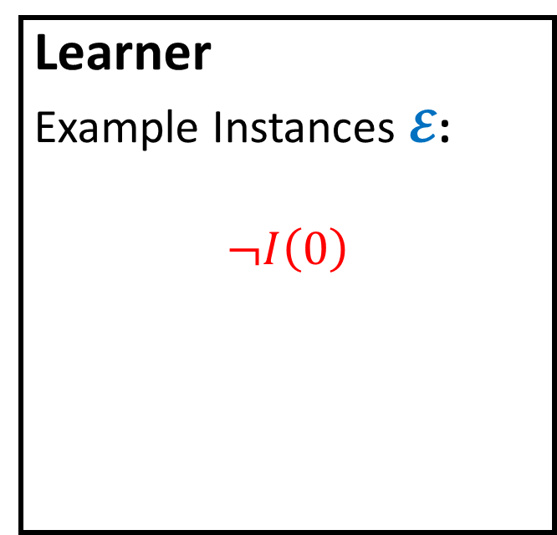

Example Run of CEGIS
Learner
Example Instances $𝓔$:
$$¬I\left(0\right)$$
Teacher
Constraints $𝓒$:
$I\left(x\right)⟸x>0$
$I\left(x−1\right)∨I\left(x+1\right)$
$⟸I\left(x\right)∧x≠0$
$⊥ ⟸I\left(x\right)∧x=0$
Is the cand. $\left\{I\left(x\right)↦x<0\right\}$ genuine?

Slide 26
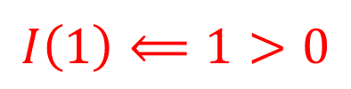
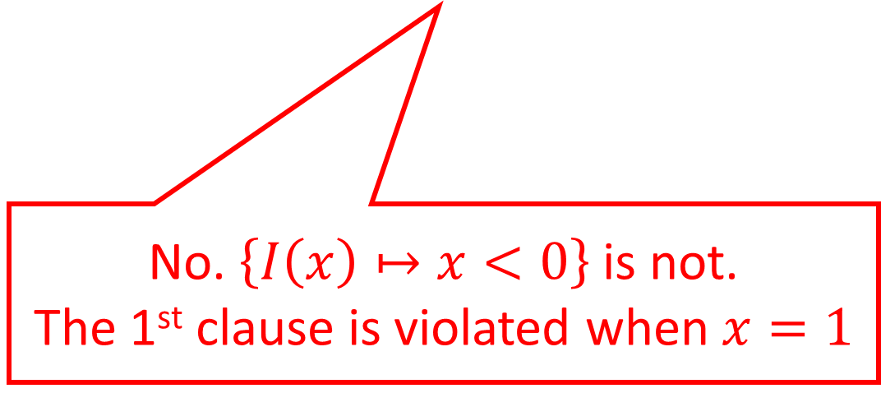
Example Run of CEGIS
Learner
Example Instances $𝓔$:
$$¬I\left(0\right)$$
Teacher
Constraints $𝓒$:
$I\left(x\right)⟸x>0$
$I\left(x−1\right)∨I\left(x+1\right)$
$⟸I\left(x\right)∧x≠0$
$⊥ ⟸I\left(x\right)∧x=0$
$$I\left(1\right)⟸1>0$$
No. $\left\{I\left(x\right)↦x<0\right\}$ is not.
The 1st clause is violated when $x=1$

Slide 27
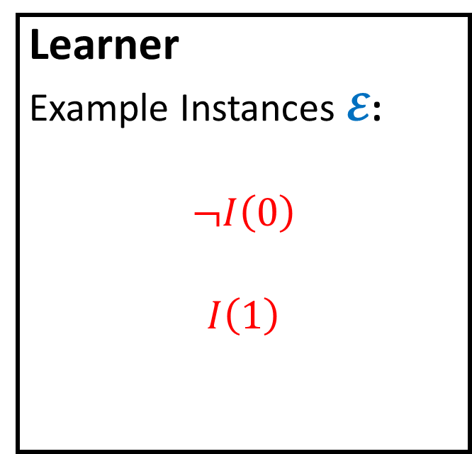

Example Run of CEGIS
Learner
Example Instances $𝓔$:
$$¬I\left(0\right)$$
$$I\left(1\right)$$
Teacher
Constraints $𝓒$:
$I\left(x\right)⟸x>0$
$I\left(x−1\right)∨I\left(x+1\right)$
$⟸I\left(x\right)∧x≠0$
$⊥ ⟸I\left(x\right)∧x=0$
Is the cand. $\left\{I\left(x\right)↦x=1\right\}$ genuine?

Slide 28
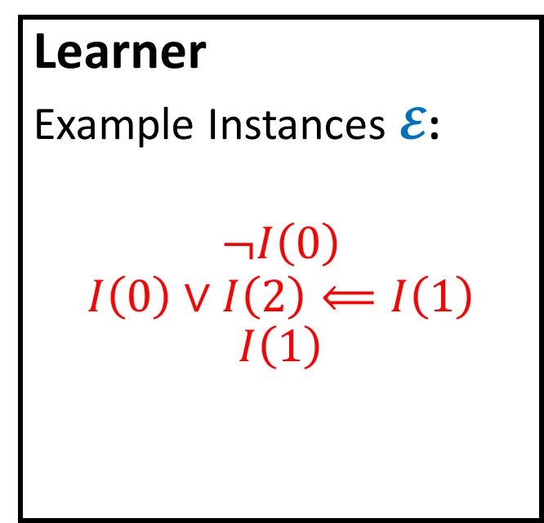
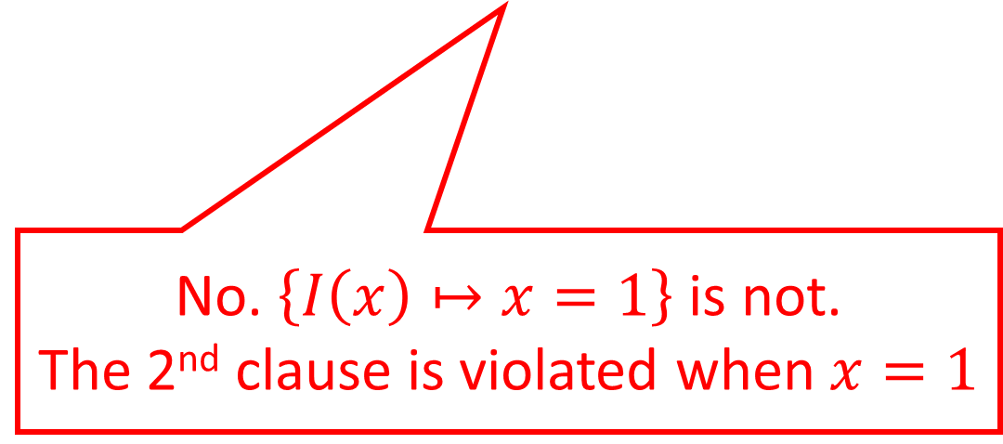
Example Run of CEGIS
Learner
Example Instances $𝓔$:
$$¬I\left(0\right)$$
$$I\left(0\right)∨I\left(2\right)⟸I\left(1\right)$$
$$I\left(1\right)$$
Teacher
Constraints $𝓒$:
$I\left(x\right)⟸x>0$
$I\left(x−1\right)∨I\left(x+1\right)$
$⟸I\left(x\right)∧x≠0$
$⊥ ⟸I\left(x\right)∧x=0$
No. $\left\{I\left(x\right)↦x=1\right\}$ is not.
The 2nd clause is violated when $x=1$

Slide 29

Example Run of CEGIS
Learner
Example Instances $𝓔$:
$$¬I\left(0\right)$$
$$I\left(0\right)∨I\left(2\right)⟸I\left(1\right)$$
$$I\left(1\right)$$
Teacher
Constraints $𝓒$:
$I\left(x\right)⟸x>0$
$I\left(x−1\right)∨I\left(x+1\right)$
$⟸I\left(x\right)∧x≠0$
$⊥ ⟸I\left(x\right)∧x=0$
Is the cand. $\left\{I\left(x\right)↦x≥1\right\}$ genuine?

Slide 30
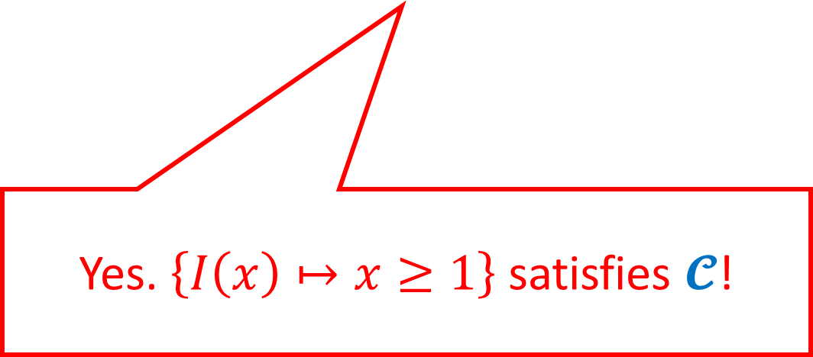
Example Run of CEGIS
Learner
Example Instances $𝓔$:
$$¬I\left(0\right)$$
$$I\left(0\right)∨I\left(2\right)⟸I\left(1\right)$$
$$I\left(1\right)$$
Teacher
Constraints $𝓒$:
$I\left(x\right)⟸x>0$
$I\left(x−1\right)∨I\left(x+1\right)$
$⟸I\left(x\right)∧x≠0$
$⊥ ⟸I\left(x\right)∧x=0$
Yes. $\left\{I\left(x\right)↦x≥1\right\}$ satisfies $𝓒$!

Slide 31

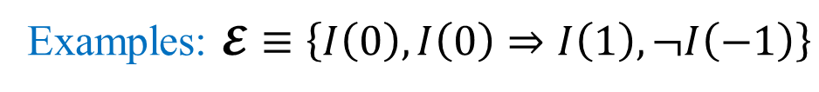


Template-based Learner
Prepare a solution template with unknown coefficients,
Generate constraints on them, and
Solve them using an SMT solver
Examples: $𝓔≡\left\{I\left(0\right),I\left(0\right)⇒I\left(1\right),¬I\left(−1\right)\right\}$
Solution Template: $I\left(x\right)↦c_{1}⋅x+c_{2}≥0$
Coeff. Constraints: $\left\{c_{2}≥0,c_{2}≥0⇒c_{1}+c_{2}≥0,−c_{1}+c_{2}<0 \right\}$
Satisfying Assignment: $\left\{c_{1}↦1,c_{2}↦0\right\}$
A Candidate Solution: $ρ≡\left\{I\left(x\right)↦x≥0\right\}$

Slide 32
Stratified Template Families
Existing invariant synthesis methods [Jhala+ ’06,Terauchi+ ’15] use a stratified template family of ordinary predicates
  To achieve completeness, often at the price of efficiency
  Search for solutions in a stratified manner: Iteratively update templates to expressive ones, if needed, according to the family
Our pfwCSP solving method combines CEGIS with stratified template families of ordinary/functional/well-founded predicates
  To achieve not only completeness but also efficiency
  The data-driven nature of CEGIS is a good match: the stratified search accelerates the convergence by avoiding the overfitting problem [Padhi+ ’19] of expressive templates to counterexamples

Slide 33
Implementation and Evaluation
Evaluated our solver PCSat for pfwCSP
on 20 relational verification problems:
  15 solved fully automatically, 5 required small hints
Notes:
(could be automated)

Slide 34
Future and Ongoing Work
Further improve the scalability of constraint solving
  Particularly, synthesis of functional predicates
Automate program verification of:
  temporal relational properties expressed in
  hyper temporal logics (e.g., HyperLTL, HyperCTL)
  probabilistic relational properties, motivated from
  security, privacy, cryptography, and machine learning

Slide 35

Summary
New class pfwCSP of predicate constraints, generalizing CHCs with non-Horn clauses and functional/well-founded predicates
Sound and complete reduction of relational verification
(of $k$-safety, co-termination, and GNI) to pfwCSP solving
  relational verification amounts to synthesis of relational invariants and fair & semantic schedulers, which can be characterized by pfwCSP
Stratified CEGIS for pfwCSP solving
  Combine CEGIS with stratified families of templates for achieving completeness and efficiency
Implementation of a solver PCSat and Evaluation
  Available from: https://github.com/hiroshi-unno/coar

