Slide 1
Constraint-based
Relational Verification
Hiroshi Unno (U. of Tsukuba / RIKEN AIP, Japan)
Tachio Terauchi (Waseda University, Japan)
Eric Koskinen (Stevens Institute of Technology, USA)

Slide 2
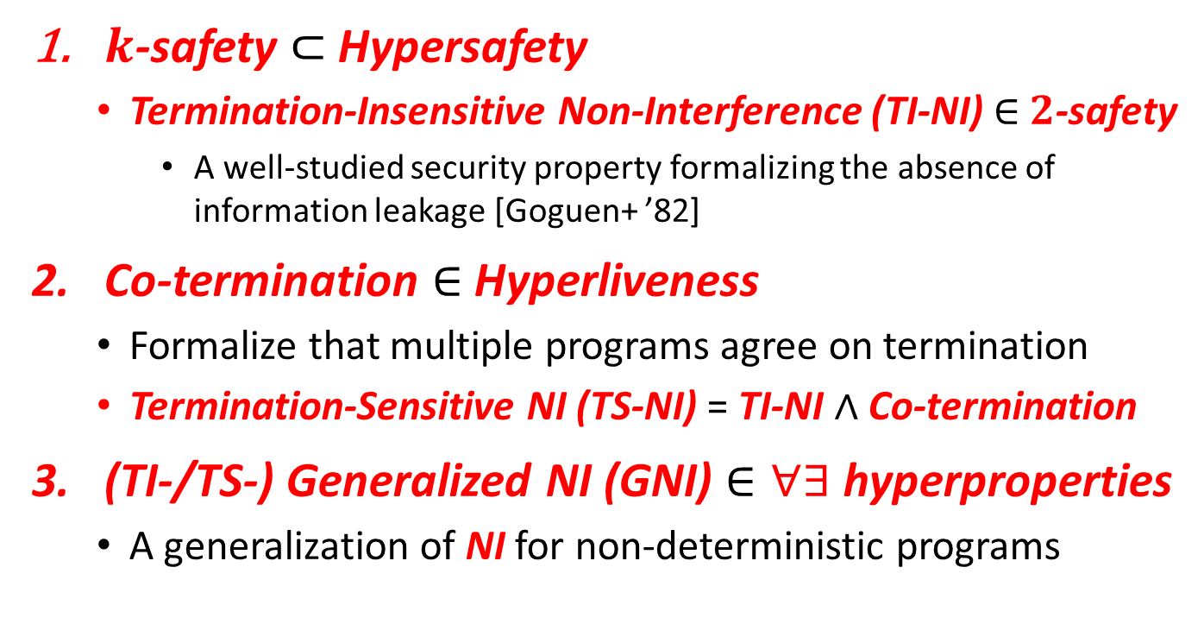
This Work: Automated Verification of Relational Properties
$k$-safety $⊂$ Hypersafety
  Termination-Insensitive Non-Interference (TI-NI) $∈$ $2$-safety
    A well-studied security property formalizing the absence of information leakage [Goguen+ ’82]
Co-termination $∈$ Hyperliveness
  Formalize that multiple programs agree on termination
  Termination-Sensitive NI (TS-NI) = TI-NI $∧$ Co-termination
(TI-/TS-) Generalized NI (GNI) $∈∀∃$ hyperproperties
  A generalization of NI for non-deterministic programs
Notes:
for Infinite-State Programs

Slide 3
Main Contributions
Sound and complete reduction to constraint solving
  Key observation: relational verification amounts to synthesis of relational invariants and fair & semantic schedulers
New expressive class of predicate constraints pfwCSP
  Extend the class of CHCs with non-Horn clauses and
  functional / well-founded predicate variables
Stratified CEGIS for pfwCSP solving
  Combine CEGIS with stratified families of templates for achieving completeness and efficiency
Implementation of a solver PCSat and Evaluation
  Available from: https://github.com/hiroshi-unno/coar

Slide 4

Relational Verification via
Synthesis of Relational Invariants and Fair & Semantic Schedulers
$k$-safety $⊂$ Hypersafety
  Termination-Insensitive Non-Interference (TI-NI) $∈$ $2$-safety
    A well-studied security property formalizing the absence of information leakage [Goguen+ ’82]
Co-termination $∈$ Hyperliveness
  Formalize that multiple programs agree on termination
  Termination-Sensitive NI (TS-NI) = TI-NI $∧$ Co-termination
(TI-/TS-) Generalized NI (GNI) $∈∀∃$ hyperproperties
  A generalization of NI for non-deterministic programs

Slide 5


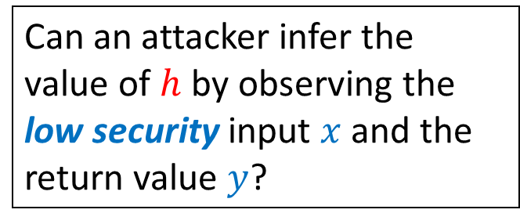

Example: Termination-Insensitive Non-Interference (TI-NI) $∈$ $2$-safety
doubleSquare$\left(h,x\right)$ [Shemer+ ’19] computes ${2⋅x}^{2}$ in two different ways depending on the high security input $h$
doubleSquare(bool h,int x) {
int z, y=0;
if(h) { z=2*x }
else { z=x }
while(z>0) { z--; y=y+x }
if(!h) { y=2*y }
return y;
}
Can an attacker infer the value of $h$ by observing the low security input $x$ and the return value $y$?
No! Formally, TI-NI holds:
$$∀h_{1},x_{1},y_{1},h_{2},x_{2},y_{2}.$$
doubleSquare$\left(h_{1},x_{1}\right)⇝y_{1}∧$ doubleSquare$\left(h_{2},x_{2}\right)⇝y_{2}∧$
$$x_{1}=x_{2}⇒y_{1}=y_{2}$$

Slide 6

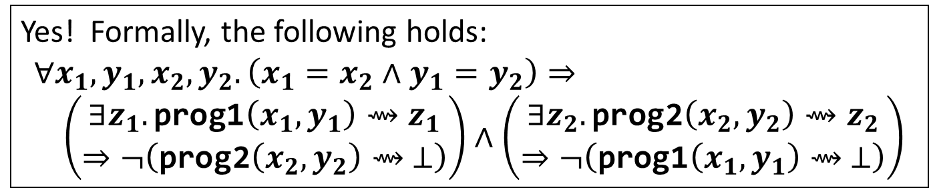
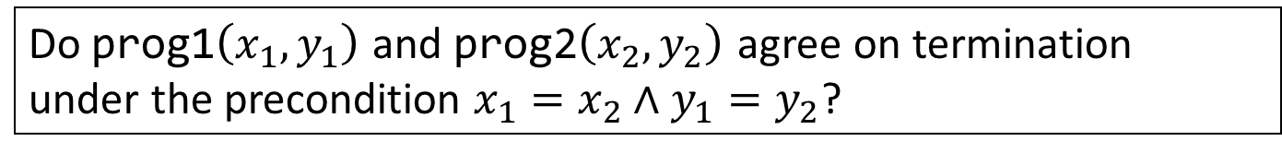
Example: Co-Termination
$∈$ Hyperliveness
prog1(int x, int y) { while(x>0) { x=x–y; } }
prog2(int x, int y) { while(x>0) { x=x–2*y; } }
Do prog1$\left(x_{1},y_{1}\right)$ and prog2$\left(x_{2},y_{2}\right)$ agree on termination
under the precondition $x_{1}=x_{2}∧y_{1}=y_{2}$?
Yes! Formally, the following holds:
$$∀x_{1},y_{1},x_{2},y_{2}. \left(x_{1}=x_{2}∧y_{1}=y_{2}\right)⇒ \\ \left(\begin{aligned}∃z_{1}.\text{prog}\text{1}\left(x_{1},y_{1}\right)⇝z_{1} \\ ⇒¬\left(\text{prog}\text{2}\left(x_{2},y_{2}\right)⇝ ⊥\right)\end{aligned}\right)∧\left(\begin{aligned}∃z_{2}.\text{prog}\text{2}\left(x_{2},y_{2}\right)⇝z_{2} \\ ⇒¬\left(\text{prog}\text{1}\left(x_{1},y_{1}\right)⇝ ⊥\right)\end{aligned}\right)$$

Slide 7

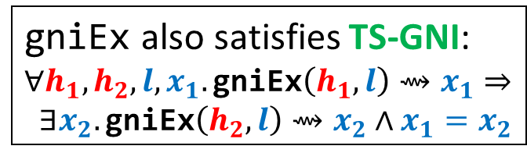
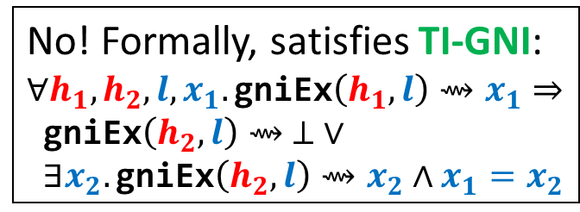
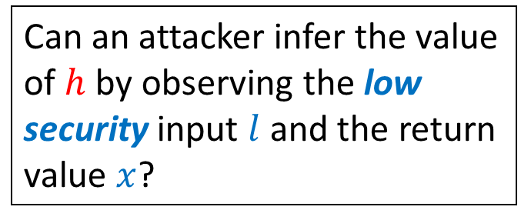

Example: (TI-/TS-)GNI
$∈$ $∀∃$hyperproperties
gniEx$\left(h,l\right)$ non-deterministically returns a value $x≥l$ in two different ways depending on the high security input $h$
gniEx(bool high, int low) {
if(high) {
int x = nondet_int();
if(x >= low) { return x }
else { while(true) {} }
} else {
int x = low;
while(nondet_bool()){x++}
return x;
}
}
Can an attacker infer the value of $h$ by observing the low security input $l$ and the return value $x$?
No! Formally, satisfies TI-GNI:
$$∀h_{1}, h_{2},l,x_{1}.\text{gniEx}\left(h_{1},l\right)⇝x_{1}⇒$$
$\text{gniEx}\left(h_{2},l\right)⇝ ⊥ ∨$
$∃x_{2}.\text{gniEx}\left(h_{2},l\right)⇝x_{2}∧x_{1}=x_{2}$
gniEx also satisfies TS-GNI:
$$∀h_{1}, h_{2},l,x_{1}.\text{gniEx}\left(h_{1},l\right)⇝x_{1}⇒$$
$∃x_{2}.\text{gniEx}\left(h_{2},l\right)⇝x_{2}∧x_{1}=x_{2}$

