Slide 1
Higher-order Program Verification as Refinement Type Inference
Hiroshi Unno (University of Tsukuba)
Joint work with: Naoki Kobayashi, Tachio Terauchi, Ryosuke Sato, Takuya Kuwahara, Kodai Hashimoto, Sho Torii

Slide 2
Path-Sensitive Verifiers for H.O. Programs
(cf. SLAM, BLAST, … for Imperative Programs)
Refinement Caml [Unno+ FLOPS’08, PPDP’09, POPL’13, TACAS’15, SAS’15, …]
MoCHi [Kobayashi+ PLDI’11, PEPM’13, ESOP’14, ESOP’15, PEPM’15, CAV’15, …]
Liquid Types [Jhala+ PLDI’08, PLDI’09, CAV’10, …, ESOP’13, ICFP’14, …]
Depcegar [Terauchi POPL’10]
HMC [Jhala, Majumdar & Rybalchenko CAV’11]
Popeye [Zhu & Jagannathan VMCAI’13]
Program & Spec.
let rec mc x =
if x > 100 then
x – 10
else
mc (mc (x + 11))
in
let n = randi() in
if n · 101 then
assert (mc n = 91)
Result
Certificate
or
Counterexample
Verifier

Slide 3
  MoCHi: Software Model Checker for Higher-Order Functional Programs
Automatically prove/disprove safety and liveness properties of high-level programs
  High-level control structures:
  higher-order functions and exceptions
  High-level data structures:
  algebraic data types and multidimensional arrays
  Absence of assertion failures, pattern matching errors, uncaught exceptions, array bounds errors, …
  Termination for all / Nontermination for some inputs
  (ongoing extension to omega-regular properties)

Slide 4
Path-Sensitive Verifiers for H.O. Programs
(cf. SLAM, BLAST, … for Imperative Programs)
Refinement Caml [Unno+ FLOPS’08, PPDP’09, POPL’13, TACAS’15, SAS’15, …]
MoCHi [Kobayashi+ PLDI’11, PEPM’13, ESOP’14, ESOP’15, PEPM’15, CAV’15, …]
Liquid Types [Jhala+ PLDI’08, PLDI’09, CAV’10, …, ESOP’13, ICFP’14, …]
Depcegar [Terauchi POPL’10]
HMC [Jhala, Majumdar & Rybalchenko CAV’11]
Popeye [Zhu & Jagannathan VMCAI’13]
Program & Spec.
All these verifiers are based on refinement type system
(cf. Hoare logic for first-order
imperative programs)
let rec mc x =
if x > 100 then
x – 10
else
mc (mc (x + 11))
in
let n = randi() in
if n · 101 then
assert (mc n = 91)
Result
Certificate
or
Counterexample
Verifier

Slide 5

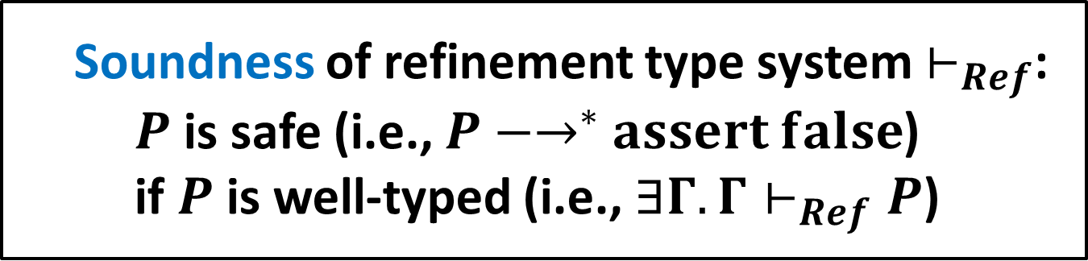
Refinement Types
[Freeman & Pfenning PLDI’91][Xi & Pfenning PLDI’98, POPL’99]
FOL formulas (e.g. QFLIA)
for type refinement
$\{x :int | x≥0\}$
  Non-negative integers
$\left(x :int\right)→\{r :int | r≥x\}$
  Functions that take an integer $x$ and
  return an integer $r$ not less than $x$
  Soundness of refinement type system $⊢_{Ref}$:
  $P$ is safe (i.e., $P{−→}^{∗}assert false$)
  if $P$ is well-typed (i.e., $∃Γ.Γ⊢_{Ref}P$)

Slide 6
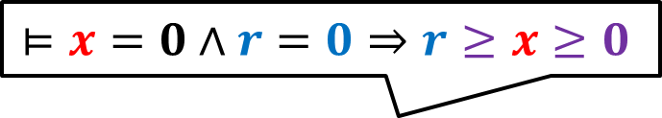
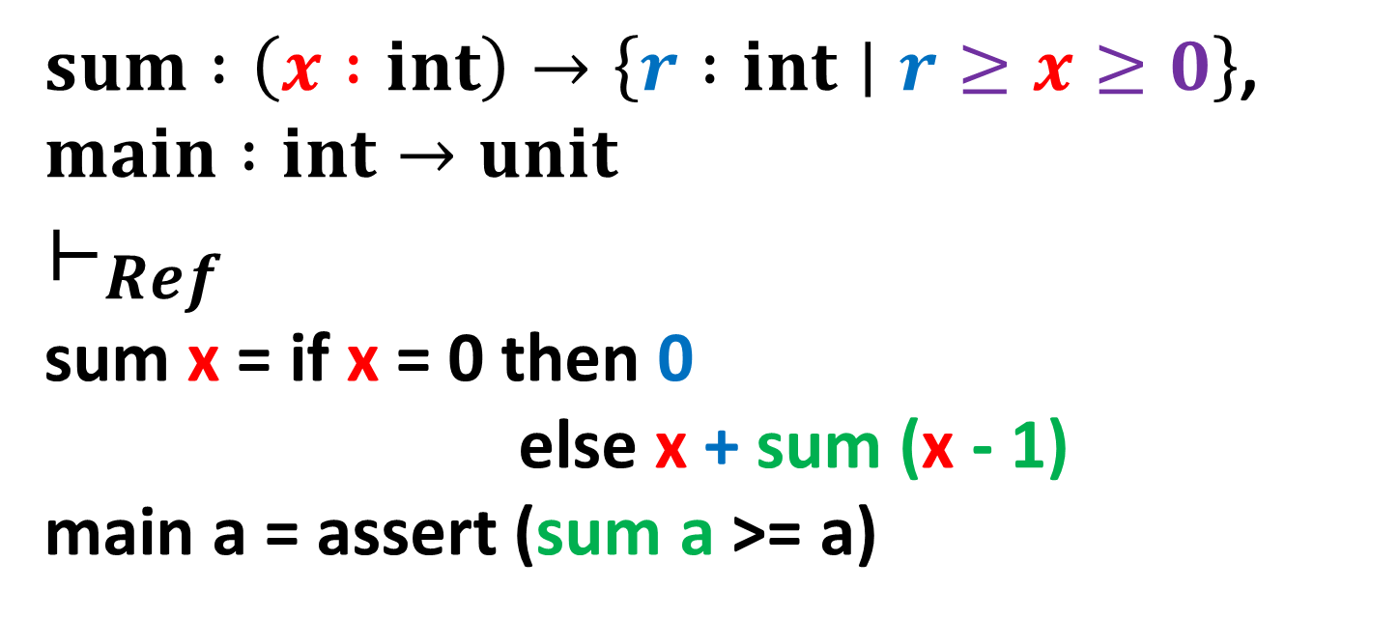
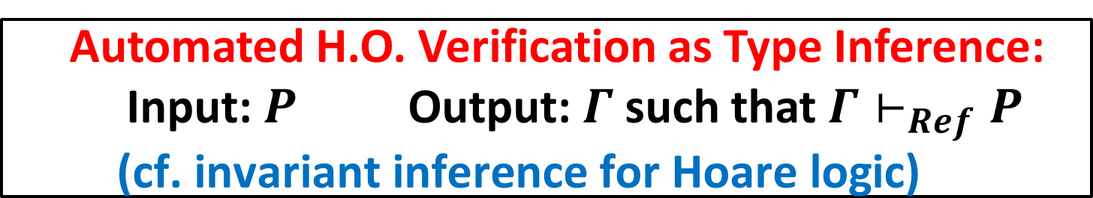
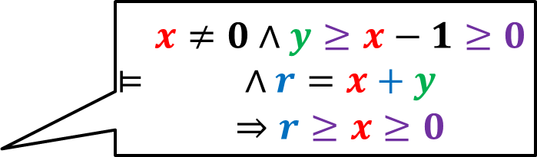

Example: Refinement Type Checking
$sum :\left(x :int\right)→\left\{r :int∣r≥x≥0\right\}$,
$$main :int→unit$$
$$⊢_{Ref}$$
sum x = if x = 0 then 0
else x + sum (x - 1)
main a = assert (sum a >= a)
$$⊨x=0∧r=0⇒r≥x≥0$$
$$⊨\begin{matrix}\begin{aligned}x≠0∧y≥x−1≥0 \\ ∧r=x+y\end{aligned} \\ ⇒r≥x≥0\end{matrix}$$
$$⊨b≥a≥0⇒b≥a$$
  Automated H.O. Verification as Type Inference:
  Input: $P$ Output: $Γ$ such that $Γ⊢_{Ref}P$
  $$\text{(}\text{cf}\text{. }\text{invariant} \text{inference} \text{for} \text{Hoare} \text{logic}\text{)}$$

Slide 7
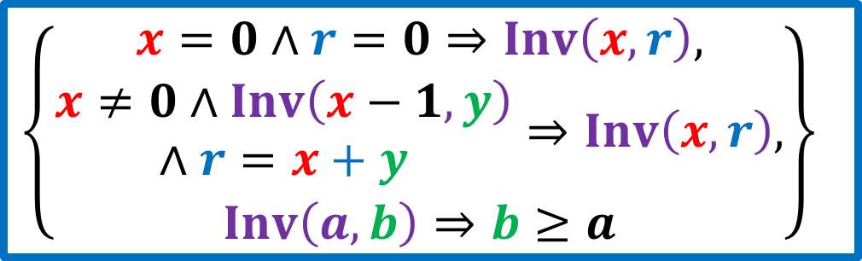
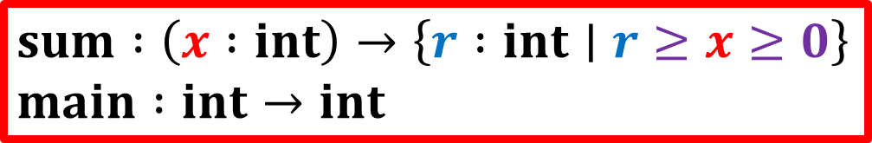
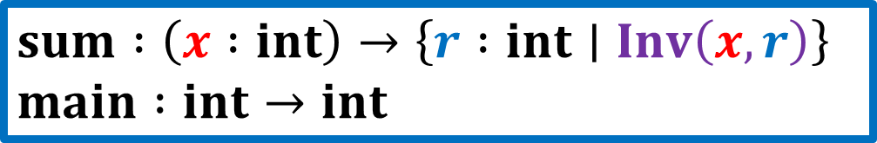
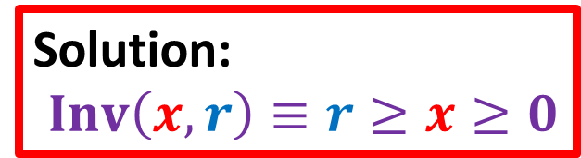
Refinement Type Inference via
Horn Constraint Solving [U.&Kobayashi FLOPS’08,PPDP’09]
$$sum :\left(x :int\right)→\left\{r :int∣Inv\left(x,r\right)\right\}$$
$$main :int→int$$
$$sum :\left(x :int\right)→\left\{r :int∣r≥x≥0\right\}$$
$$main :int→int$$
Refinement Types
sum x = if x = 0 then 0 else x + sum (x - 1)
main a = assert (sum a >= a)
sat
Program
+ Spec.
Horn Clause Constraint Generator
Horn Clauses
Horn Clause Constraint Solver
Solution:
$Inv\left(x,r\right)≡r≥x≥0$
$$\left\{\begin{aligned}\begin{matrix}x=0∧r=0⇒Inv\left(x,r\right), \\ \begin{aligned}x≠0∧Inv\left(x−1,y\right) \\ ∧r=x+y\end{aligned}⇒Inv\left(x,r\right),\end{matrix} \\ Inv\left(a,b\right)⇒b≥a\end{aligned}\right\}$$
unsat
Counter
example

Slide 8
Horn Constraint Solving Techniques
Quantifier elimination [U. & Kobayashi FLOPS’08]
Predicate abstraction [Rondon+ PLDI’08]
Craig interpolation [U.+ PPDP’09, PEPM’13][Terauchi POPL’10]
[McMillan & Rybalchenko’13]
Tree interpolation [Gupta+ POPL’11, APLAS’11] [Hoder+ CAV’11]
[Rummer+ CAV’13][Terauchi & U. ESOP’15][U. & Terauchi TACAS’15]
Template-based synthesis [Hashimoto & U. SAS’15]
…

Slide 9
Refinement Type System as Axiomatic Semantics of H.O. Functional Programs
 | Imperative | H.O. Functional
Axiomatic Semantics of Partial Correctness | Hoare Logic of Partial Correctness | ?
Axiomatic Semantics of Total Correctness | Hoare Logic of Total Correctness | ?
Axiomatic Semantics of Angelic Nondeterminism | Hoare Logic of Angelic Nondet. [Mamouras FoSSaCS’15] | ?
Predicate Transformer Semantics | Weakest Precondition Generation | Horn Clause Constraint Generation [U. & Kobayashi PPDP’09]

Slide 10
Refinement Type System as Axiomatic Semantics of H.O. Functional Programs
 | Imperative | H.O. Functional
Axiomatic Semantics of Partial Correctness | Hoare Logic of Partial Correctness | Relatively Complete Refinement Type System [U., Terauchi & Kobayashi POPL’13]
Axiomatic Semantics of Total Correctness | Hoare Logic of Total Correctness | ?
Axiomatic Semantics of Angelic Nondeterminism | Hoare Logic of Angelic Nondet. [Mamouras FoSSaCS’15] | ?
Predicate Transformer Semantics | Weakest Precondition Generation | Horn Clause Constraint Generation [U. & Kobayashi PPDP’09]

Slide 11
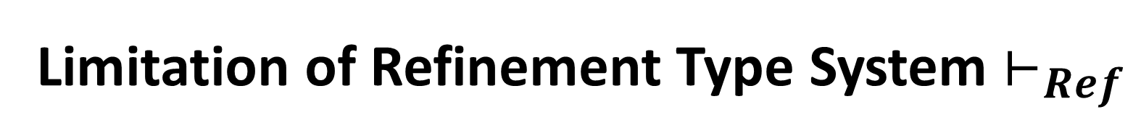
Limitation of Refinement Type System $⊢_{Ref}$
Incompleteness:
There is a safe but untypable program
whereas Hoare logic is relatively complete

Slide 12
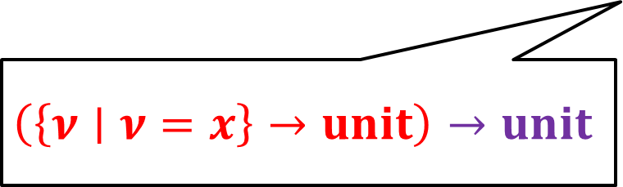
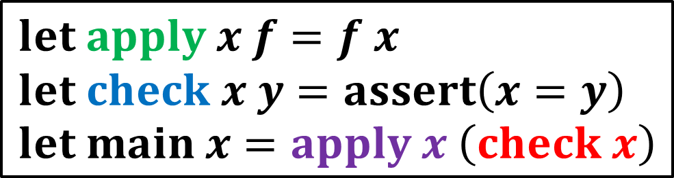
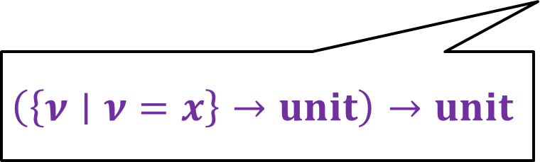
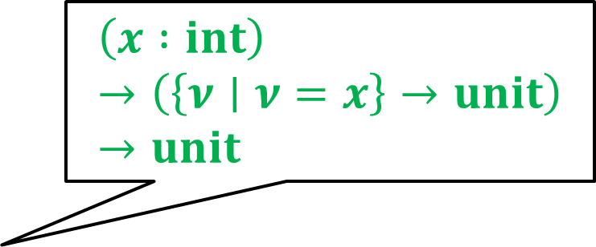
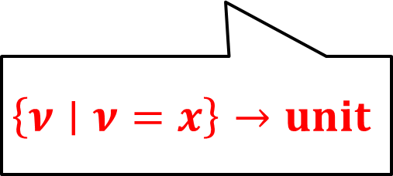
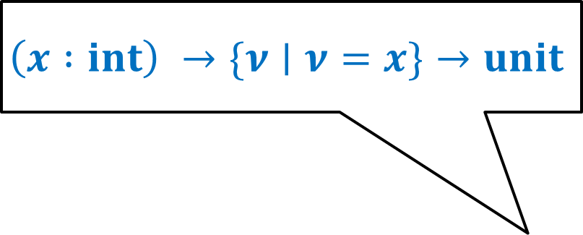
Example: Safe and Typable Program
$$\left(x :int\right)→\left(\left\{ν∣ν=x\right\}→unit\right)→unit$$
$$\left(x :int\right) →\{ν∣ν=x\}→unit$$
$$let apply x f=f x \\ let check x y=assert\left(x=y\right) \\ let main x=apply x \left(check x\right)$$
Well-typed!
$$\left(\left\{ν∣ν=x\right\}→unit\right)→unit$$
$$\left\{ν∣ν=x\right\}→unit$$
$$\left(\left\{ν∣ν=x\right\}→unit\right)→unit$$

Slide 13
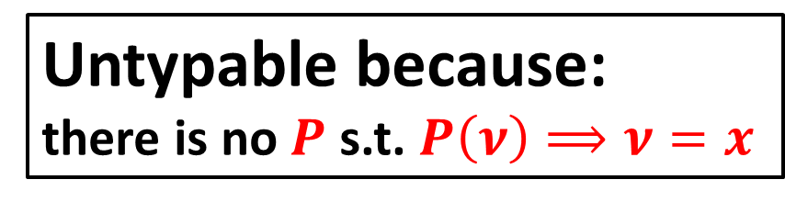
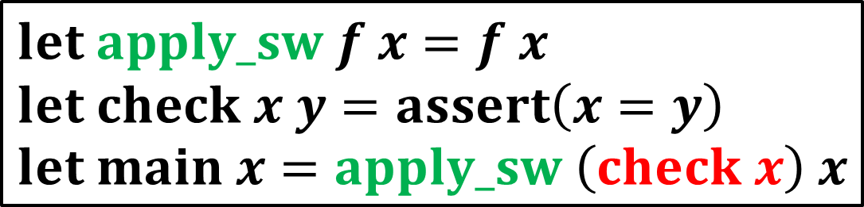
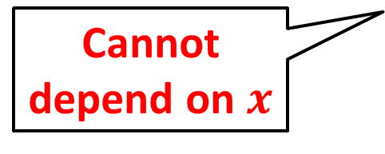
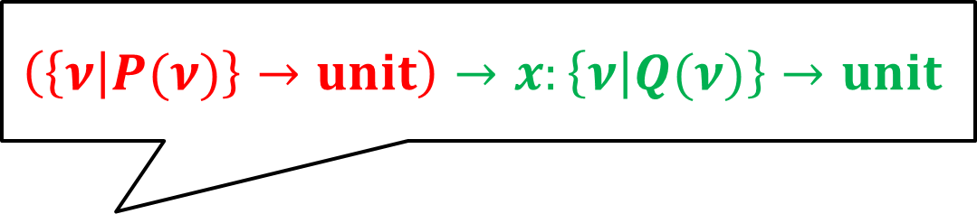
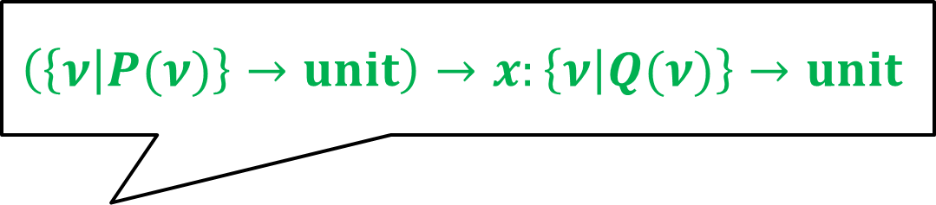
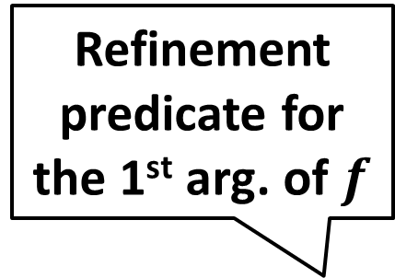
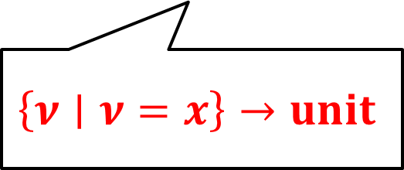
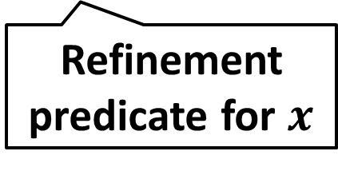
Example: Safe but Untypable Program
Refinement predicate for the 1st arg. of $f$
$$\left(\left\{ν | P(ν)\right\}→unit\right)→x:\left\{ν | Q(ν)\right\}→unit$$
$$\left(\left\{ν | P(ν)\right\}→unit\right)→x:\left\{ν | Q(ν)\right\}→unit$$
Cannot depend on $x$
Refinement predicate for $x$
$$let apply_sw f x=f x \\ let check x y=assert\left(x=y\right) \\ let main x=apply_sw \left(check x\right) x$$
Untypable because:
there is no $P$ s.t. $P\left(ν\right)⟹ν=x$
$$\left\{ν∣ν=x\right\}→unit$$

Slide 14

Our Contributions
Relatively complete extension $⊢_{RC}$ of
ordinary refinement type system $⊢_{Ref}$
Type inference method for $⊢_{RC}$

Slide 15
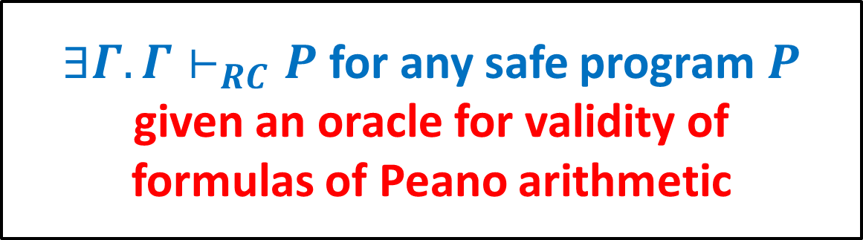

Our Contributions
Relatively complete extension $⊢_{RC}$ of
ordinary refinement type system $⊢_{Ref}$
Type inference method for $⊢_{RC}$
$∃Γ.Γ⊢_{RC}P$ for any safe program$P$
given an oracle for validity of
formulas of Peano arithmetic

Slide 16

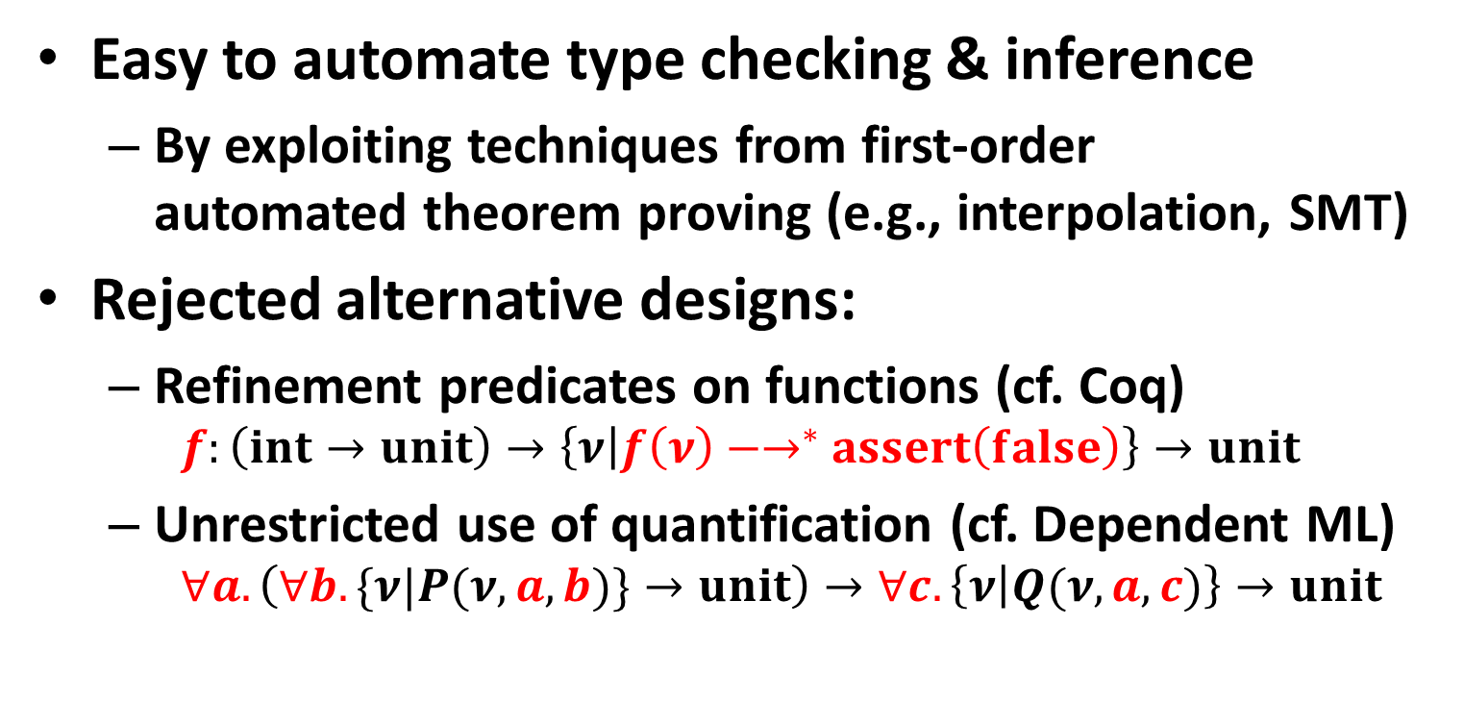
Our Design Goal of $⊢_{RC}$
Easy to automate type checking & inference
  By exploiting techniques from first-order
  automated theorem proving (e.g., interpolation, SMT)
Rejected alternative designs:
  Refinement predicates on functions (cf. Coq)
    $$f:\left(int→unit\right)→\left\{ν | f\left(ν\right){−→}^{∗}assert\left(false\right)\right\}→unit$$
  Unrestricted use of quantification (cf. Dependent ML)
    $$∀a. \left(∀b.\{ν|P(ν,a,b)\}→unit\right)→∀c.\left\{ν | Q(ν,a,c)\right\}→unit$$

Slide 17
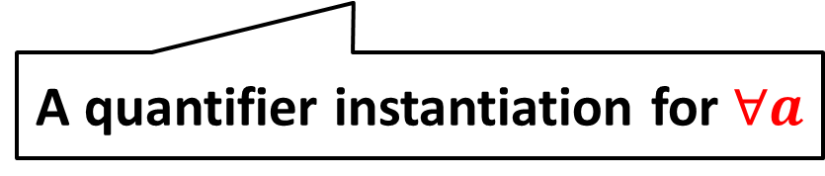
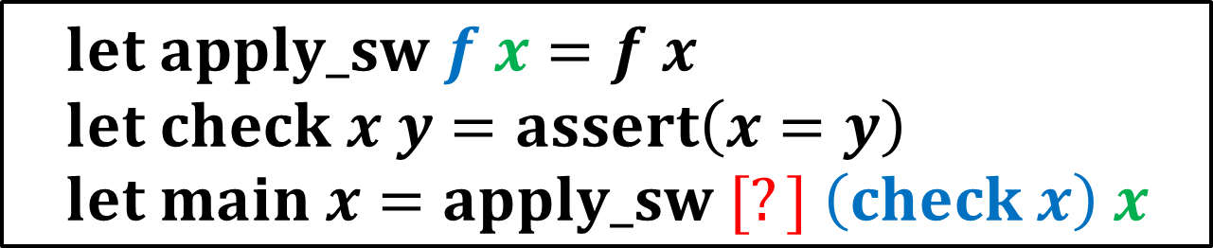
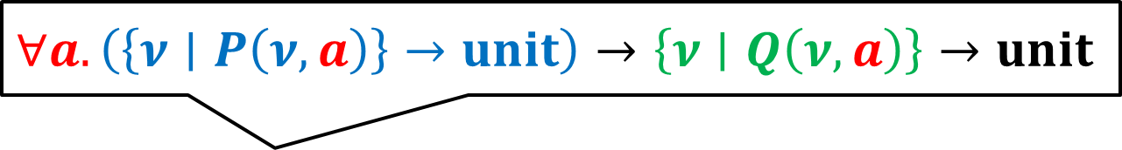
Our Approach: Restricted
Use of Quantification
Add one universal quantifier over integer
just before each function parameter
[Goerdt 1985, German, Clarke, and Halpern 1983, 1989]
$$∀a.\left(\left\{ν∣P\left(ν,a\right)\right\}→unit\right)→\left\{ν∣Q\left(ν,a\right)\right\}→unit$$
$$let apply_sw f x=f x \\ let check x y=assert\left(x=y\right) \\ let main x=apply_sw [?] \left(check x\right) x$$
A quantifier instantiation for $∀a$

Slide 18
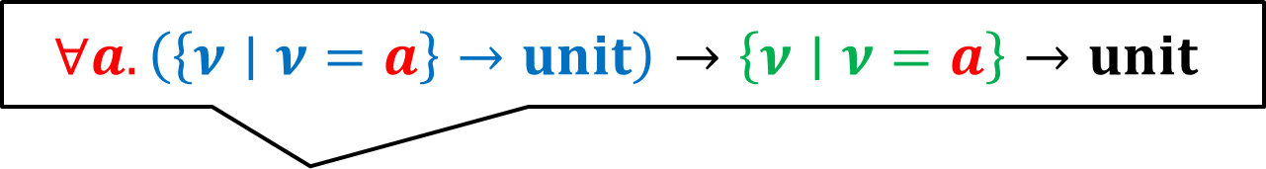
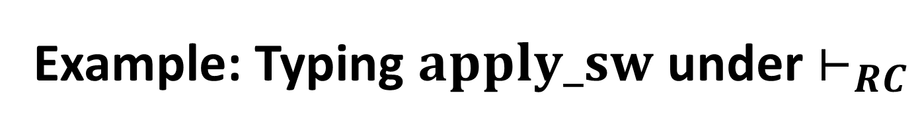
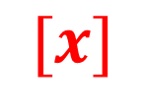
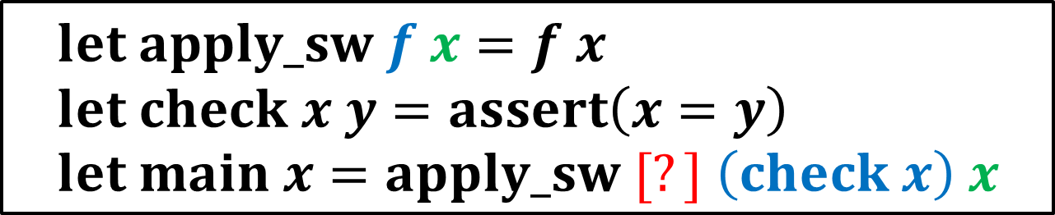

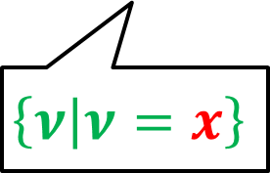
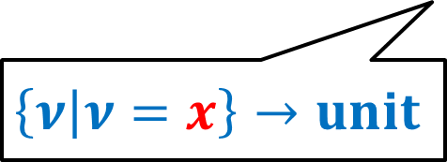
Example: Typing $apply_sw$ under $⊢_{RC}$
$$∀a.\left(\left\{ν∣ν=a\right\}→unit\right)→\left\{ν∣ν=a\right\}→unit$$
$$∀a.\left(\left\{ν∣P\left(ν,a\right)\right\}→unit\right)→\left\{ν∣Q\left(ν,a\right)\right\}→unit$$
$$let apply_sw f x=f x \\ let check x y=assert\left(x=y\right) \\ let main x=apply_sw [?] \left(check x\right) x$$
$$[x]$$
Well-typed!
$$\left\{ν | ν=x\right\}→unit$$
$$\left\{ν | ν=x\right\}$$

Slide 19

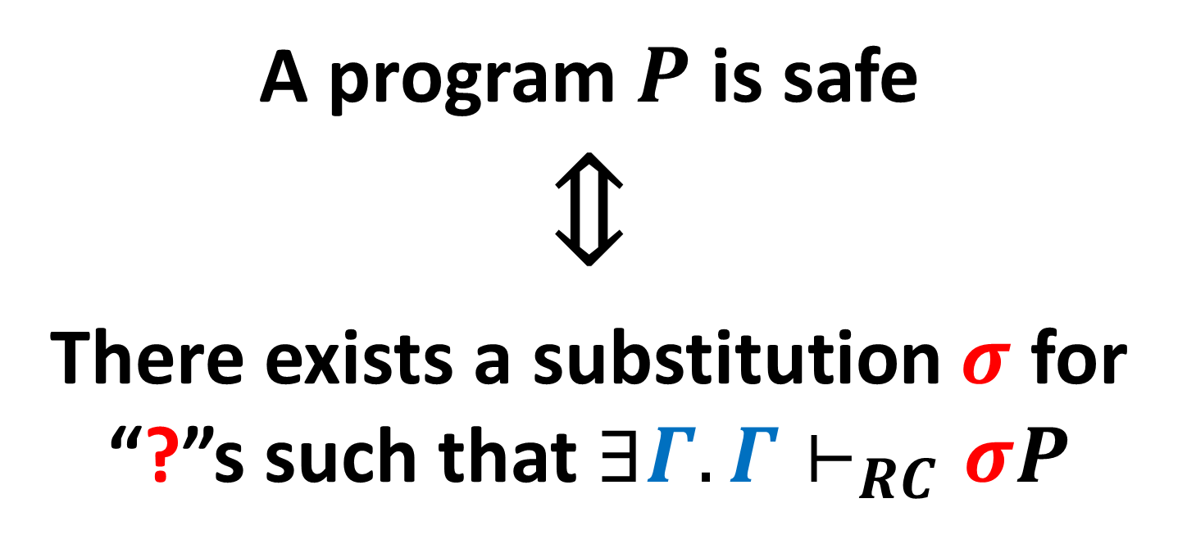
Theorem: Relative Completeness of $⊢_{RC}$
A program $P$ is safe
$$⇕$$
There exists a substitution $σ$ for “?”s such that $∃Γ.Γ⊢_{RC}σP$

Slide 20

Our Contributions
Relatively complete extension $⊢_{RC}$ of
ordinary refinement type system $⊢_{Ref}$
Type inference method for $⊢_{RC}$

Slide 21
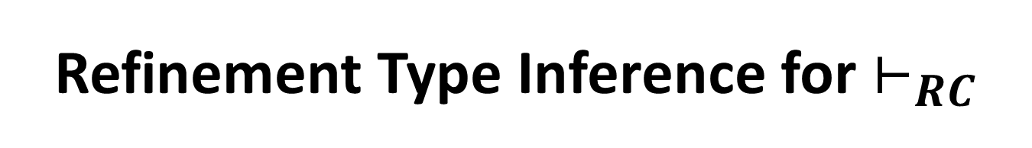
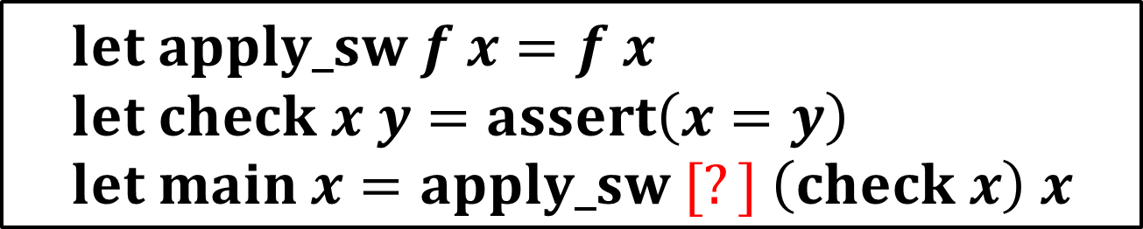
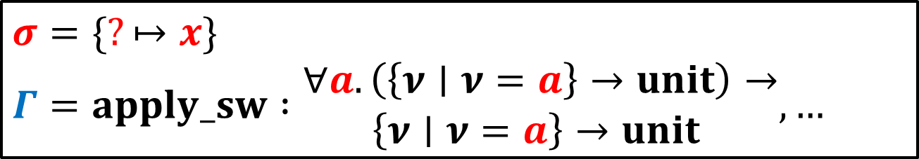

Refinement Type Inference for $⊢_{RC}$
Find a substitution $σ$ for all $?$ as well as
a type environment $Γ$ such that $Γ⊢_{RC}σP$
$$let apply_sw f x=f x \\ let check x y=assert\left(x=y\right) \\ let main x=apply_sw [?] \left(check x\right) x$$
$$σ=\{?↦x\}$$
$$Γ=apply_sw :\begin{matrix}∀a. \left(\left\{ν∣ν=a\right\}→unit\right)→ \\ \left\{ν∣ν=a\right\}→unit \end{matrix},…$$

Slide 22
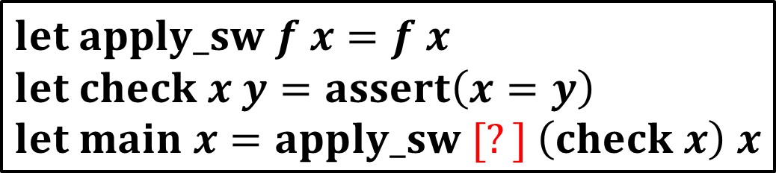
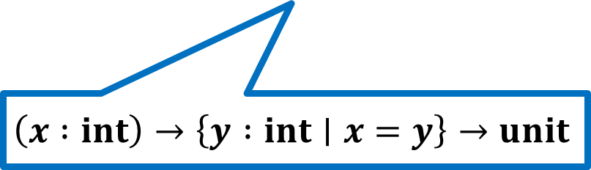
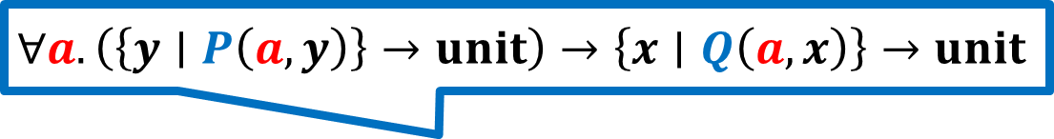
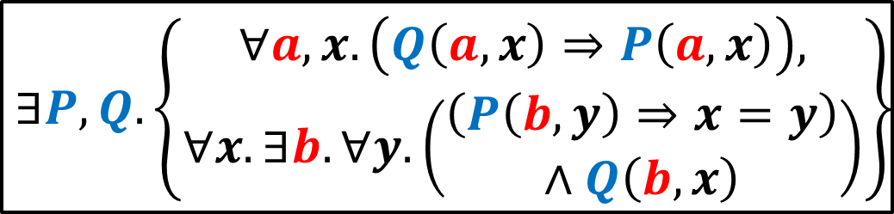

Reduction to $∃$Quantified
Horn Constraint Solving
$$∀a. \left(\left\{y∣P\left(a,y\right)\right\}→unit\right)→\left\{x∣Q\left(a,x\right)\right\}→unit$$
$$let apply_sw f x=f x \\ let check x y=assert\left(x=y\right) \\ let main x=apply_sw [?] \left(check x\right) x$$
$$\left(x :int\right)→\left\{y :int∣x=y\right\}→unit$$
$$∃P,Q.\left\{\begin{matrix}∀a,x.\left(Q\left(a,x\right)⇒P\left(a,x\right)\right), \\ ∀x. ∃b.∀y. \left(\begin{matrix}\left(P\left(b,y\right)⇒x=y\right) \\ ∧Q\left(b,x\right)\end{matrix}\right)\end{matrix}\right\}$$

Slide 23
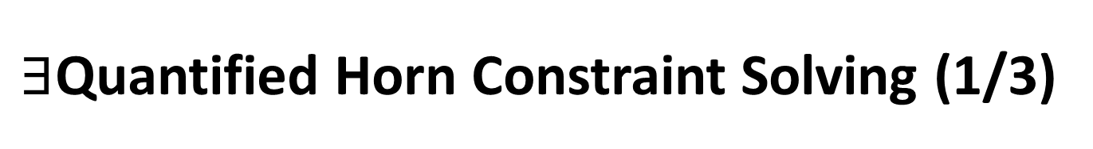

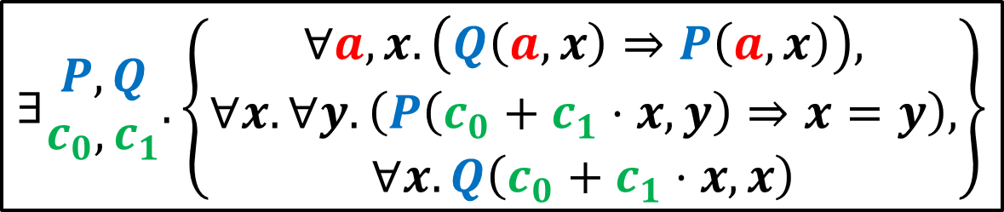
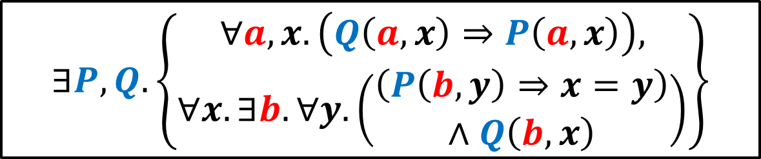



$∃$Quantified Horn Constraint Solving (1/3)
$$∃P,Q. \left\{\begin{matrix}∀a,x.\left(Q\left(a,x\right)⇒P\left(a,x\right)\right), \\ ∀x. ∃b.∀y. \left(\begin{matrix}\left(P\left(b,y\right)⇒x=y\right) \\ ∧Q\left(b,x\right)\end{matrix}\right)\end{matrix}\right\}$$
$$∃\begin{matrix}P,Q \\ c_{0},c_{1}\end{matrix}.\left\{\begin{matrix}∀a,x.\left(Q\left(a,x\right)⇒P\left(a,x\right)\right), \\ \begin{aligned}∀x. ∀y.\left(P\left(c_{0}+c_{1}⋅x,y\right)⇒x=y\right), \\ ∀x.Q\left(c_{0}+c_{1}⋅x,x\right)\end{aligned}\end{matrix}\right\}$$
Skolemize $∃b$
$$∃\begin{matrix}Q \\ c_{0},c_{1}\end{matrix}.\left\{\begin{aligned}∀x. ∀y.\left(Q\left(c_{0}+c_{1}⋅x,y\right)⇒x=y\right), \\ ∀y.Q\left(c_{0}+c_{1}⋅y,y\right)\end{aligned}\right\}$$
Elim. $∃P$
Elim. $∃Q$
$$∃c_{0},c_{1}. ∀x,y.\left(c_{1}⋅x=c_{1}⋅y⇒x=y\right)$$

Slide 24






$∃$Quantified Horn Constraint Solving (2/3)
$$∃c_{0},c_{1}. ∀x,y.\left(c_{1}⋅x=c_{1}⋅y⇒x=y\right)$$
$∀x,y$ to $∃λ_{1},λ_{2}$
$$∃c_{0},c_{1}.∃λ_{1},λ_{2}.\left(λ_{1}−λ_{2}\right){⋅c}_{1}=1$$
Farkas’ lemma: $∀\tilde{x}.\bigwedge_{i}{e_{i}}≥0⇒e≥0$ if
$$∃\tilde{λ}≥0.λ_{0}+Σ_{i}λ_{i}⋅e_{i}≡e$$
SMT Solver
$c_{0}=0,c_{1}=1$, $λ_{1}=2,λ_{2}=1$
$$let apply_sw f x=f x \\ let check x y=assert\left(x=y\right) \\ let main x=apply_sw [c_{0}+c_{1 }⋅x] \left(check x\right) x$$
$$x$$

Slide 25






$∃$Quantified Horn Constraint Solving (3/3)
$$∀a. \left(\left\{y∣P\left(a,y\right)\right\}→unit\right)→\left\{x∣Q\left(a,x\right)\right\}→unit$$
$$∀a. \left(\left\{y∣a=y\right\}→unit\right)→\left\{x∣a=x\right\}→unit$$
$$let apply_sw f x=f x \\ let check x y=assert\left(x=y\right) \\ let main x=apply_sw [x] \left(check x\right) x$$
$$∃P,Q.\left\{\begin{matrix}∀a,x.\left(Q\left(a,x\right)⇒P\left(a,x\right)\right), \\ \begin{aligned}∀x. ∀y.\left(P\left(x,y\right)⇒x=y\right), \\ ∀x.Q\left(x,x\right)\end{aligned}\end{matrix}\right\}$$
Horn Clause
Constraint Solver
$$P\left(a,y\right)≡a=y$$
$$Q\left(a,x\right)≡a=x$$

Slide 26
Refinement Type System as Axiomatic Semantics of H.O. Functional Programs
 | Imperative | H.O. Functional
Axiomatic Semantics of Partial Correctness | Hoare Logic of Partial Correctness | Relatively Complete Refinement Type System [U., Terauchi & Kobayashi POPL’13]
Axiomatic Semantics of Total Correctness | Hoare Logic of Total Correctness | ?
Axiomatic Semantics of Angelic Nondeterminism | Hoare Logic of Angelic Nondet. [Mamouras FoSSaCS’15] | Refinement Type System of Angelic Nondet. [Hashimoto & U. SAS’15]
Predicate Transformer Semantics | Weakest Precondition Generation | Horn Clause Constraint Generation [U. & Kobayashi PPDP’09]

Slide 27


Refinement Type System $⊢_{AN}$ of
Angelic Nondeterminism [Hashimoto & U. SAS’15]
Model nondeterministic behaviors in programs
  user inputs, inputs from communication channels, interrupts, and thread schedulers
Verify branching time properties of programs
  non-termination verification [Kuwahara+ CAV’15]
Proving that a program $P$ does NOT terminate for some inputs

Slide 28

Example: Non-Termination Verification
sum x = if x = 0 then 0 else x + sum (x - 1)
main () = let x = read_int () in sum x; assert false
sum does NOT terminate for some inputs
$$⇕$$
$∃$a winning strategy for the user such that
$$main ( ) {−→}^{∗}assert false$$
$$⇑$$
$$∃Γ.Γ⊢_{AN}\left\{sum…,main…\right\}$$

Slide 29




Typing Rules of $⊢_{AN}$ for Nondeterminism [Hashimoto & U. SAS’15]
Rule for Demonic Nondeterminism:
$$\frac{Γ,x :int⊢_{AN}e :τ x∉FV(τ)}{Γ⊢_{AN}let x=∗_{∀}in e :τ}$$
For some integers $x$, $e$ has $τ$ under $Γ$
Rule for Angelic Nondeterminism:
$$\frac{\begin{aligned}⊨⟦Γ⟧⇒∃x∈ℤ. φ \\ Γ,x :\left\{x :int∣φ\right\}⊢_{AN}e :τ \\ FV\left(φ\right)⊆dom\left(Γ\right)∪\left\{x\right\} x∉FV(τ)\end{aligned}}{Γ⊢_{AN}let x=∗_{∃}in e :τ}$$

Slide 30





Example: Refinement Type Checking
$sum :\left\{x :int∣x<0\right\}→\left\{r :int∣⊥\right\}$,
$$main :unit→unit$$
$$⊢_{AN}$$
sum x = if x = 0 then 0
else x + sum (x - 1)
main () = let x : $\left\{x :int∣x<0\right\}$ = $∗_{∃}$ in sum x;
assert false
$$⊨\begin{aligned}x<0∧x≠0∧⊥ \\ ∧r=x+y\end{aligned}⇒⊥$$
$$⊨x<0∧x=0∧r=0⇒⊥$$
$$⊨\begin{matrix}x<0∧x≠0 \\ ⇒x−1<0\end{matrix}$$
$$⊨∃x.x<0$$

Slide 31




Refinement Type Inference for $⊢_{AN}$
Find a substitution $θ$ for all $∗_{∃}$ as well as
a type environment $Γ$ such that $Γ⊢_{AN}θP$
sum x = if x = 0 then 0 else x + sum (x - 1)
main () = let x : $\left\{x :int∣P\left(x\right)\right\}$ = $∗_{∃}$ in sum x;
assert false
$$θ=\{P\left(x\right)↦x<0\}$$
$$Γ=sum :\left\{x :int ∣ x<0\right\}→\left\{r :int ∣ ⊥\right\},$$
$main :unit→unit$

Slide 32




Reduction to $∃$Quantified
Horn Constraint Solving
sum x = if x = 0 then 0 else x + sum (x - 1)
main () = let x : $\left\{x :int∣P\left(x\right)\right\}$ = $∗_{∃}$ in sum x;
assert false
$$sum :\left(x :\left\{x :int∣Q\left(x\right)\right\}\right)→\left\{r :int∣R\left(x,r\right)\right\}$$
$$main :unit→unit$$
$$\begin{matrix}∃P,Q,R. \\ ∀x,y,r.\end{matrix}\left\{\begin{aligned}\begin{matrix}\begin{aligned}Q\left(x\right)⇒R\left(0,0\right),Q\left(x\right)∧x≠0⇒Q\left(x−1\right), \\ Q\left(x\right)∧x≠0∧R\left(x−1,y\right)⇒R\left(x,x+y\right),\end{aligned} \\ P\left(x\right)⇒Q\left(x\right),\end{matrix} \\ ∃x.P\left(x\right), P\left(x\right)∧R\left(x,r\right)⇒ ⊥\end{aligned}\right\}$$

Slide 33






$∃$Quantified Horn Constraint Solving
$$sum :\left(x :\left\{x :int∣x<0\right\}\right)→\left\{r :int ∣ ⊥\right\}$$
$$sum :\left(x :\left\{x :int∣Q\left(x\right)\right\}\right)→\left\{r :int∣R\left(x,r\right)\right\}$$
sum x = if x = 0 then 0 else x + sum (x - 1)
main () = let x : $\left\{x :int∣x<0\right\}$ = $∗_{∃}$ in sum x;
assert false
sum x = if x = 0 then 0 else x + sum (x - 1)
main () = let x : $\left\{x :int∣P\left(x\right)\right\}$ = $∗_{∃}$ in sum x;
assert false
$$\begin{matrix}∃P,Q,R. \\ ∀x,y,r.\end{matrix}\left\{\begin{aligned}\begin{matrix}\begin{aligned}Q\left(x\right)⇒R\left(0,0\right),Q\left(x\right)∧x≠0⇒Q\left(x−1\right), \\ Q\left(x\right)∧x≠0∧R\left(x−1,y\right)⇒R\left(x,x+y\right),\end{aligned} \\ P\left(x\right)⇒Q\left(x\right),\end{matrix} \\ ∃x.P\left(x\right), P\left(x\right)∧R\left(x,r\right)⇒ ⊥\end{aligned}\right\}$$
$$P\left(x\right)≡x<0$$
$$Q\left(x\right)≡x<0$$
$$R\left(x,r\right)≡ ⊥$$
$∃$Quantified Horn
Constraint Solver

Slide 34
Refinement Type System as Axiomatic Semantics of H.O. Functional Programs
 | Imperative | H.O. Functional
Axiomatic Semantics of Partial Correctness | Hoare Logic of Partial Correctness | Relatively Complete Refinement Type System [U., Terauchi & Kobayashi POPL’13]
Axiomatic Semantics of Total Correctness | Hoare Logic of Total Correctness | Refinement Type System of Total Correctness [U., Hashimoto & Torii ‘15]
Axiomatic Semantics of Angelic Nondeterminism | Hoare Logic of Angelic Nondet. [Mamouras FoSSaCS’15] | Refinement Type System of Angelic Nondet. [Hashimoto & U. SAS’15]
Predicate Transformer Semantics | Weakest Precondition Generation | Horn Clause Constraint Generation [U. & Kobayashi PPDP’09]

Slide 35


Refinement Type System $⊢_{RCT}$ of
Total Correctness [U., Hashimoto & Torii ’15]
Verify the termination in addition to
the partial correctness of programs
sum x = if x = 0 then 0 else x + sum (x – 1)
$$∀n∈ℤ.sum n→^{∗}v$$
$$⇕$$
$$∃Γ.Γ⊢_{RCT}\left\{sum…\right\}$$

Slide 36



Example: Refinement Type Checking
$$sum :\left\{x :int∣x≥0\right\}→int ;$$
$${WF}_{sum}=\left\{\left(x,x′\right)∣x>x^{′}≥0\right\}$$
$$⊢_{RCT}$$
sum x = if x = 0 then 0
else x + sum (x - 1)
$$⊨\begin{matrix}x≥0∧x≠0 \\ ⇒x−1≥0\end{matrix}$$
$$⊨x≥0∧x≠0⇒\left(x,x−1\right)∈{WF}_{sum}$$

Slide 37



Refinement Type Inference for $⊢_{RCT}$
Find a well-founded relation $WF_{f}$ for all recursive function $f$ as well as a type environment $Γ$ such that $Γ;WF⊢_{RCT}P$
sum x = if x = 0 then 0 else x + sum (x - 1)
$${WF}_{sum}=\left\{\left(x,x′\right)∣x>x^{′}≥0\right\}$$
$$Γ=sum :\left\{x :int ∣ x≥0\right\}→int$$

Slide 38


Reduction to $WF$ Constraint
+ Horn Constraint Solving
sum x = if x = 0 then 0 else x + sum (x - 1)
$$sum :\left\{x :int∣P\left(x\right)\right\}→int$$
$$∃WF.∃P. ∀x.\left\{\begin{aligned}P\left(x\right)∧x≠0⇒P\left(x−1\right), \\ P\left(x\right)∧x≠0⇒\left(x,x−1\right)∈WF\end{aligned}\right\}$$

Slide 39





$WF$ Constraint
+ Horn Constraint Solving
[Popeea & Rybalchecnko TACAS’12][Kuwahara+ ESOP’14, …]
$$sum :\left\{x :int∣x≥0\right\}→int$$
$$sum :\left\{x :int∣P\left(x\right)\right\}→int$$
sum x = if x = 0 then 0 else x + sum (x - 1)
$$∃WF.∃P. ∀x.\left\{\begin{aligned}P\left(x\right)∧x≠0⇒P\left(x−1\right), \\ P\left(x\right)∧x≠0⇒\left(x,x−1\right)∈WF\end{aligned}\right\}$$
$$∃f.∃P. ∀x.\left\{\begin{aligned}P\left(x\right)∧x≠0⇒P\left(x−1\right), \\ P\left(x\right)∧x≠0⇒f\left(x\right)>f\left(x−1\right)≥0\end{aligned}\right\}$$
$$f\left(x\right)=x \\ WF=\left\{\left(x,x′\right)∣f\left(x\right)>f\left(x^{′}\right)≥0\right\} \\ P\left(x\right)≡x≥0$$
$∃$Quantified Horn
Constraint Solver

Slide 40

Summary: H.O. Program Verification as Refinement Type Inference
 | Type System | Type Inference
(Incomplete) Partial Correctness | Ordinary Refinement Type System $⊢_{Ref}$ | Horn Clause Constraint Solving
Partial Correctness | Relatively Complete Refinement Type System $⊢_{RC}$ [U., Terauchi & Kobayashi POPL’13] | $∃$Quantified Horn Constraint Solving
Total Correctness | Refinement Type System of Total Correctness $⊢_{RCT}$ [U., Hashimoto&Torii ‘15] | $WF$ Constraint + $∃$Quantified Horn Constraint Solving
Angelic Nondeterminism | Refinement Type System of Angelic Nondet. $⊢_{AG}$ [Hashimoto & U. SAS’15] | $∃$Quantified Horn Constraint Solving

