Slide 1
Automating Relatively Complete Verification of Higher-Order Functional Programs
Hiroshi Unno (University of Tsukuba)
Tachio Terauchi (Nagoya University)
Naoki Kobayashi (University of Tokyo)

Slide 2
Path-Sensitive Verifier for Functional Programs
(cf. SLAM, BLAST, … for Imperative Programs)
Refinement type inference by Horn clause solving
[Unno and Kobayashi 2008, 2009]
Liquid Types [Rondon, Kawaguchi and Jhala 2008, …]
Depcegar [Terauchi 2010]
MoCHi [Sato, Unno and Kobayashi 2011, 2013]
HMC [Jhala, Majumdar and Rybalchenko 2011]
Demo
Program & Spec.
All these verifiers are based on refinement type system
(cf. Hoare logic for first-order
imperative programs)
let rec mc x =
if x > 100 then
x – 10
else
mc (mc (x + 11))
in
let n = randi() in
if n · 101 then
assert (mc n = 91)
Result
Certificate
or
Counterexample
Verifier

Slide 3

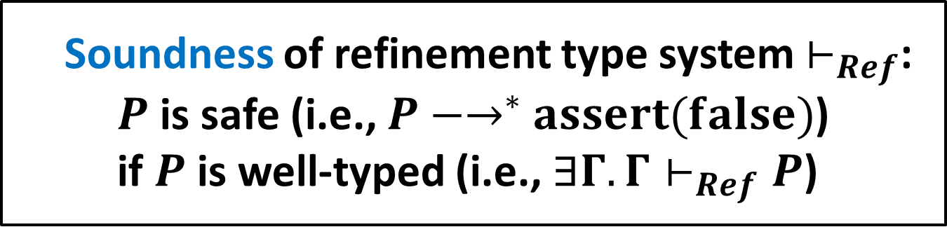
Refinement Types
FOL formulas
for refinement
$\{x:int | x≥0\}$
  Non-negative integers
$x:int→\{r:int | r≥x\}$
  Functions that take an integer $x$ and
  return an integer $r$ not less than $x$
  Soundness of refinement type system $⊢_{Ref}$:
  $P$ is safe (i.e., $P{−→}^{∗}assert(false)$)
  if $P$ is well-typed (i.e., $∃Γ.Γ⊢_{Ref}P$)

Slide 4
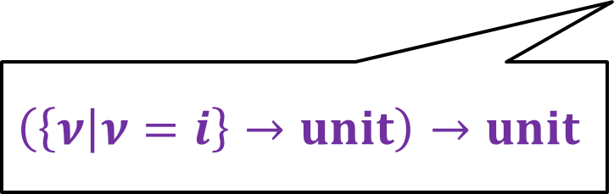
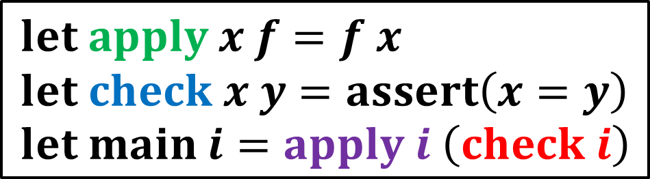
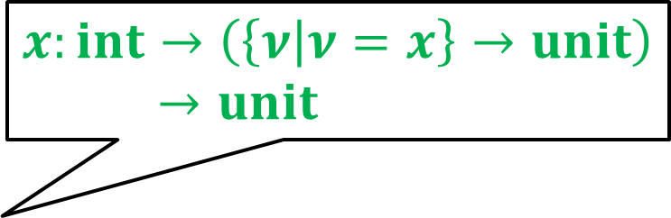
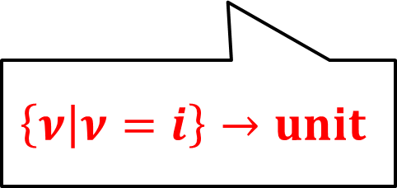
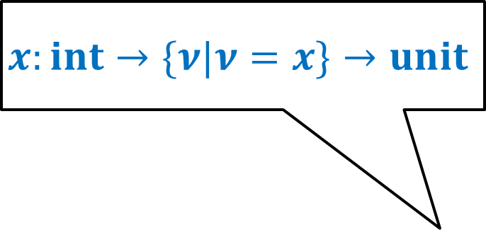

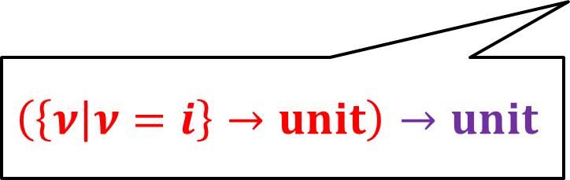
Example: Typing Safe Program under $⊢_{Ref}$
$$x:int→\{ν|ν=x\}→unit$$
$$x:int→\left(\left\{ν | ν=x\right\}→unit\right)→unit$$
$$let apply x f=f x \\ let check x y=assert\left(x=y\right) \\ let main i=apply i \left(check i\right)$$
Well-typed!
$$\left(\left\{ν | ν=i\right\}→unit\right)→unit$$
$$\left\{ν | ν=i\right\}→unit$$
$$\left(\left\{ν | ν=i\right\}→unit\right)→unit$$

Slide 5

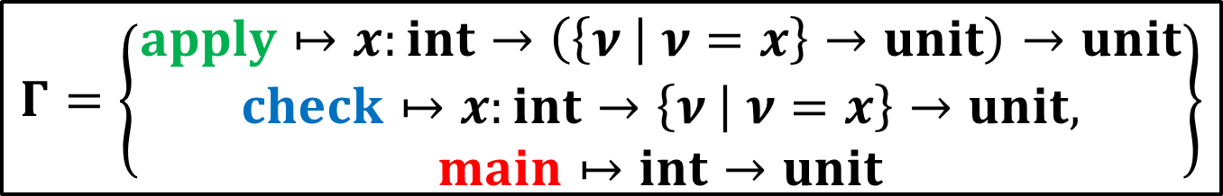
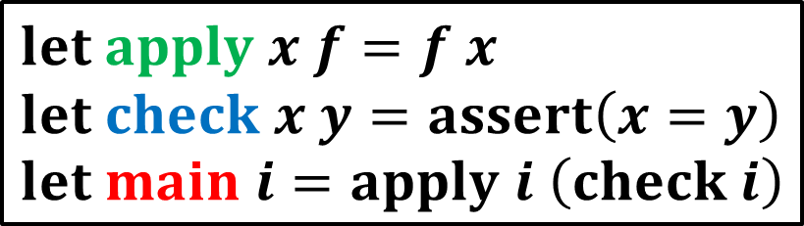
Automated Verification via
Refinement Type Inference
Input a program $P$
Infer a type environment $Γ$ such that $Γ⊢_{Ref}P$
(cf. invariant inference for Hoare logic)
$$let apply x f=f x \\ let check x y=assert\left(x=y\right) \\ let main i=apply i \left(check i\right)$$
$$Γ=\left\{\begin{aligned}apply↦x:int→\left(\left\{ν | ν=x\right\}→unit\right)→unit \\ check↦x:int→\left\{ν | ν=x\right\}→unit, \\ main↦int→unit\end{aligned}\right\}$$

Slide 6

Limitation of Refinement Type System $⊢_{Ref}$
Incompleteness:
There is a safe but untypable program
whereas Hoare logic is relatively complete

Slide 7
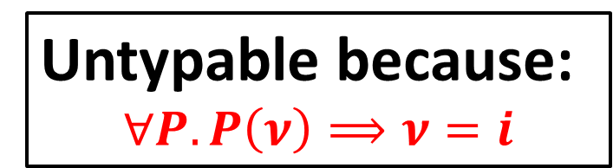
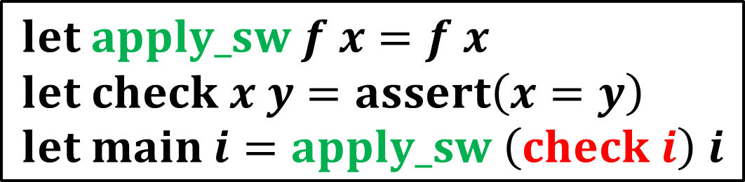
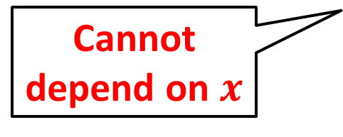
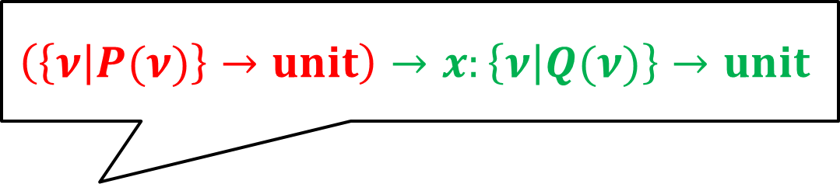
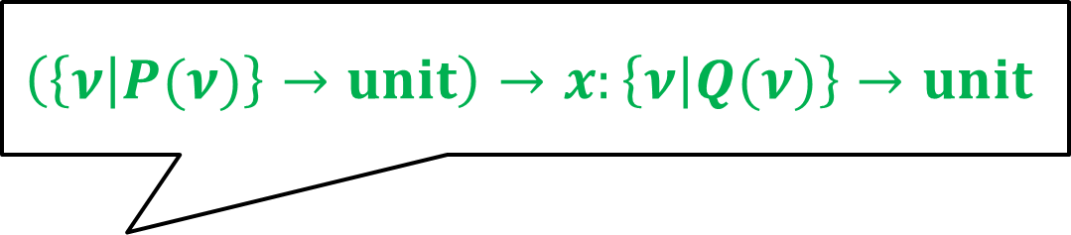
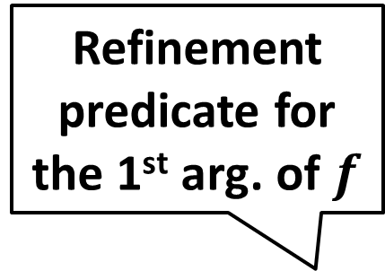
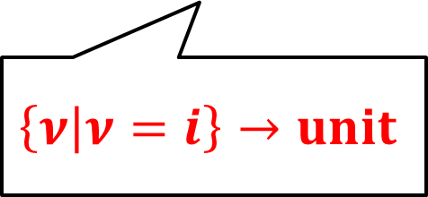
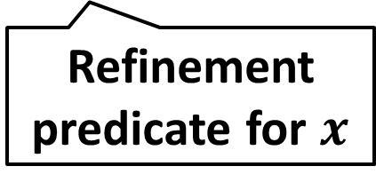
Example: Safe but Untypable Program
Refinement predicate for the 1st arg. of $f$
$$\left(\left\{ν | P(ν)\right\}→unit\right)→x:\left\{ν | Q(ν)\right\}→unit$$
$$\left(\left\{ν | P(ν)\right\}→unit\right)→x:\left\{ν | Q(ν)\right\}→unit$$
Cannot depend on $x$
Refinement predicate for $x$
$$let apply_sw f x=f x \\ let check x y=assert\left(x=y\right) \\ let main i=apply_sw \left(check i\right) i$$
Untypable because:
$$∀P.P\left(ν\right)⟹ν=i$$
$$\left\{ν | ν=i\right\}→unit$$

Slide 8

Our Contributions
Relatively complete extension $⊢_{RC}$ of
ordinary refinement type system $⊢_{Ref}$
Type inference method for $⊢_{RC}$

Slide 9
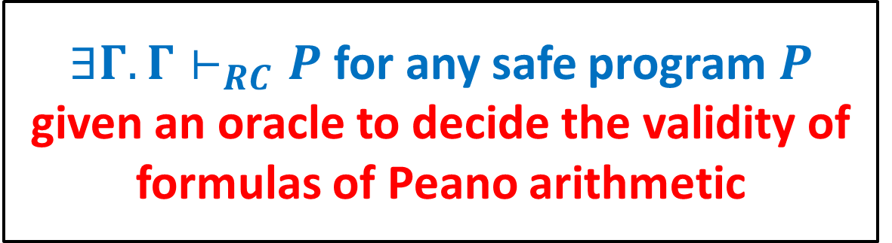

Our Contributions
Relatively complete extension $⊢_{RC}$ of
ordinary refinement type system $⊢_{Ref}$
Type inference method for $⊢_{RC}$
$∃Γ.Γ⊢_{RC}P$ for any safe program$P$
given an oracle to decide the validity of formulas of Peano arithmetic

Slide 10

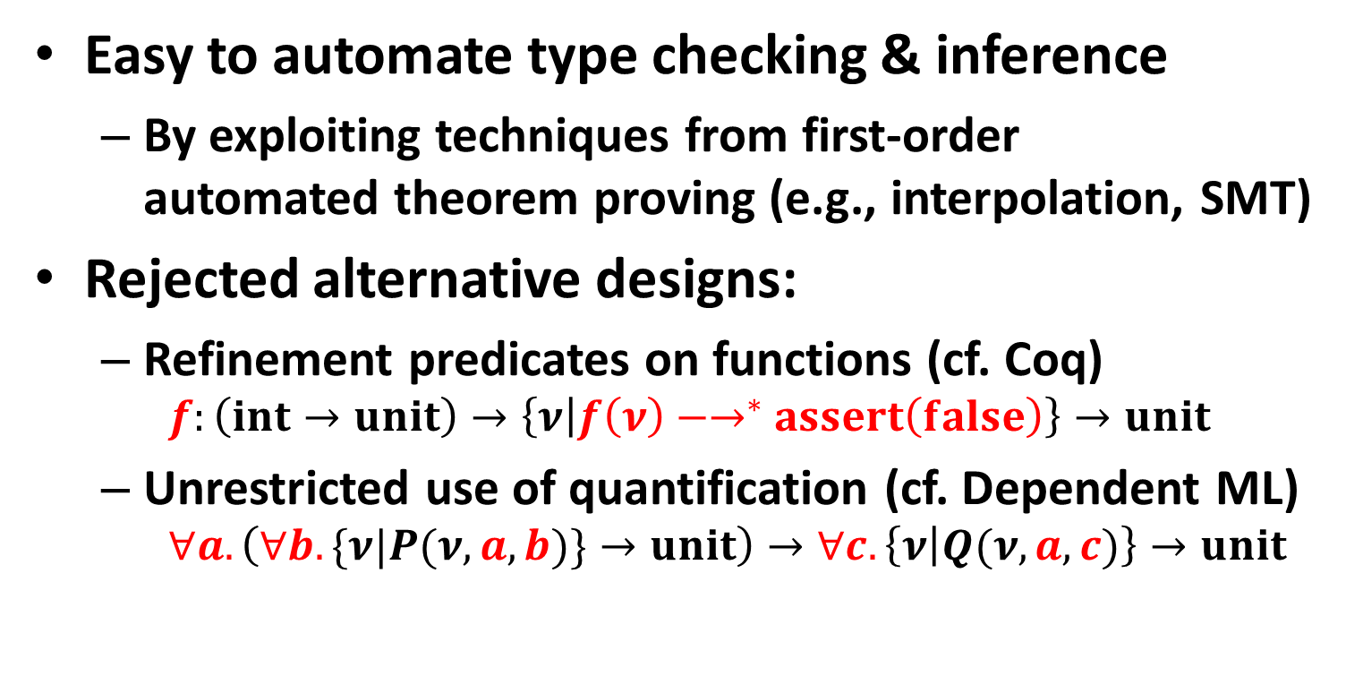
Our Design Goal of $⊢_{RC}$
Easy to automate type checking & inference
  By exploiting techniques from first-order
  automated theorem proving (e.g., interpolation, SMT)
Rejected alternative designs:
  Refinement predicates on functions (cf. Coq)
    $$f:\left(int→unit\right)→\left\{ν | f\left(ν\right){−→}^{∗}assert\left(false\right)\right\}→unit$$
  Unrestricted use of quantification (cf. Dependent ML)
    $$∀a. \left(∀b.\{ν|P(ν,a,b)\}→unit\right)→∀c.\left\{ν | Q(ν,a,c)\right\}→unit$$

Slide 11
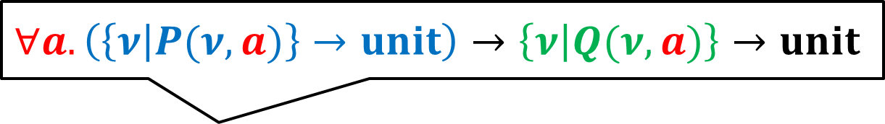
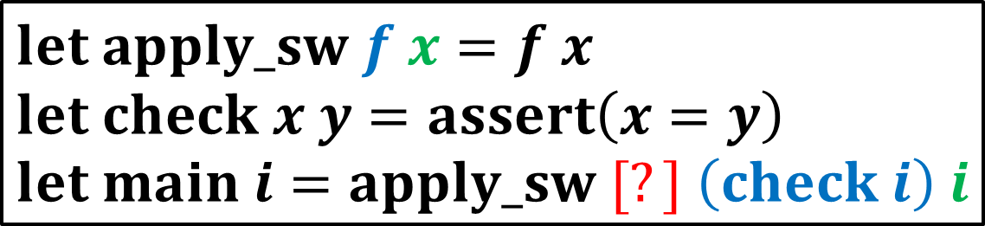
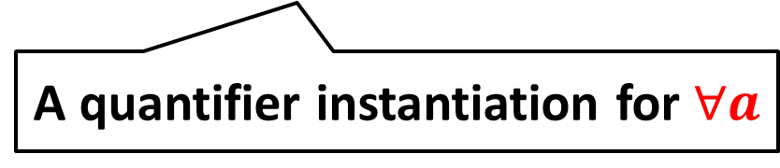
Our Approach: Restricted
Use of Quantification
Add one universal quantifier over integer
just before each function parameter
[Goerdt 1985, German, Clarke, and Halpern 1983, 1989]
$$∀a.\left(\left\{ν | P(ν,a)\right\}→unit\right)→\left\{ν | Q(ν, a)\right\}→unit$$
$$let apply_sw f x=f x \\ let check x y=assert\left(x=y\right) \\ let main i=apply_sw [?] \left(check i\right) i$$
A quantifier instantiation for $∀a$

Slide 12

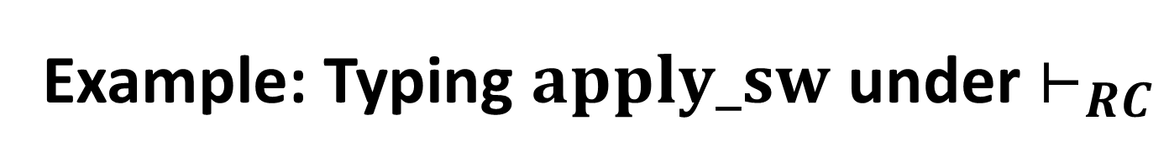

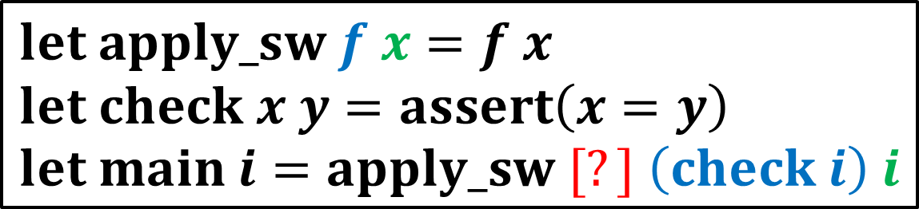

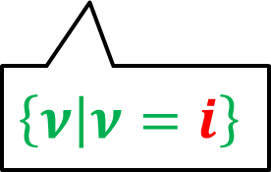
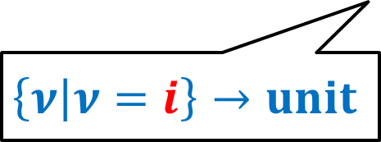

Example: Typing $apply_sw$ under $⊢_{RC}$
$$∀a.\left(\left\{ν | P(ν,a)\right\}→unit\right)→\left\{ν | Q(ν, a)\right\}→unit$$
$$\{ν|ν=a\}$$
$$\left\{ν | ν=a\right\}$$
$$let apply_sw f x=f x \\ let check x y=assert\left(x=y\right) \\ let main i=apply_sw [?] \left(check i\right) i$$
$$[i]$$
Well-typed!
$$\left\{ν | ν=i\right\}→unit$$
$$\left\{ν | ν=i\right\}$$

Slide 13
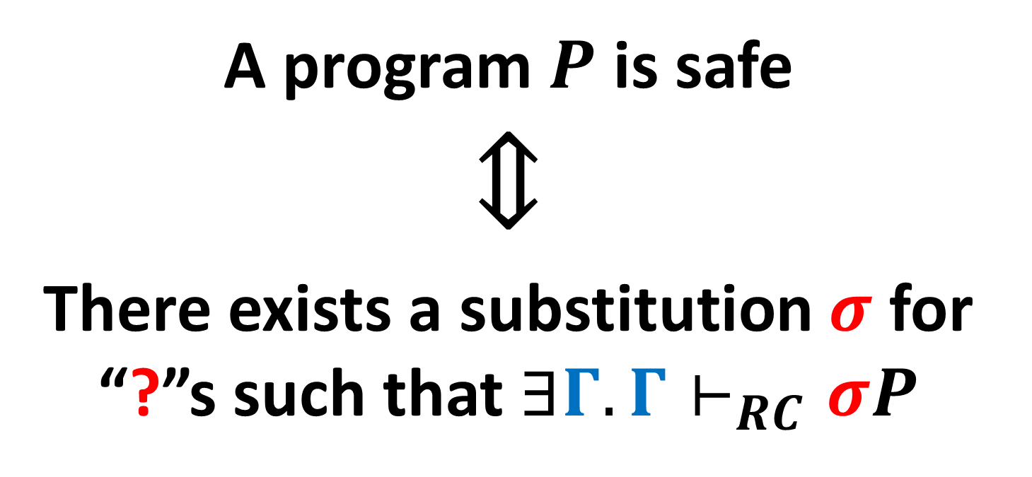

Theorem: Relative Completeness of $⊢_{RC}$
A program $P$ is safe
$$⇕$$
There exists a substitution $σ$ for “?”s such that $∃Γ.Γ⊢_{RC}σP$

Slide 14
Our Contributions
Relatively complete extension $⊢_{RC}$ of
ordinary refinement type system $⊢_{Ref}$
Type inference method for $⊢_{RC}$

Slide 15

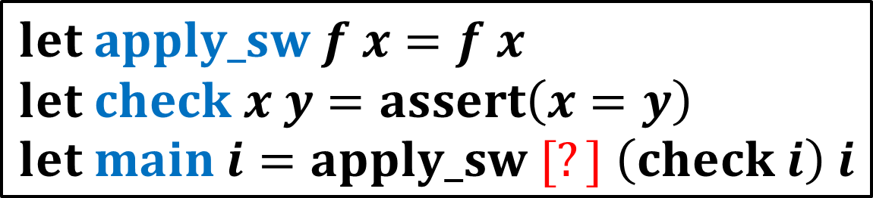
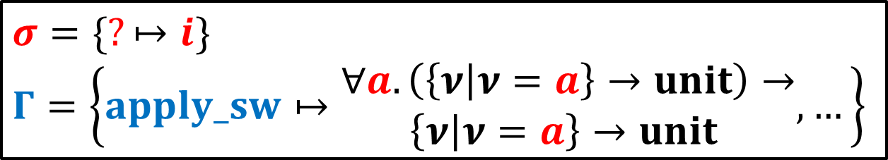

Type Inference for $⊢_{RC}$
Find a substitution $σ$as well as
a type environment $Γ$ such that $Γ⊢_{RC}σP$
$$let apply_sw f x=f x \\ let check x y=assert\left(x=y\right) \\ let main i=apply_sw [?] \left(check i\right) i$$
$$σ=\{?↦i\}$$
$$Γ=\left\{apply_sw↦\begin{matrix}∀a. \left(\left\{ν | ν=a\right\}→unit\right)→ \\ \left\{ν | ν=a\right\}→unit \end{matrix},…\right\}$$

Slide 16
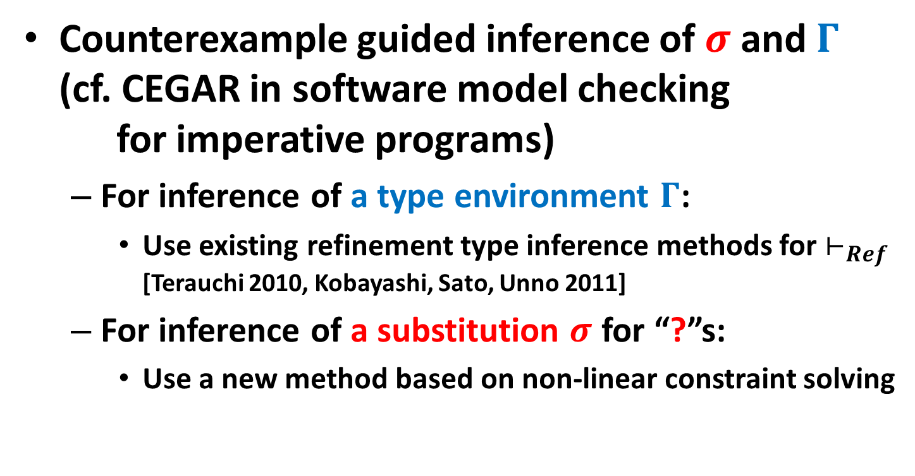
Our Approach
Counterexample guided inference of $σ$ and $Γ$
(cf. CEGAR in software model checking
for imperative programs)
  For inference of a type environment $Γ$:
    Use existing refinement type inference methods for $⊢_{Ref}$
    [Terauchi 2010, Kobayashi, Sato, Unno 2011]
  For inference of a substitution $σ$ for “?”s:
    Use a new method based on non-linear constraint solving

Slide 17
Our Approach
Counterexample guided inference of $σ$ and $Γ$
(cf. CEGAR in software model checking
for imperative programs)
  For inference of a type environment $Γ$:
    Use existing refinement type inference methods for $⊢_{Ref}$
    [Terauchi 2010, Kobayashi, Sato, Unno 2011]
  For inference of a substitution $σ$ for “?”s:
    Use a new method based on non-linear constraint solving

Slide 18

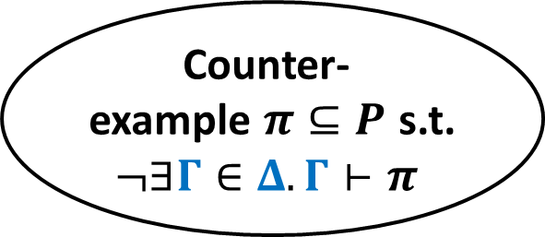
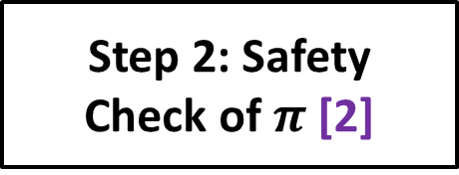






Counterexample Guided
Refinement Type Inference
safe
$$∃Γ∈Δ. Γ⊢P$$
Input Program $P$
Step 1: Fixed-Point
Type Inference [1,2]
$$¬∃Γ∈Δ. Γ⊢P$$
Candidate
Type Envs. $Δ$
New Candidate
Type Envs. $Δ$
s.t. $Γ∈Δ$
Counter-
example $π⊆P$ s.t. $¬∃Γ∈Δ. Γ⊢π$
unknown
$$¬∃Γ.Γ⊢π$$
$$∃Γ.Γ⊢π$$
Step 3: Refinement [1,2]
Step 2: Safety
Check of $π$ [2]
yes
[1] Terauchi POPL 2010 [2] Kobayashi, Sato, Unno PLDI 2011
no
unsafe

Slide 19
Our Approach
Counterexample guided inference of $σ$ and $Γ$
(cf. CEGAR in software model checking
for imperative programs)
  For inference of a type environment $Γ$:
    Use existing refinement type inference methods for $⊢_{Ref}$
    [Terauchi 2010, Kobayashi, Sato, Unno 2011]
  For inference of a substitution $σ$ for “?”s:
    Use a new method based on non-linear constraint solving

Slide 20








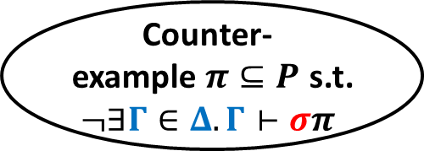


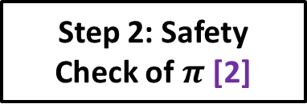

Counterexample Guided
Substitution $σ$ Inference
safe
$$∃Γ∈Δ. Γ⊢σP$$
Input Program $P$
Instantiated Program $σP$
Step 1: Fixed-Point
Type Inference [1,2]
$$¬∃Γ∈Δ. Γ⊢σP$$
New Candidate Substitution $σ$
s.t. $∃Γ.Γ⊢σπ$
Candidate Substitution $σ$
New Candidate
Type Envs. $Δ$
s.t. $Γ∈Δ$
Candidate
Type Envs. $Δ$
Counter-
example $π⊆P$ s.t. $¬∃Γ∈Δ. Γ⊢σπ$
$$¬∃Γ.Γ⊢σπ$$
$$∃Γ.Γ⊢σπ$$
Step 3: Refinement [1,2]
Step 2: Safety
Check of $π$ [2]
yes
no
[1] Terauchi POPL 2010 [2] Kobayashi, Sato, Unno PLDI 2011
unsafe

Slide 21
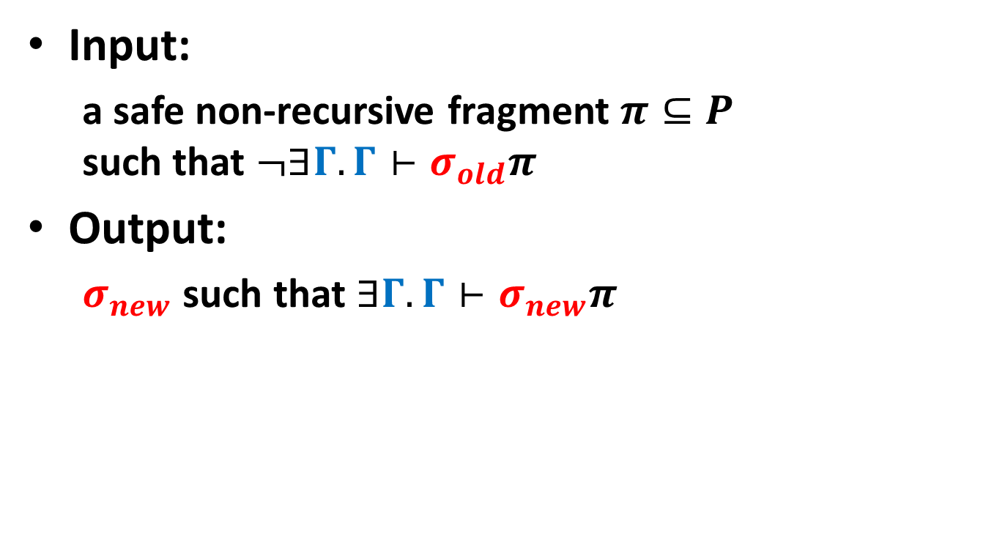

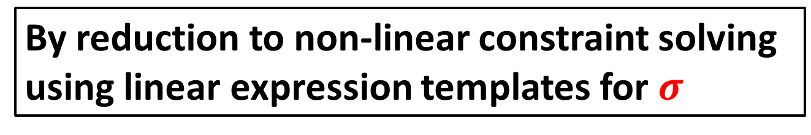
Finding New Candidate Substitution $σ$
Input:
  a safe non-recursive fragment $π⊆P$
  such that $¬∃Γ.Γ⊢σ_{old}π$
Output:
  $σ_{new}$ such that $∃Γ.Γ⊢σ_{new}π$
By reduction to non-linear constraint solving using linear expression templates for $σ$

Slide 22
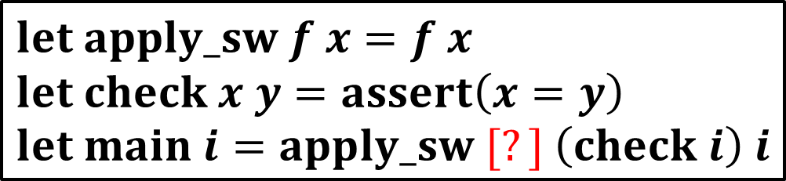
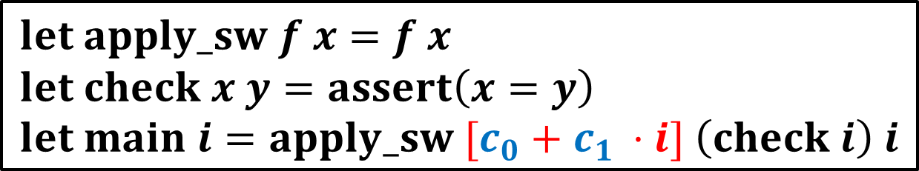
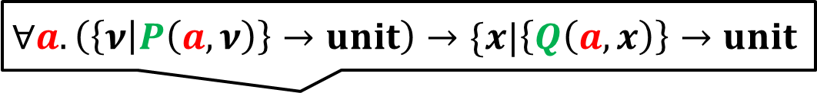
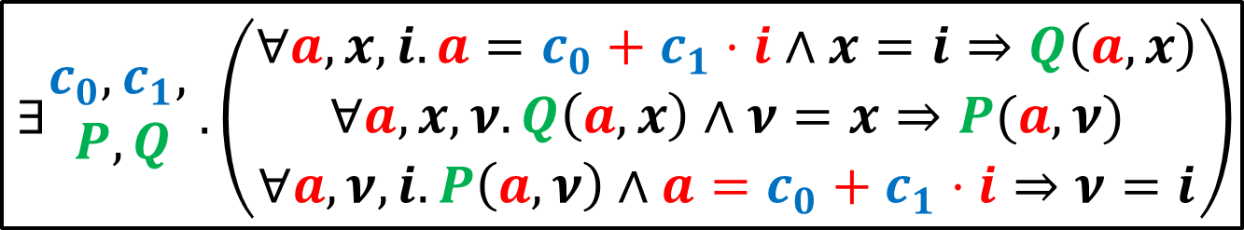
Example: Reduction to Non-Linear Constraint Solving
$$∀a. \left(\left\{ν | P\left(a,ν\right)\right\}→unit\right)→\{x|\left\{Q\left(a,x\right)\right\}→unit$$
$$let apply_sw f x=f x \\ let check x y=assert\left(x=y\right) \\ let main i=apply_sw [?] \left(check i\right) i$$
$$let apply_sw f x=f x \\ let check x y=assert\left(x=y\right) \\ let main i=apply_sw [c_{0}+c_{1 }⋅i] \left(check i\right) i$$
$$∃\begin{matrix}c_{0},c_{1}, \\ P,Q\end{matrix}.\left(\begin{aligned}∀a,x,i.a=c_{0}+c_{1}⋅i∧x=i⇒Q\left(a,x\right) \\ ∀a,x,ν.Q\left(a,x\right)∧ν=x⇒P(a,ν) \\ ∀a,ν,i.P\left(a,ν\right)∧a=c_{0}+c_{1}⋅i⇒ν=i\end{aligned}\right)$$

Slide 23
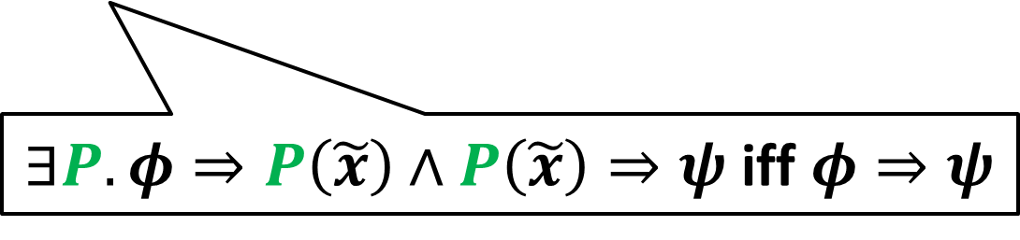

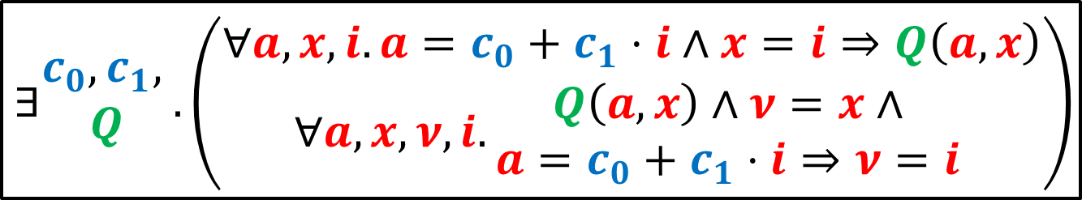


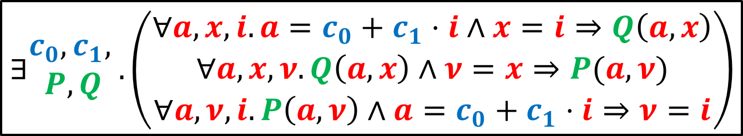
Example: Non-linear
Constraint Solving (1/2)
$$∃\begin{matrix}c_{0},c_{1}, \\ P,Q\end{matrix}.\left(\begin{aligned}∀a,x,i.a=c_{0}+c_{1}⋅i∧x=i⇒Q\left(a,x\right) \\ ∀a,x,ν.Q\left(a,x\right)∧ν=x⇒P(a,ν) \\ ∀a,ν,i.P\left(a,ν\right)∧a=c_{0}+c_{1}⋅i⇒ν=i\end{aligned}\right)$$
$$∃\begin{matrix}c_{0},c_{1}, \\ Q\end{matrix}.\left(\begin{matrix}∀a,x,i.a=c_{0}+c_{1}⋅i∧x=i⇒Q\left(a,x\right) \\ ∀a,x,ν,i.\begin{matrix}Q\left(a,x\right)∧ν=x∧ \\ a=c_{0}+c_{1}⋅i⇒ν=i\end{matrix} \end{matrix}\right)$$
Elim.$∃P$
$∃P. φ⇒P\left(\tilde{x}\right)∧P\left(\tilde{x}\right)⇒ψ$ iff $φ⇒ψ$
$$∃c_{0},c_{1}. ∀a,i,j.\begin{matrix}a=c_{0}+c_{1}⋅i∧ \\ a=c_{0}+c_{1}⋅j⇒i=j\end{matrix}$$
Elim.$∃Q$

Slide 24
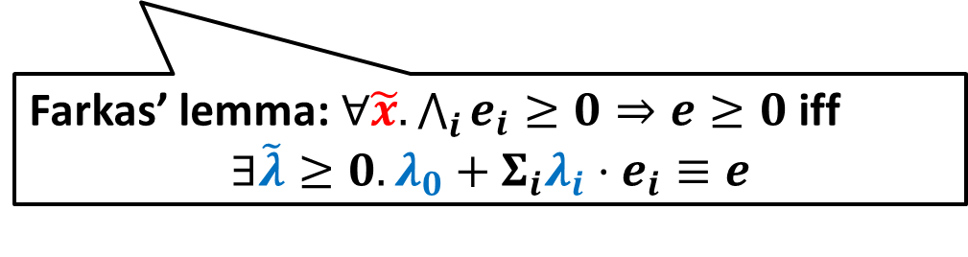





Example: Non-linear
Constraint Solving (2/2)
$$∃c_{0},c_{1}. ∀a,i,j.a=c_{0}+c_{1}⋅i∧a=c_{0}+c_{1}⋅j⇒i=j$$
$$∃c_{0},c_{1}.∃λ_{1},λ_{2}.\begin{matrix}λ_{1}+λ_{2}=0∧ \\ c_{1}⋅λ_{1}=1∧c_{1}⋅λ_{2}=−1\end{matrix}$$
$∀a,i,j$ to $∃λ_{1},λ_{2}$
Farkas’ lemma: $∀\tilde{x}.\bigwedge_{i}{e_{i}}≥0⇒e≥0$ iff
$$∃\tilde{λ}≥0.λ_{0}+Σ_{i}λ_{i}⋅e_{i}≡e$$
Bit-vector modeling & SMT [Gulwani, Srivastava, Venkatesan 2008]
$$c_{0}=0,c_{1}=1$$
$$let apply_sw f x=f x \\ let check x y=assert\left(x=y\right) \\ let main i=apply_sw [c_{0}+c_{1 }⋅i] \left(check i\right) i$$
$$i$$

Slide 25

Implementation
Extended MoCHi [Sato, Unno and Kobayashi 2011, 2013]
with the type inference method for $⊢_{RC}$
Program & Spec.
let rec mc x =
if x > 100 then
x – 10
else
mc (mc (x + 11))
in
let n = randi() in
if n · 101 then
assert (mc n = 91)
Result
Certificate
or
Counterexample
MoCHi

Slide 26

Conclusion
Relatively complete refinement type system $⊢_{RC}$
  Restricted use of quantification
    Add one universal quantifier over integer
    just before each function parameter
Type inference method for $⊢_{RC}$
  Counterexample guided inference of $σ$ and $Γ$
    $Γ$ inference by application of existing refinement type inference methods [Terauchi 2010, Kobayashi, Sato, Unno 2011]
    $σ$Inference by reduction to non-linear constraint solving

