Slide 1
Relatively Complete Refinement Type System for Verification of Higher-Order Non-deterministic Programs
Hiroshi Unno (University of Tsukuba)
Yuki Satake (University of Tsukuba)
Tachio Terauchi (Waseda University)

Slide 2
Background
Recent advances in (semi-)automated methods for verifying higher-order functional programs
  safety [Rondon+ ’08; U. & Kobayashi ’08,’09; Terauchi ’10;
  Ong & Ramsay ’11; Jhala+ ’11; Kobayashi+ ’11; U.+ ’13; …]
  termination [Sereni & Jones ’05; Giesl+ ’11; Kuwahara+ ’14; Vazou+ ’14]
  non-termination [Kuwahara+ ’15; Hashimoto & U. ’15]
  temporal properties [Koskinen & Terauchi ’14; Murase+ ’16]
Different techniques are used to verify
the different classes of properties, and are
hard to combine in a unified framework
  dependent refinement types,
  predicate abstraction for higher-order model checking,
  program transformation for (binary) reachability analysis,…

Slide 3
Our Contributions
Novel dependent refinement type system that can:
  uniformly express and verify universal and existential branching properties of call-by-value, higher-order,
  and non-deterministic programs:
    (cond.) safety, non-safety, termination, and non-termination
  seamlessly combine universal and existential reasoning
    e.g., Prove non-safety via termination
    e.g., Prove non-termination via safety
    e.g., Prove termination and non-termination simultaneously
Meta-theoretic properties of the type system:
  Closure of types under complement
  Soundness
  Relative completeness

Slide 4
Our Contributions
Novel dependent refinement type system that can:
  uniformly express and verify universal and existential branching properties of call-by-value, higher-order,
  and non-deterministic programs:
    (cond.) safety, non-safety, termination, and non-termination
  seamlessly combine universal and existential reasoning
    e.g., Prove non-safety via termination
    e.g., Prove non-termination via safety
    e.g., Prove termination and non-termination simultaneously
Meta-theoretic properties of the type system:
  Closure of types under complement
  Soundness
  Relative completeness

Slide 5


Dependent Refinement Types $τ$
predicates on
program values
$\left\{x :int | x≥0\right\}$
  Non-negative integers
$\left(x :int\right)→\{r :int | r≥x\}$
  Functions that take an integer $x$ and
  (if terminated) return $r$ not less than $x$
A type system ensures that a type-checked expression behaves according to the type
Only universal branching properties
can be expressed

Slide 6
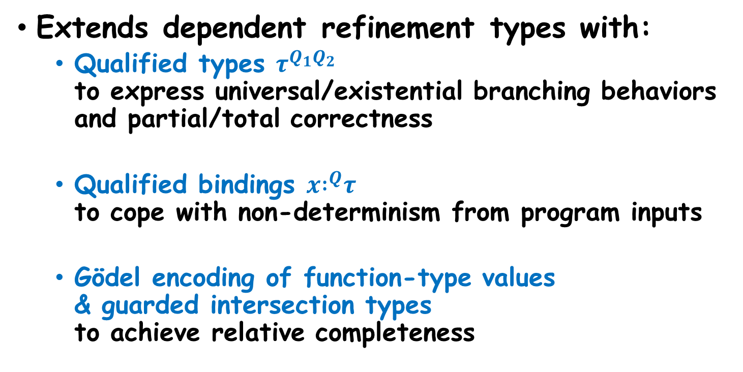
Overview: Our Type System
Extends dependent refinement types with:
  Qualified types $τ^{Q_{1}Q_{2}}$
  to express universal/existential branching behaviors and partial/total correctness
  Qualified bindings $x{ :}^{Q}τ$
  to cope with non-determinism from program inputs
  Gödel encoding of function-type values
  & guarded intersection types
  to achieve relative completeness

Slide 7
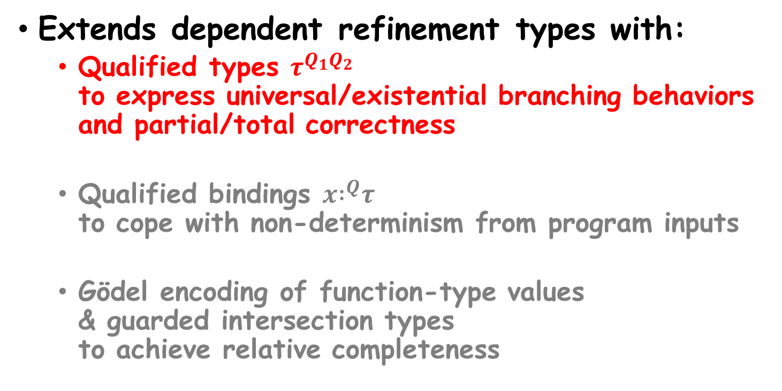
Overview: Our Type System
Extends dependent refinement types with:
  Qualified types $τ^{Q_{1}Q_{2}}$
  to express universal/existential branching behaviors and partial/total correctness
  Qualified bindings $x{ :}^{Q}τ$
  to cope with non-determinism from program inputs
  Gödel encoding of function-type values
  & guarded intersection types
  to achieve relative completeness

Slide 8

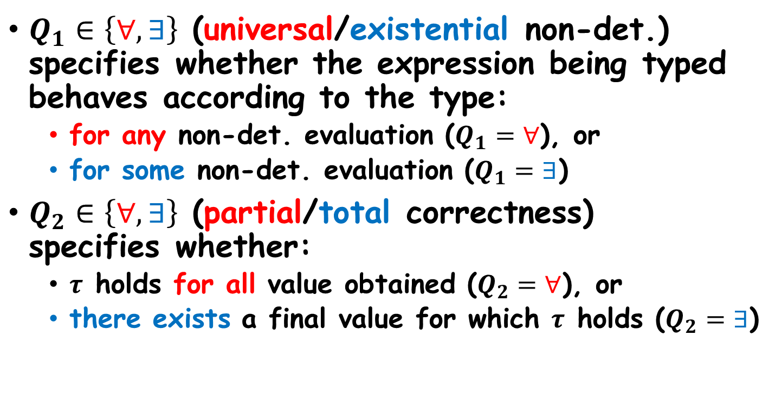
Qualified Types $τ^{Q_{1}Q_{2}}$
$Q_{1}∈\left\{∀,∃\right\}$ (universal/existential non-det.) specifies whether the expression being typed behaves according to the type:
  for any non-det. evaluation ($Q_{1}=∀$), or
  for some non-det. evaluation ($Q_{1}=∃$)
$Q_{2}∈\left\{∀,∃\right\}$ (partial/total correctness)
specifies whether:
  $τ$ holds for all value obtained ($Q_{2}=∀$), or
  there exists a final value for which $τ$ holds ($Q_{2}=∃$)

Slide 9
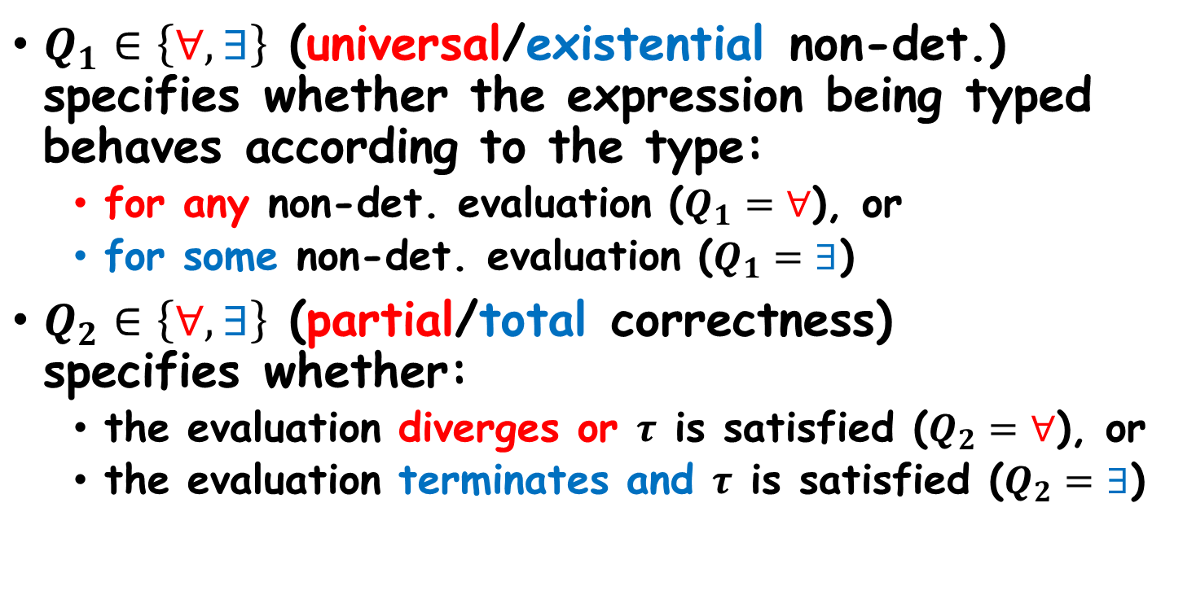
Qualified Types $τ^{Q_{1}Q_{2}}$
$Q_{1}∈\left\{∀,∃\right\}$ (universal/existential non-det.) specifies whether the expression being typed behaves according to the type:
  for any non-det. evaluation ($Q_{1}=∀$), or
  for some non-det. evaluation ($Q_{1}=∃$)
$Q_{2}∈\left\{∀,∃\right\}$ (partial/total correctness)
specifies whether:
  the evaluation diverges or $τ$ is satisfied ($Q_{2}=∀$), or
  the evaluation terminates and $τ$ is satisfied ($Q_{2}=∃$)

Slide 10
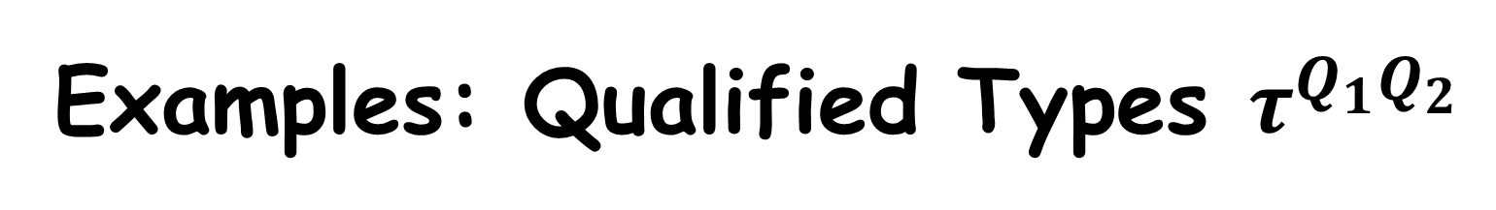
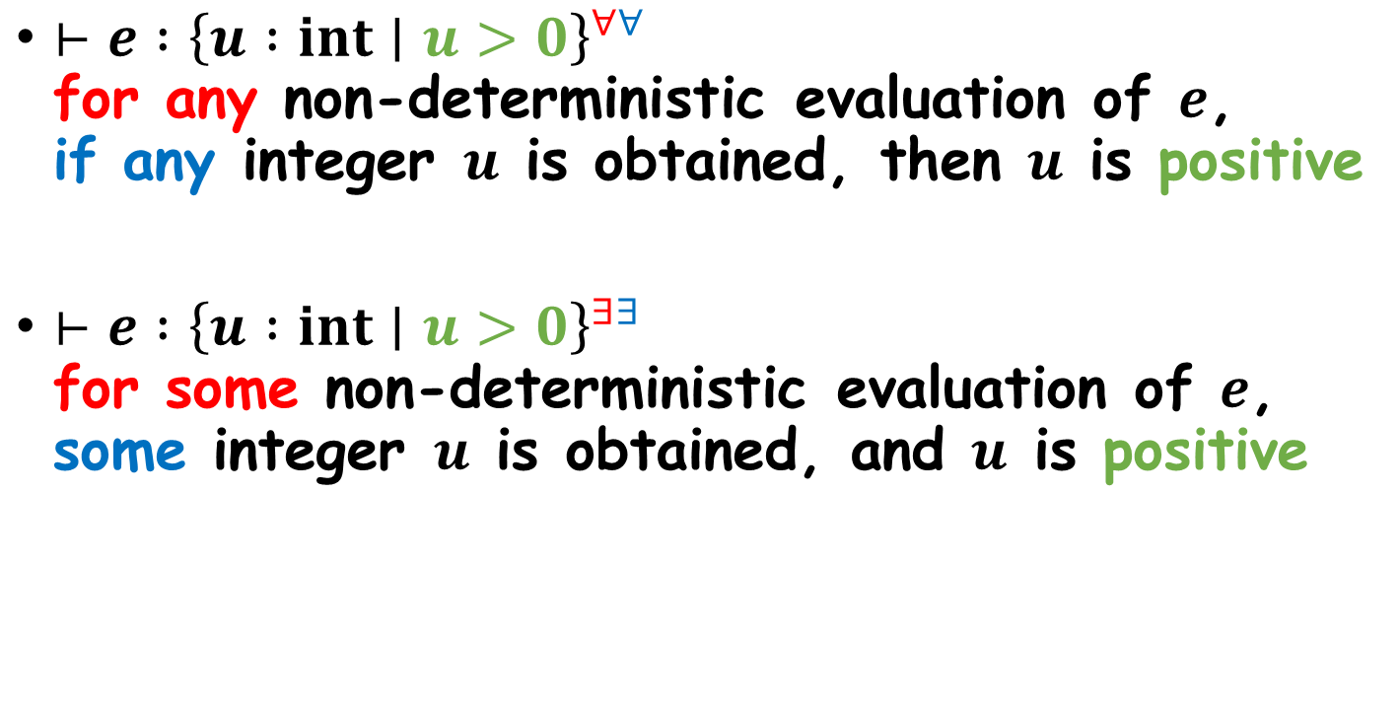
Examples: Qualified Types $τ^{Q_{1}Q_{2}}$
$⊢e :{\left\{u :int∣u>0\right\}}^{∀∀}$
for any non-deterministic evaluation of $e$,
if any integer $u$ is obtained, then $u$ is positive
$⊢e :{\left\{u :int∣u>0\right\}}^{∃∃}$
for some non-deterministic evaluation of $e$,
some integer $u$ is obtained, and $u$ is positive

Slide 11
Typing Integer Constants
Integer constant
Rule:
$$Δ⊢n :{\left\{x :int∣x=n\right\}}^{∀∃}$$
Type environment
Universal
and Total

Slide 12









Converting Qualified Types
Subtyping Rule:
$$\frac{\begin{matrix}Δ⊢τ_{1}< :τ_{2} & Q_{1}Q_{1}^{′}⊑Q_{2}Q_{2}^{′}\end{matrix}}{Δ⊢τ_{1}^{Q_{1}Q_{1}^{′}}< :τ_{2}^{Q_{2}Q_{2}^{′}}}$$
Universal
and Partial
$$∀∀$$
$$⊑$$
$$⊑$$
$$∀∃$$
$$∃∀$$
$$⊑$$
$$⊑$$
$$∃∃$$
Universal
and Total
Existential
and Partial
Existential
and Total

Slide 13
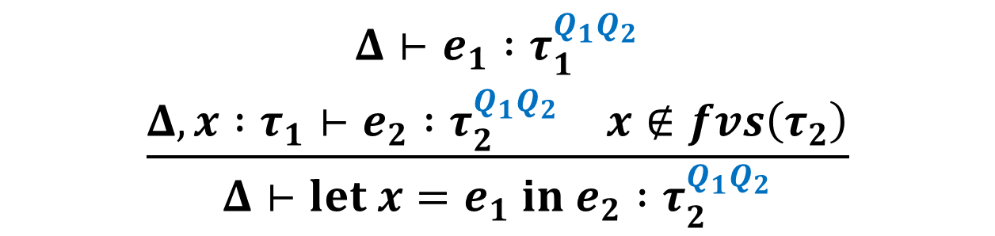
Typing Let-Bindings
Rule:
$$\frac{\begin{aligned}Δ⊢e_{1} :τ_{1}^{Q_{1}Q_{2}} \\ \begin{matrix}Δ,x :τ_{1}⊢e_{2} :τ_{2}^{Q_{1}Q_{2}} & x∉fvs\left(τ_{2}\right)\end{matrix}\end{aligned}}{Δ⊢let x=e_{1} in e_{2} :τ_{2}^{Q_{1}Q_{2}}}$$

Slide 14
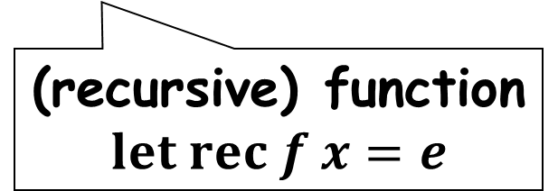
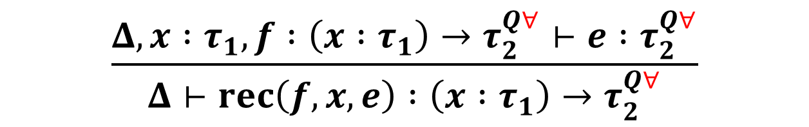
Typing Recursive Functions for Partial Correctness
Rule:
$$\frac{Δ,x :τ_{1},f :\left(x :τ_{1}\right)→τ_{2}^{Q∀}⊢e :τ_{2}^{Q∀}}{Δ⊢rec\left(f,x,e\right) :\left(x :τ_{1}\right)→τ_{2}^{Q∀}}$$
(recursive) function
$$let rec f x=e$$

Slide 15
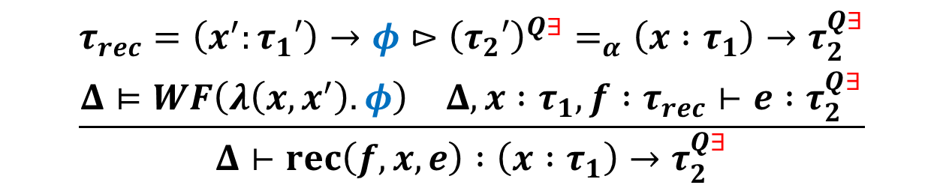
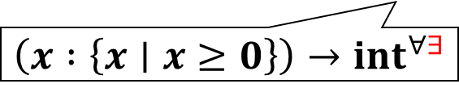
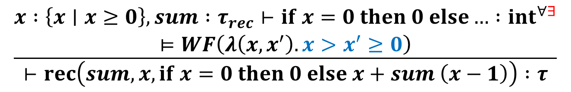

Typing Recursive Functions for Total Correctness (cf. [Xi ’01])
Well-founded relation witnessing the termination of $f$, as a recursion guard
Rule:
$$\frac{\begin{matrix}τ_{rec}=\left(x^{′}:τ_{1}′\right)→{φ⊳\left(τ_{2}′\right)}^{Q∃}=_{α}\left(x :τ_{1}\right)→τ_{2}^{Q∃} \\ \begin{matrix}Δ⊨WF\left(λ\left(x,x^{′}\right).φ\right) & Δ,x :τ_{1},f :τ_{rec}⊢e :τ_{2}^{Q∃}\end{matrix}\end{matrix}}{Δ⊢rec\left(f,x,e\right) :\left(x :τ_{1}\right)→τ_{2}^{Q∃}}$$
Example:
$$\left(x′ :\left\{x′∣x′≥0\right\}\right)→{x>x^{′}≥0⊳\left\{y′∣y′≥x′\right\}}^{∀∃}$$
$$\frac{\begin{matrix}x :\left\{x∣x≥0\right\},sum :τ_{rec}⊢if x=0 then 0 else… :{int}^{∀∃} \\ ⊨WF\left(λ\left(x,x^{′}\right).x>x^{′}≥0\right)\end{matrix}}{⊢rec\left(sum,x,if x=0 then 0 else x+sum \left(x−1\right)\right) :τ}$$
$$\left(x :\left\{x∣x≥0\right\}\right)→{int}^{∀∃}$$

Slide 16
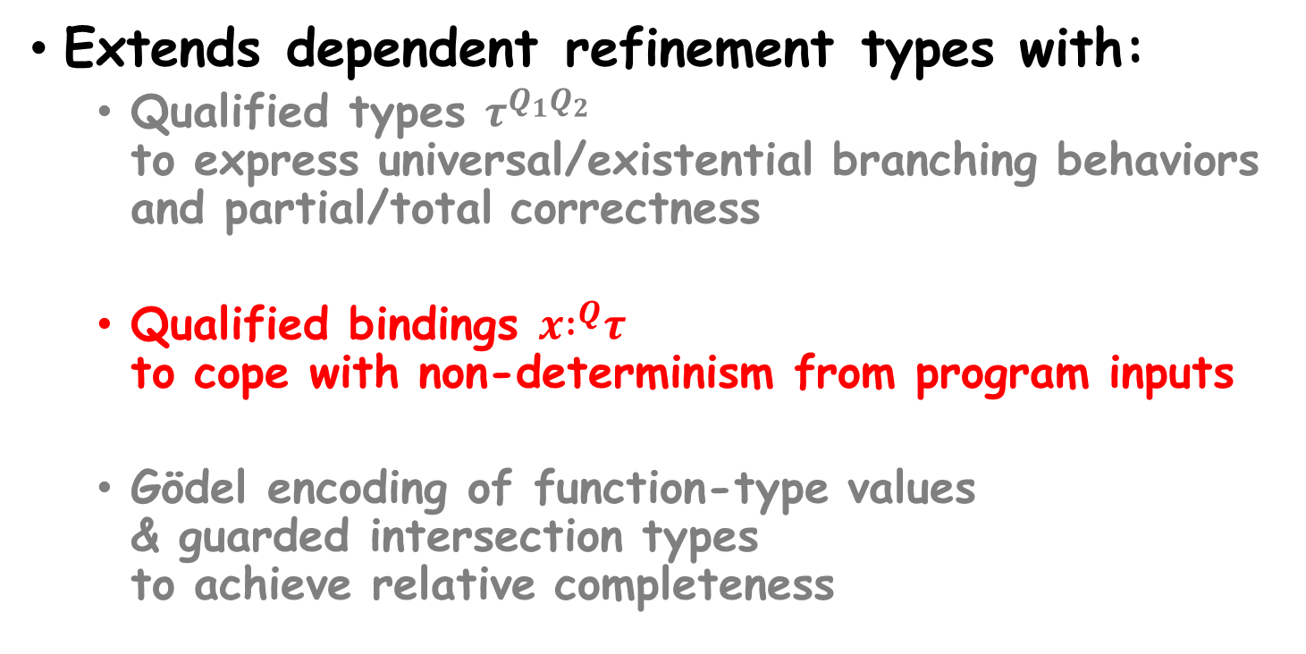
Overview: Our Type System
Extends dependent refinement types with:
  Qualified types $τ^{Q_{1}Q_{2}}$
  to express universal/existential branching behaviors and partial/total correctness
  Qualified bindings $x{ :}^{Q}τ$
  to cope with non-determinism from program inputs
  Gödel encoding of function-type values
  & guarded intersection types
  to achieve relative completeness

Slide 17

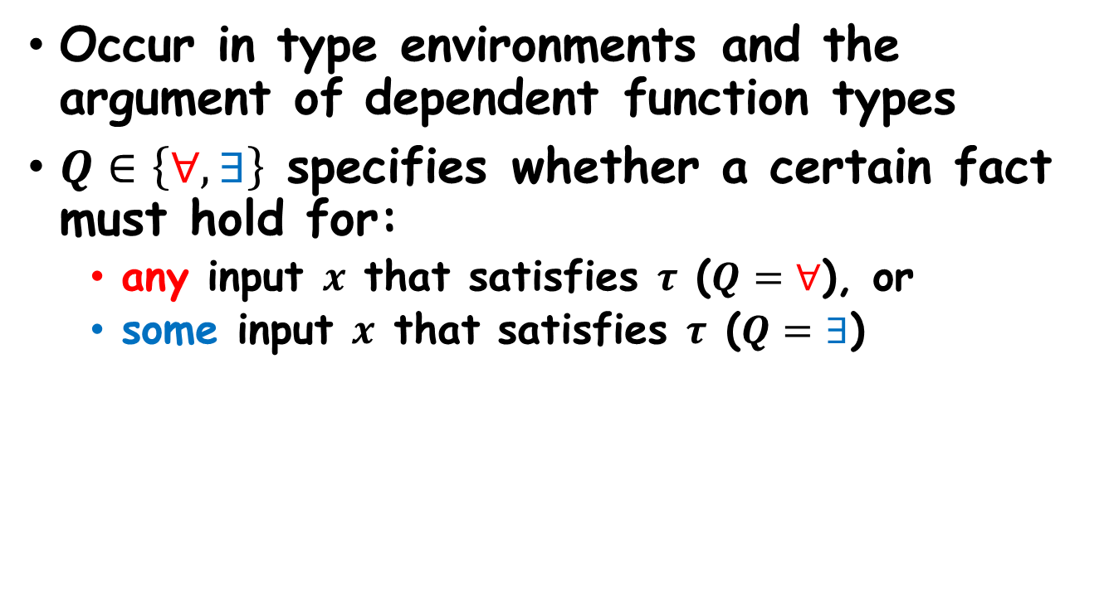
Qualified Bindings $x{ :}^{Q}τ$
Occur in type environments and the argument of dependent function types
$Q∈\left\{∀,∃\right\}$ specifies whether a certain fact must hold for:
  any input $x$ that satisfies $τ$ ($Q=∀$), or
  some input $x$ that satisfies $τ$ ($Q=∃$)

Slide 18
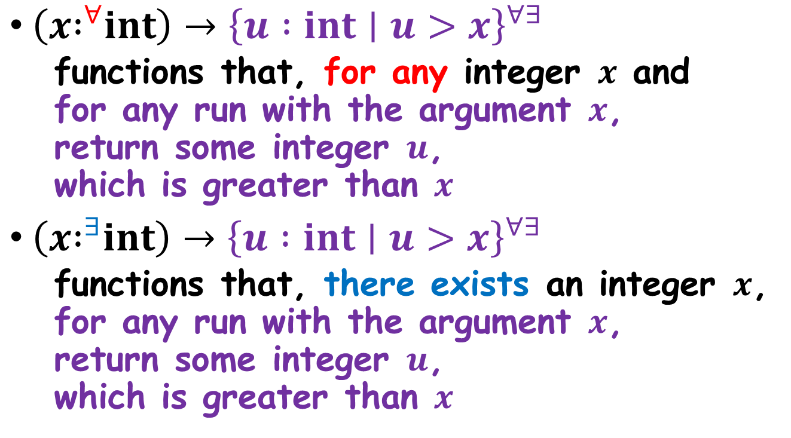

Examples: Qualified Bindings $x{ :}^{Q}τ$
$\left(x{ :}^{∀}int\right)→{\left\{u :int∣u>x\right\}}^{∀∃}$
  functions that, for any integer $x$ and
  for any run with the argument $x$,
  return some integer $u$,
  which is greater than $x$
$\left(x{ :}^{∃}int\right)→{\left\{u :int∣u>x\right\}}^{∀∃}$
  functions that, there exists an integer $x$,
  for any run with the argument $x$,
  return some integer $u$,
  which is greater than $x$

Slide 19

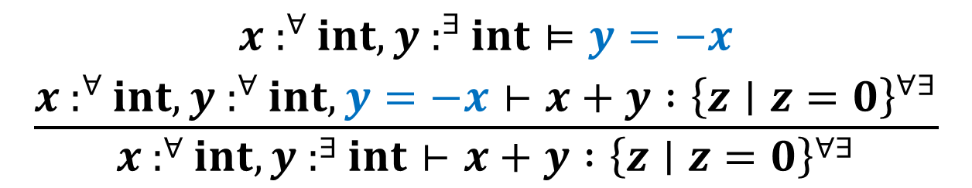


Skolemizing Existential Bindings
Rule:
Skolemization Predicate
$$\frac{\begin{aligned}Δ, x :^{∃}τ⊨φ \\ Δ,x :^{∀}τ,φ,Γ⊢e :σ\end{aligned}}{Δ, x :^{∃}τ,Γ⊢e :σ}$$
Type environment consisting of only $∀$-bindings
Type environment consisting of both $∀$- and $∃$-bindings
Example:
$$\frac{\begin{aligned}x :^{∀}int,y :^{∃}int⊨y=−x \\ x :^{∀}int,y :^{∀}int,y=−x⊢x+y :{\left\{z∣z=0\right\}}^{∀∃}\end{aligned}}{x :^{∀}int,y :^{∃}int⊢x+y :{\left\{z∣z=0\right\}}^{∀∃}}$$

Slide 20

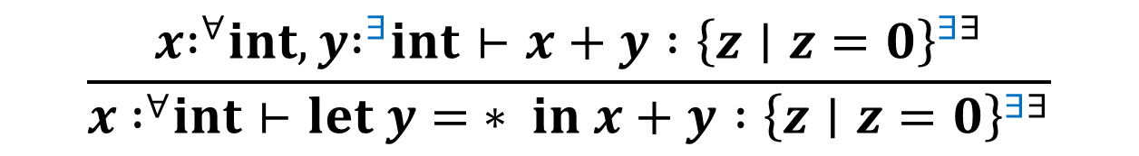
Typing Non-deterministic Choice
Rule:
$$\frac{\begin{matrix}Δ,x{ :}^{Q_{1}}int⊢e :τ^{Q_{1}Q_{2}} & x∉fvs\left(τ\right)\end{matrix}}{Δ⊢let x= ∗ in e :τ^{Q_{1}Q_{2}}}$$
Example:
$$\frac{x{ :}^{∀}int,y{ :}^{∃}int⊢x+y :{\left\{z∣z=0\right\}}^{∃∃}}{x { :}^{∀}int⊢let y= ∗ in x+y :{\left\{z∣z=0\right\}}^{∃∃}}$$

Slide 21

Typing Function Applications
(Universal Bindings)
Rule:
$$\frac{\begin{matrix}Δ⊢v_{1} :\left(x :^{∀}τ\right)→σ & Δ⊢v_{2} :τ\end{matrix}}{Δ⊢v_{1} v_{2} :[v_{2}/x]σ}$$

Slide 22
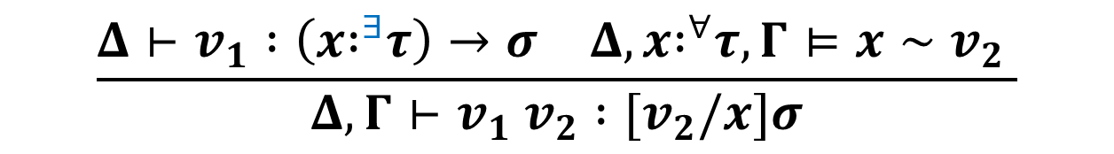

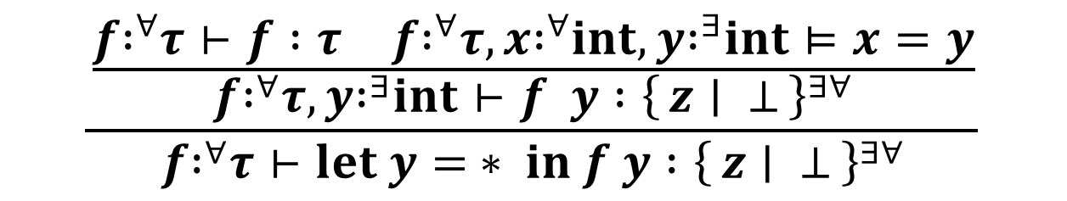
Typing Function Applications
(Existential Bindings)
Observational equivalence
Rule:
$$\frac{\begin{matrix}Δ⊢v_{1} :\left(x{ :}^{∃}τ\right)→σ & Δ,x{ :}^{∀}τ,Γ⊨x∼v_{2} \end{matrix}}{Δ,Γ⊢v_{1} v_{2} :[v_{2}/x]σ}$$
Example:
$$\frac{\frac{\begin{matrix}f{ :}^{∀}τ⊢f :τ & f{ :}^{∀}τ,x{ :}^{∀}int,y{ :}^{∃}int⊨x=y\end{matrix}}{f{ :}^{∀}τ,y{ :}^{∃}int⊢f y :{\left\{z ∣ ⊥\right\}}^{∃∀}}}{f{ :}^{∀}τ⊢let y= ∗ in f y :{\left\{z ∣ ⊥\right\}}^{∃∀}}$$
$$\left(x :^{∃}int\right)→{\left\{z ∣ ⊥\right\}}^{∃∀}$$

Slide 23
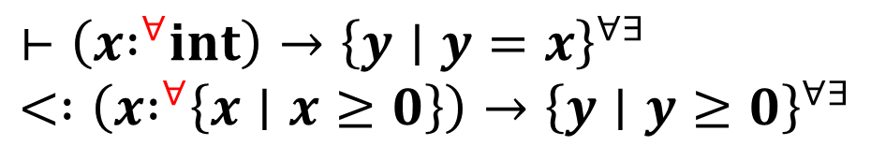
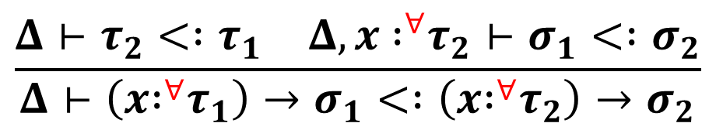
Converting Function Types (1/4)
Subtyping Rule:
$$\frac{\begin{matrix}Δ⊢τ_{2}< :τ_{1} & Δ,x { :}^{∀}τ_{2}⊢σ_{1}< :σ_{2}\end{matrix}}{Δ⊢\left(x{ :}^{∀}τ_{1}\right)→σ_{1}< :\left(x{ :}^{∀}τ_{2}\right)→σ_{2}}$$
Example:
$$⊢\left(x{ :}^{∀}int\right)→{\left\{y∣y=x\right\}}^{∀∃} \\ < :\left(x{ :}^{∀}\left\{x∣x≥0\right\}\right)→{\left\{y∣y≥0\right\}}^{∀∃}$$

Slide 24
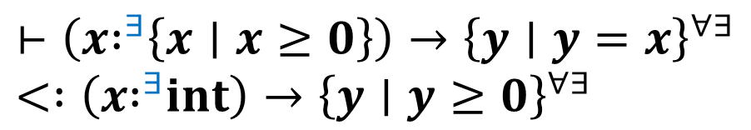
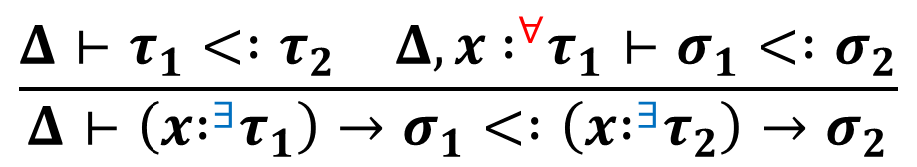
Converting Function Types (2/4)
Subtyping Rule:
$$\frac{\begin{matrix}Δ⊢τ_{1}< :τ_{2} & Δ,x { :}^{∀}τ_{1}⊢σ_{1}< :σ_{2}\end{matrix}}{Δ⊢\left(x{ :}^{∃}τ_{1}\right)→σ_{1}< :\left(x{ :}^{∃}τ_{2}\right)→σ_{2}}$$
Example:
$$⊢\left(x{ :}^{∃}\left\{x∣x≥0\right\}\right)→{\left\{y∣y=x\right\}}^{∀∃} \\ < :\left(x{ :}^{∃}int\right)→{\left\{y∣y≥0\right\}}^{∀∃}$$

Slide 25
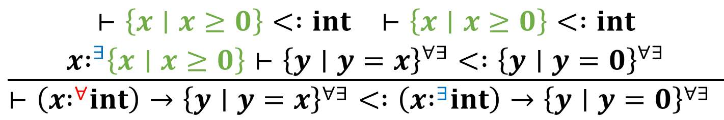
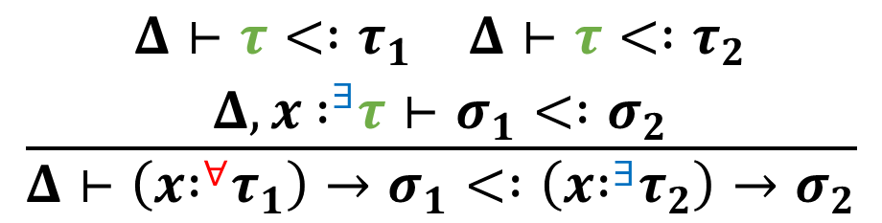
Converting Function Types (3/4)
Subtyping Rule:
$$\frac{\begin{matrix}\begin{matrix}Δ⊢τ< :τ_{1} & Δ⊢τ< :τ_{2}\end{matrix} \\ Δ,x { :}^{∃}τ⊢σ_{1}< :σ_{2}\end{matrix}}{Δ⊢\left(x{ :}^{∀}τ_{1}\right)→σ_{1}< :\left(x{ :}^{∃}τ_{2}\right)→σ_{2}}$$
Example:
$$\frac{\begin{matrix}\begin{matrix}⊢\left\{x∣x≥0\right\}< :int & ⊢\left\{x∣x≥0\right\}< :int\end{matrix} \\ x{ :}^{∃}\left\{x∣x≥0\right\}⊢{\left\{y∣y=x\right\}}^{∀∃}< :{\left\{y∣y=0\right\}}^{∀∃}\end{matrix}}{⊢\left(x{ :}^{∀}int\right)→{\left\{y∣y=x\right\}}^{∀∃}< :\left(x{ :}^{∃}int\right)→{\left\{y∣y=0\right\}}^{∀∃} }$$

Slide 26
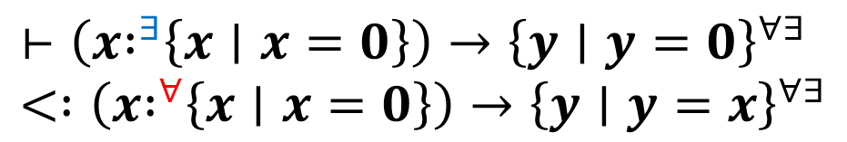
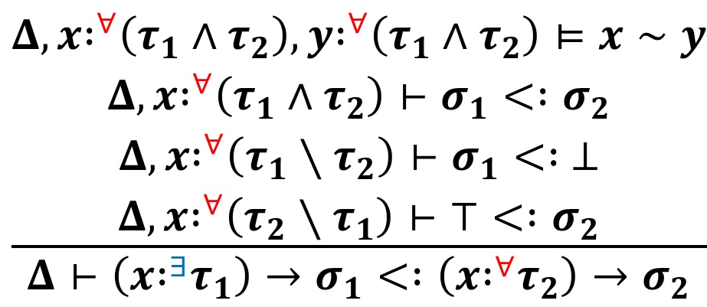
Converting Function Types (4/4)
Subtyping Rule:
$$\frac{\begin{matrix}Δ,x{ :}^{∀}\left(τ_{1}∧τ_{2}\right),y{ :}^{∀}\left(τ_{1}∧τ_{2}\right)⊨x∼y \\ Δ,x{ :}^{∀}\left(τ_{1}∧τ_{2}\right)⊢σ_{1}< :σ_{2} \\ Δ,x{ :}^{∀}\left(τ_{1}∖τ_{2}\right)⊢σ_{1}< : ⊥ \\ Δ,x{ :}^{∀}\left(τ_{2}∖τ_{1}\right)⊢⊤< :σ_{2}\end{matrix}}{Δ⊢\left(x{ :}^{∃}τ_{1}\right)→σ_{1}< :\left(x{ :}^{∀}τ_{2}\right)→σ_{2}}$$
Observational equivalence
Example:
$$⊢\left(x{ :}^{∃}\left\{x∣x=0\right\}\right)→{\left\{y∣y=0\right\}}^{∀∃} \\ < :\left(x{ :}^{∀}\left\{x∣x=0\right\}\right)→{\left\{y∣y=x\right\}}^{∀∃}$$

Slide 27
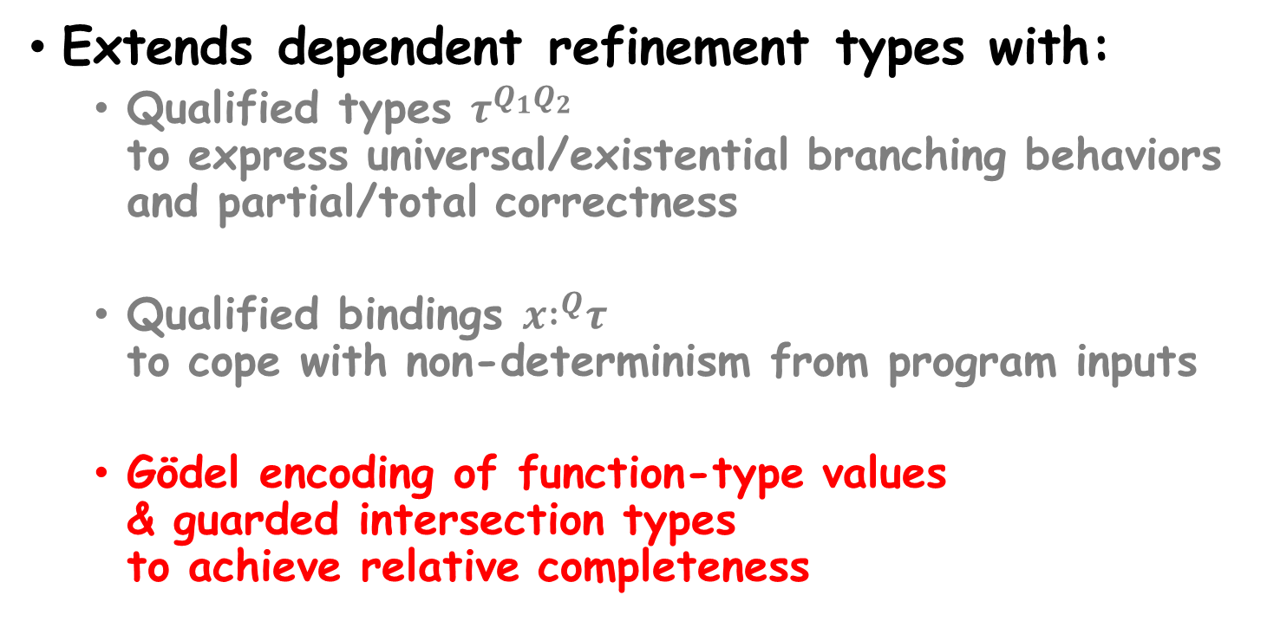
Overview: Our Type System
Extends dependent refinement types with:
  Qualified types $τ^{Q_{1}Q_{2}}$
  to express universal/existential branching behaviors and partial/total correctness
  Qualified bindings $x{ :}^{Q}τ$
  to cope with non-determinism from program inputs
  Gödel encoding of function-type values
  & guarded intersection types
  to achieve relative completeness

Slide 28
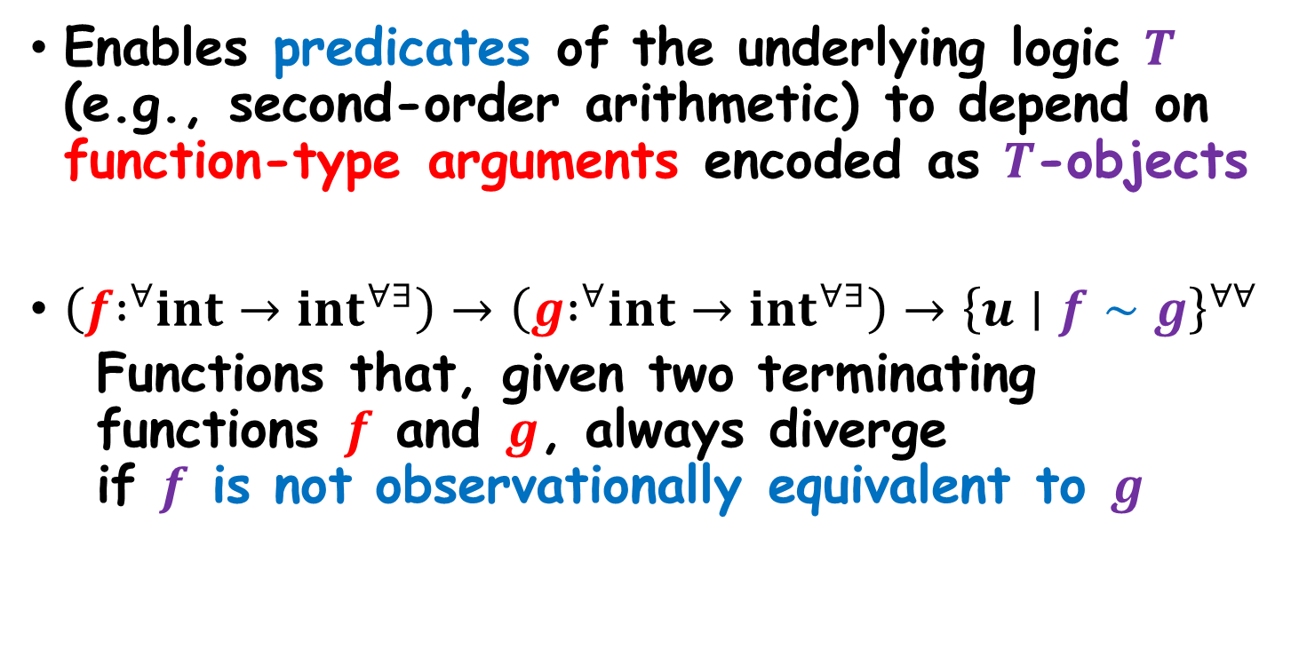
Gödel Encoding of
Function-Type Values
Enables predicates of the underlying logic $T$ (e.g., second-order arithmetic) to depend on function-type arguments encoded as $T$-objects
$\left(f{ :}^{∀}int→{int}^{∀∃}\right)→\left(g{ :}^{∀}int→{int}^{∀∃}\right)→{\left\{u∣f∼g\right\}}^{∀∀}$
  Functions that, given two terminating functions $f$ and $g$, always diverge
  if $f$ is not observationally equivalent to $g$

Slide 29
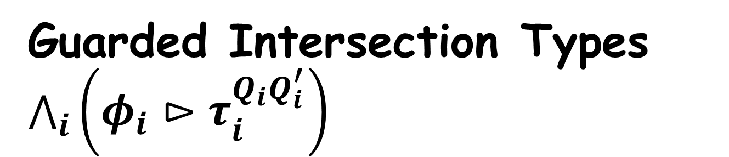
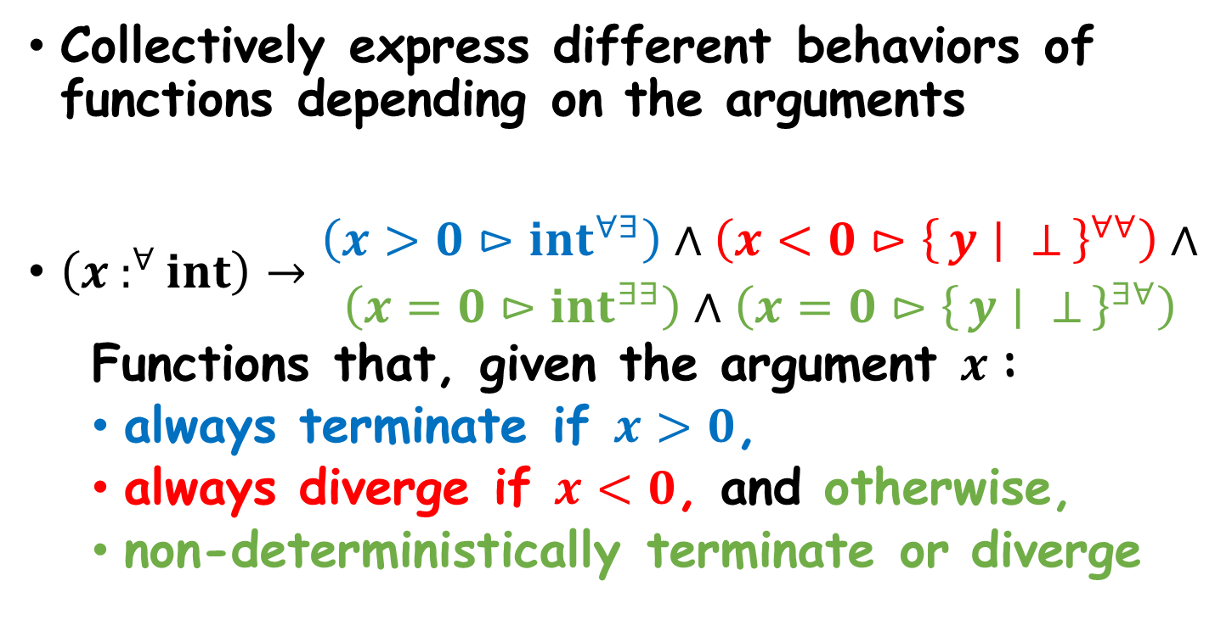
Guarded Intersection Types $\bigwedge_{i}{\left(φ_{i}⊳τ_{i}^{Q_{i}Q_{i}^{′}}\right)}$
Collectively express different behaviors of functions depending on the arguments
$\left(x :^{∀}int\right)→\begin{matrix}\left(x>0⊳{int}^{∀∃}\right)∧\left(x<0⊳{\left\{y ∣ ⊥\right\}}^{∀∀}\right)∧ \\ \left(x=0⊳{int}^{∃∃}\right)∧\left(x=0⊳{\left\{y ∣ ⊥\right\}}^{∃∀}\right)\end{matrix}$
  Functions that, given the argument $x$:
  always terminate if $x>0$,
  always diverge if $x<0$, and otherwise,
  non-deterministically terminate or diverge

Slide 30
Our Contributions
Novel dependent refinement type system that can:
  uniformly express and verify universal and existential branching properties of call-by-value, higher-order,
  and non-deterministic programs:
    (cond.) safety, non-safety, termination, and non-termination
  seamlessly combine universal and existential reasoning
    e.g., Prove non-safety via termination
    e.g., Prove non-termination via safety
    e.g., Prove termination and non-termination simultaneously
Meta-theoretic properties of the type system:
  Closure of types under complement
  Soundness
  Relative completeness

Slide 31


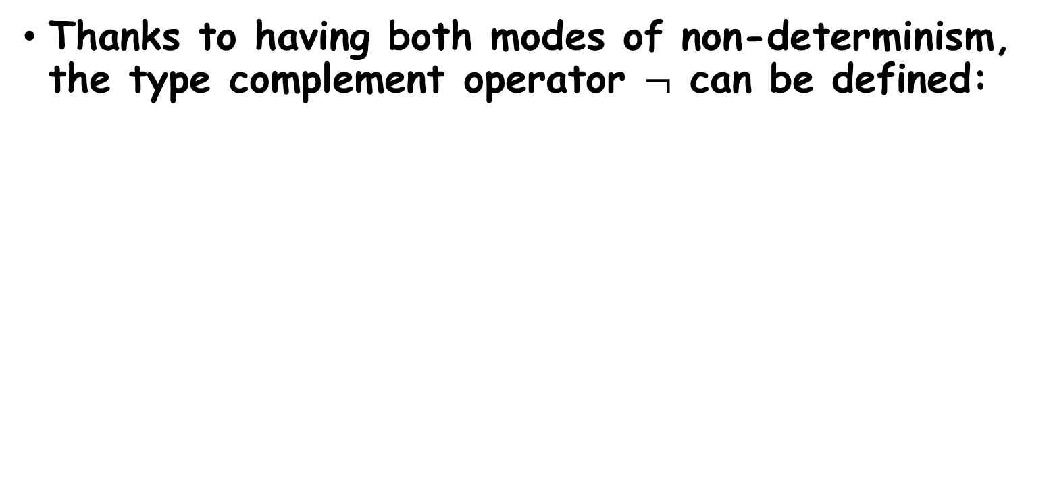
Complement Types $¬σ$
Thanks to having both modes of non-determinism, the type complement operator $¬$ can be defined:
$¬\left(τ^{Q_{1}Q_{2}}\right)≜{\left(¬τ\right)}^{\left(¬Q_{1}\right)\left(¬Q_{2}\right)}$
$$¬\left\{x :int∣φ\right\}≜\left\{x :int∣¬φ\right\}$$
$¬\left(\left(x { :}^{Q}τ\right)→σ\right)≜\left(x :^{¬Q}τ\right)→¬σ$
$$¬∀ ≜∃ ¬∃ ≜∀$$

Slide 32
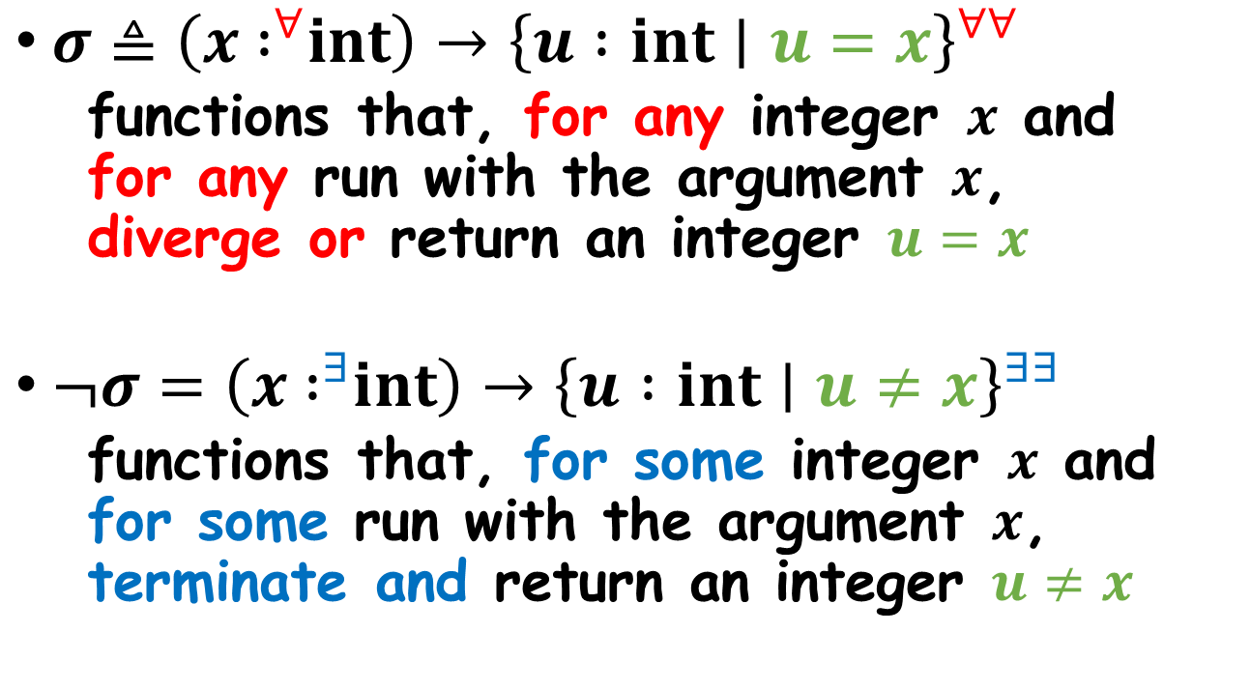

Example: Complement Types $¬σ$
$σ≜\left(x { :}^{∀}int\right)→{\left\{u :int∣u=x\right\}}^{∀∀}$
  functions that, for any integer $x$ and
  for any run with the argument $x$,
  diverge or return an integer $u=x$
$¬σ=\left(x { :}^{∃}int\right)→{\left\{u :int∣u≠x\right\}}^{∃∃}$
  functions that, for some integer $x$ and for some run with the argument $x$,
  terminate and return an integer $u≠x$

Slide 33
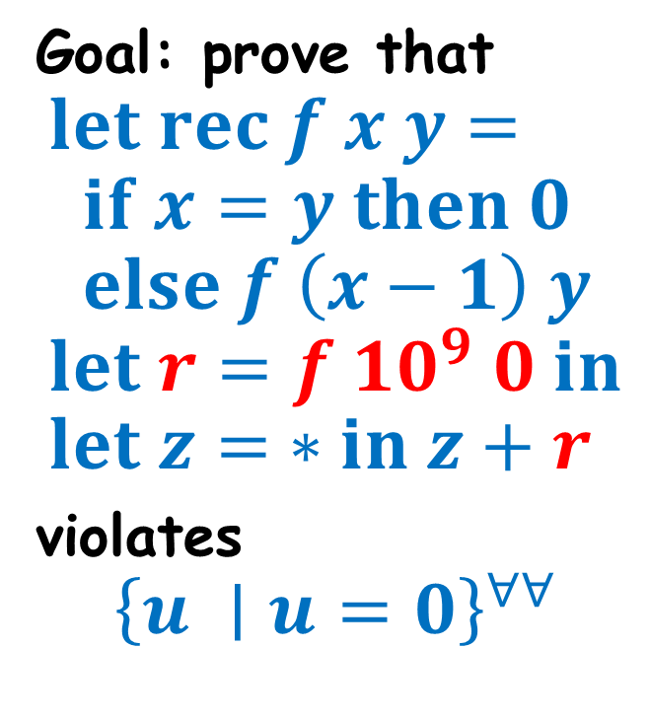
Example: Combined Reasoning
(Non-safety via Termination)
Goal: prove that
$$let rec f x y= \\ if x=y then 0 \\ else f \left(x−1\right) y \\ let r=f {10}^{9} 0 in \\ let z= ∗in z+r$$
violates
$${\left\{u ∣u=0\right\}}^{∀∀}$$

Slide 34
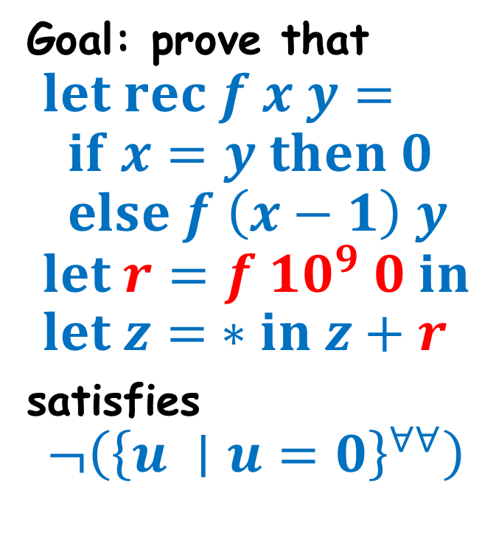
Example: Combined Reasoning
(Non-safety via Termination)
Goal: prove that
$$let rec f x y= \\ if x=y then 0 \\ else f \left(x−1\right) y \\ let r=f {10}^{9} 0 in \\ let z= ∗in z+r$$
satisfies
$$¬\left({\left\{u ∣u=0\right\}}^{∀∀}\right)$$

Slide 35
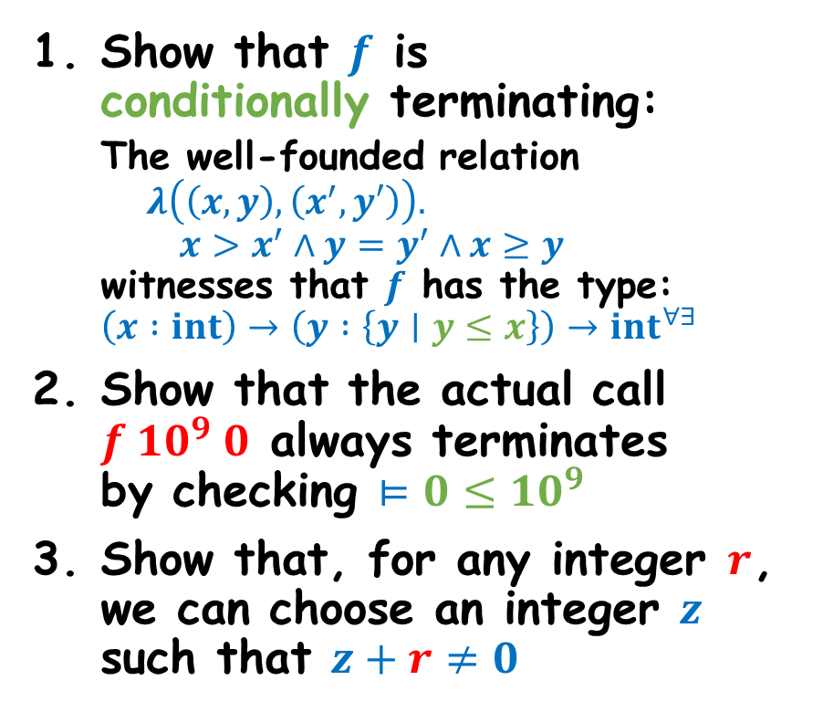
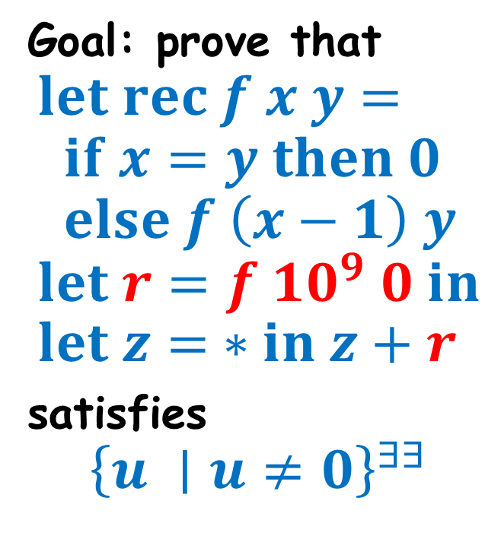
Example: Combined Reasoning
(Non-safety via Termination)
Goal: prove that
$$let rec f x y= \\ if x=y then 0 \\ else f \left(x−1\right) y \\ let r=f {10}^{9} 0 in \\ let z= ∗in z+r$$
satisfies
$${\left\{u ∣u≠0\right\}}^{∃∃}$$
Show that $f$ is
conditionally terminating:
  The well-founded relation
  $$λ\left(\left(x,y\right),\left(x^{′},y′\right)\right). \\ x>x^{′}∧y=y^{′}∧x≥y$$
  witnesses that $f$ has the type:
  $$\left(x :int\right)→\left(y :\left\{y∣y≤x\right\}\right)→{int}^{∀∃}$$
Show that the actual call $f {10}^{9} 0$ always terminates
by checking $⊨0≤10^{9}$
Show that, for any integer $r$, we can choose an integer $z$ such that $z+r≠0$
Q.E.D.

Slide 36
Our Contributions
Novel dependent refinement type system that can:
  uniformly express and verify universal and existential branching properties of call-by-value, higher-order,
  and non-deterministic programs:
    (cond.) safety, non-safety, termination, and non-termination
  seamlessly combine universal and existential reasoning
    e.g., Prove non-safety via termination
    e.g., Prove non-termination via safety
    e.g., Prove termination and non-termination simultaneously
Meta-theoretic properties of the type system:
  Closure of types under complement
  Soundness
  Relative completeness

Slide 37
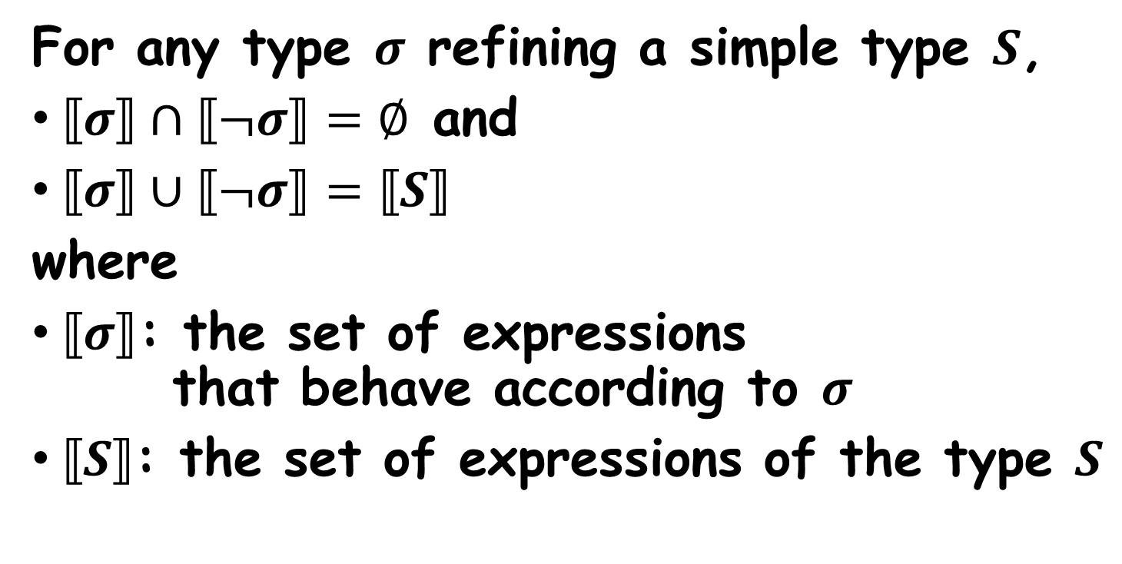
Closure of Types under Complement
For any type $σ$ refining a simple type $S$,
$⟦σ⟧∩⟦¬σ⟧=∅$ and
$⟦σ⟧∪⟦¬σ⟧=⟦S⟧$
where
$⟦σ⟧$: the set of expressions
that behave according to $σ$
$⟦S⟧$: the set of expressions of the type $S$

Slide 38
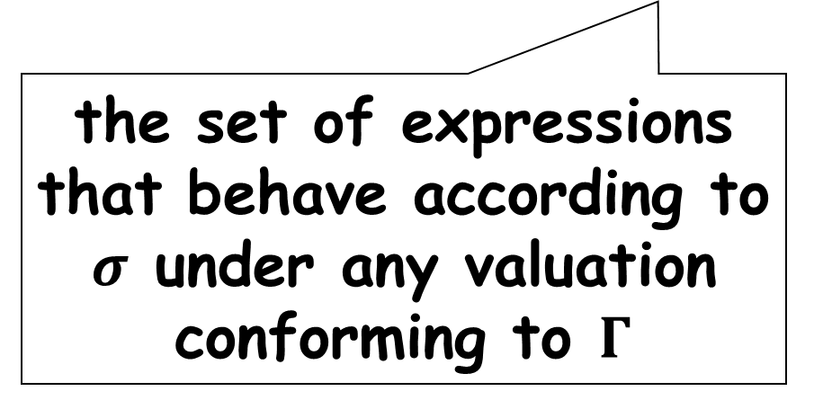
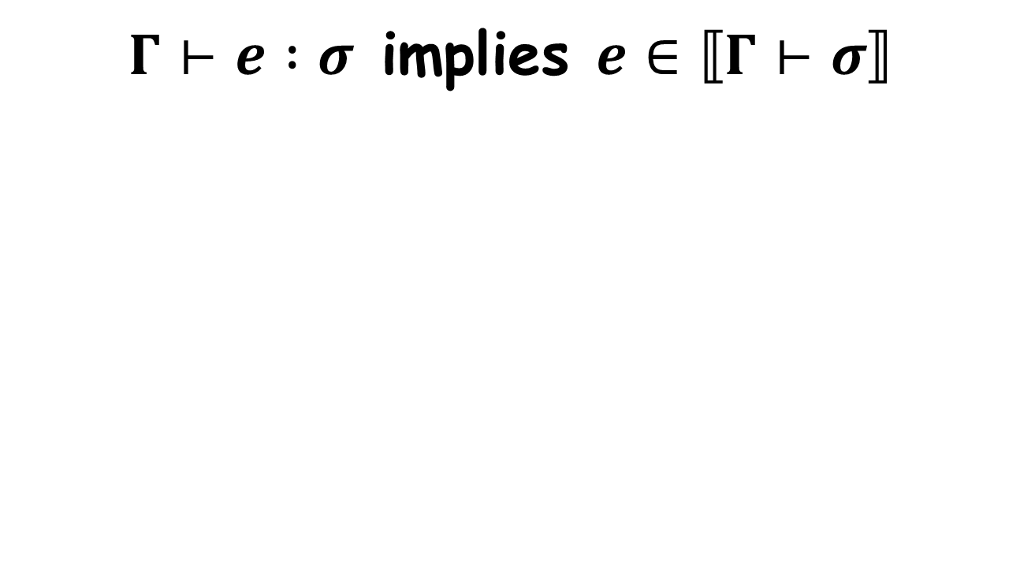
Soundness
$Γ⊢e :σ$ implies $e∈⟦Γ⊢σ⟧$
the set of expressions that behave according to $σ$ under any valuation conforming to $Γ$

Slide 39
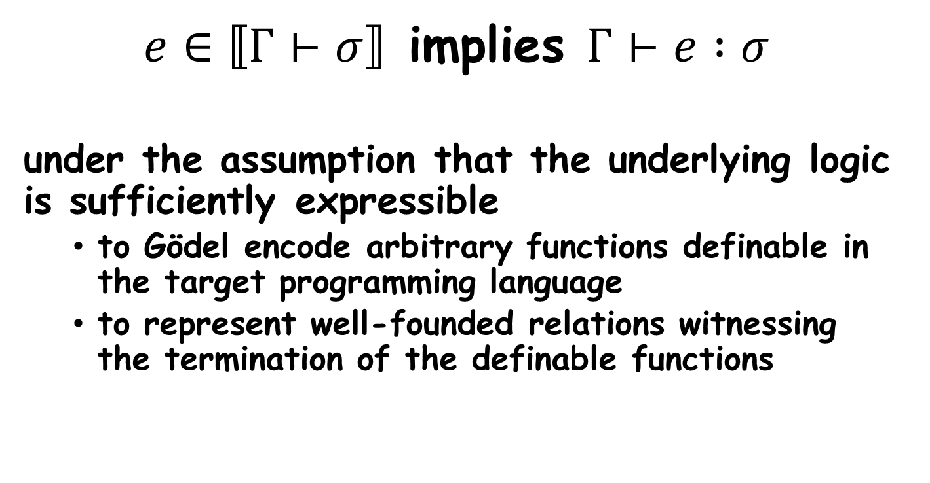
Relative Completeness
$e∈⟦Γ⊢σ⟧$ implies $Γ⊢e :σ$
under the assumption that the underlying logic is sufficiently expressible
  to Gödel encode arbitrary functions definable in the target programming language
  to represent well-founded relations witnessing the termination of the definable functions

Slide 40
Summary
Novel dependent refinement type system that can:
  uniformly express and verify universal and existential branching properties of call-by-value, higher-order,
  and non-deterministic programs:
    (cond.) safety, non-safety, termination, and non-termination
  seamlessly combine universal and existential reasoning
    e.g., Prove non-safety via termination
    e.g., Prove non-termination via safety
    e.g., Prove termination and non-termination simultaneously
Meta-theoretic properties of the type system:
  Closure of types under complement
  Soundness
  Relative completeness

Slide 41
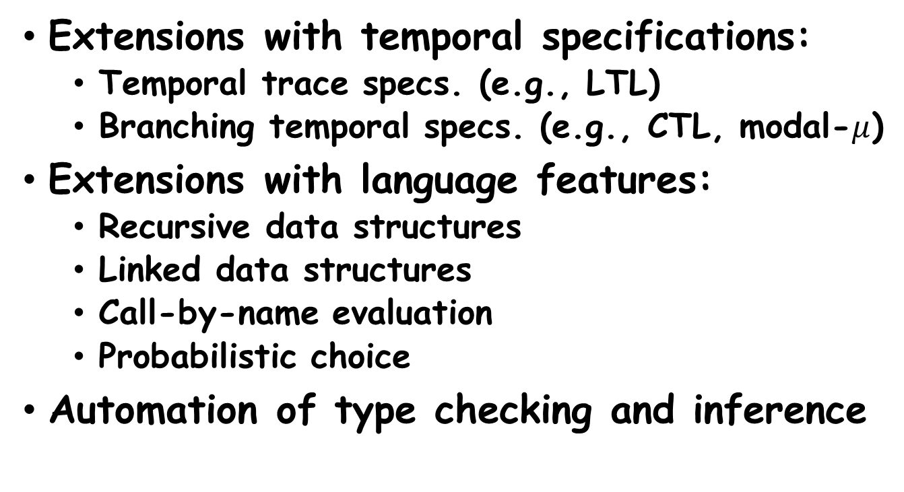
Future Work
Extensions with temporal specifications:
  Temporal trace specs. (e.g., LTL)
  Branching temporal specs. (e.g., CTL, modal-$μ$)
Extensions with language features:
  Recursive data structures
  Linked data structures
  Call-by-name evaluation
  Probabilistic choice
Automation of type checking and inference

Slide 42
Towards Automation (Ongoing)
Type Checking
  How to leverage off-the-shelf SMT solvers?
  Abstraction and counterexample guided refinement for the encoding of function-type values
Type Inference
  How to synthesize inductive invariants, well-founded relations, and Skolemization predicates?
  Reduction to existentially-quantified
  Horn clause and well-foundedness constraints
  How to achieve scalable inference?
  Combination of universal and existential reasoning

