Slide 1
Modular Primal-Dual Fixpoint Logic Solving for Temporal Verification
Hiroshi Unno University of Tsukuba
Tachio Terauchi Waseda University
Yu Gu University of Tsukuba
Eric Koskinen Stevens Institute of Technology

Slide 2



Background: Constraint-based Verification with
Constrained Horn Clauses (CHCs)
Target Program $𝓟$ & Specification $ψ$
RustHorn [Matsushita+’20,…]
JayHorn [Kahsai+’16,…]
SeaHorn [Gurfinkel+’15,…]
RCaml for OCaml [U.+‘09,…]
Verification intermediary independent of particular target and method ☺
Constraint Generation
CHCs Constraints $𝓒$ on Predicate Variables
But limited to safety verification ☹
Constraint Solving
SPACER [Komuravelli+ ’14,…]
Hoice [Champion+ ’18,…]
Eldarica [Hojjat+ ’18,…]
PCSat [U.+’20,…]
$𝓒$ is Sat ($𝓟$ satisfies $ψ$),
$𝓒$ is Unsat ($𝓟$ violates $ψ$),
or Unknown/Timeout

Slide 3

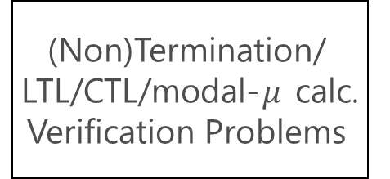
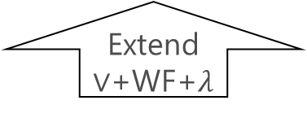
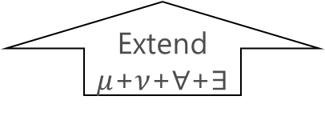
Extensions of CHCs for Non-Safety Verification
  This Work
  [U.+ AAAI’20, CAV’21]
(Non)Termination/
LTL/CTL/modal-$μ$ calc. Verification Problems
$μ$CLP
pfwCSP
Modularly Encode
Reduce
Extend
$μ$+$ν$+$∀$+$∃$
Extend $∨$+WF+$λ$
Safety Verification Problems
Constraint Logic Program (CLP)
Constrained Horn Clauses (CHCs)
Encode
Reduce
Notes:
CHCs Π^0_1-complete, pfwCSP Σ^1_2-complete, muCLP in Δ^1_2

Slide 4

Extensions of CHCs for Non-Safety Verification
  This Work
  [U.+ AAAI’20, CAV’21]
(Non)Termination/
LTL/CTL/modal-$μ$ calc. Verification Problems
$μ$CLP
pfwCSP
Modularly Encode
Reduce
Extend
$μ$+$ν$+$∀$+$∃$
Extend $∨$+WF+$λ$
Safety Verification Problems
Constraint Logic Program (CLP)
Constrained Horn Clauses (CHCs)
Encode
Reduce

Slide 5


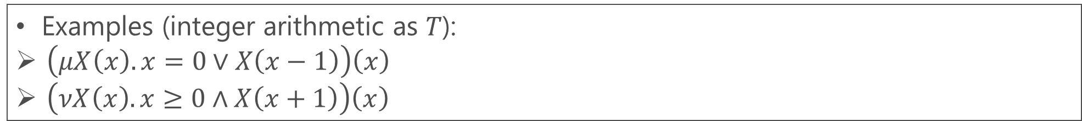
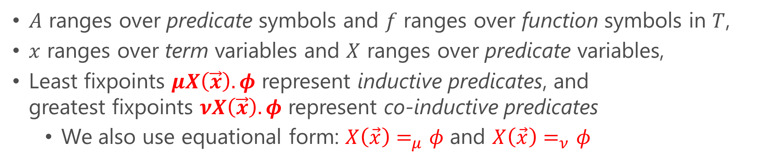

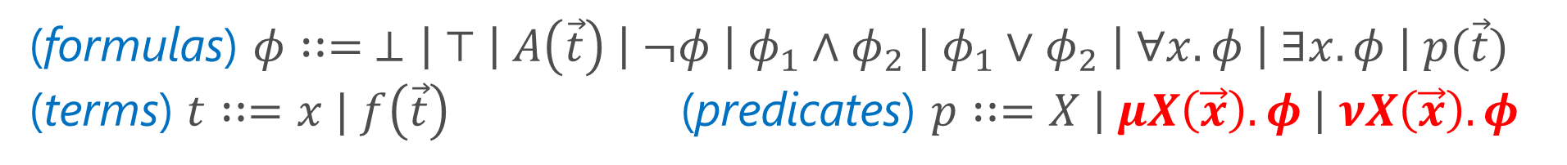


$μ$CLP: An Extension of CLP with Quantifiers and Arbitrarily-Nested (Co-)Inductive Predicates
Can be seen as a first-order fixpoint logic modulo background theories $T$
(formulas) $φ∷= ⊥\left| ⊤ \right| A\left(\vec{t}\right) \left| ¬φ \right| φ_{1}∧φ_{2} | φ_{1}∨φ_{2} \left| ∀x. φ \right| ∃x. φ | p(\vec{t})$
(terms) $t∷=x | f\left(\vec{t}\right)$(predicates) $p∷=X \left| μX\left(\vec{x}\right). φ \right| νX\left(\vec{x}\right). φ$
$A$ ranges over predicate symbols and $f$ ranges over function symbols in $T$,
$x$ ranges over term variables and $X$ ranges over predicate variables,
Least fixpoints $μX\left(\vec{x}\right).φ$ represent inductive predicates, and
greatest fixpoints $νX\left(\vec{x}\right).φ$ represent co-inductive predicates
  We also use equational form: $X\left(\vec{x}\right)=_{μ}φ$ and $X\left(\vec{x}\right)=_{ν}φ$
Examples (integer arithmetic as 𝑇):
$\left(μX\left(x\right).x=0∨X\left(x−1\right)\right)\left(x\right)$
$\left(νX\left(x\right).x≥0∧X\left(x+1\right)\right)\left(x\right)$
$$⇔x=0∨x=1∨x=2∨…$$
$$⇔∃z≥0.x=z$$
$$⇔x≥0∧x+1≥0∧x+2≥0∧…$$
$$⇔∀z≥0. x+z≥0$$

Slide 6
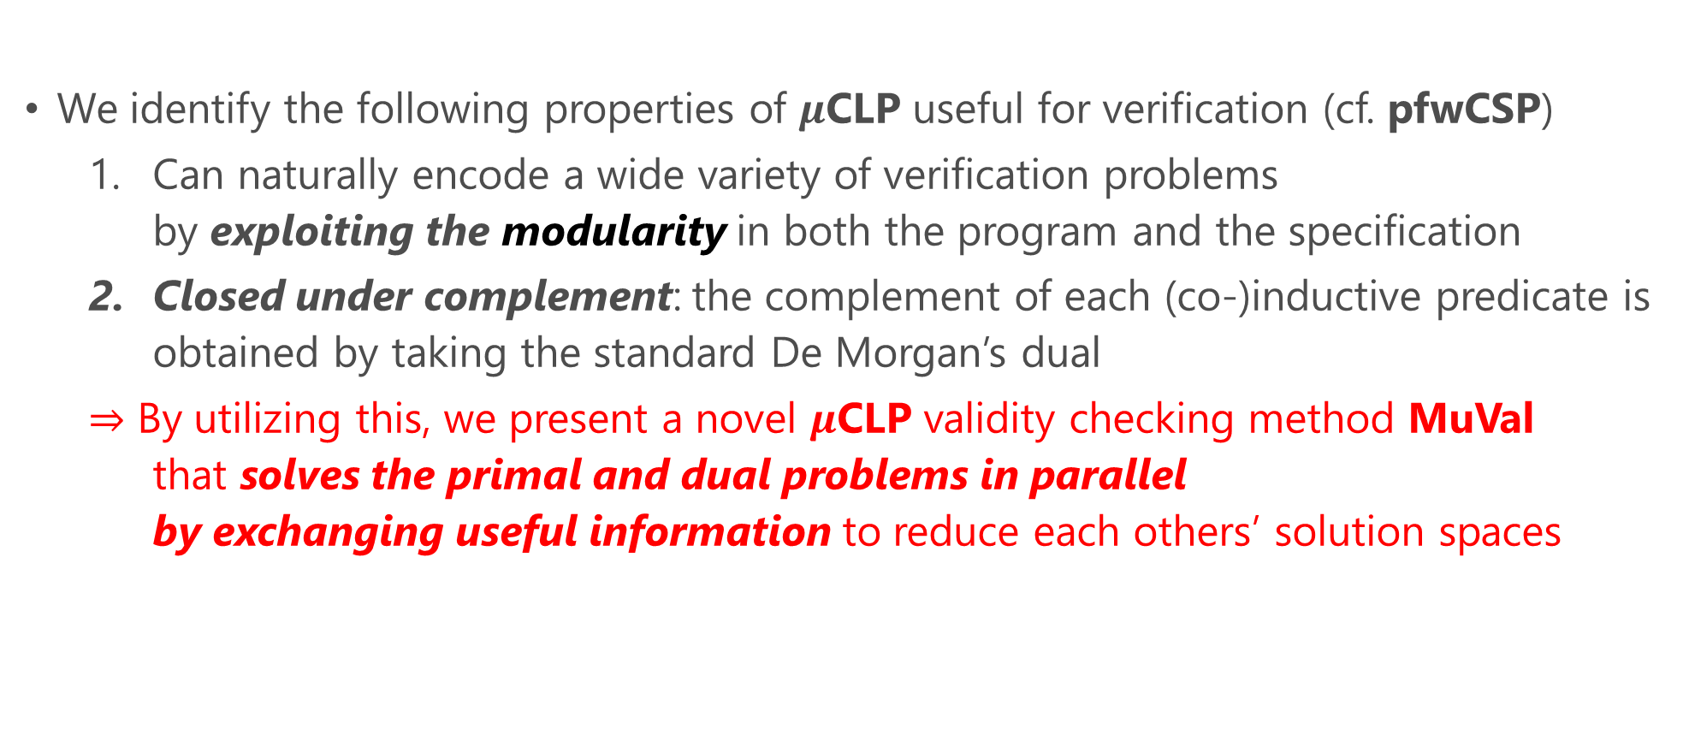
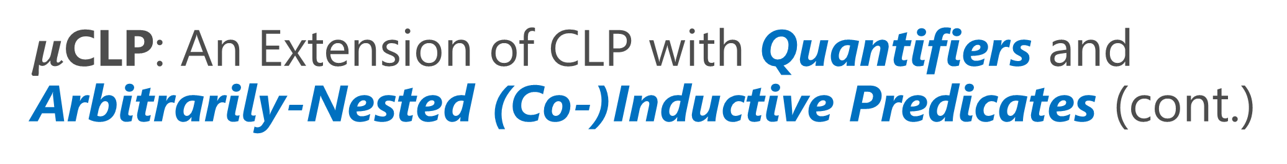
$μ$CLP: An Extension of CLP with Quantifiers and Arbitrarily-Nested (Co-)Inductive Predicates (cont.)
We identify the following properties of $μ$CLP useful for verification (cf. pfwCSP)
  Can naturally encode a wide variety of verification problems
  by exploiting the modularity in both the program and the specification
  Closed under complement: the complement of each (co-)inductive predicate is obtained by taking the standard De Morgan’s dual
  $⇒$ By utilizing this, we present a novel $μ$CLP validity checking method MuVal
  that solves the primal and dual problems in parallel
  by exchanging useful information to reduce each others’ solution spaces

Slide 7
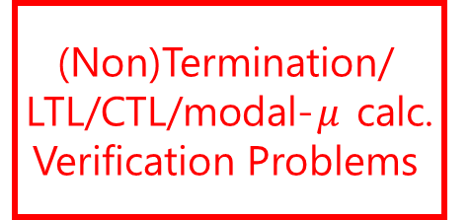
Extensions of CHCs for Non-Safety Verification
  This Work
  [U.+ AAAI’20, CAV’21]
(Non)Termination/
LTL/CTL/modal-$μ$ calc. Verification Problems
$μ$CLP
pfwCSP
Modularly Encode
Reduce
Extend
$μ$+$ν$+$∀$+$∃$
Extend $∨$+WF+$λ$
Safety Verification Problems
Constraint Logic Program (CLP)
Constrained Horn Clauses (CHCs)
Encode
Reduce

Slide 8
$μ$CLP Encoding of Various Verification Problems
Can exploit the modularity in both the program and the specification by expressing each loops and (recursive) functions in the program and sub-formulas of the property as individual (possibly nested) (co-)inductive predicates
  Modular (non-)termination verification of imperative programs (Section 3.2)
  Omega-regular model checking of labeled transition systems (Section 3.3)
  Modal 𝜇-calculus model checking of labeled transition systems [Kobayashi+’19]
  Omega-regular model checking of first-order recursive programs [Kobayashi+’19]
  Modular and value-dependent temporal verification of
  higher-order effectful programs [Nanjo+’18] and further extensions to
  delimited continuations [Sekiyama&U.’23] and algebraic effects [Kawamata+PPL’23]

Slide 9
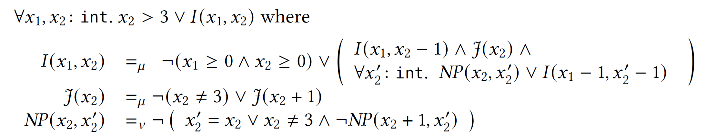
Running Example (from [Urban+’13,’14]):
assume (x2 <= 3);
while (x1 >= 0 && x2 >= 0) {
if (nondet()) {
while (x2 != 3 && nondet()) { x2 = x2 + 1; }
x1 = x1 - 1; }
x2 = x2 - 1; }
See the paper for a formal definition of this sound and complete modular encoding for termination
Modular Encoding for
Termination
The weakest precondition for the termination of the outer loop
The weakest precondition for the termination of the inner loop
The complement of the strongest postcondition of the inner loop

Slide 10
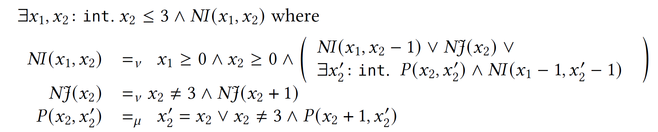
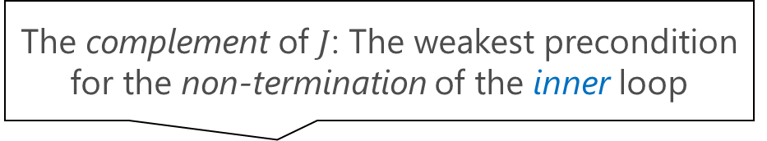
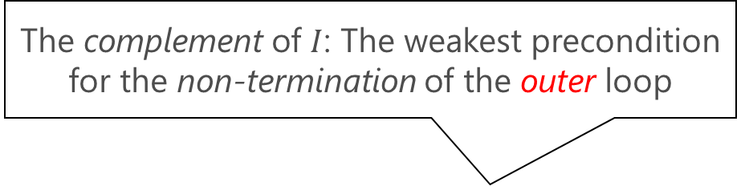
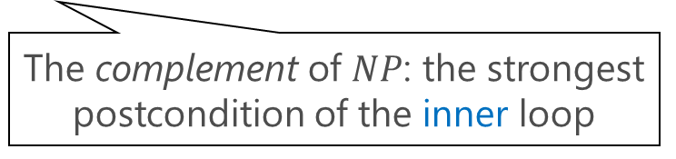
$μ$CLP encoding the termination verification problem
The complement of $I$: The weakest precondition for the non-termination of the outer loop
De Morgan’s Dual
$μ$CLP encoding the non-termination verification problem
The complement of $J$: The weakest precondition for the non-termination of the inner loop
The complement of $NP$: the strongest postcondition of the inner loop

Slide 11

Extensions of CHCs for Non-Safety Verification
  This Work
  [U.+ AAAI’20, CAV’21]
(Non)Termination/
LTL/CTL/modal-$μ$ calc. Verification Problems
$μ$CLP
pfwCSP
Modularly Encode
Reduce
Extend
$μ$+$ν$+$∀$+$∃$
Extend $∨$+WF+$λ$
Safety Verification Problems
Constraint Logic Program (CLP)
Constrained Horn Clauses (CHCs)
Encode
Reduce

Slide 12

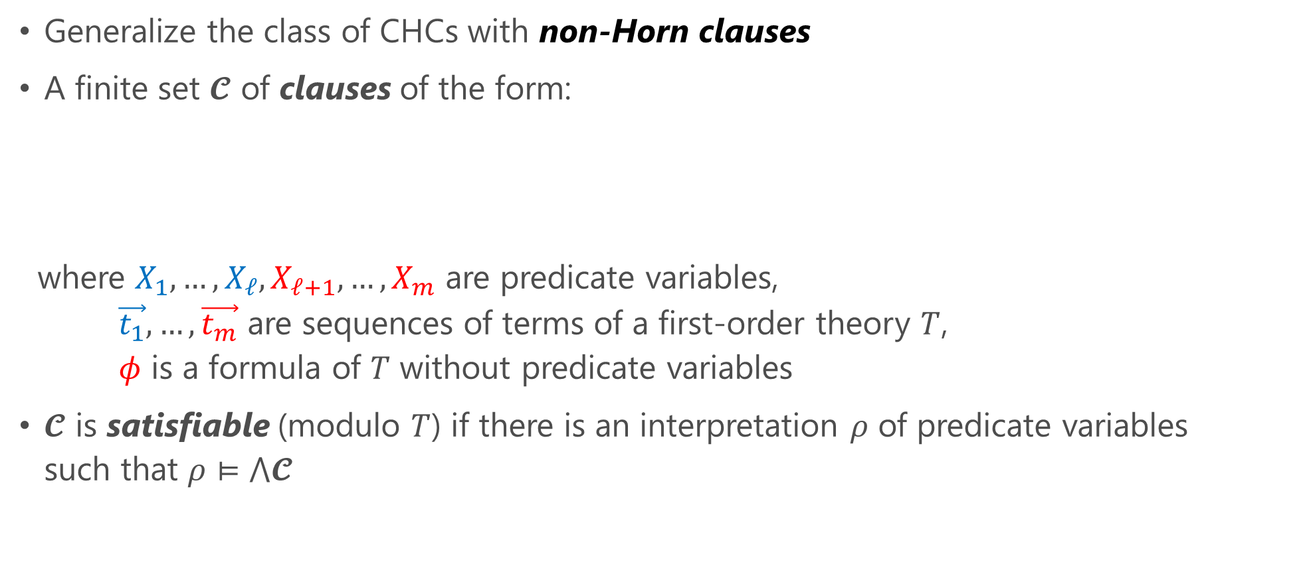
pCSP: Predicate Constraint Satisfaction Problem [U.+’20]
Generalize the class of CHCs with non-Horn clauses
A finite set $𝓒$ of clauses of the form:
where $X_{1},…,X_{ℓ},X_{ℓ+1},…,X_{m}$ are predicate variables,
$\vec{t_{1}},…,\vec{t_{m}}$ are sequences of terms of a first-order theory $T$,
$φ$ is a formula of $T$ without predicate variables
$𝓒$ is satisfiable (modulo $T$) if there is an interpretation $ρ$ of predicate variables
such that $ρ⊨⋀𝓒$
$𝓒$ is CHCs if $ℓ≤1$ for all clause in $𝓒$
$$\left(X_{1}\left(\vec{t_{1}}\right)∨…∨X_{ℓ}\left(\vec{t_{ℓ}}\right)\right)⟸\left(X_{ℓ+1}\left(\vec{t_{ℓ+1}}\right)∧…∧X_{m}\left(\vec{t_{m}}\right)∧φ\right)$$

Slide 13

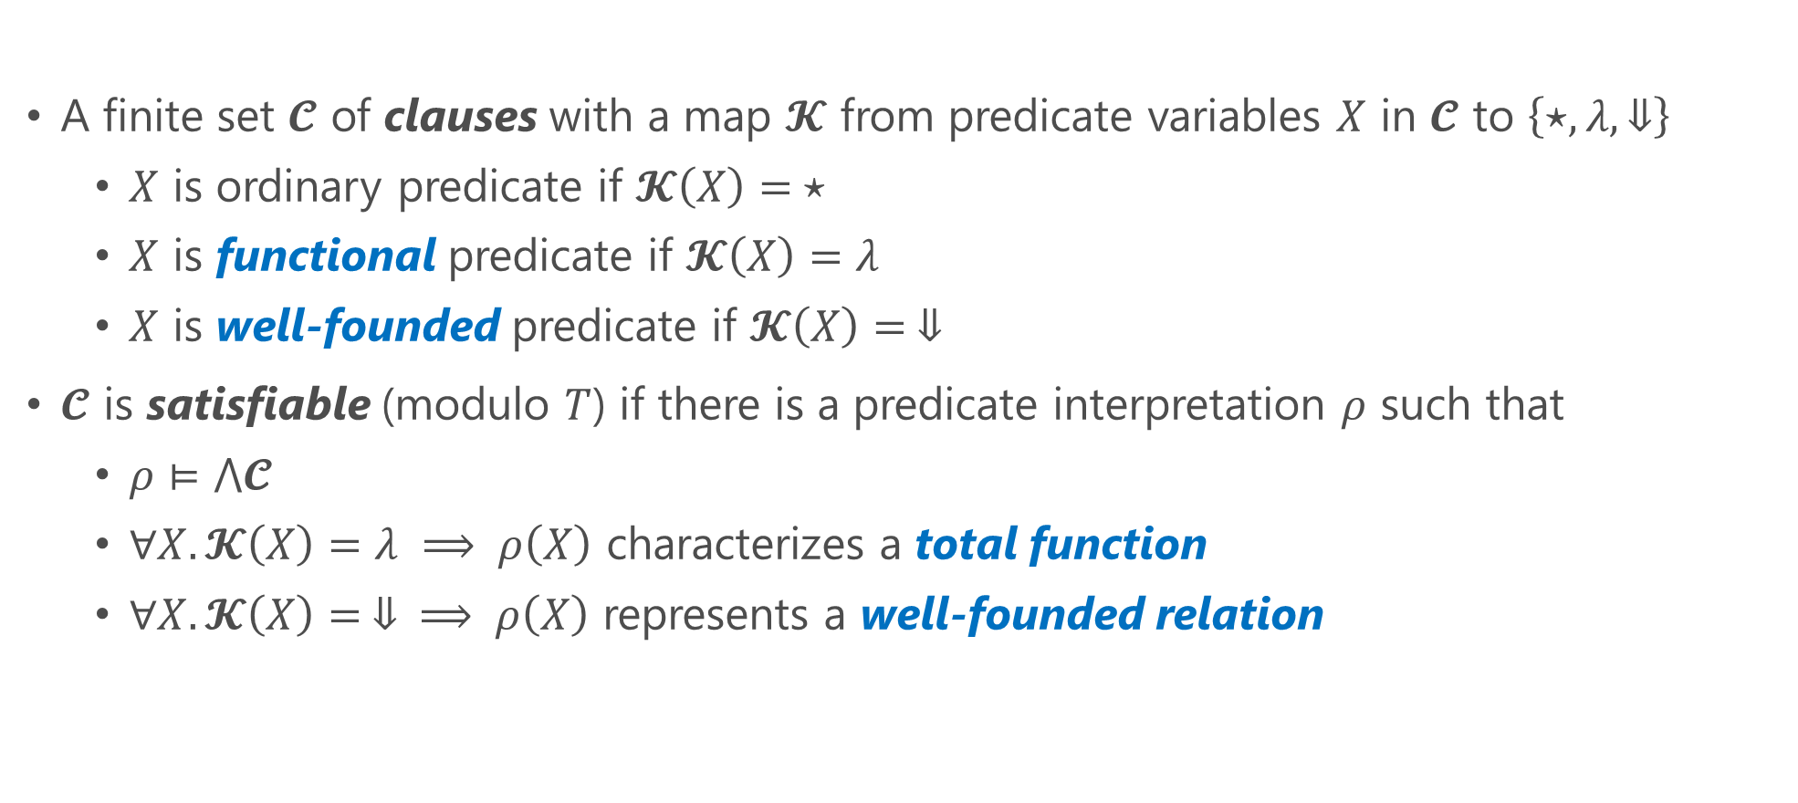
pfwCSP: pCSP with Functional and Well-founded Predicates [U.+’21] (cf. $∀∃$CHCs with dwf [Beyene+’13])
A finite set $𝓒$ of clauses with a map $𝓚$ from predicate variables $X$ in $𝓒$ to $\left\{⋆,λ,⇓\right\}$
  $X$ is ordinary predicate if $𝓚\left(X\right)= ⋆$
  $X$ is functional predicate if $𝓚\left(X\right)=λ$
  $X$ is well-founded predicate if $𝓚\left(X\right)= ⇓$
$𝓒$ is satisfiable (modulo $T$) if there is a predicate interpretation $ρ$ such that
  $ρ⊨⋀𝓒$
  $∀X.𝓚\left(X\right)=λ ⟹ ρ\left(X\right)$ characterizes a total function
  $∀X.𝓚\left(X\right)= ⇓ ⟹ ρ\left(X\right)$ represents a well-founded relation

Slide 14
Extensions of CHCs for Non-Safety Verification
  This Work
  [U.+ AAAI’20, CAV’21]
(Non)Termination/
LTL/CTL/modal-$μ$ calc. Verification Problems
$μ$CLP
pfwCSP
Modularly Encode
Reduce
Extend
$μ$+$ν$+$∀$+$∃$
Extend $∨$+WF+$λ$
Safety Verification Problems
Constraint Logic Program (CLP)
Constrained Horn Clauses (CHCs)
Encode
Reduce

Slide 15

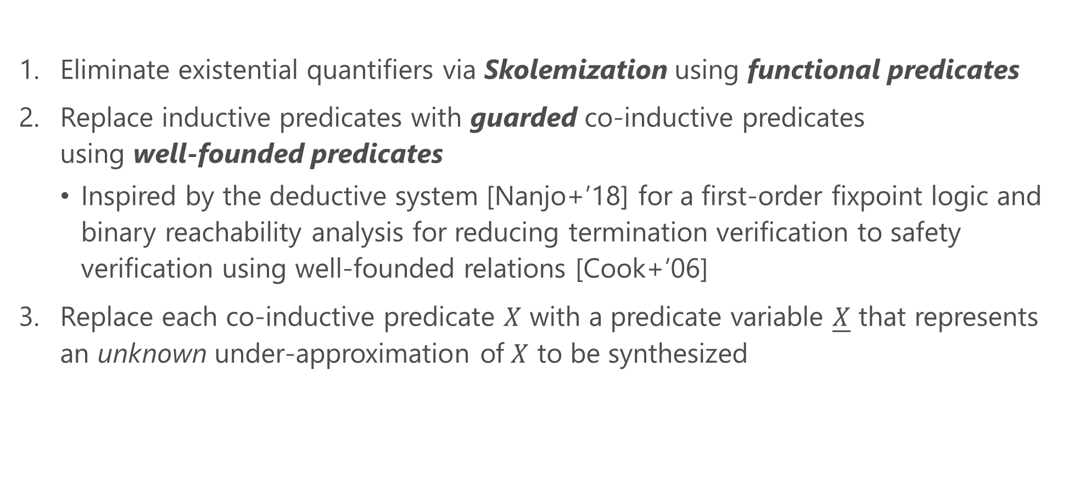
Sound and Complete Reduction of
$μ$CLP Validity to pfwCSP Satisfiability
Eliminate existential quantifiers via Skolemization using functional predicates
Replace inductive predicates with guarded co-inductive predicates
using well-founded predicates
  Inspired by the deductive system [Nanjo+’18] for a first-order fixpoint logic and binary reachability analysis for reducing termination verification to safety verification using well-founded relations [Cook+’06]
Replace each co-inductive predicate $X$ with a predicate variable $\underline{X}$ that represents an unknown under-approximation of $X$ to be synthesized

Slide 16
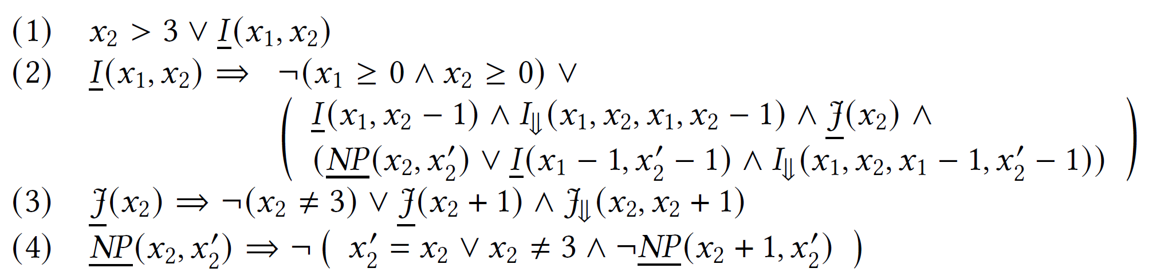
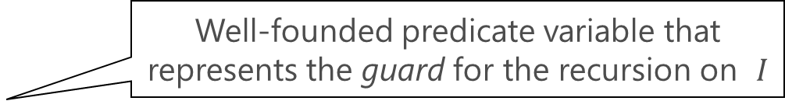
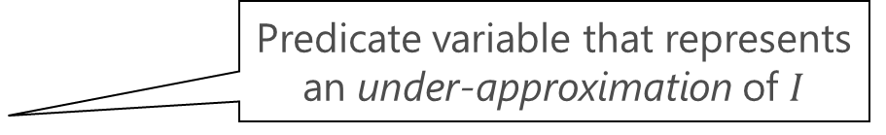
$μ$CLP encoding the termination verification problem
Reduce
Predicate variable that represents an under-approximation of $I$
The corresponding pfwCSP
Well-founded predicate variable that represents the guard for the recursion on $I$

Slide 17
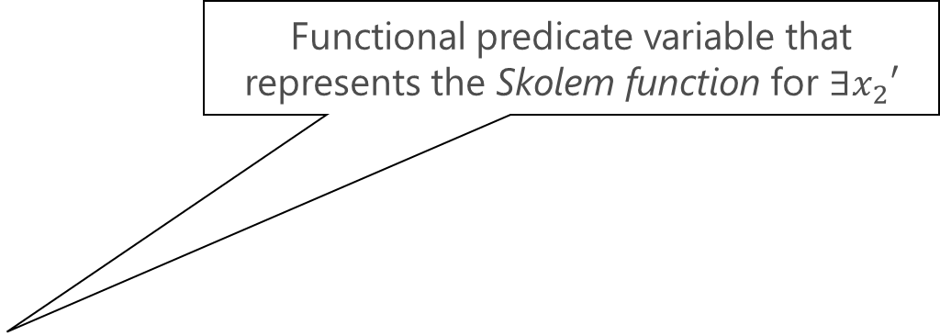
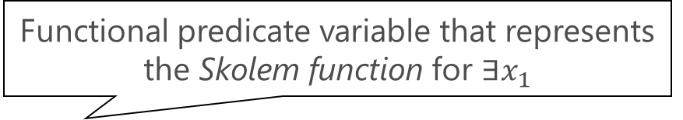
$μ$CLP encoding the non-termination verification problem
Functional predicate variable that represents the Skolem function for $∃x_{1}$
Reduce
The corresponding pfwCSP
Functional predicate variable that represents the Skolem function for $∃x_{2}′$

Slide 18
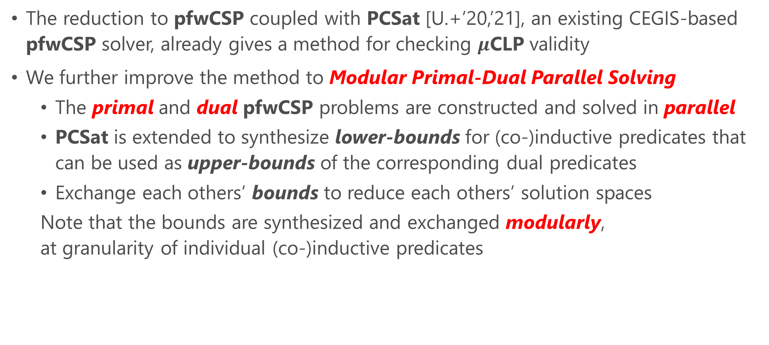
MuVal: A $μ$CLP Validity Checking Method
The reduction to pfwCSP coupled with PCSat [U.+’20,’21], an existing CEGIS-based pfwCSP solver, already gives a method for checking $μ$CLP validity
We further improve the method to Modular Primal-Dual Parallel Solving
  The primal and dual pfwCSP problems are constructed and solved in parallel
  PCSat is extended to synthesize lower-bounds for (co-)inductive predicates that can be used as upper-bounds of the corresponding dual predicates
  Exchange each others’ bounds to reduce each others’ solution spaces
  Note that the bounds are synthesized and exchanged modularly,
  at granularity of individual (co-)inductive predicates

Slide 19

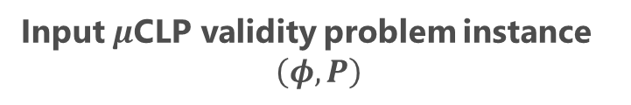


Overall Flow
Input $μ$CLP validity problem instance
$$\left(φ, P\right)$$
$$¬\left(φ, P\right)$$
Dualize
ToPfwCSP
ToPfwCSP
Primal Solver
$$\left(C_{p}, k_{p}\right)$$
Dual Solver
$$\left(C_{d}, k_{d}\right)$$
SAT
UNSAT
SAT
UNSAT
PCSAT [U.+ ‘20,’21]
PCSAT [U.+ ‘20,’21]
Cand. Sol.
Cand. Sol.
UB
UB
LOWERBOUNDSCHECK
LOWERBOUNDSCHECK
Valid
Invalid

Slide 20





Intuition behind Exchanging Upper Bounds
$$νNP=¬ μP$$
$\underline{P},\underline{NP}$ represent lower bounds synthesized by PCSat:
$\underline{P}⊆μP$ and $\underline{NP}⊆νNP$
Therefore,
$$μP⊆¬ \underline{NP}$$
and
$$νNP⊆¬ \underline{P}$$
$$μP$$
$$νNP$$
$$\underline{NP}$$
$$\underline{P}$$

Slide 21
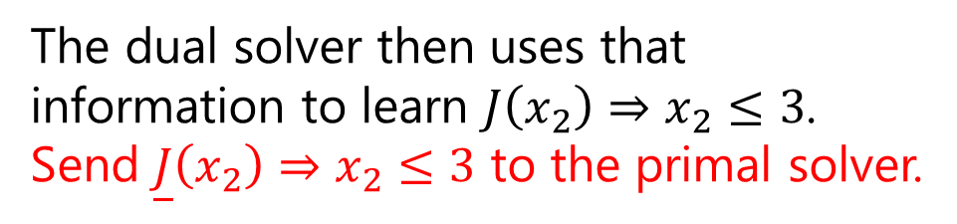
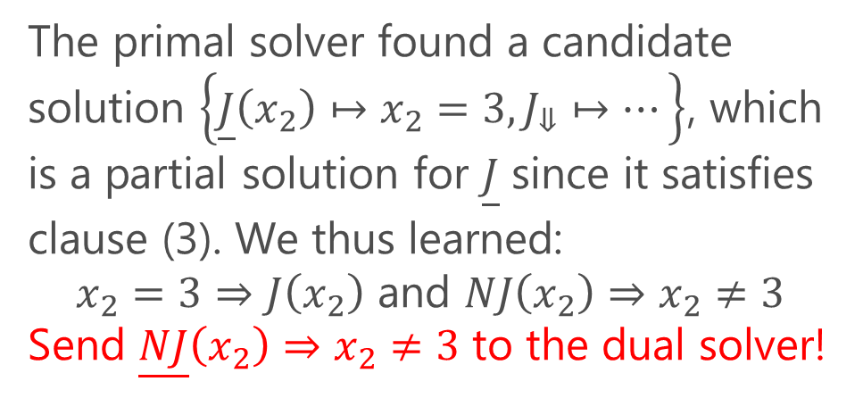
The primal pfwCSP
The primal solver found a candidate solution $\left\{\underline{J}\left(x_{2}\right)↦x_{2}=3,J_{⇓}↦…\right\}$, which is a partial solution for $\underline{J}$ since it satisfies clause (3). We thus learned:
$x_{2}=3⇒J\left(x_{2}\right)$ and $NJ\left(x_{2}\right)⇒x_{2}≠3$
Send $\underline{NJ}\left(x_{2}\right)⇒x_{2}≠3$ to the dual solver!
The dual solver then uses that information to learn $J\left(x_{2}\right)⇒x_{2}≤3$.
Send $\underline{J}\left(x_{2}\right)⇒x_{2}≤3$ to the primal solver.
The primal solver then uses it to obtain an actual solution, thus proving termination:

Slide 22
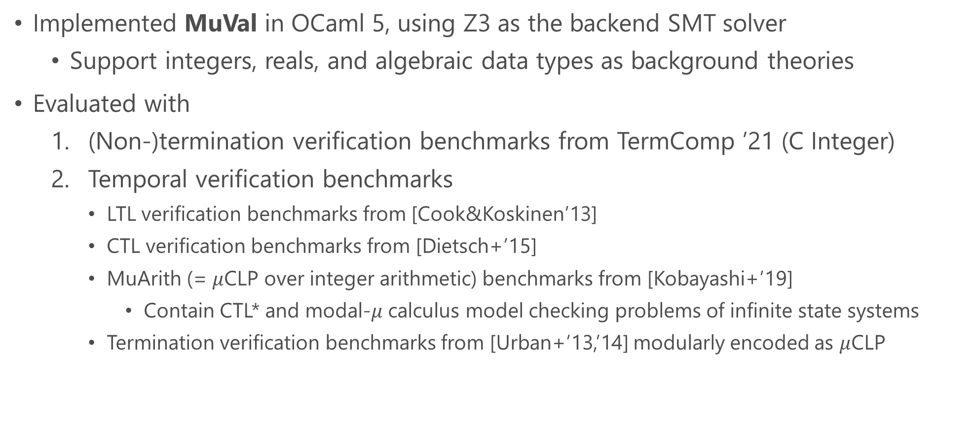
Implementation and Evaluation
Implemented MuVal in OCaml 5, using Z3 as the backend SMT solver
  Support integers, reals, and algebraic data types as background theories
Evaluated with
  (Non-)termination verification benchmarks from TermComp ’21 (C Integer)
  Temporal verification benchmarks
    LTL verification benchmarks from [Cook&Koskinen’13]
    CTL verification benchmarks from [Dietsch+’15]
    MuArith (= $μ$CLP over integer arithmetic) benchmarks from [Kobayashi+’19]
      Contain CTL* and modal-$μ$ calculus model checking problems of infinite state systems
    Termination verification benchmarks from [Urban+’13,’14] modularly encoded as $μ$CLP

Slide 23
Evaluation with TermComp Benchmarks
MuVal-parallel: MuVal with primal-dual parallel solving (but without exchange of learned upper-bounds)
AProVE: The winner of the C Integer track in 2018, 2020, and 2021
iRankFinder [Ben-Amram&Genaim’14]
UltimateAutomizer [Heizmann+’14]

Slide 24
Evaluation with TermComp Benchmarks
Mu2CHC: A MuArith validity checker based on a reduction to CHCs [Kobayashi+’19]
MuVal-parallel-exc: MuVal-parallel + exchange of learned upper-bounds
Notes:
Mu2CHC
Under-approximates (positive occurrences of) $μ$-predicates using heuristically-enumerated symbolic upper bounds for the number of expansion
translates the results into CHC constraints and solves them using CHC solvers (Spacer and HoICE)

Slide 25
Evaluation with Temporal Verification Benchmarks
The paper also presents a comparison with UltimateLTLAutomizer
[Dietsch+‘15]

Slide 26
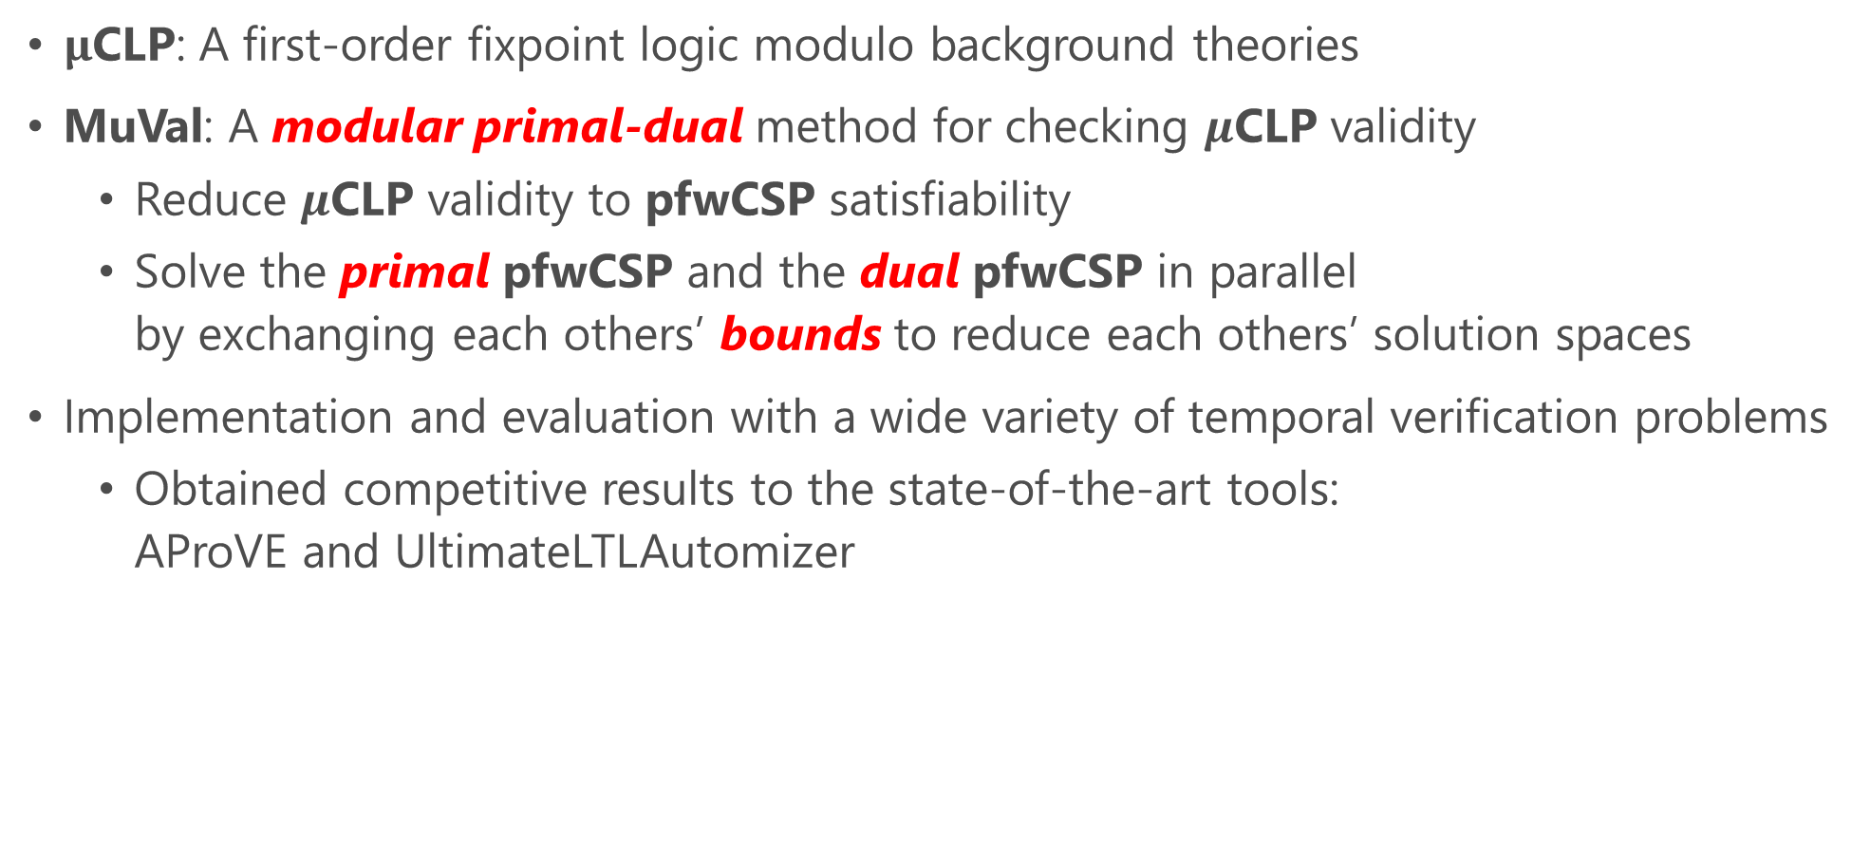
Summary
$μ$CLP: A first-order fixpoint logic modulo background theories
MuVal: A modular primal-dual method for checking $μ$CLP validity
  Reduce $μ$CLP validity to pfwCSP satisfiability
  Solve the primal pfwCSP and the dual pfwCSP in parallel
  by exchanging each others’ bounds to reduce each others’ solution spaces
Implementation and evaluation with a wide variety of temporal verification problems
  Obtained competitive results to the state-of-the-art tools:
  AProVE and UltimateLTLAutomizer

Slide 27
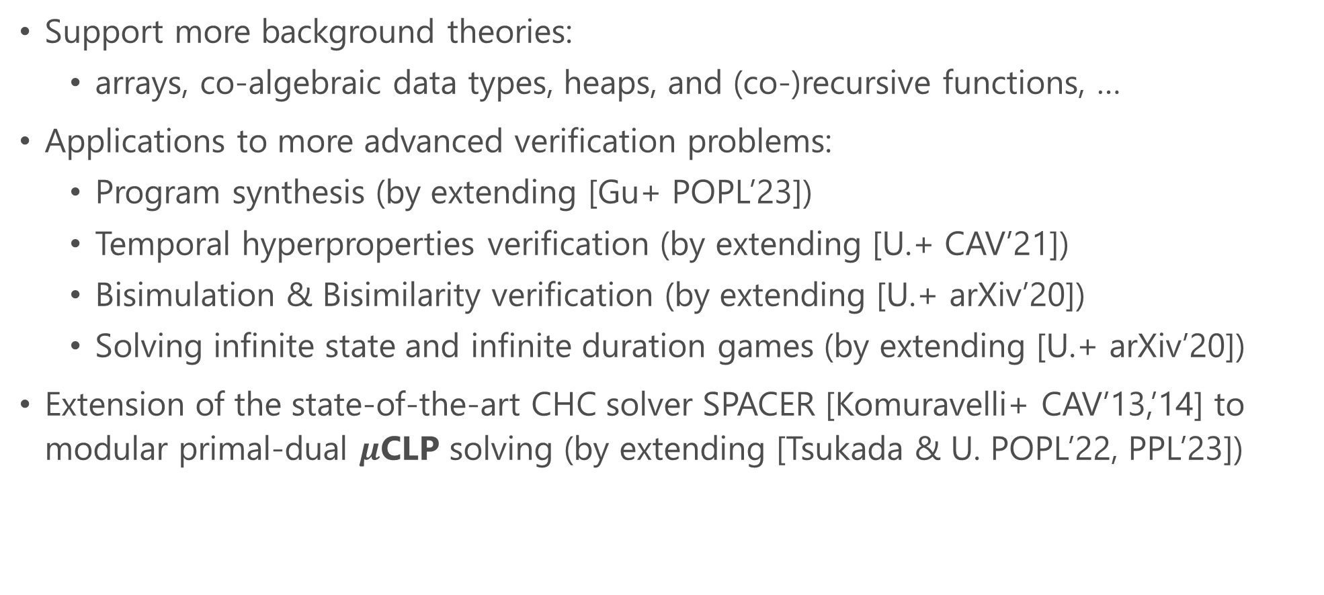
Future and Ongoing Work
Support more background theories:
  arrays, co-algebraic data types, heaps, and (co-)recursive functions, …
Applications to more advanced verification problems:
  Program synthesis (by extending [Gu+ POPL’23])
  Temporal hyperproperties verification (by extending [U.+ CAV’21])
  Bisimulation & Bisimilarity verification (by extending [U.+ arXiv’20])
  Solving infinite state and infinite duration games (by extending [U.+ arXiv’20])
Extension of the state-of-the-art CHC solver SPACER [Komuravelli+ CAV’13,’14] to
modular primal-dual $μ$CLP solving (by extending [Tsukada & U. POPL’22, PPL’23])

