Slide 1
Optimal CHC Solving via Termination Proofs
Yu Gu University of Tsukuba
Takeshi Tsukada Chiba University
Hiroshi Unno University of Tsukuba

Slide 2


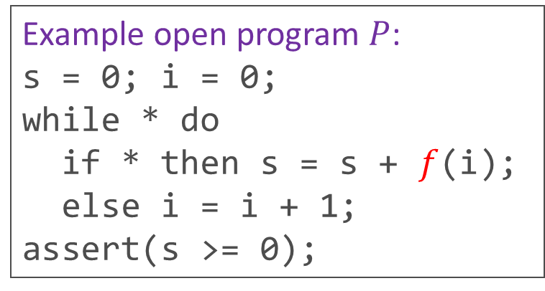
Background: Verification of Open Programs
Maximal specification synthesis [Albarghouthi+’16, Prabhu+’21, Zhou+’21, …]
  Given an open program $P$ that invokes an unknown function $f$
  Synthesize a maximally-weak specification of $f$among those ensuring the safety of $P$
Refinement type optimization [Hashimoto & U. ’15]
  Maximal specification synthesis for higher-order functional programs
  Maximize (resp. minimize) predicates in contravariant (resp. covariant) type positions
Example open program $P$:
s = 0; i = 0;
while * do
if * then s = s + $f$(i);
else i = i + 1;
assert(s >= 0);
Maximal specification of $f$:
$$f :\left(x :int\right)→\left\{y :int | x≥0⇒y≥0\right\}$$
For any $x$, if $f x$ terminates by returning $y$, then $x≥0⇒y≥0$ holds

Slide 3

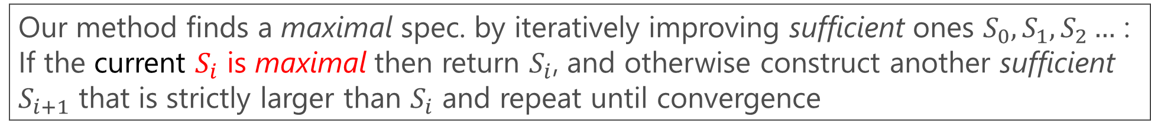
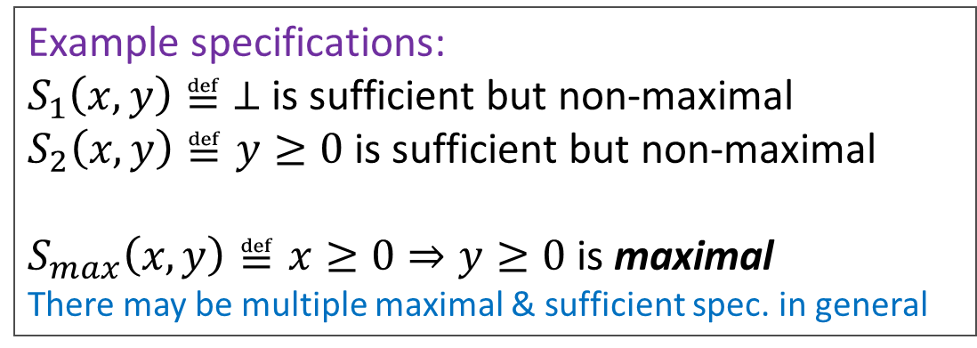

Our Approach to Maximal Specification Synthesis
The goal is to find a maximal specification of $f$among sufficient specifications
  A specification of $f :D→D′$ is a predicate $S⊆D×D′$ ($≈$ a postcondition of $f$)
  $S$ is sufficient $⟺$ The program $P$ is assertion safe for any implementation of $f$ satisfying $S$
  $S$ is maximal $⟺$ $∀\left(a,b\right)∉S$, $S∪\left\{\left(a,b\right)\right\}$ is insufficient
Example open program $P$:
s = 0; i = 0;
while * do
if * then s = s + $f$(i);
else i = i + 1;
assert(s >= 0);
Example specifications:
$S_{1}\left(x,y\right)≝ ⊥$ is sufficient but non-maximal
$S_{2}\left(x,y\right)≝y≥0$ is sufficient but non-maximal
$S_{max}\left(x,y\right)≝x≥0⇒y≥0$ is maximal
There may be multiple maximal & sufficient spec. in general
Check maximality via reduction to reachability analysis!
Our method finds a maximal spec. by iteratively improving sufficient ones $S_{0},S_{1},S_{2}…$ :
If the current $S_{i}$ is maximal then return $S_{i}$, and otherwise construct another sufficient $S_{i+1}$ that is strictly larger than $S_{i}$ and repeat until convergence

Slide 4

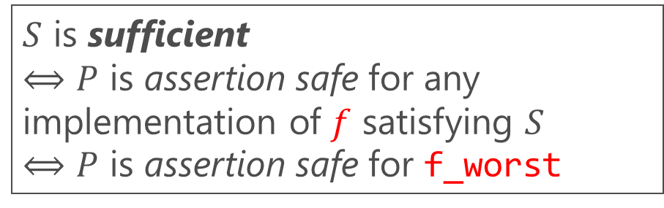
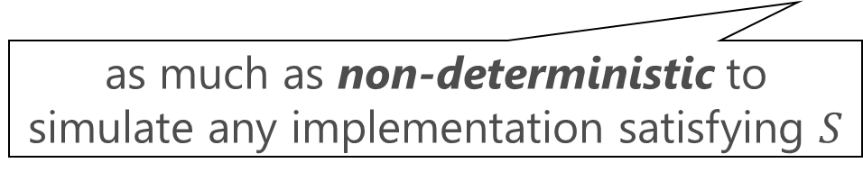

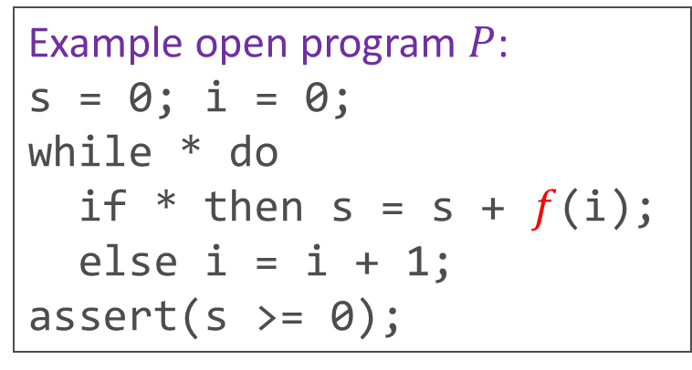
Sufficiency Checking as Safety Analysis
Use an implementation of $f$ that is the “worst” among those satisfying $S$
as much as non-deterministic to
simulate any implementation satisfying $S$
The sufficiency of $S$ is reduced to safety under demonic($∀$) non-deterministic choices of:
def f_worst(x):
y = nondet$∀$();
if $S$(x,y) then
return y else diverge
s = 0; i = 0;
while *$∀$ do
if *$∀$ then s = s + f_worst(i);
else i = i + 1;
assert(s >= 0);
Example open program $P$:
s = 0; i = 0;
while * do
if * then s = s + $f$(i);
else i = i + 1;
assert(s >= 0);
$S$ is sufficient
$⟺$ $P$ is assertion safe for any implementation of $f$ satisfying $S$
$⟺$ $P$ is assertion safe for f_worst

Slide 5
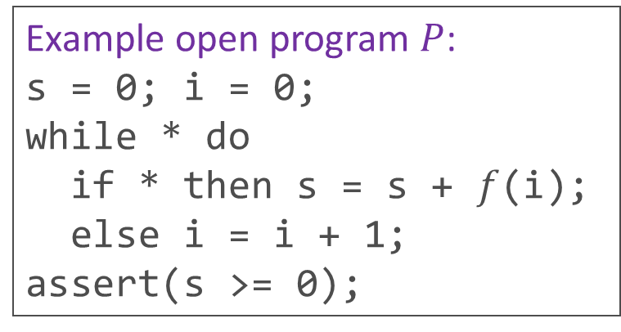
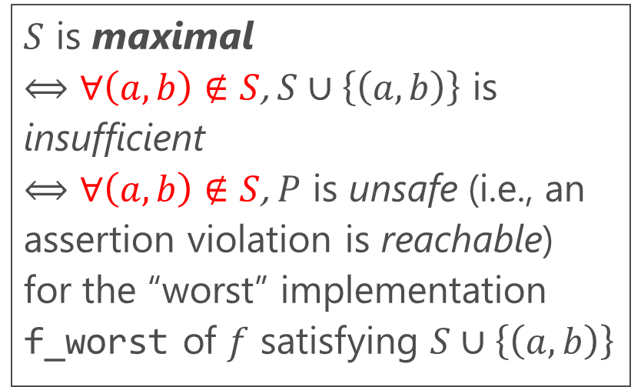
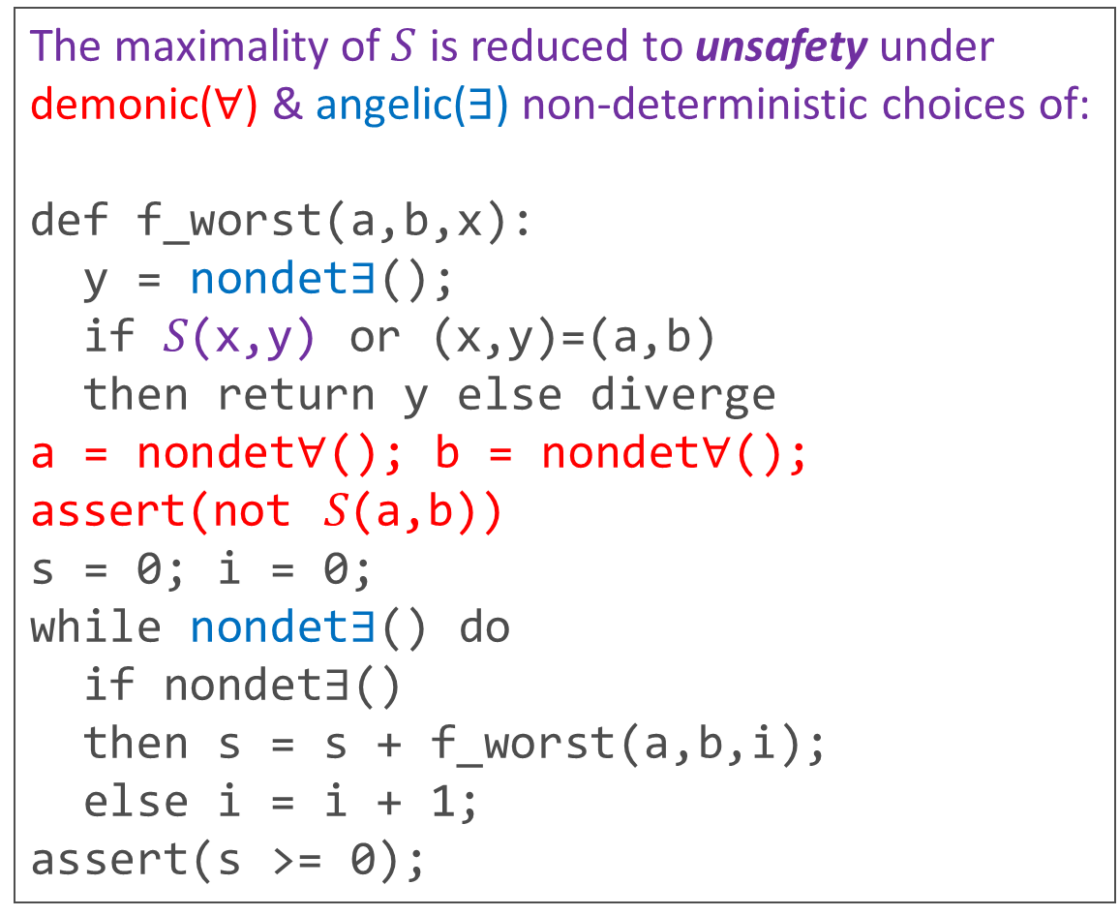
Maximality Checking as Reachability Analysis
$S$ is maximal
$⟺$ $∀\left(a,b\right)∉S$, $S∪\left\{\left(a,b\right)\right\}$ is insufficient
$⟺$ $∀\left(a,b\right)∉S$, $P$ is unsafe (i.e., an assertion violation is reachable)
for the “worst” implementation f_worst of $f$ satisfying $S∪\left\{\left(a,b\right)\right\}$
The maximality of $S$ is reduced to unsafety under demonic($∀$) & angelic($∃$) non-deterministic choices of:
def f_worst(a,b,x):
y = nondet$∃$();
if 𝑆(x,y) or (x,y)=(a,b)
then return y else diverge
a = nondet$∀$(); b = nondet$∀$();
assert(not 𝑆(a,b))
s = 0; i = 0;
while nondet$∃$() do
if nondet$∃$()
then s = s + f_worst(a,b,i);
else i = i + 1;
assert(s >= 0);
Example open program $P$:
s = 0; i = 0;
while * do
if * then s = s + $f$(i);
else i = i + 1;
assert(s >= 0);

Slide 6

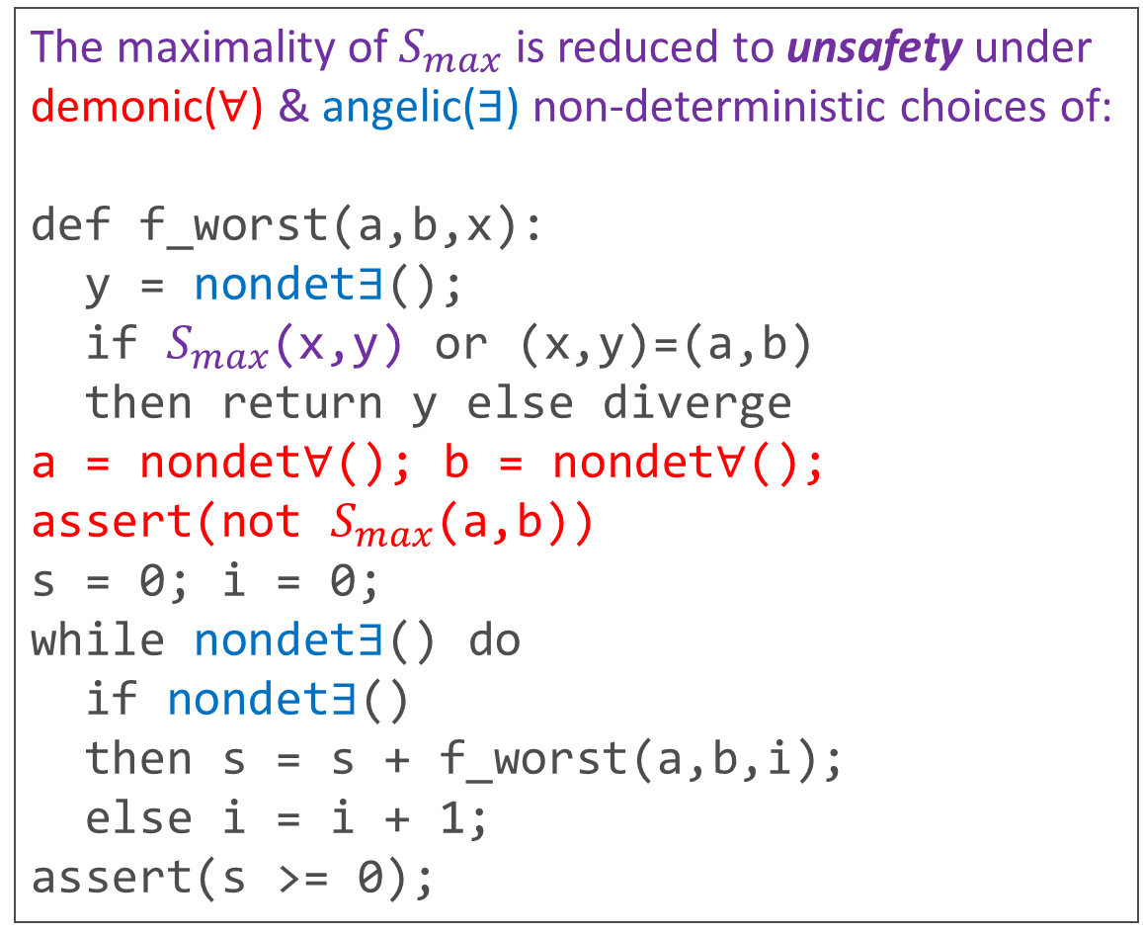
Maximality Checking as Reachability Analysis
$S$ is maximal
$⟺$ $∀\left(a,b\right)∉S$, $S∪\left\{\left(a,b\right)\right\}$ is insufficient
$⟺$ $∀\left(a,b\right)∉S$, $P$ is unsafe (i.e., an assertion violation is reachable)
for the “worst” implementation f_worst of $f$ satisfying $S∪\left\{\left(a,b\right)\right\}$
The maximality of $S_{max}$ is reduced to unsafety under demonic($∀$) & angelic($∃$) non-deterministic choices of:
def f_worst(a,b,x):
y = nondet$∃$();
if $S_{max}$(x,y) or (x,y)=(a,b)
then return y else diverge
a = nondet$∀$(); b = nondet$∀$();
assert(not $S_{max}$(a,b))
s = 0; i = 0;
while nondet$∃$() do
if nondet$∃$()
then s = s + f_worst(a,b,i);
else i = i + 1;
assert(s >= 0);
$$S_{max}\left(x,y\right)≝x≥0⇒y≥0$$
Example open program $P$:
s = 0; i = 0;
while * do
if * then s = s + $f$(i);
else i = i + 1;
assert(s >= 0);

Slide 7
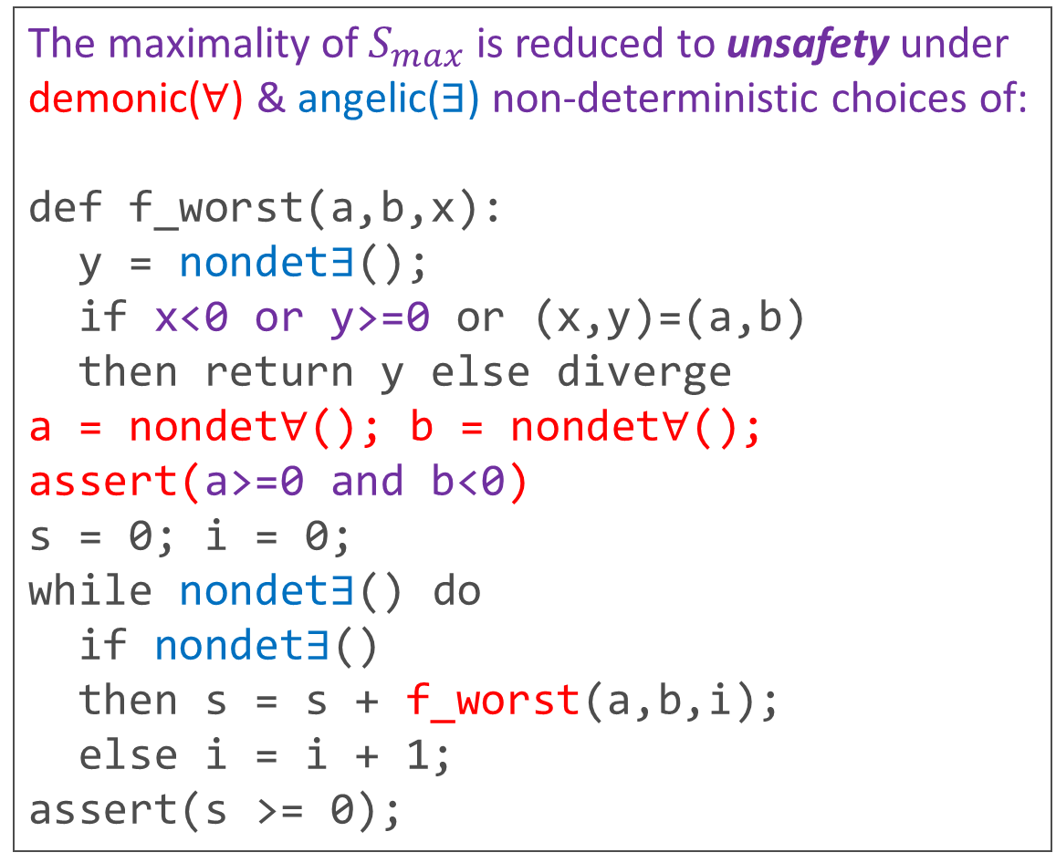
Maximality Checking as Reachability Analysis
$S$ is maximal
$⟺$ $∀\left(a,b\right)∉S$, $S∪\left\{\left(a,b\right)\right\}$ is insufficient
$⟺$ $∀\left(a,b\right)∉S$, $P$ is unsafe (i.e., an assertion violation is reachable)
for the “worst” implementation f_worst of $f$ satisfying $S∪\left\{\left(a,b\right)\right\}$
The maximality of $S_{max}$ is reduced to unsafety under demonic($∀$) & angelic($∃$) non-deterministic choices of:
def f_worst(a,b,x):
y = nondet$∃$();
if x<0 or y>=0 or (x,y)=(a,b)
then return y else diverge
a = nondet$∀$(); b = nondet$∀$();
assert(a>=0 and b<0)
s = 0; i = 0;
while nondet$∃$() do
if nondet$∃$()
then s = s + f_worst(a,b,i);
else i = i + 1;
assert(s >= 0);
$$S_{max}\left(x,y\right)≝x≥0⇒y≥0$$
Example open program $P$:
s = 0; i = 0;
while * do
if * then s = s + $f$(i);
else i = i + 1;
assert(s >= 0);

Slide 8
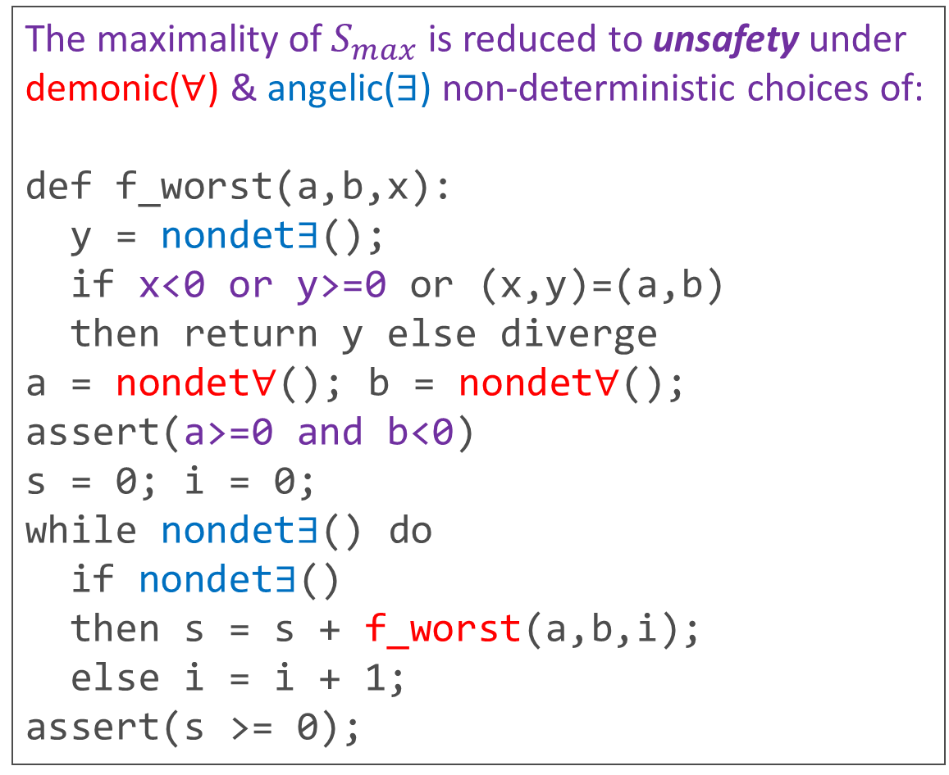
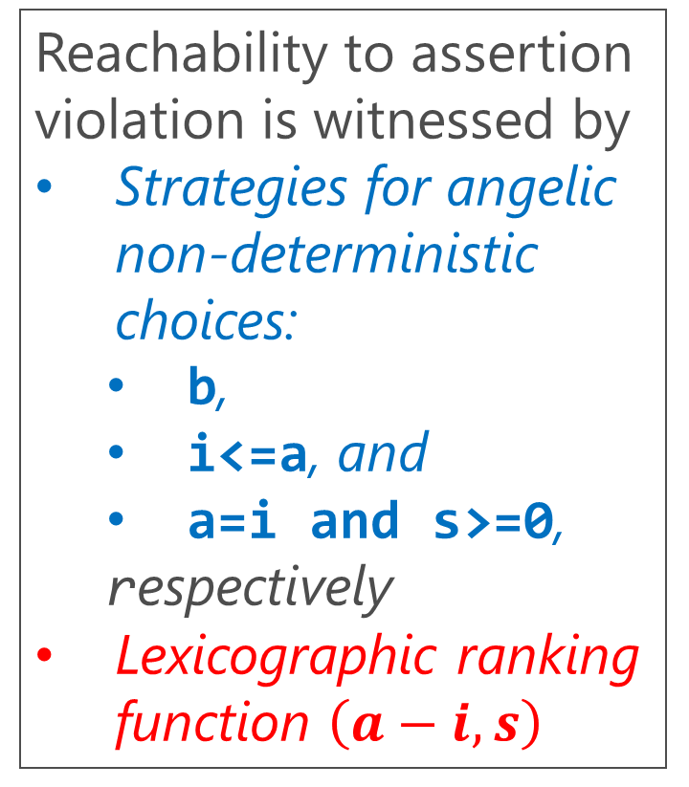

Maximality Checking as Reachability Analysis
The maximality of $S_{max}$ is reduced to unsafety under demonic($∀$) & angelic($∃$) non-deterministic choices of:
def f_worst(a,b,x):
y = nondet$∃$();
if x<0 or y>=0 or (x,y)=(a,b)
then return y else diverge
a = nondet$∀$(); b = nondet$∀$();
assert(a>=0 and b<0)
s = 0; i = 0;
while nondet$∃$() do
if nondet$∃$()
then s = s + f_worst(a,b,i);
else i = i + 1;
assert(s >= 0);
$$S_{max}\left(x,y\right)≝x≥0⇒y≥0$$
Reachability to assertion violation is witnessed by
Strategies for angelic non-deterministic choices:
  b,
  i<=a, and
  a=i and s>=0,
  respectively
Lexicographic ranking function $\left(a−i,s\right)$

Slide 9
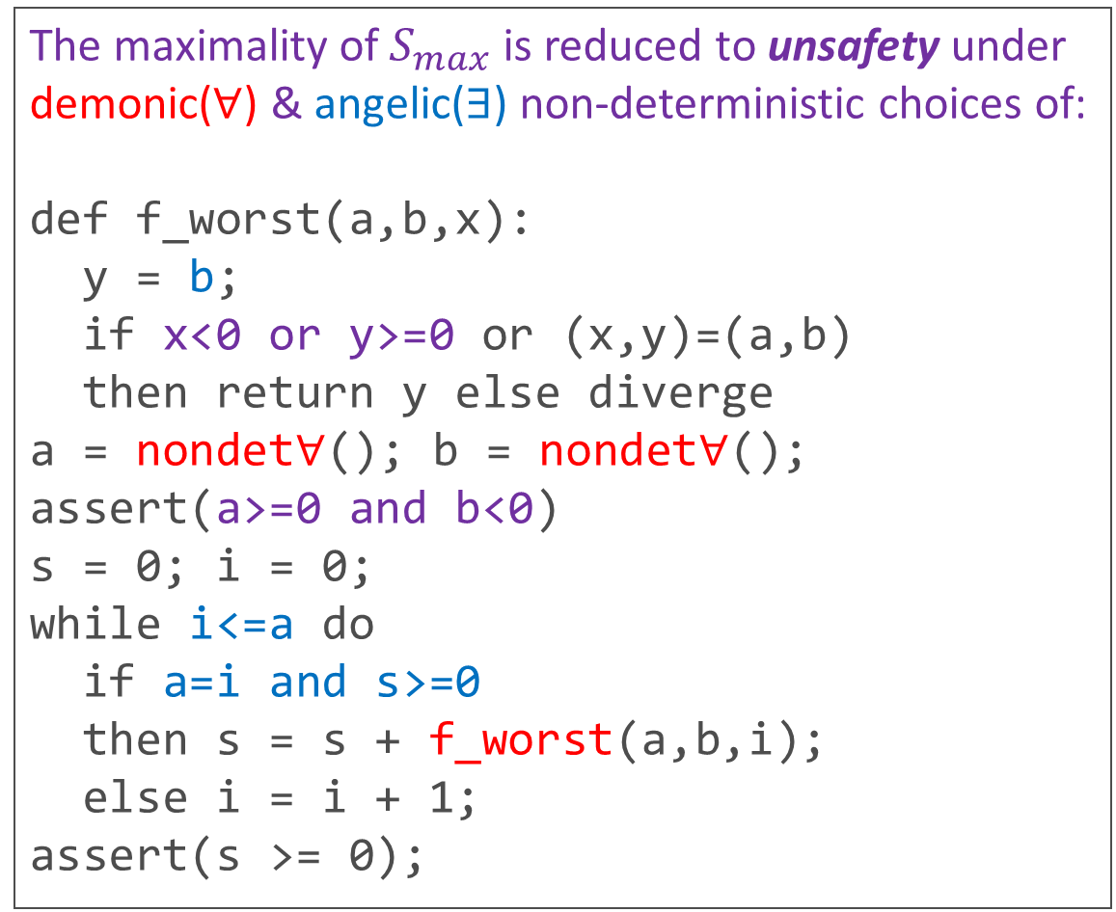
Maximality Checking as Reachability Analysis
The maximality of $S_{max}$ is reduced to unsafety under demonic($∀$) & angelic($∃$) non-deterministic choices of:
def f_worst(a,b,x):
y = b;
if x<0 or y>=0 or (x,y)=(a,b)
then return y else diverge
a = nondet$∀$(); b = nondet$∀$();
assert(a>=0 and b<0)
s = 0; i = 0;
while i<=a do
if a=i and s>=0
then s = s + f_worst(a,b,i);
else i = i + 1;
assert(s >= 0);
$$S_{max}\left(x,y\right)≝x≥0⇒y≥0$$
Reachability to assertion violation is witnessed by
Strategies for angelic non-deterministic choices:
  b,
  i<=a, and
  a=i and s>=0,
  respectively
Lexicographic ranking function $\left(a−i,s\right)$

Slide 10
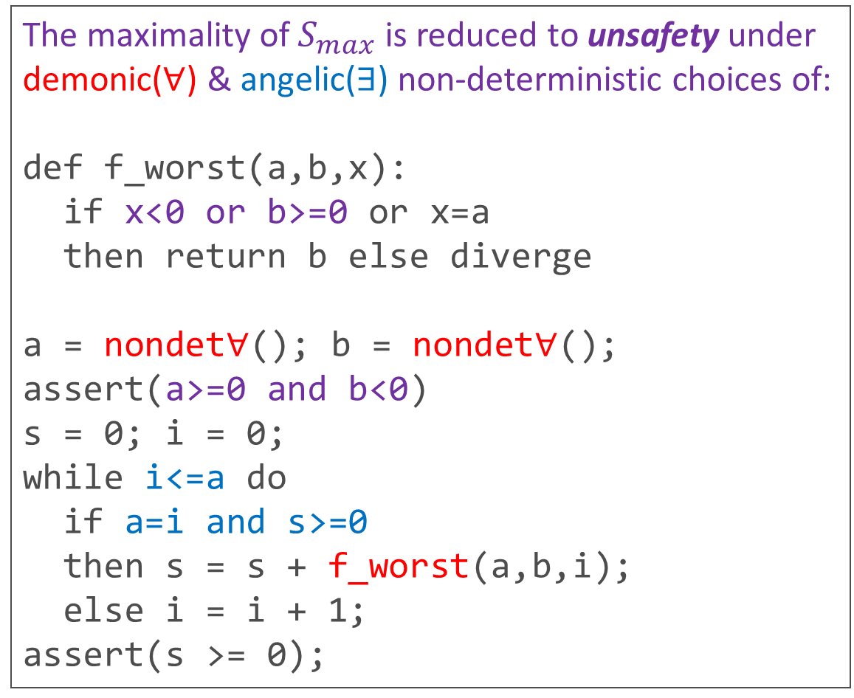
Maximality Checking as Reachability Analysis
The maximality of $S_{max}$ is reduced to unsafety under demonic($∀$) & angelic($∃$) non-deterministic choices of:
def f_worst(a,b,x):
if x<0 or b>=0 or x=a
then return b else diverge
a = nondet$∀$(); b = nondet$∀$();
assert(a>=0 and b<0)
s = 0; i = 0;
while i<=a do
if a=i and s>=0
then s = s + f_worst(a,b,i);
else i = i + 1;
assert(s >= 0);
$$S_{max}\left(x,y\right)≝x≥0⇒y≥0$$
Reachability to assertion violation is witnessed by
Strategies for angelic non-deterministic choices:
  b,
  i<=a, and
  a=i and s>=0,
  respectively
Lexicographic ranking function $\left(a−i,s\right)$

Slide 11
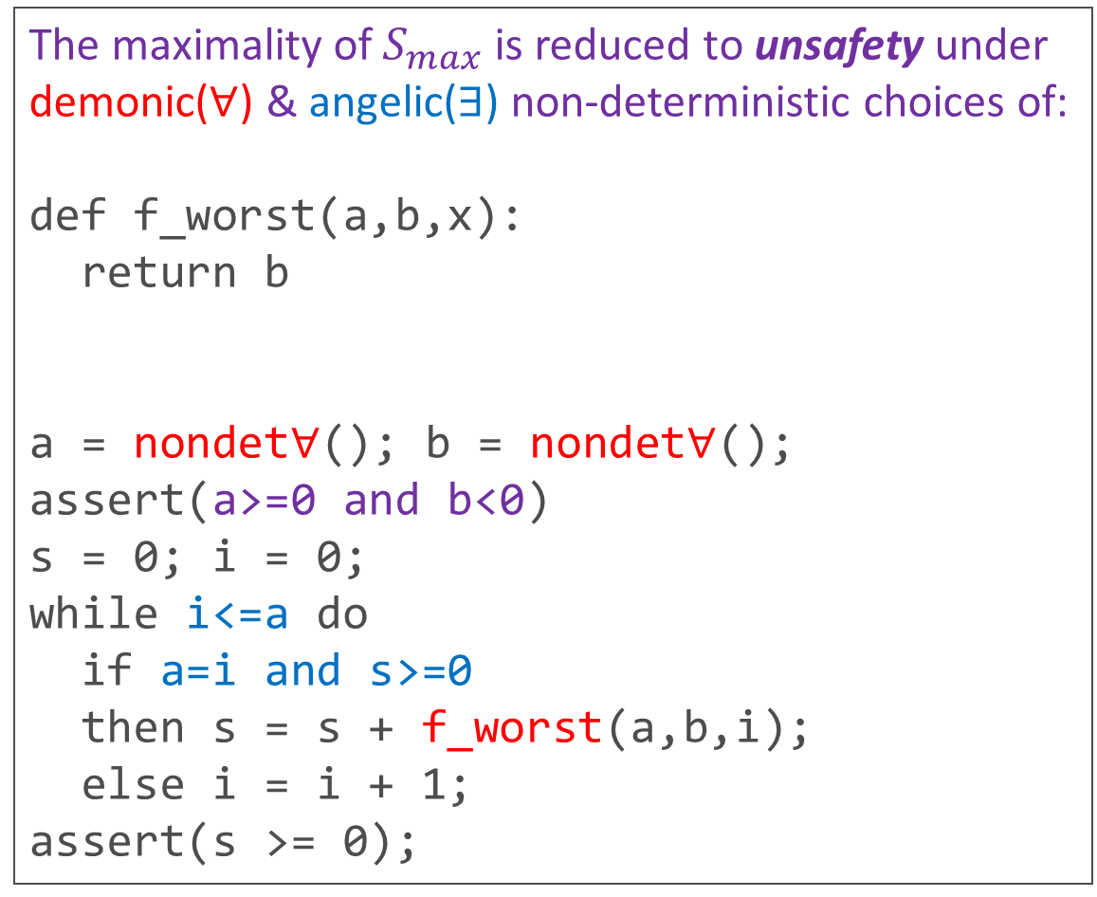
Maximality Checking as Reachability Analysis
The maximality of $S_{max}$ is reduced to unsafety under demonic($∀$) & angelic($∃$) non-deterministic choices of:
def f_worst(a,b,x):
return b
a = nondet$∀$(); b = nondet$∀$();
assert(a>=0 and b<0)
s = 0; i = 0;
while i<=a do
if a=i and s>=0
then s = s + f_worst(a,b,i);
else i = i + 1;
assert(s >= 0);
$$S_{max}\left(x,y\right)≝x≥0⇒y≥0$$
Reachability to assertion violation is witnessed by
Strategies for angelic non-deterministic choices:
  b,
  i<=a, and
  a=i and s>=0,
  respectively
Lexicographic ranking function $\left(a−i,s\right)$

Slide 12
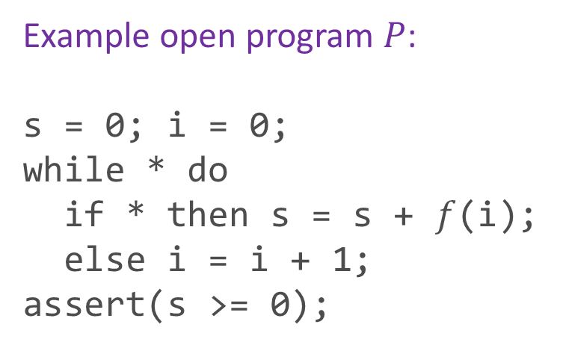


Maximal Specification Synthesis as CHC Optimization
Maximal specification synthesis problems can be reduced to problems of finding an optimal solution of Constrained Horn Clauses (CHCs), by using a standard translation from programs to CHCs and introducing a fresh predicate variable $F$ representing an unknown specification for the external function $f$
Example open program $P$:
s = 0; i = 0;
while * do
if * then s = s + $f$(i);
else i = i + 1;
assert(s >= 0);
Reduced CHC optimization problem:
$$maximize F s.t. \\ \left\{\begin{aligned}I\left(0,0\right), \\ I\left(s,i\right)∧F\left(i,r\right)⇒I\left(s+r,i\right), \\ I\left(s,i\right)⇒I\left(s,i+1\right), \\ I\left(s,i\right)⇒s≥0\end{aligned}\right\}$$

Slide 13

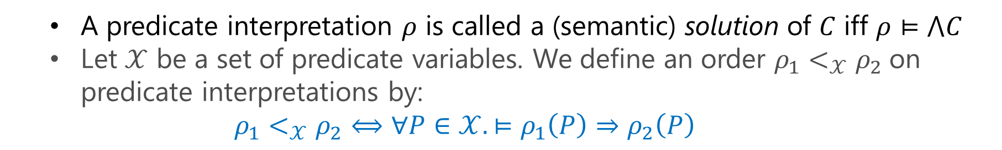
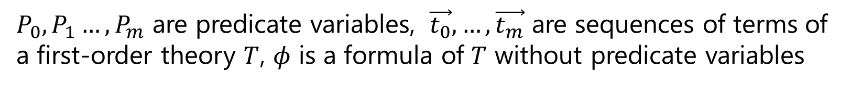

CHC Solving
A CHC system $C$ is a finite set of constrained Horn Clauses of either form:
$$P_{0}\left(\vec{t_{0}}\right)⟸\left(P_{1}\left(\vec{t_{1}}\right)∧…∧P_{m}\left(\vec{t_{m}}\right)∧φ\right)$$
or
$$⊥ ⟸\left(P_{1}\left(\vec{t_{1}}\right)∧…∧P_{m}\left(\vec{t_{m}}\right)∧φ\right)$$
$P_{0},P_{1}…,P_{m}$ are predicate variables, $\vec{t_{0}},…,\vec{t_{m}}$ are sequences of terms of a first-order theory $T$, $φ$ is a formula of $T$ without predicate variables
  A predicate interpretation $ρ$ is called a (semantic) solution of $C$ iff $ρ⊨⋀C$
  Let $𝒳$ be a set of predicate variables. We define an order ${ρ_{1}<}_{𝒳}ρ_{2}$on predicate interpretations by:
  ${ρ_{1}<}_{𝒳}ρ_{2}⟺∀P∈𝒳.⊨ρ_{1}\left(P\right)⇒ρ_{2}\left(P\right)$

Slide 14
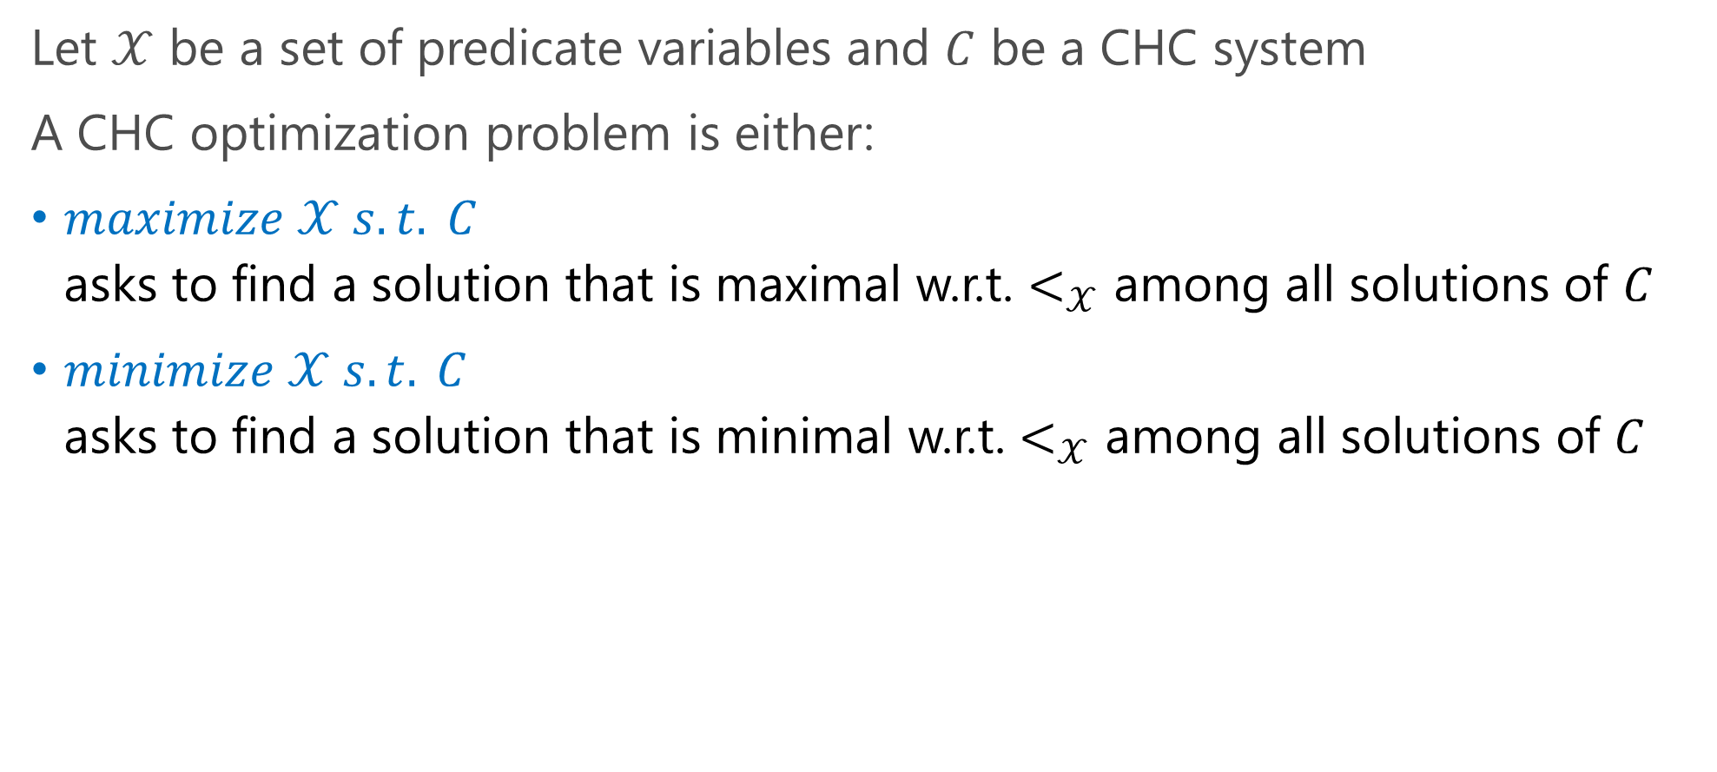
CHC Optimization [Hashimoto & U. ’15]
Let $𝒳$ be a set of predicate variables and $C$ be a CHC system
A CHC optimization problem is either:
$maximize 𝒳 s.t. C$
asks to find a solution that is maximal w.r.t. $<_{𝒳}$ among all solutions of $C$
$minimize 𝒳 s.t. C$
asks to find a solution that is minimal w.r.t. $<_{𝒳}$ among all solutions of $C$

Slide 15
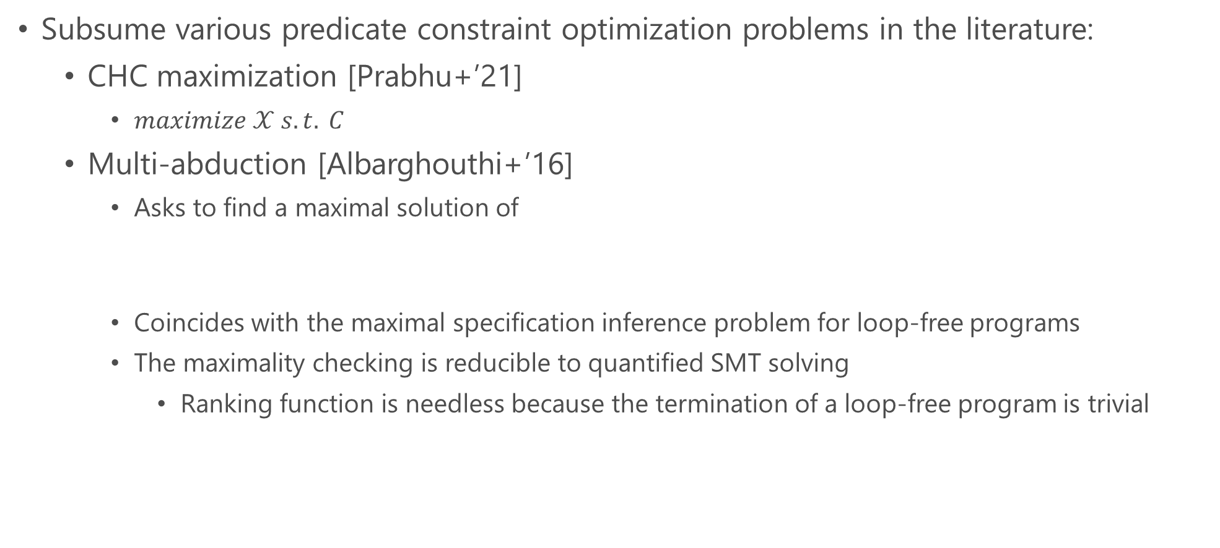
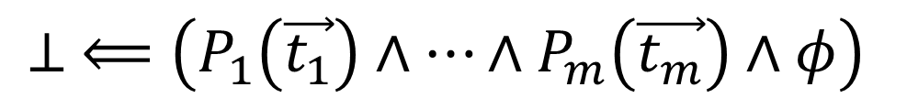
CHC Optimization [Hashimoto & U. ’15] (cont.)
Subsume various predicate constraint optimization problems in the literature:
  CHC maximization [Prabhu+’21]
    $maximize 𝒳 s.t. C$
  Multi-abduction [Albarghouthi+’16]
    Asks to find a maximal solution of
    Coincides with the maximal specification inference problem for loop-free programs
    The maximality checking is reducible to quantified SMT solving
      Ranking function is needless because the termination of a loop-free program is trivial
$$⊥ ⟸\left(P_{1}\left(\vec{t_{1}}\right)∧…∧P_{m}\left(\vec{t_{m}}\right)∧φ\right)$$

Slide 16
Our Contributions
A computational theoretical analysis of the optimality checking problem for CHCs
OptPCSat: A CHC optimization method based on termination analysis
Implementation and evaluation of OptPCSat

Slide 17
Our Contributions
A computational theoretical analysis of the optimality checking problem for CHCs
OptPCSat: A CHC optimization method based on termination analysis
Implementation and evaluation of OptPCSat

Slide 18
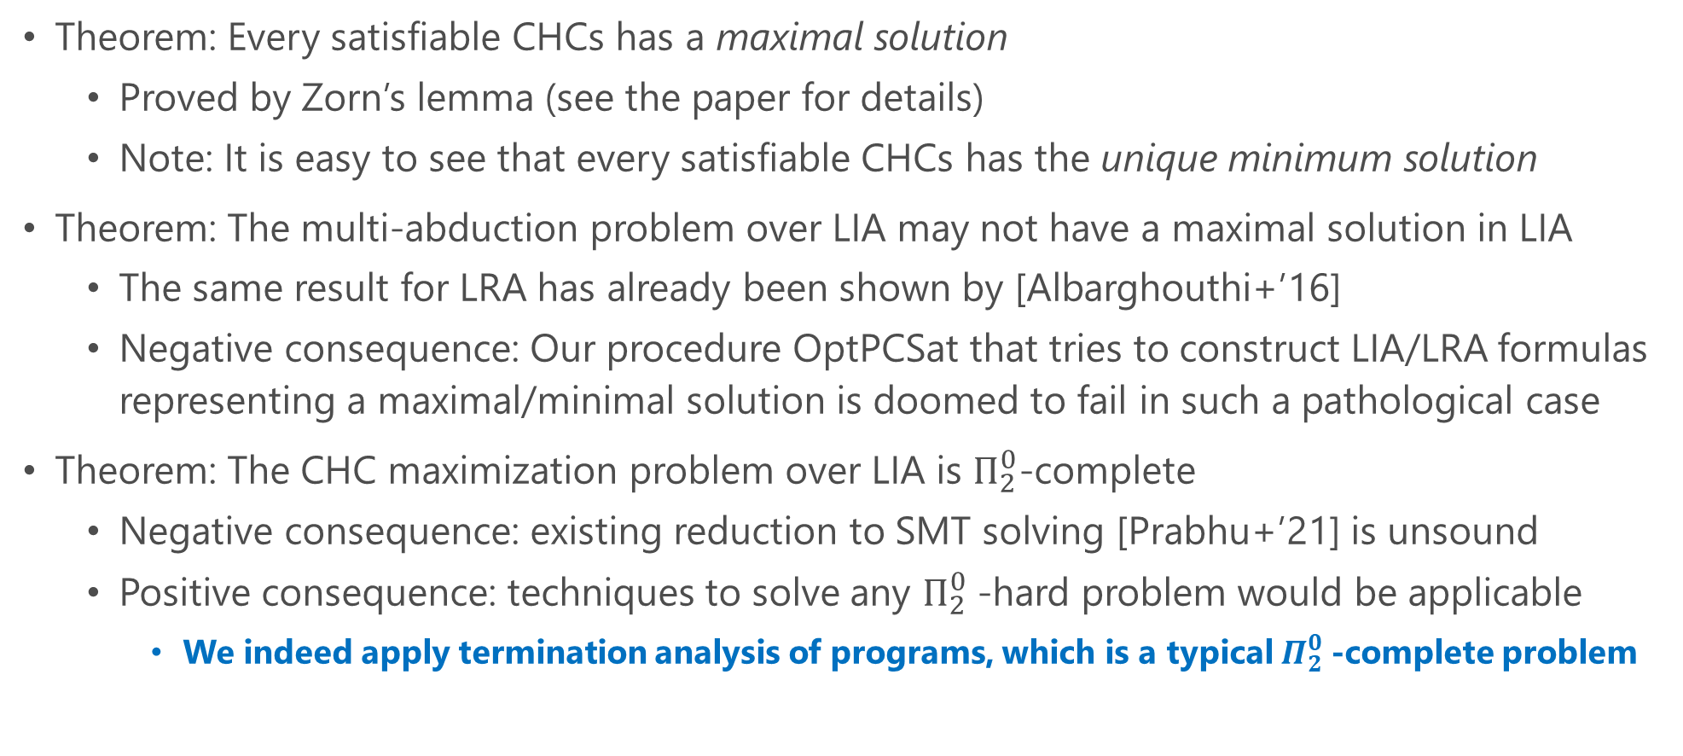
Computational Theoretical Analysis of
CHC Optimization and Multi-Abduction
Theorem: Every satisfiable CHCs has a maximal solution
  Proved by Zorn’s lemma (see the paper for details)
  Note: It is easy to see that every satisfiable CHCs has the unique minimum solution
Theorem: The multi-abduction problem over LIA may not have a maximal solution in LIA
  The same result for LRA has already been shown by [Albarghouthi+’16]
  Negative consequence: Our procedure OptPCSat that tries to construct LIA/LRA formulas representing a maximal/minimal solution is doomed to fail in such a pathological case
Theorem: The CHC maximization problem over LIA is $Π_{2}^{0}$-complete
  Negative consequence: existing reduction to SMT solving [Prabhu+’21] is unsound
  Positive consequence: techniques to solve any $Π_{2}^{0}$-hard problem would be applicable
    We indeed apply termination analysis of programs, which is a typical $Π_{2}^{0}$-complete problem

Slide 19
Our Contributions
A computational theoretical analysis of the optimality checking problem for CHCs
OptPCSat: A CHC optimization method based on termination analysis
Implementation and evaluation of OptPCSat

Slide 20
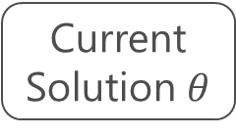

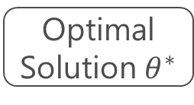
OptPCSat
Iteratively refine the current solution until an optimal one is found
Check optimality and non-optimality of the current solution in parallel
  Reduce non-optimality to satisfiability of CHCs with non-emptiness constraints
  Reduce optimality to satisfiability of pfwCSP
Current Solution $θ$
Refine $θ$
Non-Optimality Check
Optimality Check
Optimal Solution${ θ}^{∗}$

Slide 21
OptPCSat
Iteratively refine the current solution until an optimal one is found
Check optimality and non-optimality of the current solution in parallel
  Reduce non-optimality to satisfiability of CHCs with non-emptiness constraints
  Reduce optimality to satisfiability of pfwCSP
Current Solution $θ$
Refine $θ$
Non-Optimality Check
Optimality Check
Optimal Solution${ θ}^{∗}$

Slide 22
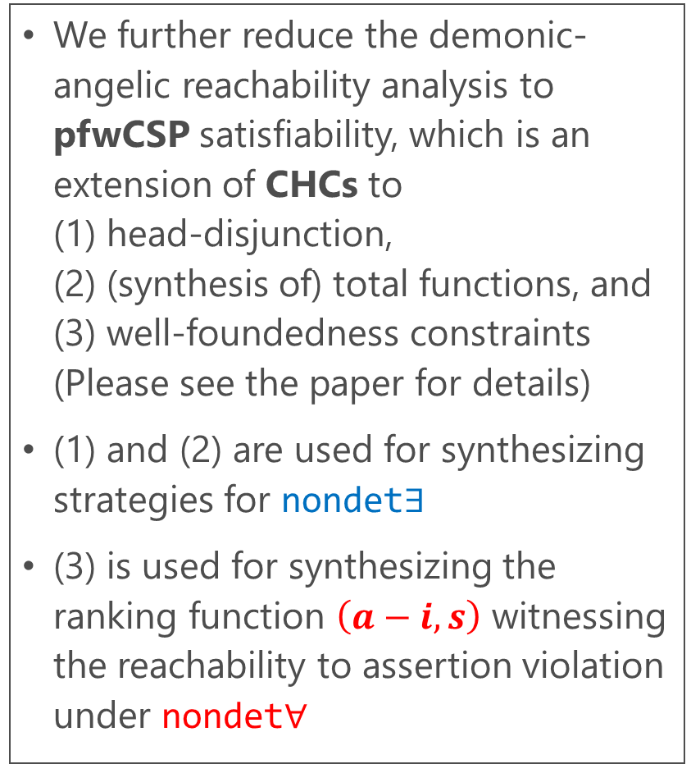
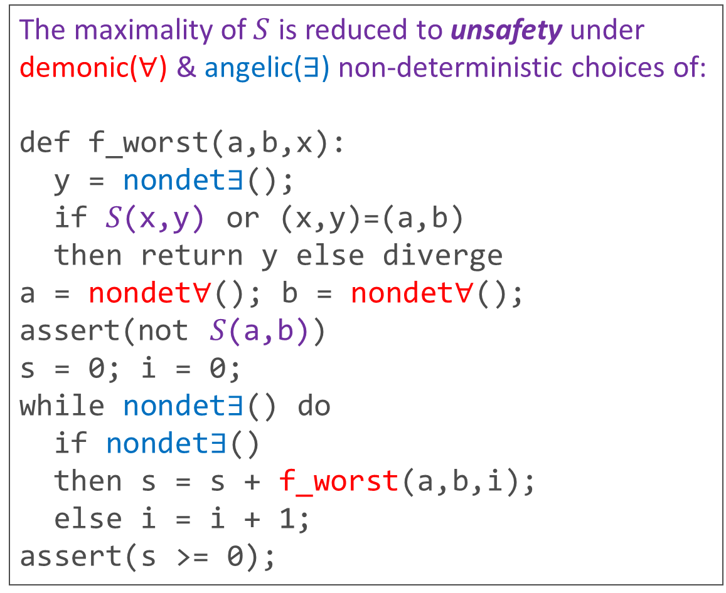
Constraint-based Maximality Checking
The maximality of $S$ is reduced to unsafety under demonic($∀$) & angelic($∃$) non-deterministic choices of:
def f_worst(a,b,x):
y = nondet$∃$();
if 𝑆(x,y) or (x,y)=(a,b)
then return y else diverge
a = nondet$∀$(); b = nondet$∀$();
assert(not 𝑆(a,b))
s = 0; i = 0;
while nondet$∃$() do
if nondet$∃$()
then s = s + f_worst(a,b,i);
else i = i + 1;
assert(s >= 0);
We further reduce the demonic-angelic reachability analysis to pfwCSP satisfiability, which is an extension of CHCs to
(1) head-disjunction,
(2) (synthesis of) total functions, and
(3) well-foundedness constraints
(Please see the paper for details)
(1) and (2) are used for synthesizing strategies for nondet$∃$
(3) is used for synthesizing the ranking function $\left(a−i,s\right)$ witnessing the reachability to assertion violation under nondet$∀$

Slide 23
OptPCSat
Iteratively refine the current solution until an optimal one is found
Check optimality and non-optimality of the current solution in parallel
  Reduce non-optimality to satisfiability of CHCs with Non-Emptiness constraints
  Reduce optimality to satisfiability of pfwCSP
Current Solution $θ$
Refine $θ$
Non-Optimality Check
Optimality Check
Optimal Solution${ θ}^{∗}$

Slide 24

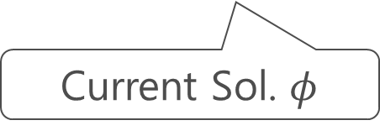

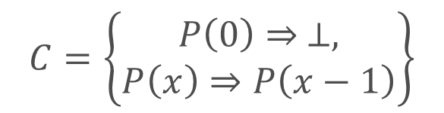

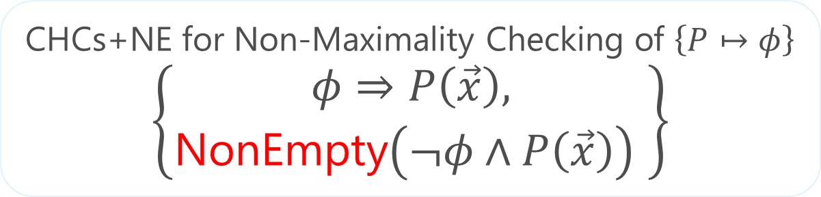
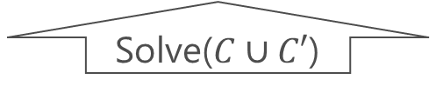
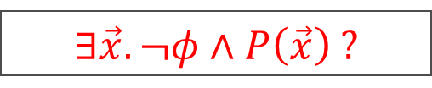
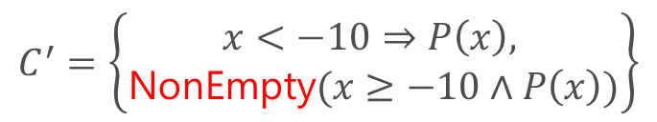


Constraint-based Non-Maximality Checking
$$∃\vec{x}. ¬φ∧P\left(\vec{x}\right) ?$$
$$P$$
Current Solution $φ$
CHCs+NE for Non-Maximality Checking of $\left\{P↦φ\right\}$
$$\left\{\begin{aligned}φ⇒P\left(\vec{x}\right), \\ \text{NonEmpty}\left(¬φ∧P\left(\vec{x}\right)\right) \end{aligned}\right\}$$
$$C=\left\{\begin{aligned}P\left(0\right)⇒ ⊥, \\ P\left(x\right)⇒P\left(x−1\right)\end{aligned}\right\}$$
$$θ′=\left\{P\left(x\right)↦x<0\right\}$$
Solve($C∪C′$)
Solve($C$)
$$C^{′}=\left\{\begin{aligned}x<−10⇒P\left(x\right), \\ \text{N}\text{on}\text{E}\text{mpty}(x≥−10∧P\left(x\right))\end{aligned}\right\}$$
$$θ=\left\{P\left(x\right)↦x<−10\right\}$$
Current Sol. $φ$

Slide 25
Our Contributions
A computational theoretical analysis of the optimality checking problem for CHCs
OptPCSat: A CHC optimization method based on termination analysis
Implementation and evaluation of OptPCSat

Slide 26
Implementation and Evaluation
Implemented OptPCSat in OCaml 5, using Z3 as a backend SMT solver
Compared with HornSpec [Prabhu+’21] that uses unsound SMT-based maximality checker,
using CHC Maximization Benchmarks (Total 72)
  65 instances from [Prabhu+’21] that encode maximal specification synthesis problems
  7 new instances manually designed to work as a counterexample for HornSpec
OptPCSat found optimal solutions for non-trivial CHC optimization problems, despite the hardness
HornSpec is generally faster as expected
  Among 57 solutions returned, OptPCSat has successfully shown that 47 solutions are optimal and 2 solutions are nonoptimal
  Practically useful to combine OptPCSat and HornSpec to complement each other!
Notes:
Amazon Linux 2, Intel(R) Xeon(R) Platinum 8259CL CPU @ 2.50GHz CPU and 32 GiB RAM. The time limit was 600 seconds

Slide 27
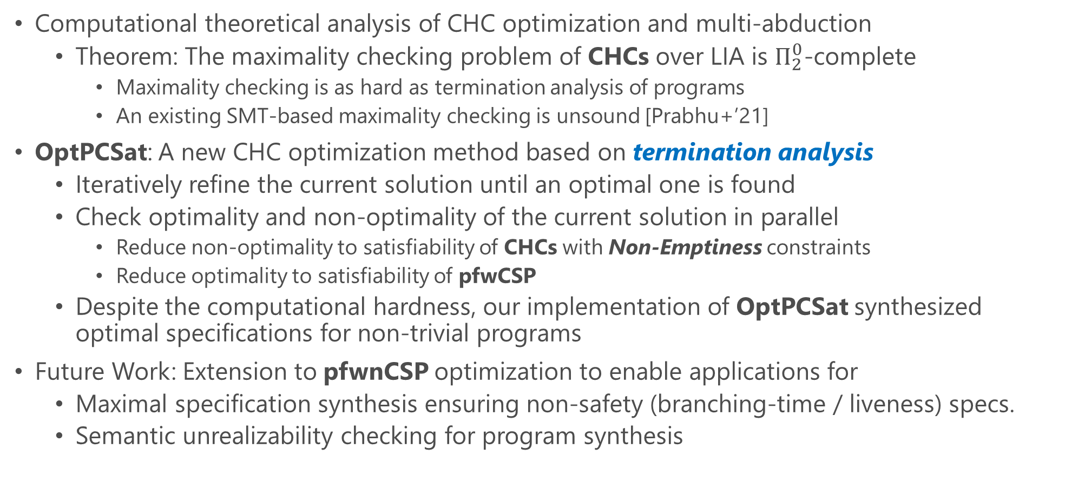
Conclusion
Computational theoretical analysis of CHC optimization and multi-abduction
  Theorem: The maximality checking problem of CHCs over LIA is $Π_{2}^{0}$-complete
    Maximality checking is as hard as termination analysis of programs
    An existing SMT-based maximality checking is unsound [Prabhu+’21]
OptPCSat: A new CHC optimization method based on termination analysis
  Iteratively refine the current solution until an optimal one is found
  Check optimality and non-optimality of the current solution in parallel
    Reduce non-optimality to satisfiability of CHCs with Non-Emptiness constraints
    Reduce optimality to satisfiability of pfwCSP
  Despite the computational hardness, our implementation of OptPCSat synthesized optimal specifications for non-trivial programs
Future Work: Extension to pfwnCSP optimization to enable applications for
  Maximal specification synthesis ensuring non-safety (branching-time / liveness) specs.
  Semantic unrealizability checking for program synthesis

