Slide 1
Refinement Type Inference via Horn Constraint Optimization
Kodai Hashimoto and Hiroshi Unno
(University of Tsukuba, Japan)
Notes:
Good morning everyone.
I’m Kodai Hashimoto a master course student of University of Tsukuba.
This is a joint work with Hiroshi Unno.
In this talk, we propose refinement type optimization, which is a problem of inferring maximally-preferred refinement types with respect to a user-specified preference order on types.
It has various applications in static analysis.

Slide 2
Our Goal: Path-Sensitive Program Analysis of Higher-order Non-det. Functional Programs
Precondition inference
Bug finding
(Conditional) termination analysis
Non-termination analysis
Modular verification
…
Refinement type optimization
a generalization of ordinary
refinement type inference
Notes:
More precisely, our goal is a path-sensitive program analysis of higher-order and non-deterministic functional programs, such as precondition inference, bug finding, termination and non-termination analysis and so on.
We can reduce these analysis problems into our refinement type optimization, a generalization of ordinary refinement type inference.
Before explaining type optimization, let me explain ordinary refinement type inference.

Slide 3
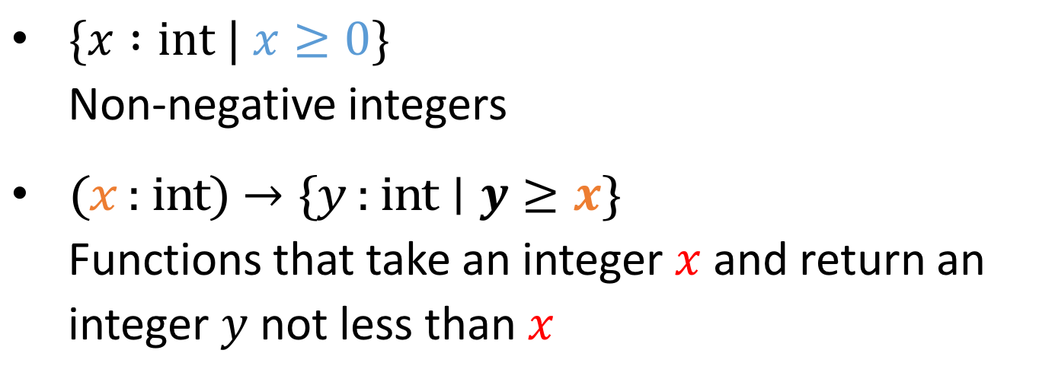
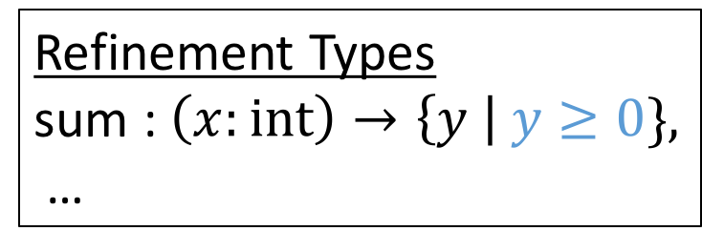
Refinement Type Inference
Program
let rec sum x =
…
Infer
Refinement Types
sum : $\left(x:int\right)→\left\{y \right| y≥0\},$
…
Refinement types can precisely express
program behaviors
$\{x :int | x≥0\}$
Non-negative integers
$\text{(}\text{x}\text{ :} \text{int}\text{)}→\text{\{}\text{y}\text{ : }\text{int}∣y≥x\text{\}}$
Functions that take an integer $\text{x}$ and return an integer $\text{y}$ not less than $x$
FOL predicates (e.g., QFLIA)
Notes:
Refinement type inference is a problem of inferring refinement types of the given program.
Refinement types are ordinary ML types equipped with first-order predicates, which can thus express behaviors of programs precisely.
For example, the first refinement type expresses the type of non-negative integers./
And the second one expresses the type of functions that take an integer x and return an integer y not less than x.
We here adopt predicates in theories like quantifier-free linear integer arithmetic that can be efficiently decided by the state-of-the-art SMT solvers.

Slide 4







A Challenge in Refinement Type Inference
Which refinement type should be inferred?
let rec sum x = if x = 0 then 0 else x + sum (x-1)
contradiction
$$< :$$
$$\left\{x ∣ x<0\right\}→\{y∣ ⊥\}$$
$$\left\{x ∣ x=−1\right\}→\{y∣ ⊥\}$$
$$< :$$
incomparable
$$\text{int}→\{y∣y≥0\}$$
$$\left\{x ∣ x<−5\right\}→\{y∣ ⊥\}$$
…
$$\left\{x ∣ x=0\right\}→\{y∣y=0\}$$
  The most general types are often not expressible in the underlying logic (e.g., QFLIA)
Notes:
There, however, is a challenge in refinement type inference: Which refinement type should be inferred? Note that we need to address this kind of challenge not only in refinement type system, but also in other rich type systems.
For example, consider a recursive function sum, which takes an integer x and returns the summation from 0 to x.
This function, for example, has this type. Here, bottom means the contradiction and this type says that if -1 is given to the function, it never returns any value, namely the function is non-terminating. The function also has this type. this type says that if the function returns some value y, then y is not less than 0. Moreover, the function has these types as well.
So the question here is “Which refinement type should be inferred?”
One might think that the most general type should be inferred.
For example this is a subtype of these two types, but this and the other two are incomparable.
Actually, in refinement type system the most general refinement types are often not expressible in the underlying logic like quantifier-free theory of linear integer arithmetic. Moreover, even if the most general ones exist, inferring them is costly.
Let me explain how existing refinement inference tools address this challenge.

Slide 5
Existing Refinement Type Inference Tools
Infer refinement types precise enough
to verify a given safety specification
Refinement Caml [Unno+ ’08, ’09, ’13, ’15]
Liquid Types [Jhala+ ’08, ’09, …, ’15]
MoCHi [Kobayashi+ ’11, ’13, ’14, ’15, ’15]
Depcegar [Terauchi ’10]
HMC [Jhala+ ’11]
Popeye [Zhu & Jagannathan ’13]
Inferred types are often too specific to the spec.
→ Limited applications
Notes:
The approach taken by these existing tools is to infer refinement types precise enough to verify a given safety specification.
So types inferred by these tools are often too specific to the particular specification,
And therefore they have limited applications.

Slide 6





Our Approach: Refinement Type Optimization
Infer maximally preferred (i.e. Pareto optimal) refinement types with respect to a user-specified preference order
…
…
$$\left\{x ∣ x<0\right\}→\{y∣ ⊥\}$$
high
low
…
$$\left\{x ∣ x<−5\right\}→\{y∣ ⊥\}$$
$$\left\{x ∣ x=−1\right\}→\{y∣ ⊥\}$$
…
…
…
$$\left\{x ∣ x=0\right\}→\{y∣y=0\}$$
…
…
…
…
$$\text{int}→\{y∣y≥0\}$$
…
…
Notes:
To deal with this limitation, we propose a new class of problems called refinement type optimization as a generalization of ordinary refinement type inference.
Refinement type optimization is a problem of inferring maximally preferred refinement types with respect to a user specified preference order.
For example, given a user-specified preference order, the refinement types of the function sum are arranged like this.
Here, a refinement type placed in a higher position is more preferable with respect to the order.
And no other type is more preferable than this one placed in the top,
We call such types Pareto optimal.
There possibly exist multiple Pareto optimal types, and refinement type optimization infers one of them for each function.
Let me next explain how we specify a preference order on types.

Slide 7
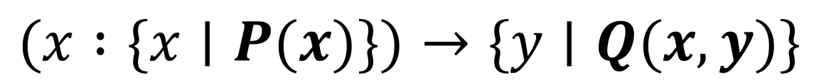



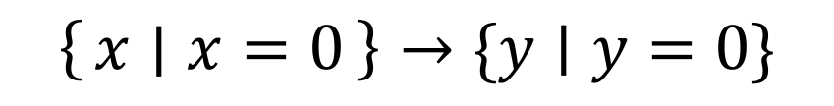
How to Specify Preference Orders (1/3)
Refinement type template
Predicate variables
$$(x :\{x∣P(x)\})→\{y∣Q(x, y)\}$$
$$P\left(x\right)↦x<0 ,$$
$$Q\left(x,y\right)↦ ⊥$$
$$P\left(x\right)↦x=0 ,$$
$$Q\left(x,y\right)↦y=0$$
$$\left\{x \right| x<0\}→\{y∣ ⊥\}$$
$$\left\{x ∣ x=0\right\}→\{y∣y=0\}$$
Notes:
To this end, we use refinement type templates, which are obtained from the ordinary ML types by replacing each base type with a refinement base type with some fresh predicate variable that represents an unknown predicate to be inferred.
This is the refinement type template of sum, where P and Q are fresh predicate variables.
By using the template, each refinement type of sum is expressed by a substitution for the predicate variables P and Q.
For example, this predicate substitution represents this refinement type of sum.
And this substitution represents this type.
We then specify a preference order on the refinement types of sum by using two kinds of constraints on the predicate variables in the template.

Slide 8
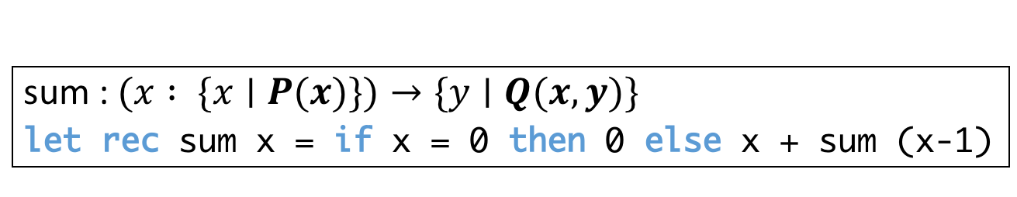
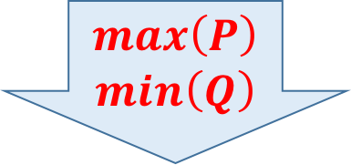
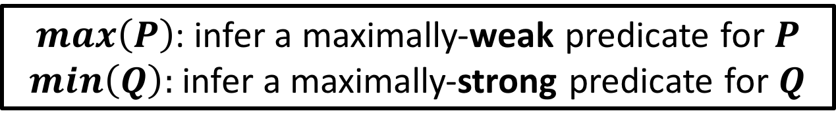



How to Specify Preference Orders (2/3)
max/min optimization constraints
$max\left(P\right)$: infer a maximally-weak predicate for $P$
$min\left(Q\right):$ infer a maximally-strong predicate for $Q$
Precondition
Postcondition
sum : $(x : \{x∣P(x)\})→\{y∣Q(x, y)\}$
let rec sum x = if x = 0 then 0 else x + sum (x-1)
$$max\left(P\right)$$
$$min\left(Q\right)$$
$$\left\{x ∣ x<0\right\}→\{y∣ ⊥\}$$
$$\text{int}→\{y∣y≥0\}$$
$$\left\{x ∣ x=0\right\}→\{y∣y=0\}$$
Notes:
The first kind of constraints are max/min constraints.
max(P) means that the set of the models of P(x) should be maximized.
In other words, infer a maximally-*weak* predicate for P.
min(Q) has opposite meaning. That is, the set of the models of Q(x,y) should be minimized.
So, we infer a maximally-*strong* predicate for Q.
For example, consider the function sum and its refinement type template, where
P(x) represents a precondition and Q(x,y) represents a postcondition of sum.
Under the optimization constraints max(P) and min(Q), this type becomes parato-optimal.
But, sum also has these pareto optimal types because there is a trade-off between the two optimization constraints.
Namely, the precondition P of sum may not be weakened without also weakening the postcondition Q, and
Q may not be strengthened without also strengthening the precondition P.

Slide 9
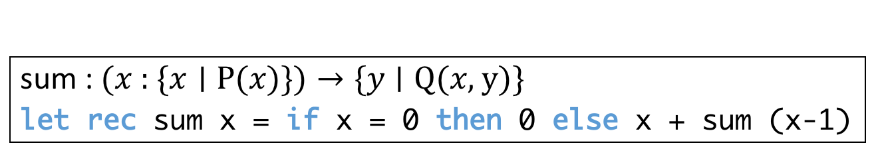






How to Specify Preference Orders (3/3)
a priority order $⊏$on predicate variables
$Q⊏P$: $Q$ is given higher priority over $P$
sum : $\text{(}\text{x}\text{ : \{}\text{x}∣\text{P}\text{(}\text{x}\text{)\})}→\text{\{}\text{y}∣\text{Q}\text{(}\text{x}\text{, }\text{y}\text{)\}}$
let rec sum x = if x = 0 then 0 else x + sum (x-1)
$$max\left(P\right)$$
$$min\left(Q\right)$$
$$Q⊏P$$
$$P⊏Q$$
$$\left(x :\left\{x ∣ x<0\right\}\right)→\{y∣ ⊥\}$$
$$\left(x :\text{int}\right)→\{y∣y≥0\}$$
Notes:
To deal with this situation, we consider the second kind of constraints, priority orders on predicate variables.
Here, $Q⊏P$ means that Q is given a higher priority over P, in other words, P cannot be optimized in a way that makes Q worse.
If Q is given a higher priority over P, this type becomes a unique Pareto optimal type.
And if P is given a higher priority over Q, we get this Pareto optimal type.

Slide 10
Outline
Refinement Type Optimization
  Applications
  Our Type Optimization Method
Implementation & Experiments
Summary
Notes:
Now I will present applications of refinement type optimization

Slide 11
Applications of Refinement Type Optimization
Non-termination analysis
Conditional termination analysis
Precondition inference
Bug finding
Modular verification
…
Notes:
Refinement type optimization has a variety of program analysis applications such as non-termination analysis, conditional termination analysis …, and so on.
In this presentation, I’m going to explain these two.
Please see our paper for more applications.
Okay, let me explain non-termination analysis first.

Slide 12
Non-Termination Analysis
Find a program input that violates the termination property
No return value = Non-terminating
$$⊥ ⇐Q\left(x,y\right)$$
sum : $\text{(}\text{x}\text{ : \{}\text{x}∣\text{P}\text{(}\text{x}\text{)\})}→\text{\{}\text{y}∣Q(x,y)\text{\}}$
let rec sum x = if x = 0 then 0 else x + sum (x-1)
infer a maximally-weak precondition $P$
$$max\left(P\right)$$
Existing non-termination analysis tool may infer:
$$\left\{x ∣ x=−1\right\}→\{y∣ ⊥\}$$
$$\left(x :\left\{x ∣ x<0\right\}\right)→\{y∣ ⊥\}$$
sum never terminates if$x<0$
Notes:
Non-termination analysis is a problem of finding a program input that violates the termination property of a given program.
Let me use the sum function to explain how to reduce non-termination analysis to refinement type optimization.
The sum function never terminates when a negative integer is given as an input.
Recall that if the postcondition Q of sum implies the contradiction, it is guaranteed that sum never returns any value, and thus is non-terminating.
So, in non-termination analysis, we require Q to satisfy this additional constraint.
In order to infer as weak precondition P as possible, we give the optimization constraint max(P), and then our type optimization method infers this Pareto-optimal refinement type, which says sum never terminates if the input value x is less than 0.
Note that existing non-termination analysis tools may infer a stronger and less useful precondition, like x=-1.

Slide 13
Non-Termination Analysis of
Non-Deterministic Programs
$$⊥ ⇐Q\left(r\right)$$
f : $\text{(}x:int)→\text{\{}r∣Q(r)\text{\}}$
let rec f x =
let n:$\left\{n\right|P(x,n)\}$ = read_int() in
if n = x then f (x+1) else x
non-determinism
= read_int() in
f never terminates
if the user always
inputs same value
as an argument $x$
infer a maximally-weak condition 𝑷
$$max\left(P\right)$$
n : $\left\{ n \right| n=x \}$
f : $\text{(}x:int)→\text{\{}r∣ ⊥\text{\}}\text{, }…$
Notes:
Let me next explain non-termination analysis of non-deterministic programs.
This function f takes an integer x, and reads an integer value n from the standard input by the library function read_int.
If n is equal to the argument x, f calls itself recursively with x+1 and otherwise returns x.
So, f never terminates if the user always inputs the same value as the argument x.
Here, read_int is modeled as a non-deterministic integer value generator, and then non-termination analysis boils down to inferring a condition P on the argument x and the generated integer n that is sufficient for the function f to return no value.
To infer such a condition P, we can use refinement type optimization as before. Moreover, under the optimization constraint max(P), our method infers this Pareto-optimal type for n.
These types say that f never terminates if the user always inputs the same value as x.

Slide 14
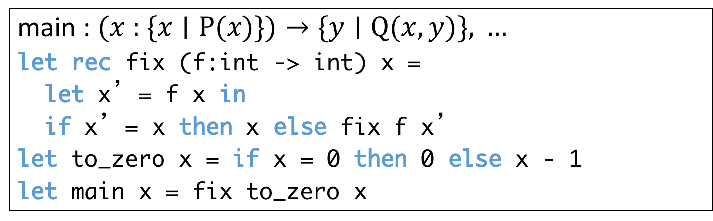

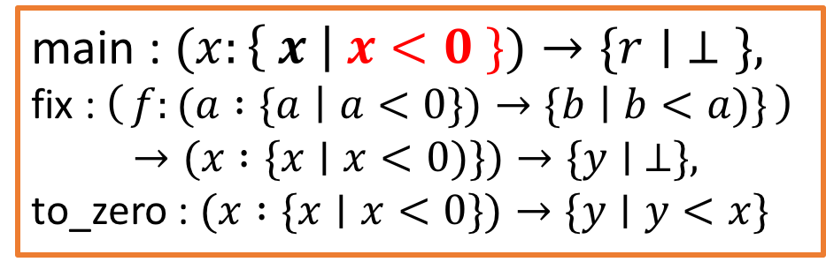

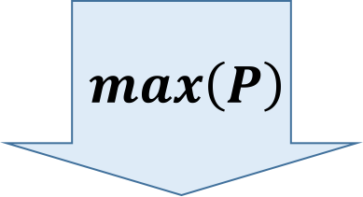
Non-Termination Analysis of
Higher-Order Programs
$$⊥ ⇐Q\left(x,y\right)$$
main : $\text{(}\text{x}\text{ : \{}\text{x}∣\text{P}\text{(}\text{x}\text{)\})}→\text{\{}\text{y}∣Q(x,y)\text{\}}\text{, }…$
let rec fix (f:int -> int) x =
let x’= f x in
if x’= x then x else fix f x’
let to_zero x = if x = 0 then 0 else x - 1
let main x = fix to_zero x
infer a maximally-weak precondition 𝑷
$$max\left(P\right)$$
main never terminates
if $x<0$
main : $\text{(}x:\left\{ x \right| x<0 \})→\text{\{}r∣ ⊥\text{\}}\text{,}$
fix : $\left(f:(a :\{a ∣ a<0\})→\{b ∣ b<a)\}\right)$
$$→(x :\{x∣x<0)\})→\{y∣ ⊥\},$$
to_zero : $(x :\{x∣x<0\})→\{y∣y<x\}$
Notes:
Our method can also handle higher-order programs.
Let us consider non-termination analysis of this higher-order program.
This function fix is a higher-order one that takes a function f and an integer x an returns a fixed-point of f computed from x..
If f x is equal to x, the function returns x, and otherwise it calls itself recursively with the argument f x.
And the function to_zero takes an integer x and returns 0 if x is equal to 0, and returns x – 1 otherwise.
The function main calls fix with to_zero and x as the arguments
So, main never terminates if a negative integer x is given to main.
Now, to infer a maximally-weak precondition that violates the termination property of main, we can use refinement type optimization as before.
Then our method infers this Pareto-optimal type for main, which says that main never terminates if a negative integer is passed to main.

Slide 15
Applications of Refinement Type Optimization
Non-termination analysis
Conditional termination analysis
Precondition inference
Bug finding
Modular verification
…
Notes:
Next I will explain how to reduce conditional termination analysis to refinement type optimization

Slide 16
Conditional Termination Analysis (1/2)
Infer a sufficient condition for termination
Our approach is inspired by a program transformation approach to termination analysis
of imperative programs [Gulwani+ ’08, ’09]
let rec sum x = if x = 0 then 0 else x + sum (x-1)
the initial
value of x
the number of recursive calls
let rec sum_t x i c =
if x = 0 then 0 else x + sum_t (x-1) i (c+1)
Notes:
Conditional termination analysis is a problem of inferring a sufficient precondition for the target function to terminate.
Our approach here is inspired by a program transformation approach to termination analysis of imperative programs.
For example, recall the recursive function sum. We transform it into this function sum_t.
Here, two arguments are inserted. i represents the initial value of the argument x, and c represents the number of recursive calls so far.
And at the recursive call, we pass i and c+1.

Slide 17
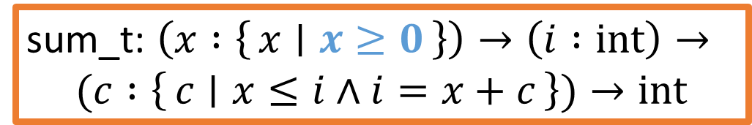
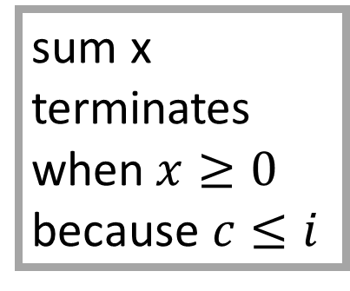
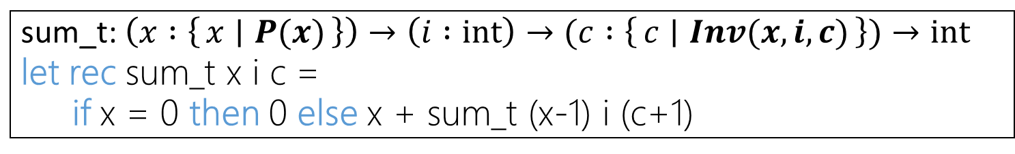
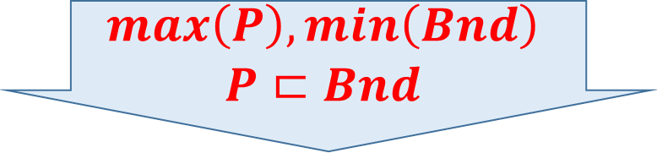
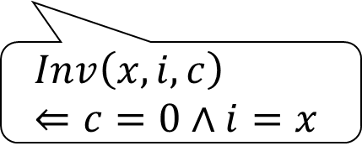
Conditional Termination Analysis (2/2)
Infer a sufficient condition for termination
$$∃f. c≤f\left(i\right)⇐P\left(x\right)∧Inv\left(x,i,c\right)$$
$$∃f. c≤f\left(i\right)⇐Bnd\left(i,c\right). Bnd\left(i,c\right)⇐P\left(x\right)∧Inv\left(x,i,c\right)$$
sum_t: $\left(x :\left\{x ∣ P(x)\right\}\right)→\left(i :\text{int}\right)→(c :\left\{c ∣ Inv(x,i,c)\right\})→\text{int}$
let rec sum_t x i c =
  if x = 0 then 0 else x + sum_t (x-1) i (c+1)
$$Inv\left(x,i,c\right) \\ ⇐c=0∧i=x$$
$$max\left(P\right), min\left(Bnd\right) \\ P⊏Bnd$$
sum x terminates when$x≥0$
because $c≤i$
sum_t: $\left(x :\left\{x ∣ x≥0\right\}\right)→\left(i :\text{int}\right)→$
$$(c :\left\{c ∣ x≤i∧i=x+c\right\})→\text{int}$$
$$f\left(i\right)=i Bnd\left(i,c\right)↦c≤i$$
Notes:
Conditional termination analysis is then reduced to type optimization as follows.
We use this refinement type template for sum_t, which has two predicate variables P and Inv to be inferred. Here, P represents a precondition, and Inv represents an invariant among the arguments x, i, c of sum_t.
Because Inv must satisfy the initial conditions c=0 and i=x, we add this constraint for Inv.
We prove that the function sum is terminating by showing that the number of recursive calls c is bounded from above by f of i for some function f.
Conditional termination analysis thus boils down to inferring a precondition P and an invariant Inv that imply this condition.
So that we can specify an optimization constraint for the right-hand-side of the implication, we add an extra predicate variable Bnd in this way.
We then use refinement type optimization as before to find a solution for P and Bnd.
We here maximize P to infer as weak precondition as possible, and minimize Bnd to infer as tight upper bound as possible. Also, P is here given a higher priority over Bnd.
Under these constraints, our method infers this refinement type and these solutions for f and Bnd.
Thus, we can conclude that sum terminates for any input x not less than 0 because the number of recursive calls c is bounded from above by the initial value i of the argument x.

Slide 18
Outline
Refinement Type Optimization
  Applications
  Our Type Optimization Method
Implementation & Experiments
Summary
Notes:
We now present our method to solve refinement type optimization problems.

Slide 19
Overall Structure
Functional Program
Constraint
Generation
user-specified
preference order
(max/min opt.
constraints +
a priority order)
additional
Horn Clause
constraints
Horn Clause
Constraints
Horn Constraint
Optimization
Refinement Types
Notes:
This slide shows the overall structure of our method.
It reduces refinement type optimization for a given functional program into a new class of constraint optimization problems called Horn constraint optimization where the constraints are expressed by Horn clauses over predicate variables and the optimization objectives are specified by max/min optimization constraints and a priority order on the predicate variables.
Our method performs Horn constraint optimization on the Horn constraints that are partly generated from the given program and partly given by users to realize a desired program analysis. This constraint optimization part is explained later.
If a solution for the predicate variables is found, our method returns refinement types of the program.

Slide 20
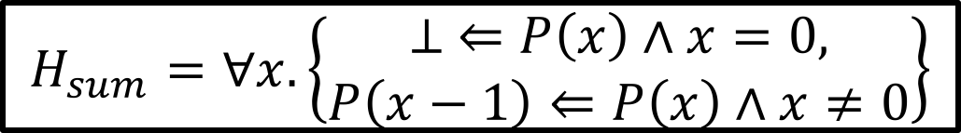
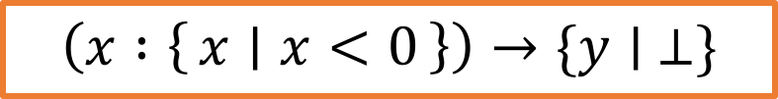

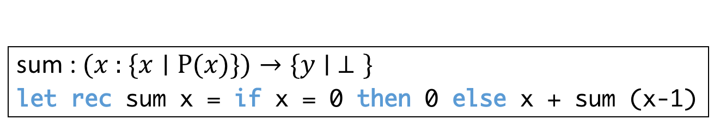
Example: Type Optimization by Our Method
sum : $\text{(}\text{x}\text{ : \{}\text{x}∣\text{P}\text{(}\text{x}\text{)\})}→\text{\{}\text{y}∣ ⊥\text{\}}$
let rec sum x = if x = 0 then 0 else x + sum (x-1)
Constraint
Generation
$$H_{sum}=∀x.\left\{\begin{aligned}⊥ ⇐P\left(x\right)∧x=0, \\ P\left(x−1\right)⇐P\left(x\right)∧x≠0\end{aligned}\right\}$$
Horn Constraint
Optimization
Horn Constraint
Optimization
$$max⁡(P)$$
$$\left(x :\left\{x ∣ x<0\right\}\right)→\{y∣ ⊥\}$$
Notes:
For example, recall the non-termination analysis problem of the recursive function sum.
Our method first generates this set of Horn constraints Hsum over the predicate variable P, which represents a precondition that violate the termination property of sum.
Our method then performs Horn constraint optimization on Hsum with the optimization constraint max(P) so that we can infer as weak precondition as possible. As the result, we obtain this Pareto optimal refinement type for sum.
Now I’m going to explain how our Horn constraint optimization method proceeds.

Slide 21


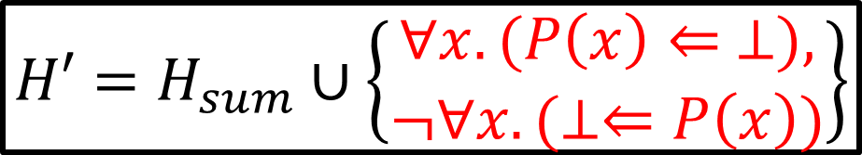


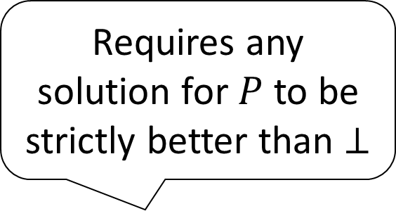
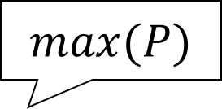
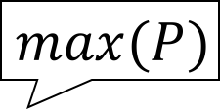
Example: Horn Constraint Optimization
repeatedly improves a current solution
until convergence
Solve
Solve
Requires any solution for $P$ to be strictly better than $⊥$
$H_{sum}$
$$P\left(x\right)↦⊥$$
$$max⁡(P)$$
Gen. Horn Constraints for improved Sols.
$${H′=H}_{sum}∪\left\{\begin{aligned}∀x.(P\left(x\right)⇐ ⊥), \\ ¬∀x.(⊥⇐P\left(x\right))\end{aligned}\right\}$$
$$max⁡(P)$$
Gen.
Solve
Solve
Solve
Solve
…
Converge
(No Solution)
$$P\left(x\right)↦x<0$$
$$P\left(x\right)↦x<0$$
Notes:
The idea of our method is to repeatedly improve a current solution until convergence.
It first calls a sub-procedure Solve, which is explained later, to find an initial solution of Hsum. We obtain a solution, for example, bottom for P.
Our method then generates additional constraints that require any solution for P to be strictly better than the initial solution bottom with respect to the optimization constraint, in this case, max(P).
Our method then calls the sub-procedure again to find a solution for the strengthened Horn constraints, and repeats the same process until convergence.
Here, convergence means that the strengthened Horn constraints have no solution.
In other words, no improvement is possible and hence the current solution is Pareto-optimal.
There also is a case where the sub-procedure fails or time-outs and the existence of an improved solution is left unknown.
In such a case, our method returns the current solution as possibly non-Pareto optimal solution.
Next I will briefly explain the sub-procedure Solve.

Slide 22
Horn Constraint Solver Solve
Extended template-based invariant generation techniques [Colon+ ’03, Gulwani+ ’08] to solve existentially-quantified Horn clause constraints
  Extend the reach from imperative programs w/o recursion to higher-order non-det. programs
Any other solver for the class of constraints can be used instead [Unno+ ’13, Beyene+ ’14, Kuwahara+ ’15]
Notes:
The class of constraints we need to solve here is called existentially-quantified Horn clause constraints.
There already exist a few solvers but we proposed a new one based on template-based invariant generation techniques, which performed better in many cases in our preliminary experiments.
Please see the paper for details.

Slide 23
Outline
Refinement Type Optimization
  Applications
  Our Type Optimization Method
Implementation & Experiments
Summary
Notes:
Next, I will explain our prototype implementation and the preliminary experiments.

Slide 24
Implementation & Experiments
A refinement type checking and inference tool for OCaml
Implemented in Refinement Caml [Unno+ ’08, ’09, …]
  Z3 [Moura+ ’08] as a backend SMT solver
Two preliminary experiments:
  Various program analysis problems for
  higher-order non-deterministic programs
  (partly obtained from [Kuwahara+ ’14, Kuwahara+ ’15])
  Non-termination verification problems
  for first-order non-deterministic programs
  (obtained from [Chen+ ’14, Larraz+’14, Kuwahara+ ’15, …])
Notes:
We have implemented our refinement type optimization method in Refinement Caml, which is a refinement type checking and inference tool for OCaml. As a backend SMT solver, we adopted Z3.
We have conducted experiments on two benchmark sets to evaluate the effectiveness of our type optimization method.
The first benchmark set consists of various program analysis problems, such as non-termination verification, conditional-termination verification, precondition inference and bug finding, for higher-order non-deterministic programs. Some of the programs are obtained from exiting work on termination and non-termination verification of higher-order recursive programs.
The second benchmark set consists of non-termination verification problems of first-order non-deterministic programs. This benchmark set is often used to compare the performance of non-termination verification tools.

Slide 25
Results of the Various Program Analysis Problems (excerpt)
Program | Application | #Iter. | Time (sec) | Opt.
foldr_nonterm [Kuwahara+ ’15] | Non-termination | 4 | 8.04 | ✔
fixpoint_nonterm [Kuwahara+ ’15] | Non-termination | 2 | 0.30 | ✔
indirectHO_e [Kuwahara+ ’15] | Non-termination | 2 | 0.31 | ✔
zip [Kuwahara+ ’14] | Conditional Termination Analysis | 4 | 12.24
sum | Conditional Termination Analysis | 6 | 12.02 | ✔
append [Kuwahara+ ’14] | Conditional Termination Analysis | 11 | 10.66 | ✔
  Environment: Intel Core i7-3770 (3.40GHz), 16 GB of RAM
Notes:
Some of the results of the first benchmark set are shown in this table.
The column #Iter. shows the number of iterations needed by our Horn constraint optimization method until convergence,
and the column Opt. shows whether Pareto optimal refinement types are inferred.
For non-termination analysis, our method inferred Pareto optimal types of higher-order functions in few iterations.
But conditional termination analysis often required a larger number of iterations because the analysis involves two optimization objectives with a trade off, namely maximization of the precondition and the minimization of the upper bound. Accelerating the convergence of Horn constraint optimization of multi-objective problems is thus one of the important future research directions.

Slide 26
Results of the First-Order
Non-Termination Verification Problems
 | Verified | Time Out | Other
Our tool | 41 | 27 | 13
CppInv [Larraz+ ’14] | 70 | 6 | 5
T2-TACAS [Chen+ ’14] | 51 | 0 | 30
MoCHi [Kuwahara+ ’15] | 48 | 26 | 7
TNT [Emmes+ ’12] | 19 | 3 | 59
Notes:
This table compares our results of first-order non-termination verification with those of existing state-of-the-art tools dedicated to non-termination verification.
Our tool is not the best but performed reasonably well albeit the fact that it is designed for solving more general problems and *not* tweaked for *non-termination* analysis of *first-order* programs.

Slide 27
Summary
Refinement type optimization problems
Infer Pareto-optimal refinement types with respect to a user-specified preference order
Has applications to various program analysis problems of higher-order and non-deterministic functional programs
Refinement type optimization method
Reduction to a Horn constraint optimization problem
Horn constraint optimization method
  Repeatedly improve the current solution until convergence
Prototype implementation and preliminary experiments
Thank you!
Notes:
To summarize, we proposed refinement type optimization as a generalization of ordinary refinement type inference.
Refinement type optimization is a problem of inferring Pareto-optimal refinement types with respect to a user-specified preference order.
As shown in the presentation, refinement type optimization has various applications to program analysis problems for higher-order and non-deterministic functional programs.
We also proposed a refinement type optimization method based on the reduction to a Horn constraint optimization problem, which is solved by repeatedly improving a current solution until convergence.
We have also implemented a prototype refinement type optimization tool, conducted preliminary experiments, and obtained promising results.
That’s all. Thank you for your attention.

