Slide 1
Inferring Simple Solutions to Recursion-free Horn Clauses via Sampling
Hiroshi Unno (University of Tsukuba)
Tachio Terauchi (JAIST)

Slide 2
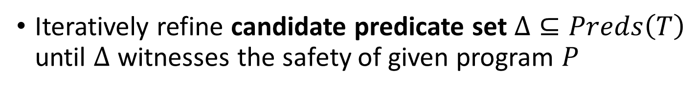

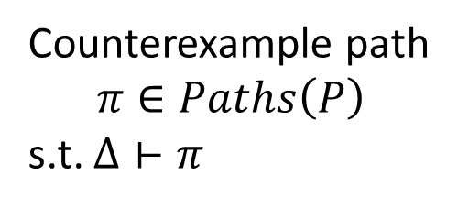
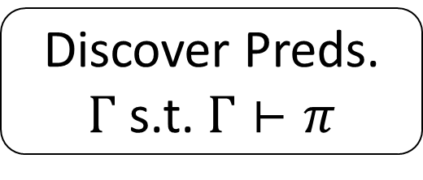
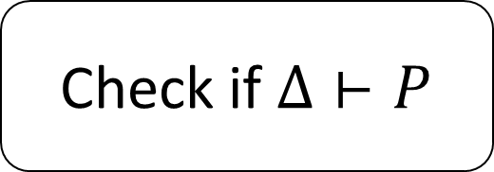
Program Verification with CEGAR
Iteratively refine candidate predicate set $Δ⊆Preds\left(T\right)$ until $Δ$ witnesses the safety of given program $P$
background FOL theory (e.g., QFLRA)
Check if $Δ⊢P$
safe
$$Δ≔Δ∪Γ$$
Counterexample path
$$π∈Paths\left(P\right)$$
s.t. $Δ⊢π$
Discover Preds.
$Γ$ s.t. $Γ⊢π$
unsafe
How to guarantee convergence of CEGAR?
Our talk at ESOP on Thursday 16
How to find “good” solutions achieving faster convergence?
This talk
Much success for imperative programs (SLAM, BLAST, …) for concurrent programs (Threader, SymmPA, …) for functional programs (Depcegar, MoCHi, …)

Slide 3

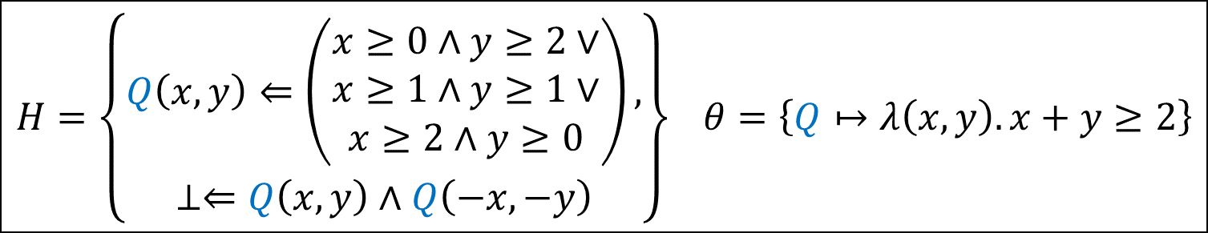
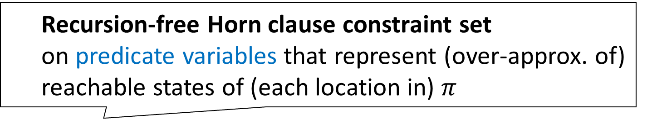
Horn Clause Solving as Unified Framework for Predicate Discovery [U.+2009] [Terauchi2010] [Gupta+2011] [Grebenshchikov+2012] [Rümmer+2013] …
Generate and solve a set of constraints $H$ s.t.
$$H has a solution θ⟹Rng(θ)⊢π$$
Recursion-free Horn clause constraint set on predicate variables that represent (over-approx. of) reachable states of (each location in) $π$
Substitution for the predicate variables
$$H=\left\{\begin{aligned}Q\left(x,y\right)⇐\left(\begin{aligned}x≥0∧y≥2∨ \\ x≥1∧y≥1∨ \\ x≥2∧y≥0\end{aligned}\right), \\ ⊥⇐Q\left(x,y\right)∧Q\left(−x,−y\right)\end{aligned}\right\} θ=\left\{Q↦λ\left(x,y\right). x+y≥2\right\}$$

Slide 4


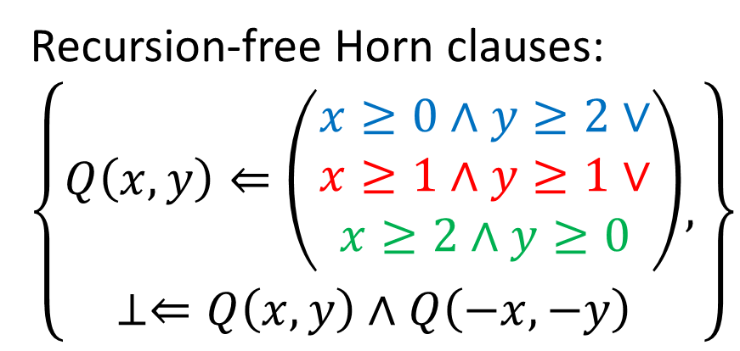





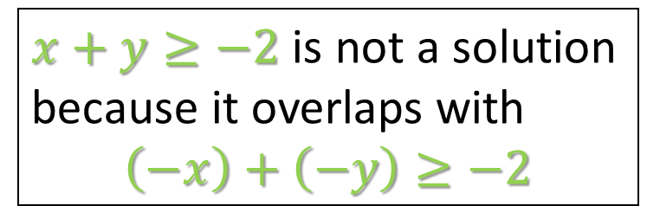



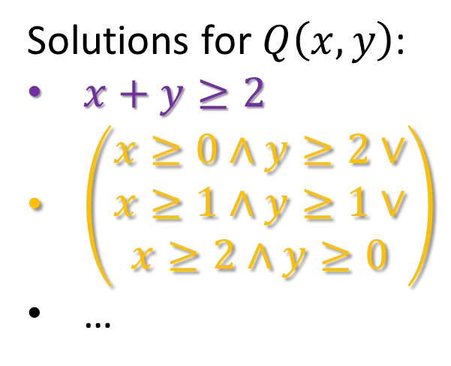
Example: Solutions of Recursion-Free Horn Clauses
$x+y≥−2$ is not a solution
because it overlaps with
$$\left(−x\right)+\left(−y\right)≥−2$$
Recursion-free Horn clauses:
$$\left\{\begin{aligned}Q\left(x,y\right)⇐\left(\begin{matrix}x≥0∧y≥2∨ \\ x≥1∧y≥1∨ \\ x≥2∧y≥0\end{matrix}\right) \\ ⊥⇐Q\left(x,y\right)∧Q\left(−x,−y\right)\end{aligned},\right\}$$
$$y$$
$$2$$
$$1$$
Solutions for $Q\left(x,y\right)$:
$x+y≥2$
$\left(\begin{matrix}x≥0∧y≥2∨ \\ x≥1∧y≥1∨ \\ x≥2∧y≥0\end{matrix}\right)$
…
$$x$$
$$−2$$
$$−1$$
$$1$$
$$2$$
$$−1$$
$$−2$$

Slide 5












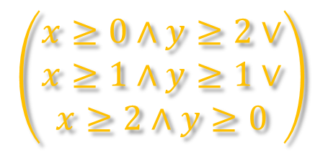









Simple Preds. aid in Faster Convergence? [Hoder+2012] [Albarghouthi+2013]
Correct programs tend to be correct for simple reasons, per Occam’s razor
Simple predicates often covers emerging patterns
$$y$$
$$y$$
$$2$$
$$2$$
$$1$$
$$1$$
$$−2$$
$$−1$$
$$1$$
$$2$$
$$x$$
$$−2$$
$$−1$$
$$1$$
$$2$$
$$x$$
$$−1$$
$$\left(\begin{matrix}x≥0∧y≥2∨ \\ x≥1∧y≥1∨ \\ x≥2∧y≥0\end{matrix}\right)$$
$$−1$$
$$−2$$
$$−2$$
$$x+y≥2$$

Slide 6
Contribution
New algorithm for finding simple solutions of recursion-free Horn clauses over QFLRA based on
Iterative sampling
Constraint decomposition
for head-joining predicate variables
for body-joining predicate variables
Solution composition using solution space
Implementation and experiments

Slide 7
Contribution
New algorithm for finding simple solutions of recursion-free Horn clauses over QFLRA based on
Iterative sampling
Constraint decomposition
for head-joining predicate variables
for body-joining predicate variables
Solution composition using solution space
Implementation and experiments

Slide 8
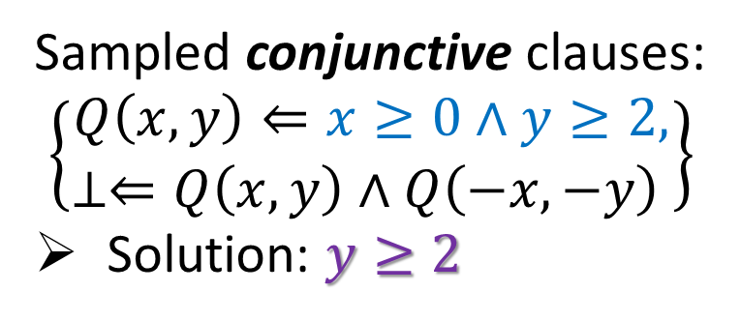
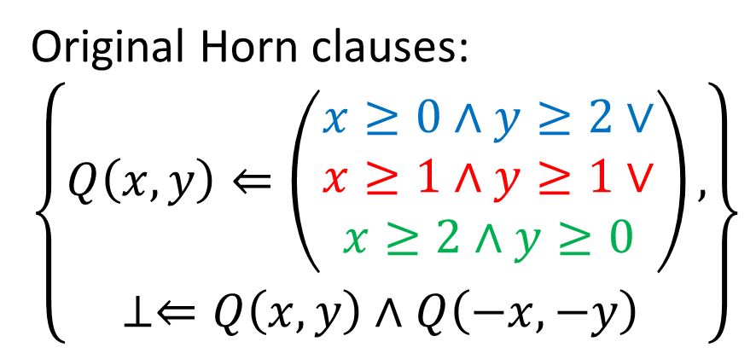
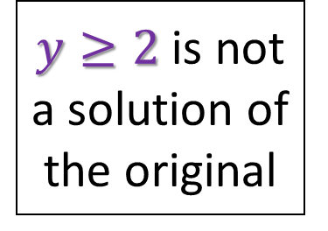
Iterative Sampling of Horn Clauses (cf. sampling for interpolation [Albarghouthi+2013])
Original Horn clauses:
$$\left\{\begin{aligned}Q\left(x,y\right)⇐\left(\begin{matrix}x≥0∧y≥2∨ \\ x≥1∧y≥1∨ \\ x≥2∧y≥0\end{matrix}\right), \\ ⊥⇐Q\left(x,y\right)∧Q\left(−x,−y\right) \end{aligned}\right\}$$
$$y$$
$$2$$
$$1$$
$y≥2$ is not a solution of the original
Sampled conjunctive clauses: $$\left\{\begin{aligned}Q\left(x,y\right)⇐x≥0∧y≥2, \\ ⊥⇐Q\left(x,y\right)∧Q\left(−x,−y\right) \end{aligned}\right\}$$
Solution: $y≥2$
$$x$$
$$−2$$
$$−1$$
$$1$$
$$2$$
$$−1$$
$$−2$$

Slide 9
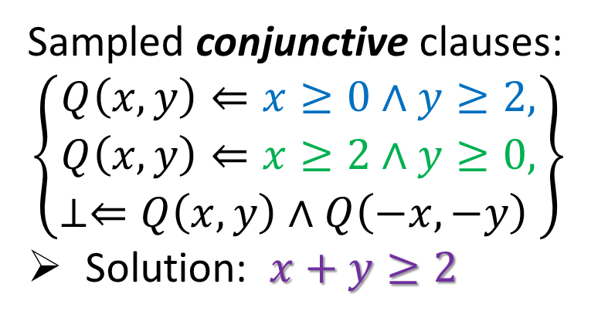
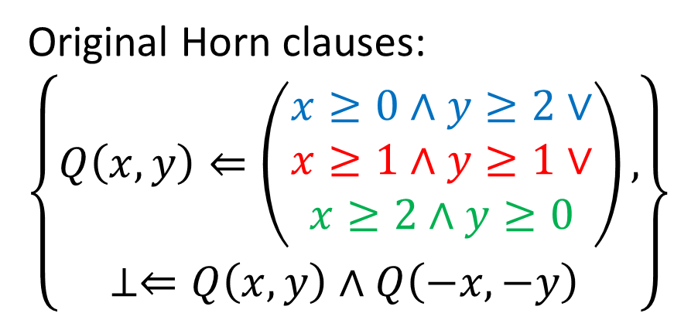
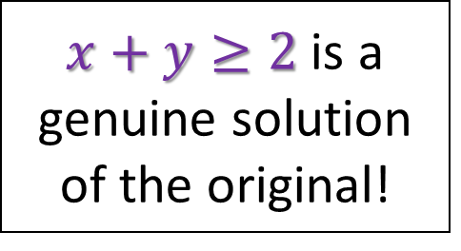
Iterative Sampling of Horn Clauses (cf. sampling for interpolation [Albarghouthi+2013])
Original Horn clauses:
$$\left\{\begin{aligned}Q\left(x,y\right)⇐\left(\begin{matrix}x≥0∧y≥2∨ \\ x≥1∧y≥1∨ \\ x≥2∧y≥0\end{matrix}\right), \\ ⊥⇐Q\left(x,y\right)∧Q\left(−x,−y\right) \end{aligned}\right\}$$
$$y$$
$$2$$
$$1$$
$x+y≥2$ is a genuine solution of the original!
Sampled conjunctive clauses:
$$\left\{\begin{aligned}Q\left(x,y\right)⇐x≥0∧y≥2, \\ Q\left(x,y\right)⇐x≥2∧y≥0, \\ ⊥⇐Q\left(x,y\right)∧Q\left(−x,−y\right) \end{aligned}\right\}$$
Solution: $x+y≥2$
$$x$$
$$−2$$
$$−1$$
$$1$$
$$2$$
$$−1$$
$$−2$$

Slide 10
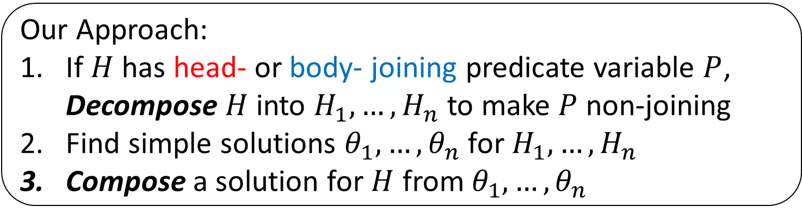
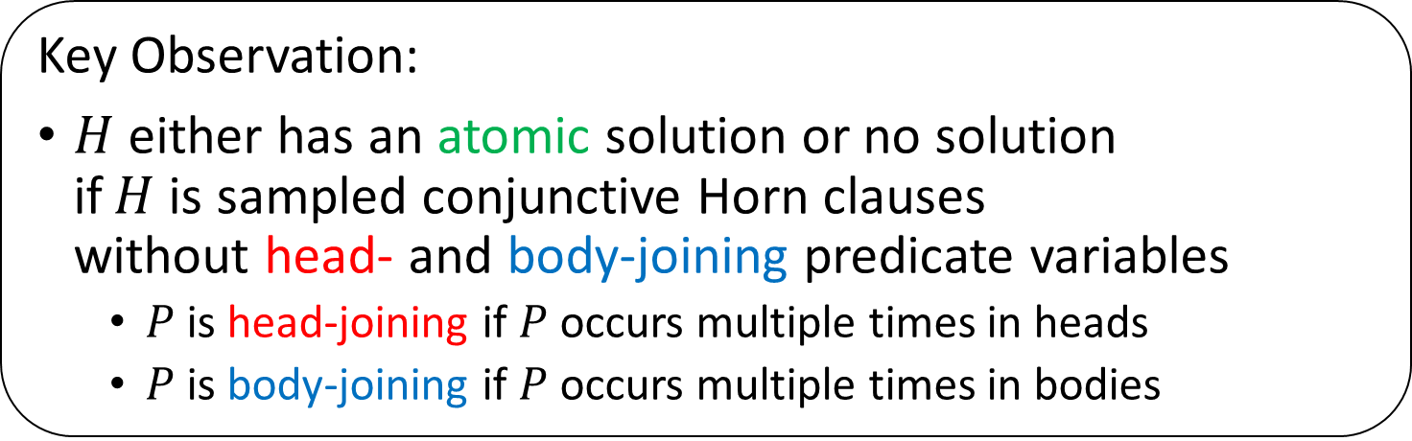
How to Solve Sampled Horn Clauses?
Key Observation:
$H$ either has an atomic solution or no solution if $H$ is sampled conjunctive Horn clauses without head- and body-joining predicate variables
$P$ is head-joining if $P$ occurs multiple times in heads
$P$ is body-joining if $P$ occurs multiple times in bodies
Our Approach:
If $H$ has head- or body- joining predicate variable $P$, Decompose $H$ into $H_{1},…,H_{n}$ to make $P$ non-joining
Find simple solutions $θ_{1},…,θ_{n}$ for $H_{1},…,H_{n}$
Compose a solution for $H$ from $θ_{1},…,θ_{n}$

Slide 11
Contribution
New algorithm for finding simple solutions of recursion-free Horn clauses over QFLRA based on
Iterative sampling
Constraint decomposition
for head-joining predicate variables
for body-joining predicate variables
Solution composition using solution space
Implementation and experiments

Slide 12
Contribution
New algorithm for finding simple solutions of recursion-free Horn clauses over QFLRA based on
Iterative sampling
Constraint decomposition
for head-joining predicate variables
for body-joining predicate variables
Solution composition using solution space
Implementation and experiments

Slide 13

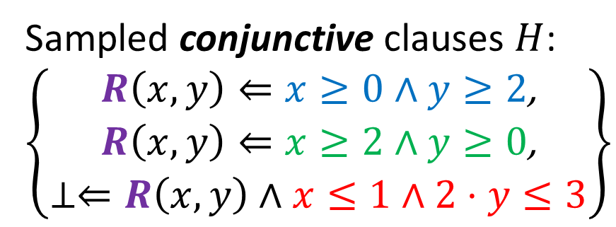

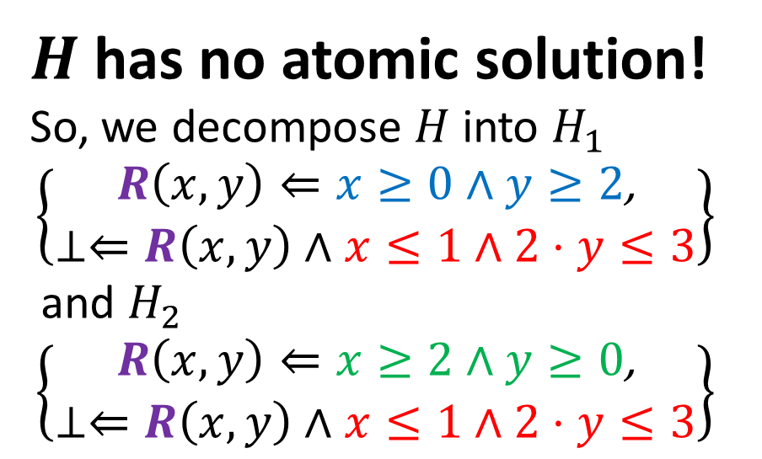




Lazy Constraint Decomposition for Head-Joining Predicate Variables
Sampled conjunctive clauses $H$:
$$\left\{\begin{aligned}R\left(x,y\right)⇐x≥0∧y≥2\text{,} \\ R\left(x,y\right)⇐x≥2∧y≥0\text{,} \\ ⊥⇐R\left(x,y\right)∧x≤1∧2⋅y≤3\end{aligned}\right\}$$
$$y$$
$H$ has no atomic solution!
So, we decompose $H$ into $H_{1}$ $$\left\{\begin{aligned}R\left(x,y\right)⇐x≥0∧y≥2\text{,} \\ ⊥⇐R\left(x,y\right)∧x≤1∧2⋅y≤3\end{aligned}\right\}$$
and $H_{2}$ $$\left\{\begin{aligned}R\left(x,y\right)⇐x≥2∧y≥0\text{,} \\ ⊥⇐R\left(x,y\right)∧x≤1∧2⋅y≤3\end{aligned}\right\}$$
$$2$$
$$1$$
$$x$$
$$1$$
$$2$$

Slide 14
Contribution
New algorithm for finding simple solutions of recursion-free Horn clauses over QFLRA based on
Iterative sampling
Constraint decomposition
for head-joining predicate variables
for body-joining predicate variables
Solution composition using solution space
Implementation and experiments

Slide 15
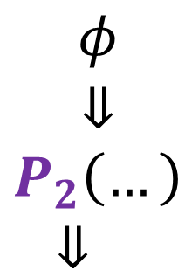
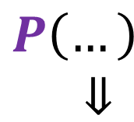
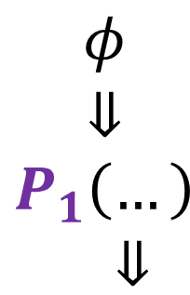



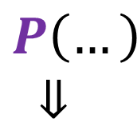

Eager Constraint Decomposition for Body-Joining Predicate Variables
$$\begin{aligned}⋮ \\ ⇓ \\ P\left(…\right)\end{aligned}$$
$$\begin{aligned}⋮ \\ ⇓ \\ P\left(…\right)\end{aligned}$$
$$\begin{aligned}φ \\ ⇓ \\ P_{1}\left(…\right) \\ ⇓\end{aligned}$$
$$\begin{aligned}φ \\ ⇓ \\ P_{2}\left(…\right) \\ ⇓ \end{aligned}$$
$$\begin{aligned}P\left(…\right) \\ ⇓\end{aligned}$$
$$\begin{aligned}P\left(…\right) \\ ⇓ \end{aligned}$$
$$\begin{aligned}⇓ \\ ⊥\end{aligned}$$
$$\begin{aligned}⇓ \\ ⊥\end{aligned}$$

Slide 16
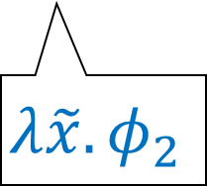

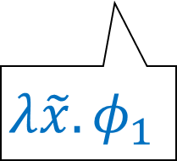




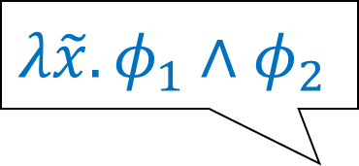
Solution Composition
$$λ\tilde{x}.φ_{1}∧φ_{2}$$
$$\begin{aligned}⋮ \\ ⇓ \\ P\left(…\right)\end{aligned}$$
Iteratively solve each tree component from the root-most one
$$\begin{aligned}φ \\ ⇓ \\ P_{1}\left(…\right) \\ ⇓\end{aligned}$$
$$\begin{aligned}φ \\ ⇓ \\ P_{2}\left(…\right) \\ ⇓ \end{aligned}$$
Composed solution $λ\tilde{x}.φ_{1}∧φ_{2}$ for $P$ may not be the simplest
$$λ\tilde{x}.φ_{1}$$
$$λ\tilde{x}.φ_{2}$$
$$\begin{aligned}⇓ \\ ⊥\end{aligned}$$

Slide 17
Contribution
New algorithm for finding simple solutions of recursion-free Horn clauses over QFLRA based on
Iterative sampling
Constraint decomposition
for head-joining predicate variables
for body-joining predicate variables
Solution composition using solution space
Implementation and experiments

Slide 18
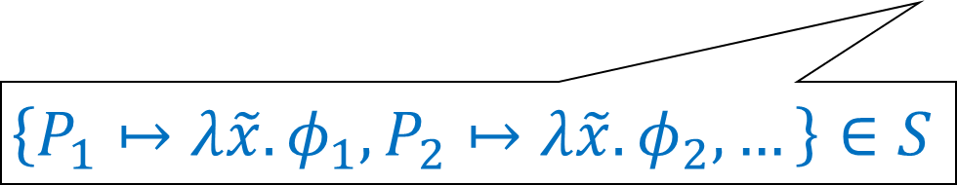

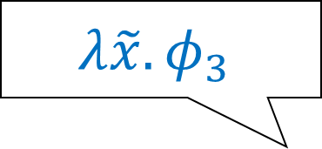
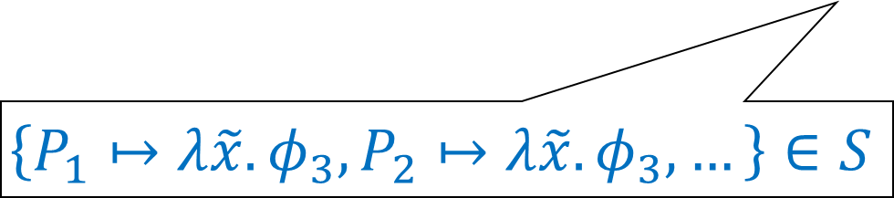
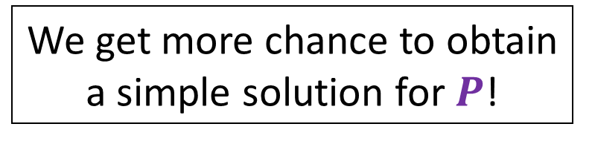
Solution Composition using Solution Space
$$λ\tilde{x}.φ_{3}$$
$$\begin{aligned}⋮ \\ ⇓ \\ P\left(…\right)\end{aligned}$$
Iteratively compute a solution space $S$ for each tree component from the root-most one using Farkas’ lemma (see paper for details)
$$\begin{aligned}φ \\ ⇓ \\ P_{1}\left(…\right) \\ ⇓\end{aligned}$$
$$\begin{aligned}φ \\ ⇓ \\ P_{2}\left(…\right) \\ ⇓ \end{aligned}$$
We get more chance to obtain a simple solution for $P$!
$$\left\{P_{1}↦λ\tilde{x}.φ_{1},P_{2}↦λ\tilde{x}.φ_{2},…\right\}∈S$$
$$\left\{P_{1}↦λ\tilde{x}.φ_{3},P_{2}↦λ\tilde{x}.φ_{3},…\right\}∈S$$
$$\begin{aligned}⇓ \\ ⊥\end{aligned}$$

Slide 19















Previous Approaches to Solving Horn Clauses with Body-Joining Pred. Vars.
Iteration-based [U.+2009] [Terauchi2010]
Iteratively solve each Horn clause from the root
Expansion-based [McMillan+2013] [Rümmer+2013]
Eliminate body-joining pred. vars. by expansion
$$Q$$
$$\begin{aligned}⋮ \\ ⇓ \\ P\left(…\right)\end{aligned}$$
$$R$$
$$Q_{1}$$
$$R_{1}$$
$$Q_{2}$$
$$R_{2}$$
$$⋮$$
$$⇓$$
$$⋮$$
$$⇓$$
$$\begin{aligned}P_{1}\left(…\right) \\ ⇓\end{aligned}$$
$$\begin{aligned}P_{2}\left(…\right) \\ ⇓ \end{aligned}$$
$$\begin{aligned}P\left(…\right) \\ ⇓\end{aligned}$$
$$\begin{aligned}P\left(…\right) \\ ⇓ \end{aligned}$$
$$\begin{aligned}⇓ \\ ⊥\end{aligned}$$
$$\begin{aligned}⇓ \\ ⊥\end{aligned}$$

Slide 20
Prototype Implementation as Predicate Discovery Engine of MoCHi
MoCHi [1]: CEGAR-based safety and termination verifier for higher-order functional programs
Our implementation uses:
GLPK [2] for operating on solution spaces
Z3 [3] for checking candidate solutions
[1] MoCHI (http://www-kb.is.s.u-tokyo.ac.jp/~ryosuke/mochi/)
[2] GLPK (http://www.gnu.org/software/glpk)
[3] Z3 (http://z3.codeplex.com)

Slide 21
Experiment Results: Elapsed Time of Individual Refinement Runs
Iteration-based
Expansion-based
New algorithm
New algorithm
327 counterexamples generated from 139 benchmark programs
Three refinement algorithms: New algorithm, Iteration-based, and Expansion-based

Slide 22
Experiment Results: Solution Size of Individual Refinement Runs
Iteration-based
Expansion-based
New algorithm
New algorithm
327 counterexamples generated from 139 benchmark programs
Three refinement algorithms: New algorithm, Iteration-based, and Expansion-based

Slide 23
Experiment Results: Overall Verification Performance
Iteration-based
Expansion-based
New algorithm
New algorithm
139 benchmark programs
MoCHi with each three refinement process: New algorithm, Iteration-based, and Expansion-based

Slide 24
Summary
New algorithm for finding simple solutions of recursion-free Horn clauses over QFLRA based on
Iterative sampling
Constraint decomposition
for head-joining predicate variables
for body-joining predicate variables
Solution composition using solution space
Implementation and experiments as predicate discovery engine of MoCHi

