Slide 1
Automating Relational Program Verification
Hiroshi Unno (University of Tsukuba, Japan)

Slide 2
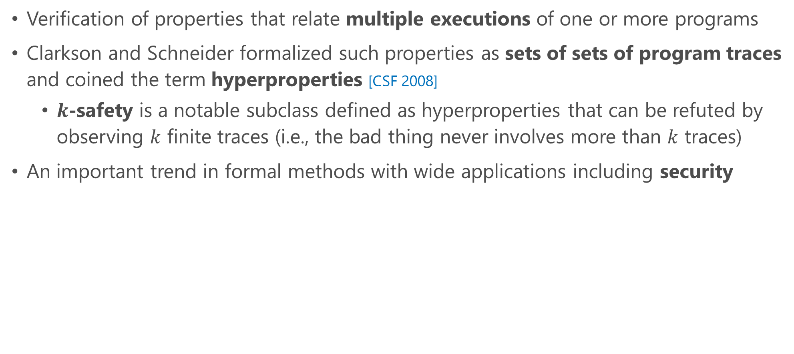
Relational Program Verification
Verification of properties that relate multiple executions of one or more programs
Clarkson and Schneider formalized such properties as sets of sets of program traces and coined the term hyperproperties [CSF 2008]
  $k$-safety is a notable subclass defined as hyperproperties that can be refuted by observing $k$ finite traces (i.e., the bad thing never involves more than $k$ traces)
An important trend in formal methods with wide applications including security
[CSF 2008] Clarkson, Schneider. Hyperproperties.

Slide 3
Example Hyperproperties on Multiple Programs

Slide 4
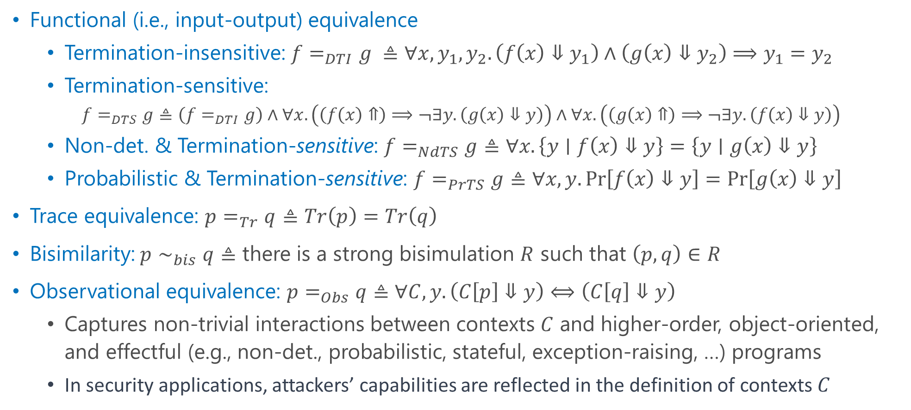

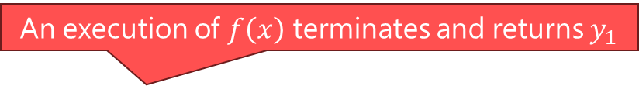
Variants of Program Equivalence
An execution of $f\left(x\right)$ terminates and returns $y_{1}$
Functional (i.e., input-output) equivalence
  Termination-insensitive: $f=_{DTI}g ≜∀x,y_{1},y_{2}.\left(f\left(x\right)⇓y_{1}\right)∧\left(g\left(x\right)⇓y_{2}\right)⟹y_{1}=y_{2}$
  Termination-sensitive:
    $$f=_{DTS}g≜\left(f=_{DTI}g\right)∧∀x. \left(\left(f\left(x\right)⇑\right)⟹¬∃y.\left(g\left(x\right)⇓y\right)\right)∧∀x.\left(\left(g\left(x\right)⇑\right)⟹¬∃y.\left(f\left(x\right)⇓y\right)\right)$$
  Non-det. & Termination-sensitive: $f=_{NdTS}g≜∀x.\left\{y∣f\left(x\right)⇓y\right\}=\left\{y∣g\left(x\right)⇓y\right\}$
  Probabilistic & Termination-sensitive: $f=_{PrTS}g≜∀x,y.\operatorname{Pr}\left[f\left(x\right)⇓y\right]=\operatorname{Pr}\left[g\left(x\right)⇓y\right]$
Trace equivalence: $p=_{Tr}q$ $≜Tr\left(p\right)=Tr\left(q\right)$
Bisimilarity:$p∼_{bis}q≜$ there is a strong bisimulation $R$ such that $\left(p,q\right)∈R$
Observational equivalence: $p=_{Obs}q≜∀C,y.\left(C\left[p\right]⇓y\right)⟺\left(C\left[q\right]⇓y\right)$
  Captures non-trivial interactions between contexts $C$ and higher-order, object-oriented, and effectful (e.g., non-det., probabilistic, stateful, exception-raising, …) programs
  In security applications, attackers’ capabilities are reflected in the definition of contexts $C$
$f\left(x\right)$ has a diverging execution
The set of finite and infinite execution traces of $q$

Slide 5
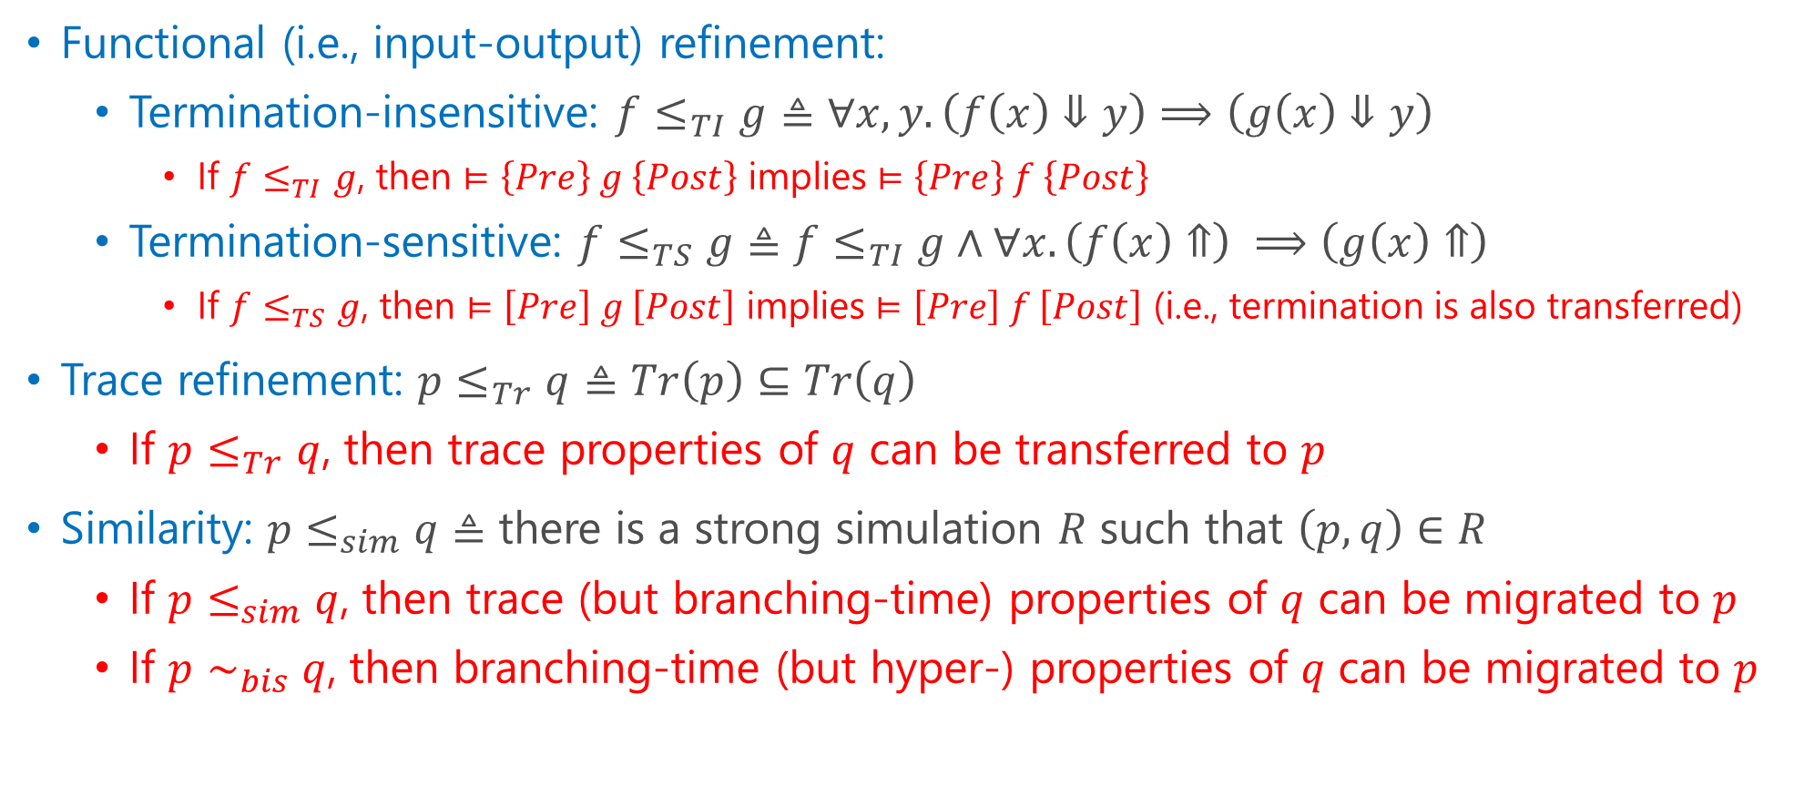
Variants of Program Refinement
Useful to transfer properties and proofs!
Functional (i.e., input-output) refinement:
  Termination-insensitive: $f≤_{TI}g≜∀x,y.\left(f\left(x\right)⇓y\right)⟹\left(g\left(x\right)⇓y\right)$
    If $f≤_{TI}g$, then $⊨\left\{Pre\right\} g \left\{Post\right\}$ implies $⊨\left\{Pre\right\} f \left\{Post\right\}$
  Termination-sensitive: $f≤_{TS}g≜f≤_{TI}g∧∀x.\left(f\left(x\right)⇑\right) ⟹\left(g\left(x\right)⇑\right)$
    If $f≤_{TS}g$, then $⊨\left[Pre\right] g \left[Post\right]$ implies $⊨\left[Pre\right] f \left[Post\right]$ (i.e., termination is also transferred)
Trace refinement: $p≤_{Tr}q$ $≜Tr\left(p\right)⊆Tr\left(q\right)$
  If $p≤_{Tr}q$, then trace properties of $q$ can be transferred to $p$
Similarity: $p≤_{sim}q≜$ there is a strong simulation $R$ such that $\left(p,q\right)∈R$
  If $p≤_{sim}q$, then trace (but branching-time) properties of $q$ can be migrated to $p$
  If $p∼_{bis}q$, then branching-time (but hyper-) properties of $q$ can be migrated to $p$

Slide 6
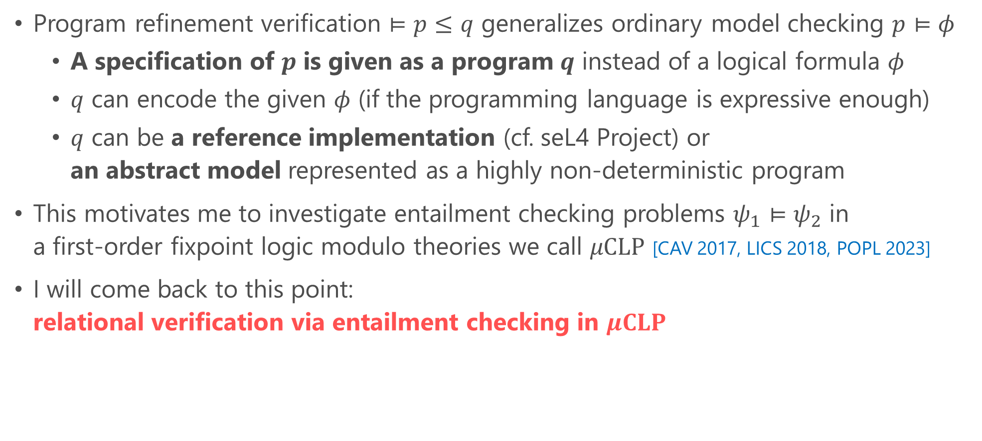
Program Refinement as Generalized Model Checking
Program refinement verification $⊨p≤q$ generalizes ordinary model checking $p⊨φ$
  A specification of $p$ is given as a program $q$ instead of a logical formula $φ$
  $q$ can encode the given $φ$ (if the programming language is expressive enough)
  $q$ can be a reference implementation (cf. seL4 Project) or
  an abstract model represented as a highly non-deterministic program
This motivates me to investigate entailment checking problems $ψ_{1}⊨ψ_{2}$ in
a first-order fixpoint logic modulo theories we call $μCLP$ [CAV 2017, LICS 2018, POPL 2023]
I will come back to this point:
relational verification via entailment checking in $μCLP$
[CAV 2017] Unno et al. Automating Induction for Solving Horn Clauses.
[LICS 2018] Nanjo et al. A Fixpoint Logic and Dependent Effects for Temporal Property Verification.
[POPL 2023] Unno et al. Modular Primal-Dual Fixpoint Logic Solving for Temporal Verification.

Slide 7
Example Hyperproperties on Single Program

Slide 8
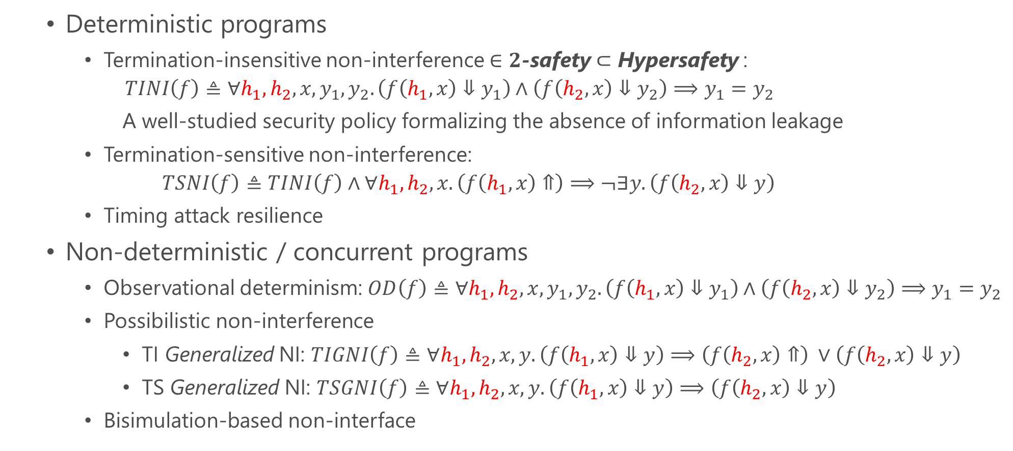
Information Flow Confidentiality & Integrity [JSAC 2003]
  Deterministic programs
    Termination-insensitive non-interference $∈2$-safety $⊂$ Hypersafety :
      $$TINI\left(f\right)≜∀h_{1},h_{2},x,y_{1},y_{2}.\left(f\left(h_{1},x\right)⇓y_{1}\right)∧\left(f\left(h_{2},x\right)⇓y_{2}\right)⟹y_{1}=y_{2}$$
      A well-studied security policy formalizing the absence of information leakage
    Termination-sensitive non-interference:
    $TSNI\left(f\right)≜TINI\left(f\right)∧∀h_{1},h_{2}, x.\left(f\left(h_{1},x\right)⇑\right)⟹¬∃y.\left(f\left(h_{2},x\right)⇓y\right)$
    Timing attack resilience
  Non-deterministic / concurrent programs
    Observational determinism: $OD\left(f\right)≜∀h_{1},h_{2},x,y_{1},y_{2}.\left(f\left(h_{1},x\right)⇓y_{1}\right)∧\left(f\left(h_{2},x\right)⇓y_{2}\right)⟹y_{1}=y_{2}$
    Possibilistic non-interference
      TI Generalized NI: $TIGNI\left(f\right)≜∀h_{1},h_{2},x,y.\left(f\left(h_{1},x\right)⇓y\right)⟹\left(f\left(h_{2},x\right)⇑\right) ∨\left(f\left(h_{2},x\right)⇓y\right)$
      TS Generalized NI: $TSGNI\left(f\right)≜∀h_{1},h_{2},x,y.\left(f\left(h_{1},x\right)⇓y\right)⟹\left(f\left(h_{2},x\right)⇓y\right)$
    Bisimulation-based non-interface
[JSAC 2003] Sabelfeld, Myers. Language-based Information-flow Security.

Slide 9
Availability
Denial of Service (DoS) attack resilience
  Property that “the average response time over all executions is bounded” is relational while “the maximum response time is bounded” is non-relational

Slide 10

Algorithm Analysis
Robustness and sensitivity [CACM 2012, ICFP 2010]
  Continuity:
  $Cont\left(f\right)≜\begin{matrix}∀x_{1},x_{2}.∀ε>0.∃δ>0.d\left(x_{1},x_{2}\right)<δ⟹ \\ ∀y_{1},y_{2}. \left(f\left(x_{1}\right)⇓y_{1}\right)∧\left(f\left(x_{2}\right)⇓y_{2}\right)⟹d\left(y_{1},y_{2}\right)<ε\end{matrix}$
  Lipschitz Continuity:
  ${LC\left(f,c\right)≜∀x}_{1},x_{2},y_{1},y_{2}. \left(f\left(x_{1}\right)⇓y_{1}\right)∧\left(f\left(x_{2}\right)⇓y_{2}\right)⟹\frac{d\left(y_{1},y_{2}\right)}{d\left(x_{1},x_{2}\right)}<c$
[CACM 2012] Chaudhuri et al. Continuity and Robustness of Programs.
[ICFP 2010] Reed, Pierce. Distance Makes the Types Grow Stronger.

Slide 11
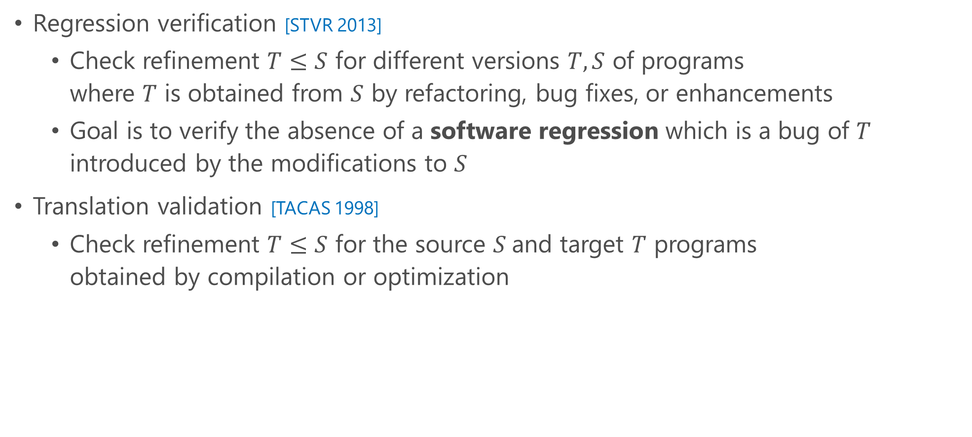
Specific Use Cases (1/2)
Regression verification [STVR 2013]
  Check refinement $T≤S$ for different versions $T,S$ of programs
  where $T$ is obtained from $S$ by refactoring, bug fixes, or enhancements
  Goal is to verify the absence of a software regression which is a bug of $T$ introduced by the modifications to $S$
Translation validation [TACAS 1998]
  Check refinement $T≤S$ for the source $S$and target $T$ programs
  obtained by compilation or optimization
[STVR 2013] Godlin, Strichman. Regression verification: proving the equivalence of similar programs.
[TACAS 1998] Pnueli et al. Translation Validation.

Slide 12
Specific Use Cases (2/2)
Verification of an implementation of an
abstract data type with algebraic specs.
Arithmetic operations with:
equivalence, associativity, commutativity,
distributivity, idempotency, monotonicity,
invertibility, symmetry, transitivity, …
(see the right table from [CAV 2017])
List operations with algebraic specs. like:
append (take xs n) (drop xs n) = xs
Try out a web interface of our relational
verifier from http://lfp.dip.jp/rcaml/
[CAV 2017] Unno et al. Automating Induction for Solving Horn Clauses.

Slide 13
Goal of This Talk
Stimulate the “immature” research field and, hopefully, find research collaborators by
  discussing the challenges in relational verification,
  introducing our automated relational verification methods, and
  highlighting the current limitations as well as future research directions
Disclaimer: This talk will
mainly deal with fully automated deductive relational verification,
target functional properties and will not address trace or contextual properties, and
focus on infinite-state systems that can exhibit effects such as non-termination and non-determinism, and we will not cover other effects or finite-state systems

Slide 14
Outline
Introduction
Challenges in Relational Verification
Automating Relational Verification
  Self-Composition (or Product Programs) [CAV 2021]
  Entailment Checking in 𝝁𝐂𝐋𝐏 [CAV 2017]
Current Limitations and Future Directions
[CAV 2021] Unno et al. Constraint-Based Relational Verification.
[CAV 2017] Unno et al. Automating Induction for Solving Horn Clauses.

Slide 15
Outline
Introduction
Challenges in Relational Verification
Automating Relational Verification
  Self-Composition (or Product Programs) [CAV 2021]
  Entailment Checking in 𝝁𝐂𝐋𝐏 [CAV 2017]
Current Limitations and Future Directions
[CAV 2021] Unno et al. Constraint-Based Relational Verification.
[CAV 2017] Unno et al. Automating Induction for Solving Horn Clauses.

Slide 16
Challenges in Relational Verification
Although each program execution is independent (except the input correlation ensured by the precondition), proving relational properties is challenging without reasoning about the correlation of intermediate execution states
  Analyzing each execution separately does not work well as it necessitates
  an exact summarization of the input-output relation for each execution
  Thus, an automated verifier is required to simultaneously synthesize
    a correlation of intermediate states, namely a relational invariant and
    a scheduler (or alignment) that preserves it!

Slide 17
Comparison with Concurrent Programs Verification
Executions of programs that run concurrently can be highly dependent as states can be synchronized with locks or semaphores, and data races can occur due to shared memory
  Concurrent program is checked to satisfy the specification
  for all possible interleaving executions under a demonic scheduler
Multiple executions in relational verification are independent
  It is sufficient to prove that the specification holds in a certain interleaving execution, chosen by an angelic scheduler
  However, to reason about the correlation between states at the time of output,
  it is still necessary to effectively synchronize at other intermediate points as well
  Therefore, the complexity of the verification is more significantly influenced by the differences between the programs than by the complexity of each program individually

Slide 18



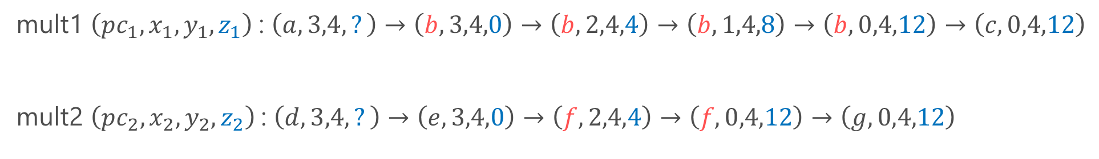

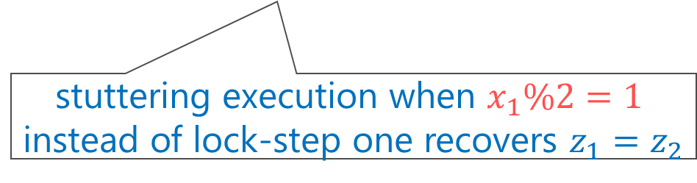


Example: Program Equivalence
int mult1(int x, int y) {
a: int z=0;
b: while(x>0) { x=x-1; z=z+y }
c: return z;
}
int mult2(int x, int y) {
d: int z=0;
e: if(x % 2 == 1) { x=x-1; z=z+y }
f: while(x>0) { x=x-2; z=z+2*y }
g: return z;
}
Let’s align the executions to preserve $z_{1}=z_{2}$ as much as possible
mult1 $\left(pc_{1},x_{1},y_{1},z_{1}\right)$: $\left(a,3,4,?\right)→\left(b,3,4,0\right)→\left(b,2,4,4\right)→\left(b,1,4,8\right)→\left(b,0,4,12\right)→\left(c,0,4,12\right)$
mult2 $\left(pc_{2},x_{2},y_{2},z_{2}\right)$: $\left(d,3,4,?\right)→\left(e,3,4,0\right)→\left(f,2,4,4\right)→\left(f,0,4,12\right)→\left(g,0,4,12\right)$
$$z_{1}=z_{2}$$
$$z_{1}=z_{2}$$
$$z_{1}≠z_{2}$$
$$z_{1}=z_{2}$$
$$z_{1}=z_{2}$$
But how to infer such predicate $x_{1}\%2=1$?
stuttering execution when $x_{1}\%2=1$
instead of lock-step one recovers $z_{1}=z_{2}$
A relational invariant preserved by the above alignment:
$$y_{1}=y_{2}∧\left(pc_{1}=b∧pc_{2}=f∧x_{1}\% 2=0⇒z_{1}=z_{2}\right)∧\left(pc_{1}=b∧pc_{2}=f∧x_{1}\% 2=1⇒z_{1}+y_{1}=z_{2}\right)$$

Slide 19

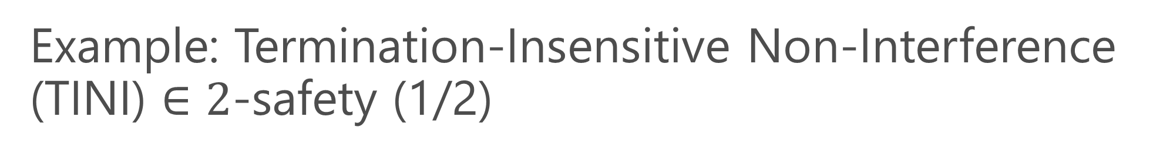
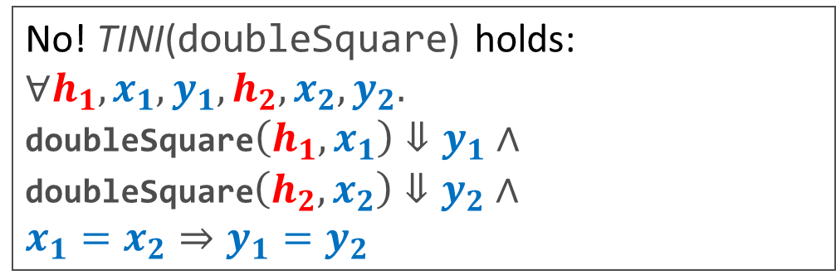
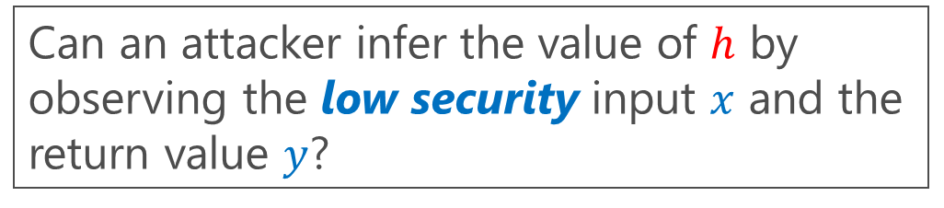
Example: Termination-Insensitive Non-Interference (TINI) $∈$ $2$-safety (1/2)
doubleSquare$\left(h,x\right)$ [CAV 2019] computes ${2⋅x}^{2}$ in two different ways depending on the high security input $h$
doubleSquare(bool h, int x) {
int z, y=0;
if(h) { z=2*x } else { z=x }
while(z>0) { z--; y=y+x }
if(!h) { y=2*y }
return y;
}
Can an attacker infer the value of $h$ by observing the low security input $x$ and the return value $y$?
No! TINI(doubleSquare) holds:
$$∀h_{1},x_{1},y_{1},h_{2},x_{2},y_{2}.$$
doubleSquare$\left(h_{1},x_{1}\right)⇓y_{1}∧$ doubleSquare$\left(h_{2},x_{2}\right)⇓y_{2}∧$
$$x_{1}=x_{2}⇒y_{1}=y_{2}$$
[CAV 2019] Shemer et al. Property Directed Self Composition.

Slide 20





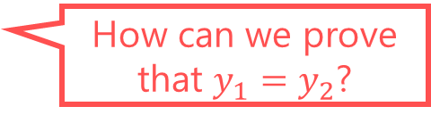






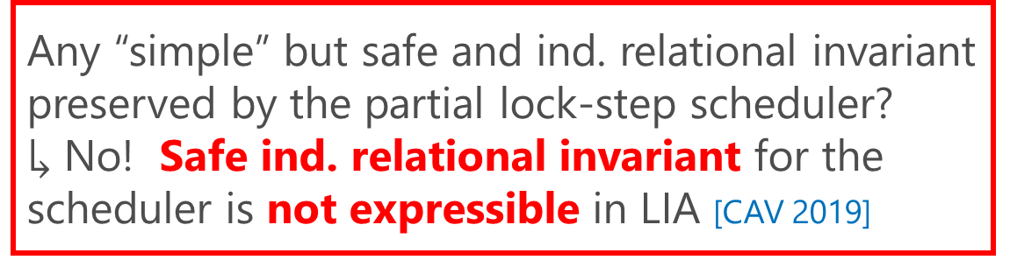

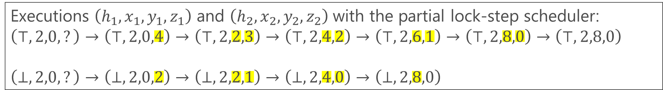




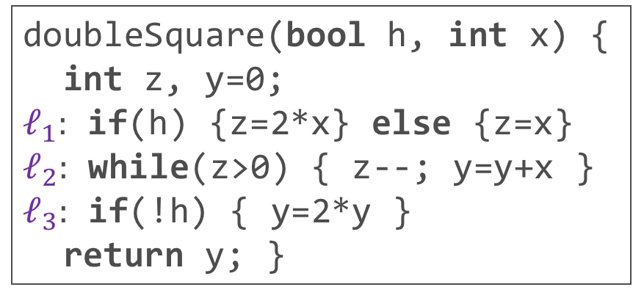



Example: Termination-Insensitive Non-Interference (TINI) $∈$ $2$-safety (2/2)
The parallel executions of 2 copies of the program under the partial lock-step scheduler makes a safe relational invariant “complex”
doubleSquare(bool h, int x) {
int z, y=0;
$ℓ_{1}:$ if(h) {z=2*x} else {z=x}
$ℓ_{2}:$ while(z>0) { z--; y=y+x }
$ℓ_{3}:$ if(!h) { y=2*y }
return y; }
Any “simple” but safe and ind. relational invariant preserved by the partial lock-step scheduler?
$↳$ No! Safe ind. relational invariant for the scheduler is not expressible in LIA [CAV 2019]
Copy2 has exited the loop. Partial lock-step scheduler waits for Copy1 to exit the loop to synchronize
Executions $\left(h_{1},x_{1},y_{1},z_{1}\right)$ and $\left(h_{2},x_{2},y_{2},z_{2}\right)$ with the partial lock-step scheduler:
$$\left(⊤,2,0,?\right)→\left(⊤,2,0,4\right)→\left(⊤,2,2,3\right)→\left(⊤,2,4,2\right)→\left(⊤,2,6,1\right)→\left(⊤,2,8,0\right)→\left(⊤,2,8,0\right)$$
$$\left(⊥,2,0,?\right)→\left(⊥,2,0,2\right)→\left(⊥,2,2,1\right)→\left(⊥,2,4,0\right)→\left(⊥,2,8,0\right)$$
$$ℓ_{1}$$
$$ℓ_{2}$$
$$ℓ_{2}$$
$$ℓ_{2}$$
$$ℓ_{2}$$
$$ℓ_{2}$$
$$ℓ_{3}$$
$$x_{1}=x_{2}$$
$$y_{1}=y_{2}$$
$$y_{1}=y_{2}$$
$$y_{1}=y_{2}$$
$$y_{1}≠y_{2}$$
$$y_{1}≠y_{2}$$
How can we prove that $y_{1}=y_{2}$?
$$ℓ_{1}$$
$$ℓ_{2}$$
$$ℓ_{2}$$
$$ℓ_{2}$$
$$ℓ_{3}$$
[CAV 2019] Shemer et al. Property Directed Self Composition.

Slide 21
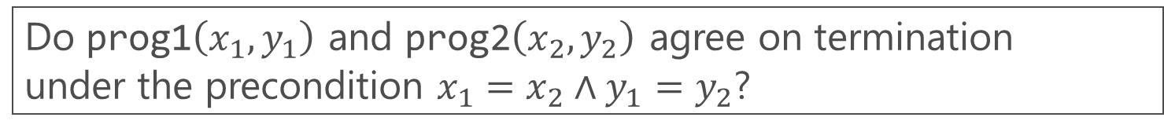
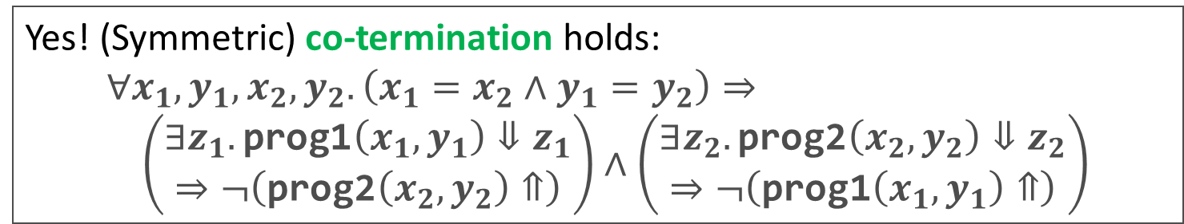
Example: Co-Termination $∈$ Hyperliveness (1/2)
prog1(int x, int y) { while(x>0) { x=x–y; } }
prog2(int x, int y) { while(x>0) { x=x–2*y; } }
Do prog1$\left(x_{1},y_{1}\right)$ and prog2$\left(x_{2},y_{2}\right)$ agree on termination
under the precondition $x_{1}=x_{2}∧y_{1}=y_{2}$?
Yes! (Symmetric) co-termination holds:
$$∀x_{1},y_{1},x_{2},y_{2}. \left(x_{1}=x_{2}∧y_{1}=y_{2}\right)⇒ \\ \left(\begin{aligned}∃z_{1}.\text{prog}\text{1}\left(x_{1},y_{1}\right)⇓z_{1} \\ ⇒¬\left(\text{prog}\text{2}\left(x_{2},y_{2}\right)⇑\right)\end{aligned}\right)∧\left(\begin{aligned}∃z_{2}.\text{prog}\text{2}\left(x_{2},y_{2}\right)⇓z_{2} \\ ⇒¬\left(\text{prog}\text{1}\left(x_{1},y_{1}\right)⇑\right)\end{aligned}\right)$$
One symmetric co-termination problem boils down to two asymmetric co-termination problems

Slide 22
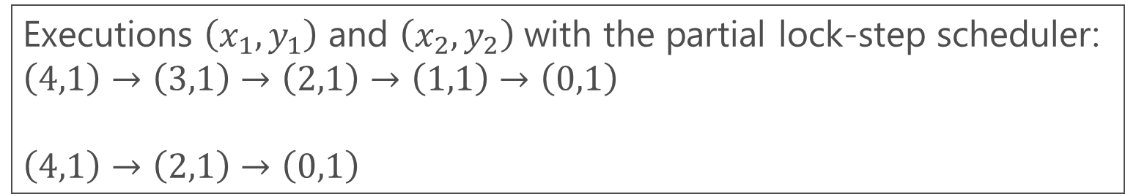

Example: Co-Termination $∈$ Hyperliveness (2/2)
prog1(int x, int y) { while(x>0) { x=x–y; } }
prog2(int x, int y) { while(x>0) { x=x–2*y; } }
How can we prove that this residual execution always terminates?
Executions $\left(x_{1},y_{1}\right)$ and $\left(x_{2},y_{2}\right)$ with the partial lock-step scheduler:
$$\left(4,1\right)→\left(\text{3,1}\right)→\left(2,1\right)→\left(1,1\right)→\left(0,1\right)$$
$$\left(4,1\right)→\left(2,1\right)→\left(0,1\right)$$
$$x_{1}=x_{2} \\ ∧y_{1}=y_{2}$$
prog2 terminated

Slide 23


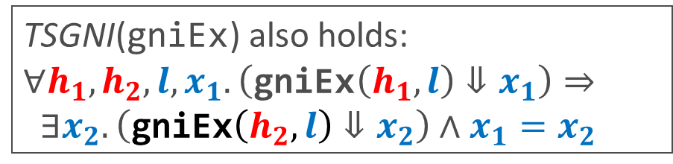

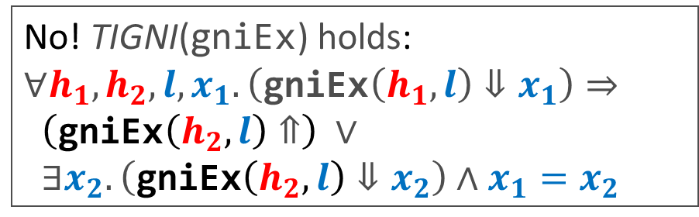
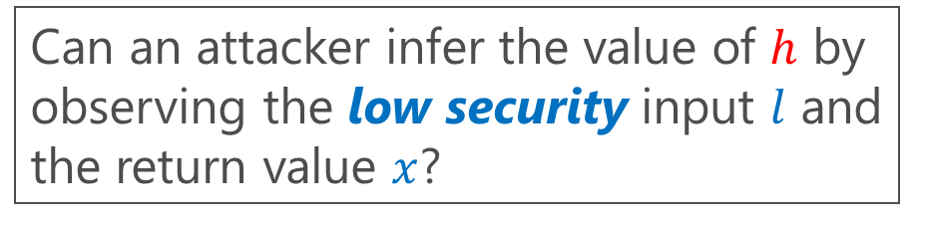
Example: (TI-/TS-)GNI $∈$ $∀∃$hyperproperties
gniEx$\left(h,l\right)$ non-deterministically returns a value $x≥l$ in two different ways depending on the high security input $h$
gniEx(bool high, int low) {
if(high) {
int x = nondet_int();
if(x >= low) { return x }
else { while(true) {} }
} else {
int x = low;
while(nondet_bool()){x++}
return x;
}
}
Can an attacker infer the value of $h$ by observing the low security input $l$ and the return value $x$?
Demonic ($∀$) choice
No! TIGNI($\text{gniEx}$) holds:
$$∀h_{1}, h_{2},l,x_{1}.\left(\text{gniEx}\left(h_{1},l\right)⇓x_{1}\right)⇒$$
$\left(\text{gniEx}\left(h_{2},l\right)⇑\right) ∨$
$∃x_{2}.\left(\text{gniEx}\left(h_{2},l\right)⇓x_{2}\right)∧x_{1}=x_{2}$
Angelic ($∃$) choice
TSGNI($\text{gniEx}$) also holds:
$$∀h_{1}, h_{2},l,x_{1}.\left(\text{gniEx}\left(h_{1},l\right)⇓x_{1}\right)⇒$$
$∃x_{2}.\left(\text{gniEx}\left(h_{2},l\right)⇓x_{2}\right)∧x_{1}=x_{2}$
But how to solve such games between $∀$ and $∃$?

Slide 24
Other Challenging Examples in the Literature
[LFCS 2013]
[PLDI 2019]
[CAV 2016]
[PLDI 2019] Churchill et al. Semantic program alignment for equivalence checking.
[LFCS 2013] Barthe et al. Beyond 2-Safety: Asymmetric Product Programs for Relational Program Verification
[CAV 2016] Fedyukovich et al. Property Directed Equivalence via Abstract Simulation

Slide 25
Outline
Introduction
Challenges in Relational Verification
Automating Relational Verification
  Self-Composition (or Product Programs) [CAV 2021]
  Entailment Checking in 𝝁𝐂𝐋𝐏 [CAV 2017]
Current Limitations and Future Directions
[CAV 2021] Unno et al. Constraint-Based Relational Verification.
[CAV 2017] Unno et al. Automating Induction for Solving Horn Clauses.

Slide 26
Self-Composition
(or Product Programs)

Slide 27
Self-Composition (or Product Programs)
Relational verification amounts to synthesis of relational invariants and schedulers
Self-composition refers to a range of techniques aimed at synthesizing alignments represented symbolically as programs, automata, logical constraints, and games
  Syntactic: [CSFW 2004, SAS 2005, PLAS 2006, FM 2011, LFCS 2013, SAS 2016, LPAR 2017]
  Semantic: [CAV 2019a, CAV 2019b, PLDI 2019, CAV 2021, CAV 2022]
[CSFW 2004] Barthe et al. Secure Information Flow by Self-Composition.
[SAS 2005] Terauchi, Aiken. Secure Information Flow as a Safety Problem.
[PLAS 2006] Unno et al. Combining Type-Based Analysis and Model Checking for Finding Counterexamples against Non-Interference.
[FM 2011] Barthe et al. Relational Verification Using Product Programs.
[LFCS 2013] Barthe et al. Beyond 2-Safety: Asymmetric Product Programs for Relational Program Verification
[SAS 2016] Angelis et al. Relational Verification Through Horn Clause Transformation.
[LPAR 2017] Mordvinov, Fedyukovich. Synchronizing Constrained Horn Clauses.
[CAV 2019a] Farzan, Vandika. Automated Hypersafety Verification.
[CAV 2019b] Shemer et al. Property Directed Self Composition.
[PLDI 2019] Churchill et al. Semantic program alignment for equivalence checking.
[CAV 2021] Unno et al. Constraint-Based Relational Verification.
[CAV 2022] Beutner, Finkbeiner. Software Verification of Hyperproperties Beyond k-Safety.

Slide 28
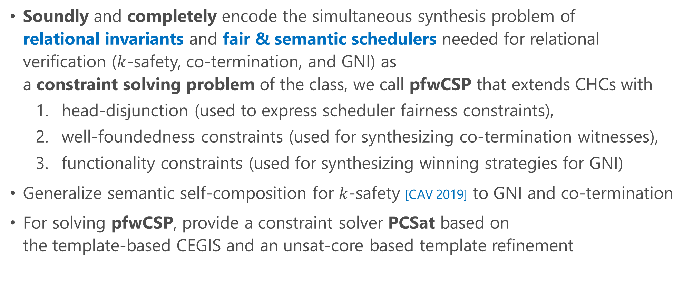
Our Approach to Semantic Self-Composition [CAV 2021]
Soundly and completely encode the simultaneous synthesis problem of
relational invariants and fair & semantic schedulers needed for relational verification ($k$-safety, co-termination, and GNI) as
a constraint solving problem of the class, we call pfwCSP that extends CHCs with
  head-disjunction (used to express scheduler fairness constraints),
  well-foundedness constraints (used for synthesizing co-termination witnesses),
  functionality constraints (used for synthesizing winning strategies for GNI)
Generalize semantic self-composition for $k$-safety [CAV 2019] to GNI and co-termination
For solving pfwCSP, provide a constraint solver PCSat based on
the template-based CEGIS and an unsat-core based template refinement
[CAV 2019] Shemer et al. Property Directed Self Composition.
[CAV 2021] Unno et al. Constraint-Based Relational Verification.

Slide 29

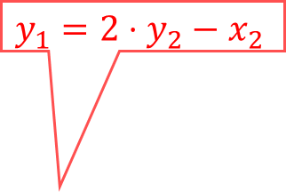

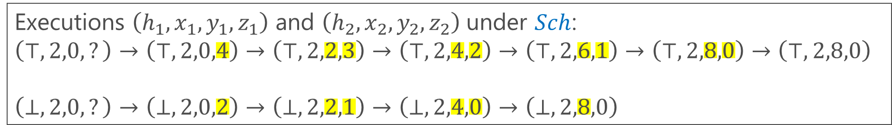
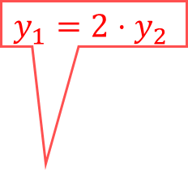
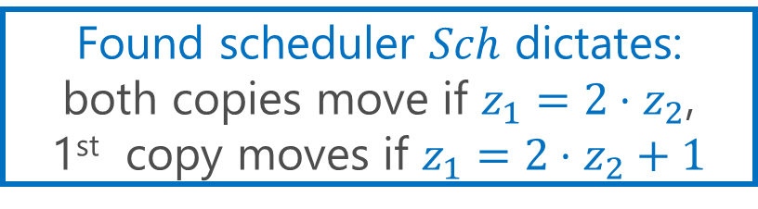
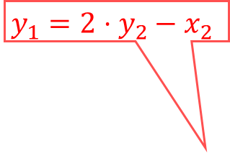
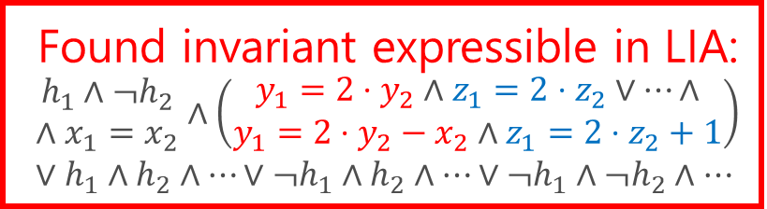

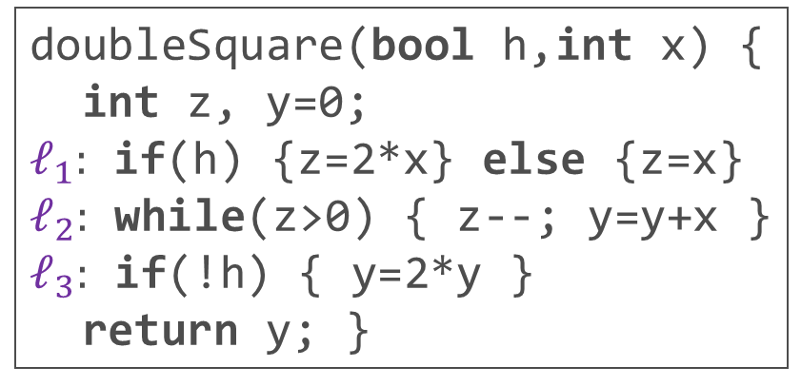

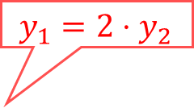
Semantic Self-Composition for TI-NI
Can choose which program to execute depending on the states
Find a semantic scheduler $Sch$ and a safe invariant of the parallel executions of 2 copies of the program under $Sch$
Found scheduler $Sch$ dictates:
both copies move if $z_{1}=2⋅z_{2}$,
1st copy moves if $z_{1}=2⋅z_{2}+1$
doubleSquare(bool h,int x) {
int z, y=0;
$ℓ_{1}:$ if(h) {z=2*x} else {z=x}
$ℓ_{2}:$ while(z>0) { z--; y=y+x }
$ℓ_{3}:$ if(!h) { y=2*y }
return y; }
Found invariant expressible in LIA:
$$\begin{matrix}h_{1}∧¬h_{2} \\ ∧x_{1}=x_{2}\end{matrix}∧\left(\begin{matrix}y_{1}=2⋅y_{2}∧z_{1}=2⋅z_{2}∨…∧ \\ y_{1}=2⋅y_{2}−x_{2}∧z_{1}=2⋅z_{2}+1\end{matrix}\right)∨h_{1}∧h_{2}∧…∨¬h_{1}∧h_{2}∧…∨¬h_{1}∧¬h_{2}∧…$$
$$y_{1}={2⋅y}_{2}−x_{2}$$
$$y_{1}={2⋅y}_{2}$$
$$y_{1}={2⋅y}_{2}−x_{2}$$
Executions $\left(h_{1},x_{1},y_{1},z_{1}\right)$ and $\left(h_{2},x_{2},y_{2},z_{2}\right)$ under $Sch$:
$$\left(⊤,2,0,?\right)→\left(⊤,2,0,4\right)→\left(⊤,2,2,3\right)→\left(⊤,2,4,2\right)→\left(⊤,2,6,1\right)→\left(⊤,2,8,0\right)→\left(⊤,2,8,0\right)$$
$$\left(⊥,2,0,?\right)→\left(⊥,2,0,2\right)→\left(⊥,2,2,1\right)→\left(⊥,2,4,0\right)→\left(⊥,2,8,0\right)$$
$$y_{1}={2⋅y}_{2}$$
$$ℓ_{1}$$
$$ℓ_{2}$$
$$ℓ_{2}$$
$$ℓ_{2}$$
$$ℓ_{2}$$
$$ℓ_{2}$$
$$ℓ_{3}$$
$$y_{1}=y_{2}$$
$$y_{1}={2⋅y}_{2}$$
$$ℓ_{1}$$
$$y_{1}=y_{2}$$
$$ℓ_{2}$$
$$ℓ_{2}$$
$$ℓ_{2}$$
$$ℓ_{3}$$

Slide 30


Prog. & Spec.
pfwCSP
SAT or UNSAT
Constraint Generation
Constraint Solving
represents a relational invariant
preserved by a semantic scheduler
the relational invariant is inductive and implies TI-NI
Input:
doubleSquare
(bool h, int x) {
int z, y=0;
if(h) { z=2*x }
else { z=x }
while(z>0)
{ z--; y=y+x }
if(!h) { y=2*y }
return y;
}
Output $𝓒$ (with $h_{1}=⊤∧h_{2}= ⊥$ fixed):
$I\left(V_{1},V_{2}\right)⟸\begin{matrix}x_{1}=x_{2}∧y_{1}=y_{2}=0 \\ ∧z_{1}=2⋅x_{1}∧z_{2}=x_{2}\end{matrix}$,
$I\left(x_{1},y_{1}^{′},z_{1}^{′},V_{2}\right)⟸I\left(V_{1},V_{2}\right)∧Sch_{1}\left(V_{1},V_{2}\right)∧ \left(\begin{aligned}z_{1}>0∧z_{1}^{′}=z_{1}−1∧y_{1}^{′}=y_{1}+x_{1}∨ \\ z_{1}≤0∧z_{1}^{′}=z_{1}∧y_{1}^{′}=y_{1}\end{aligned}\right)$,…,
$y_{1}=2⋅y_{2}⟸$ $I\left(V_{1},V_{2}\right)∧z_{1}≤0∧z_{2}≤0$,
$\left(Sch_{1}\left(V_{1},V_{2}\right)∨Sch_{2}\left(V_{1},V_{2}\right)∨Sch_{1,2}\left(V_{1},V_{2}\right)\right)$
$⟸I\left(V_{1},V_{2}\right)∧\left(z_{1}>0∨z_{2}>0\right)$,
$z_{1}>0⟸I\left(V_{1},V_{2}\right)∧Sch_{1}\left(V_{1},V_{2}\right)∧z_{2}>0$,
$z_{2}>0⟸I\left(V_{1},V_{2}\right)∧Sch_{2}\left(V_{1},V_{2}\right)∧z_{1}>0,$
where $V_{1}=x_{1},y_{1},z_{1}$ and $V_{2}=x_{2},y_{2},z_{2}$
the scheduler is fair: at least one unfinished program must be scheduled if there is any
(necessary for the soundness)
non-Horn clause that goes beyond CHCs !
represent the semantic scheduler: if $Sch_{1}$ holds, 1st copy is scheduled

Slide 31
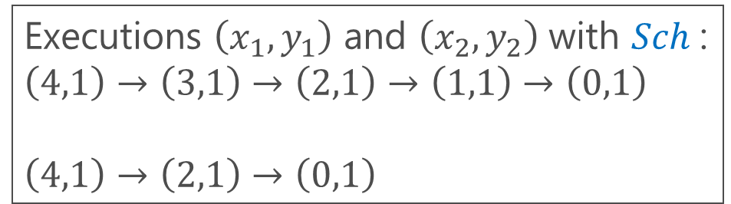
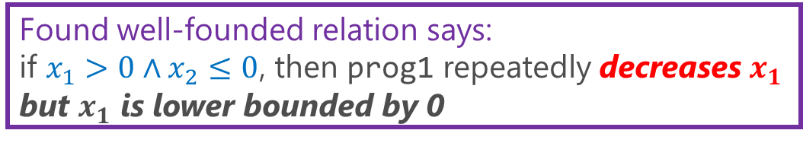

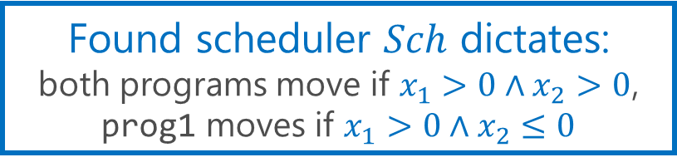


Semantic Self-Composition for Asymmetric Co-Termination
Find a fair semantic scheduler $Sch$, a relational invariant, and a well-founded relation under $Sch$
prog1(int x, int y) { while(x>0) { x=x–y; } }
prog2(int x, int y) { while(x>0) { x=x–2*y; } }
Found scheduler $Sch$ dictates:
both programs move if $x_{1}>0∧x_{2}>0$,
prog1 moves if $x_{1}>0∧x_{2}≤0$
Found well-founded relation says:
if $x_{1}>0∧x_{2}≤0$, then prog1 repeatedly decreases $x_{1}$ but $x_{1}$ is lower bounded by 0
Executions $\left(x_{1},y_{1}\right)$ and $\left(x_{2},y_{2}\right)$ with $Sch$:
$$\left(4,1\right)→\left(\text{3}\text{,}\text{1}\right)→\left(2,1\right)→\left(1,1\right)→\left(0,1\right)$$
$$\left(4,1\right)→\left(2,1\right)→\left(0,1\right)$$
prog1 terminated
$$x_{1}=x_{2} \\ ∧y_{1}=y_{2}$$
prog2 terminated
Found relational invariant implies:
$$x_{1}>0∧x_{2}≤0⇒y_{1}≥1$$

Slide 32

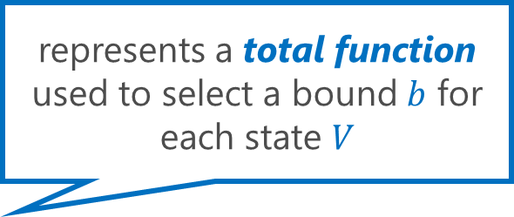
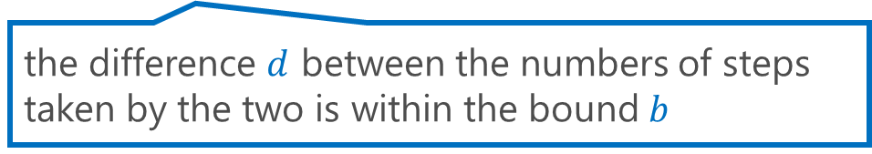
Prog. & Spec.
pfwCSP
SAT or UNSAT
the relational invariant is inductive and, along with the well-founded relation, implies Co-Termination
Constraint Generation
represents a total function used to select a bound $b$ for each state $V$
Constraint Solving
represents a relational invariant
preserved by a semantic scheduler
Input:
prog1(x, y) {
while(x>0)
{ x=x–y }
}
prog2(x, y) {
while(x>0)
{ x=x-2*y }
}
Output $𝓒$:
$I\left(0,b,V\right)⟸F_{λ}\left(V,b\right)∧x_{1}=x_{2}∧y_{1}=y_{2}$,
$I\left({d^{′},b,x}_{1}^{′},y_{1}, x_{2},y_{2}\right)⟸I\left(d,b,V\right)∧Sch_{1}\left(V\right)∧$
$\left(x_{1}>0∧x_{1}^{′}=x_{1}−y_{1}∨x_{1}≤0∧x_{1}^{′}=x_{1}\right)∧$
$\left(x_{1}>0∧x_{2}>0⇒d^{′}=d+1\right)$,…,
$R_{⇓}\left(V_{1},x_{1}−y_{1},y_{1}\right)⟸$ $I\left({d,b,V}_{1},V_{2}\right)∧x_{1}>0∧x_{2}≤0$,
$\left(Sch_{1}\left(d,b,V\right)∨Sch_{2}\left(d,b,V\right)∨Sch_{1,2}\left(d,b,V\right)\right)$
$⟸I\left(d,b,V\right)∧\left(x_{1}>0∨x_{2}>0\right)$,
$x_{1}>0⟸I\left(d,b,V\right)∧Sch_{1}\left(d,b,V\right)∧x_{2}>0$,
$x_{2}>0⟸I\left(d,b,V\right)∧Sch_{2}\left(d,b,V\right)∧x_{1}>0,$
$d∈\left[−b,b\right]∧b≥0 ⟸I\left({d,b,V}_{1},V_{2}\right)∧x_{1}>0∧x_{2}>0$
where $V=x_{1},y_{1}$,$x_{2},y_{2}$
the scheduler is fair: all unfinished programs must be eventually scheduled
(necessary for soundness)
represents a well-founded relation witnessing the termination of prog1 relative to the termination of prog2
the difference $d$ between the numbers of steps taken by the two is within the bound $b$

Slide 33
Semantic Self-Composition for (TI-/TS-)GNI
Find a fair semantic scheduler, a relational invariant, a well-founded relation, and strategies for the non-deterministic choices of the angelic side
Augment the encodings for TI-NI and Co-Term with
  predicate variables that represent the strategies:
  total functions from states to choices of the angelic side
  prophecy variables that represent the final outputs of the demonic side (necessary for the completeness)
Please refer to [CAV 2021] for details and examples
[CAV 2021] Unno et al. Constraint-Based Relational Verification.

Slide 34
Implementation and Evaluation
Evaluated our solver PCSat for solving pfwCSP
on 20 relational verification problems:
  15 solved fully automatically, 5 required small hints

Slide 35
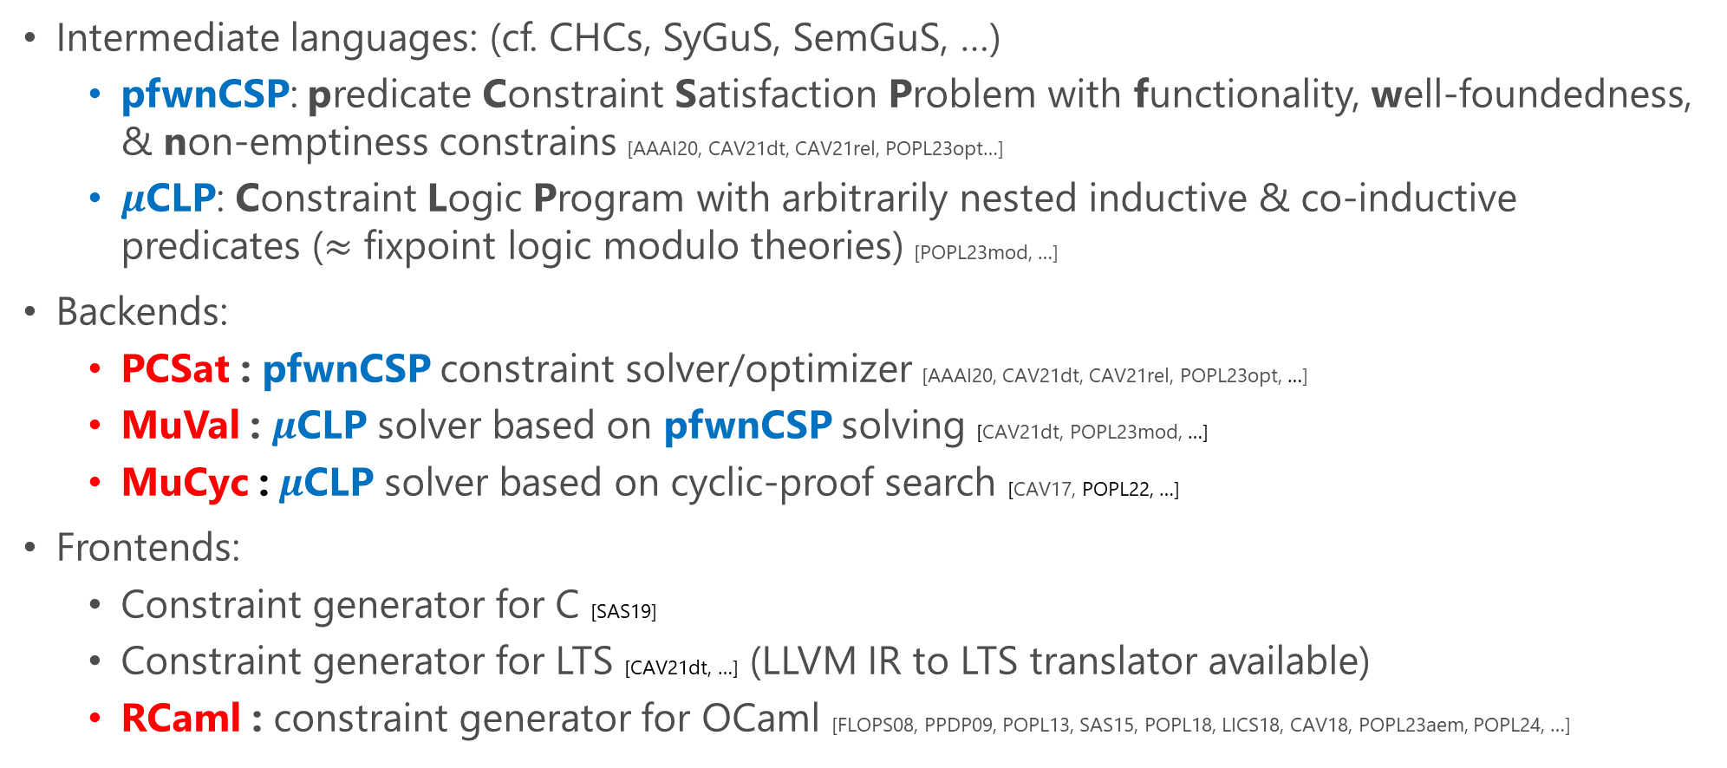
The CoAR Verification & Synthesis Tool Chain (https://github.com/hiroshi-unno/coar)
Intermediate languages: (cf. CHCs, SyGuS, SemGuS, …)
  pfwnCSP: predicate Constraint Satisfaction Problem with functionality, well-foundedness, & non-emptiness constrains [AAAI20, CAV21dt, CAV21rel, POPL23opt…]
  $μ$CLP: Constraint Logic Program with arbitrarily nested inductive & co-inductive predicates ($≈$ fixpoint logic modulo theories) [POPL23mod, …]
Backends:
  PCSat : pfwnCSP constraint solver/optimizer [AAAI20, CAV21dt, CAV21rel, POPL23opt, …]
  MuVal : $μ$CLP solver based on pfwnCSP solving [CAV21dt, POPL23mod, …]
  MuCyc : $μ$CLP solver based on cyclic-proof search [CAV17, POPL22, …]
Frontends:
  Constraint generator for C [SAS19]
  Constraint generator for LTS [CAV21dt, …] (LLVM IR to LTS translator available)
  RCaml : constraint generator for OCaml [FLOPS08, PPDP09, POPL13, SAS15, POPL18, LICS18, CAV18, POPL23aem, POPL24, …]

Slide 36
Discussion
Semantic self-composition has a high theoretical potential and promising experimental results have actually been obtained
Current limitations
  Relational verifiers based on semantic self-composition exhibit increased search costs and reduced efficiency as the capability of representable schedulers grows
Future directions
  Leverage various existing syntactic and semantic abstraction, search pruning, and symmetry breaking techniques to accelerate the search

Slide 37
  Entailment Checking in 𝝁𝐂𝐋𝐏

Slide 38
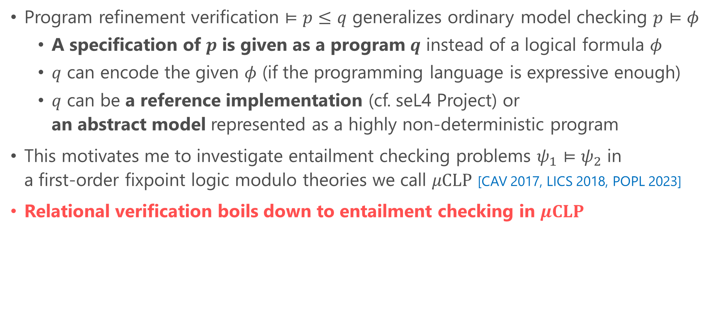
Program Refinement as Generalized Model Checking
Program refinement verification $⊨p≤q$ generalizes ordinary model checking $p⊨φ$
  A specification of $p$ is given as a program $q$ instead of a logical formula $φ$
  $q$ can encode the given $φ$ (if the programming language is expressive enough)
  $q$ can be a reference implementation (cf. seL4 Project) or
  an abstract model represented as a highly non-deterministic program
This motivates me to investigate entailment checking problems $ψ_{1}⊨ψ_{2}$ in
a first-order fixpoint logic modulo theories we call $μCLP$ [CAV 2017, LICS 2018, POPL 2023]
Relational verification boils down to entailment checking in $μCLP$
[CAV 2017] Unno et al. Automating Induction for Solving Horn Clauses.
[LICS 2018] Nanjo et al. A Fixpoint Logic and Dependent Effects for Temporal Property Verification.
[POPL 2023] Unno et al. Modular Primal-Dual Fixpoint Logic Solving for Temporal Verification.

Slide 39
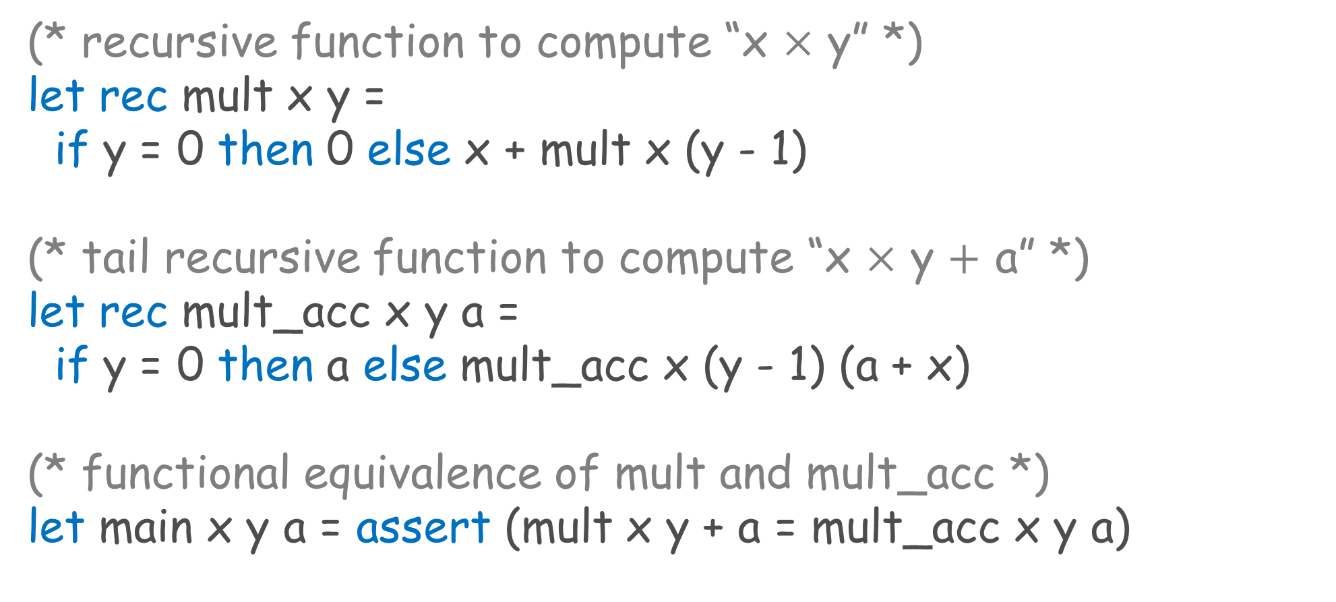
Example: Functional Program & Relational Spec.
(* recursive function to compute “x $×$ y” *)
let rec mult x y =
if y = 0 then 0 else x + mult x (y - 1)
(* tail recursive function to compute “x $×$ y $+$ a” *)
let rec mult_acc x y a =
if y = 0 then a else mult_acc x (y - 1) (a + x)
(* functional equivalence of mult and mult_acc *)
let main x y a = assert (mult x y + a = mult_acc x y a)

Slide 40







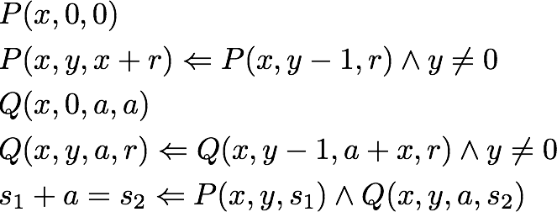

CHCs Constraint Generation based on Dependent Refinement Types [PPDP 2009]
let rec mult x y =
if y = 0 then 0
else x + mult x (y - 1)
let rec mult_acc x y a =
if y = 0 then a
else mult_acc x (y - 1) (a + x)
let main x y a =
assert (mult x y + a
= mult_acc x y a)
[PPDP 2009] Unno, Kobayashi. Dependent Type Inference with Interpolants.

Slide 41
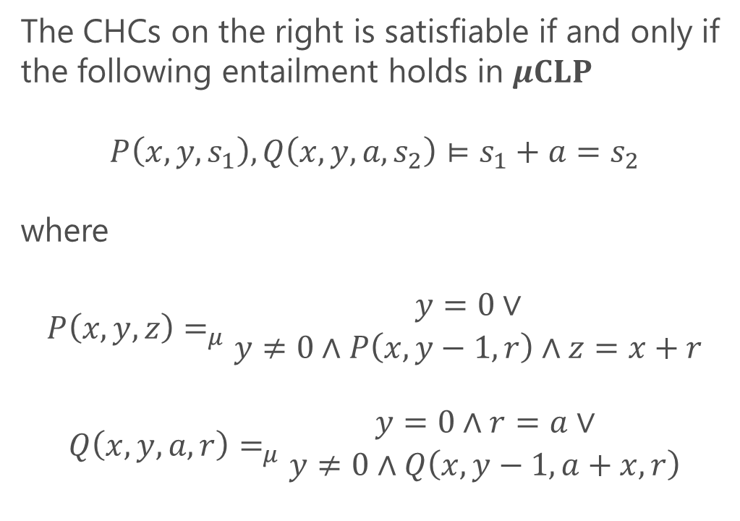
CHC Solving via Entailment Checking in $μ$CLP
The CHCs on the right is satisfiable if and only if
the following entailment holds in $μCLP$
$$P\left(x,y,s_{1}\right),Q\left(x,y,a,s_{2}\right)⊨s_{1}+a=s_{2}$$
where
$$P\left(x,y,z\right)=_{μ}\begin{matrix}y=0∨ \\ y≠0∧P\left(x,y−1,r\right)∧z=x+r\end{matrix}$$
$$Q\left(x,y,a,r\right)=_{μ}\begin{matrix}y=0∧r=a∨ \\ y≠0∧Q\left(x,y−1,a+x,r\right)\end{matrix}$$

Slide 42


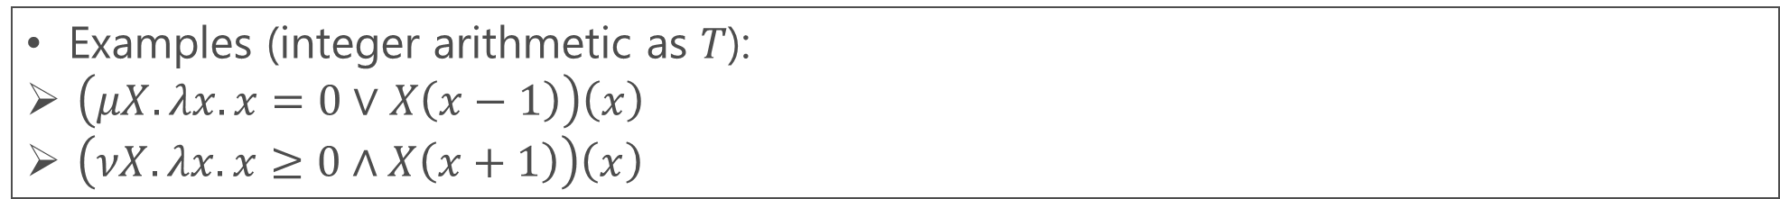
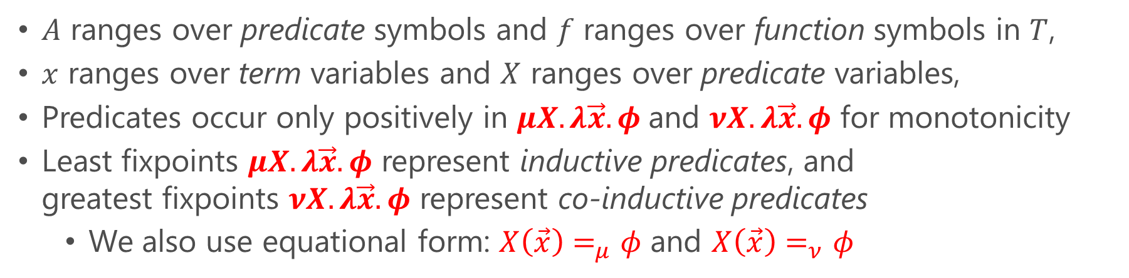




$μ$CLP: An Extension of CLP with Quantifiers and Arbitrarily-Nested (Co-)Inductive Predicates
Can be seen as a first-order fixpoint logic modulo background theories $T$
(formulas) $φ∷= ⊥\left| ⊤ \right| A\left(\vec{t}\right) \left| ¬φ \right| φ_{1}∧φ_{2} | φ_{1}∨φ_{2} \left| ∀x. φ \right| ∃x. φ | p(\vec{t})$
(terms) $t∷=x | f\left(\vec{t}\right)$(predicates) $p∷=X \left| μX.λ\vec{x}. φ \right| νX.λ\vec{x}. φ$
$A$ ranges over predicate symbols and $f$ ranges over function symbols in $T$,
$x$ ranges over term variables and $X$ ranges over predicate variables,
Predicates occur only positively in $μX.λ\vec{x}. φ$and $νX.λ\vec{x}. φ$ for monotonicity
Least fixpoints $μX.λ\vec{x}. φ$ represent inductive predicates, and
greatest fixpoints $νX.λ\vec{x}. φ$ represent co-inductive predicates
  We also use equational form: $X\left(\vec{x}\right)=_{μ}φ$ and $X\left(\vec{x}\right)=_{ν}φ$
Examples (integer arithmetic as 𝑇):
$\left(μX.λx.x=0∨X\left(x−1\right)\right)\left(x\right)$
$\left(νX.λx.x≥0∧X\left(x+1\right)\right)\left(x\right)$
$$⇔x=0∨x=1∨x=2∨…$$
$$⇔∃z≥0.x=z$$
$$⇔x≥0∧x+1≥0∧x+2≥0∧…$$
$$⇔∀z≥0. x+z≥0$$

Slide 43






Entailment Checking via Inductive Theorem Proving
$$P\left(x,0,0\right) P\left(x,y,x+r\right)⇐P\left(x,y−1,r\right)∧y≠0 \\ Q\left(x,0,a,a\right) Q\left(x,y,a,r\right)⇐Q\left(x,y−1,a+x,r\right)∧y≠0 \\ s_{1}+a=s_{2}⇐P\left(x,y,s_{1}\right)∧Q\left(x,y,a,s_{2}\right)$$
Prove this by induction on derivation of $P\left(x,y,s_{1}\right)$
$$P\left(x,y,s_{1}\right)∧Q\left(x,y,a,s_{2}\right)⊨s_{1}+a=s_{2}$$

Slide 44



Principle of Induction on Derivation
    $∀D. ψ\left(D\right)$ if and only if
    $∀D. \left(∀D^{′}.D^{′}≺D⇒ψ\left(D′\right)\right)⇒ψ\left(D\right)$
    where $D′≺D$ represents that
    $D′$ is a strict sub-derivation of $D$
Assume $ψ\left(D_{1}\right),ψ\left(D_{2}\right),$ $ψ\left(D_{3}\right),ψ\left(D_{4}\right),$
$$ψ\left(\frac{⋮}{J_{2}}\right), ψ\left(\frac{⋮}{J_{3}}\right),ψ\left(\frac{⋮}{J_{4}}\right)$$
and prove $ψ\left(D\right)$
$$D=\frac{\begin{matrix}\frac{\begin{matrix}\frac{D_{1}}{J_{3}} & \begin{matrix} \\ D_{2}\end{matrix}\end{matrix}}{J_{2}} & \begin{matrix} \\ D_{3}\end{matrix} & \frac{D_{4}}{J_{4}}\end{matrix}}{J_{1}}$$

Slide 45

CHC Solving:
Induction hypotheses and lemmas
Judgment
Inductive Theorem Proving:
$$∅;P\left(x,y,s_{1}\right),Q\left(x,y,a,s_{2}\right)⊢s_{1}+a=s_{2}$$
Premises

Slide 46

Guard to avoid unsound application
Add an induction hypothesis:
$$γ=\begin{matrix}∀x^{′},y^{′},s_{1}^{′},a^{′},s_{2}^{′}.D\left(P\left(x^{′},y^{′},s_{1}^{′}\right)\right)≺D\left(P\left(x,y,s_{1}\right)\right)∧ \\ P\left(x′,y′,s_{1}′\right)∧Q\left(x^{′},y^{′},a^{′},s_{2}^{′}\right)⇒s_{1}′+a′=s_{2}′\end{matrix}$$
Induct
Unfold
Case analysis on the last rule used

Slide 47
Case analysis on the last rule used
Unfold

Slide 49
Validity checking
Valid

Slide 51
Valid

Slide 54
Unfold
Case analysis on the last rule used

Slide 56
Valid

Slide 58


$$σ\left(γ\right)=\begin{matrix}D\left(P\left(x,y−1,s_{1}−x\right)\right)≺D\left(P\left(x,y,s_{1}\right)\right)∧P\left(x,y−1,s_{1}−x\right)∧ \\ Q\left(x,y−1,a+x,s_{2}\right)⇒\left(s_{1}−x\right)+(a+x)=s_{2}\end{matrix}$$
$$γ=\begin{matrix}∀x^{′},y^{′},s_{1}^{′},a^{′},s_{2}^{′}.D\left(P\left(x^{′},y^{′},s_{1}^{′}\right)\right)≺D\left(P\left(x,y,s_{1}\right)\right)∧ \\ P\left(x′,y′,s_{1}′\right)∧Q\left(x^{′},y^{′},a^{′},s_{2}^{′}\right)⇒s_{1}′+a′=s_{2}′\end{matrix}$$
IndHyp
Apply induction hypothesis

Slide 59
Valid
QED

Slide 60
Properties of the Inductive Proof System for CHCs Solving
Soundness: If the goal is proved, the original CHCs have a solution (which may not be expressible in the background theory)
Relative Completeness: If the original CHCs have a solution expressible in the background theory, the goal is provable

Slide 61

Automating Induction
Use the following rule application strategy:
  Repeatedly apply INDHYP until no new premises are added
  Apply VALID whenever a new premise is added
  Select some $P\left(\tilde{t}\right)$ and apply INDUCT and UNFOLD
Close a proof branch by VALID that uses
  SMT solvers: provide efficient and powerful reasoning about data structures (e.g., integers, reals, algebraic data structures) but predicates are abstracted as uninterpreted functions
  CHC solvers: provide bit costly but powerful reasoning about inductive predicates

Slide 62

A Prototype Entailment Checker MuCyc http://lfp.dip.jp/rcaml/
Use Z3 and SPACER respectively as the backend SMT and CHC solvers
Integrated with a dependent refinement type based CHC generation tool RCaml for OCaml
Currently support entailments in
  The fragment corresponding to CHCs: $P_{1}\left(\vec{x_{1}}\right),…,P_{n}\left(\vec{x_{n}}\right)⊨φ$ and
  $P_{1}\left(\vec{x_{1}}\right),…,P_{n}\left(\vec{x_{n}}\right)⊨Q\left(\vec{y}\right)$, which is useful for program refinement verification and proving lemmas to prove entailments in the above fragment (cf. commutativity proof of mult)
Can prove and then exploit lemmas which are:
  User-supplied,
  Heuristically conjectured from the given constraints, or
  Automatically generated by an abstract interpreter
Can generate a counterexample (if any)

Slide 63
Experiments on IsaPlanner Benchmark Set
85 (mostly) relational verification problems of
total functions on inductively defined data structures
Inductive Theorem Prover | #Successfully Proved
RCaml | 68
Zeno | 82 [Sonnex+ ’12]
HipSpec | 80 [Claessen+ ’13]
CVC4 | 80 [Reynolds+ ’15]
ACL2s | 74 (according to [Sonnex+ ’12])
IsaPlanner | 47 (according to [Sonnex+ ’12])
Dafny | 45 (according to [Sonnex+ ’12])
Support automatic
lemma discovery &
goal generalization

Slide 64
Experiments on Benchmark Programs with Advanced Language Features & Side-Effects
30 (mostly) relational verification problems for:
  Complex integer functions: Ackermann, McCarthy91
  Nonlinear real functions: dyn_sys
  Higher-order functions: fold_left, fold_right, repeat, find, ...
  Exceptions: find
  Non-terminating functions: mult, sum, …
  Non-deterministic functions: randpos
  Imperative procedures: mult_Ccode

Slide 65

28 (2 required lemmas) successfully proved by MuCyc
3 proved by CHC constraint solver $μ$Z PDR
2 proved by inductive theorem prover CVC4 (if inductive predicates are encoded using uninterpreted functions)

Slide 66

Discussion
The integration of SMT solving, CHC solving, and inductive theorem proving resulted in an automated relational verifier across programs in various paradigms with advanced language features and side-effects
Current limitations
  Limited support for automatic lemma discovery and goal generalization
  Does not support the full fragment of $μ$CLP
Future directions
  Generalize the recently observed connection of (co)inductive theorem proving to invariant and ranking function synthesis [LICS 2018, POPL 2023] and software model checking [POPL 2022] to the full fragment of $μ$CLP
[LICS 2018] Nanjo et al. A Fixpoint Logic and Dependent Effects for Temporal Property Verification.
[POPL 2022] Tsukada, Unno. Software Model-Checking as Cyclic-Proof Search.
[POPL 2023] Unno et al. Modular Primal-Dual Fixpoint Logic Solving for Temporal Verification.

Slide 67
Outline
Introduction
Challenges in Relational Verification
Automating Relational Verification
  Self-Composition (or Product Programs) [CAV 2021]
  Entailment Checking in 𝝁𝐂𝐋𝐏 [CAV 2017]
Current Limitations and Future Directions
[CAV 2021] Unno et al. Constraint-Based Relational Verification.
[CAV 2017] Unno et al. Automating Induction for Solving Horn Clauses.

Slide 68

Current Limitations of Both Approaches
It often becomes impossible to establish program refinement and equivalence, when there is movement of statements across loops or recursions
  E.g., loop-invariant code motion, loop interchange, loop fusion, …
  Using commutativity or idempotency at the right times may help establish program refinement or equivalence, but more research is needed to automate it
    Although not automated, the proof system for entailment in $μ$CLP can prove commutativity and idempotency and use them as lemmas to prove other entailments that involve reordering

Slide 69

Ongoing and Future Work
Develop a general theory and algorithms for aligning reordered executions
Improve the efficiency of semantic self-composition by incorporating abstraction, search pruning, and symmetry breaking techniques
Automate relational entailments checking in the full class of $μ$CLP
Automate program verification of:
  Temporal relational properties expressed in hyperlogics (HyperLTL, HyperCTL*, …)
  Probabilistic relational properties, motivated from
  security, privacy, cryptography, and machine learning

Slide 70

Conclusion
Relational verification amounts to synthesis of relational invariants and schedulers
Emerging semantic self-composition techniques enable precise alignment but require further development to be refined into an efficient solver
An alternative approach based on entailment checking in $μ$CLP, a first-order fixpoint logic, shows promise, though it requires more automation through the adoption of software model checking and theorem proving techniques to fully realize the potential of this approach
In both automated approaches, aligning reordered executions remains a challenge

Slide 71
Acknowledgements
This talk is based in part on the following two papers
  Hiroshi Unno, Tachio Terauchi, Eric Koskinen:
  Constraint-Based Relational Verification. CAV (1) 2021: 742-766
  Hiroshi Unno, Sho Torii, Hiroki Sakamoto:
  Automating Induction for Solving Horn Clauses. CAV (2) 2017: 571-591
I would like to thank my research collaborators Tachio and Eric as well as my former students Sho and Hiroki.

Slide 72
Questions?

